Slide 1

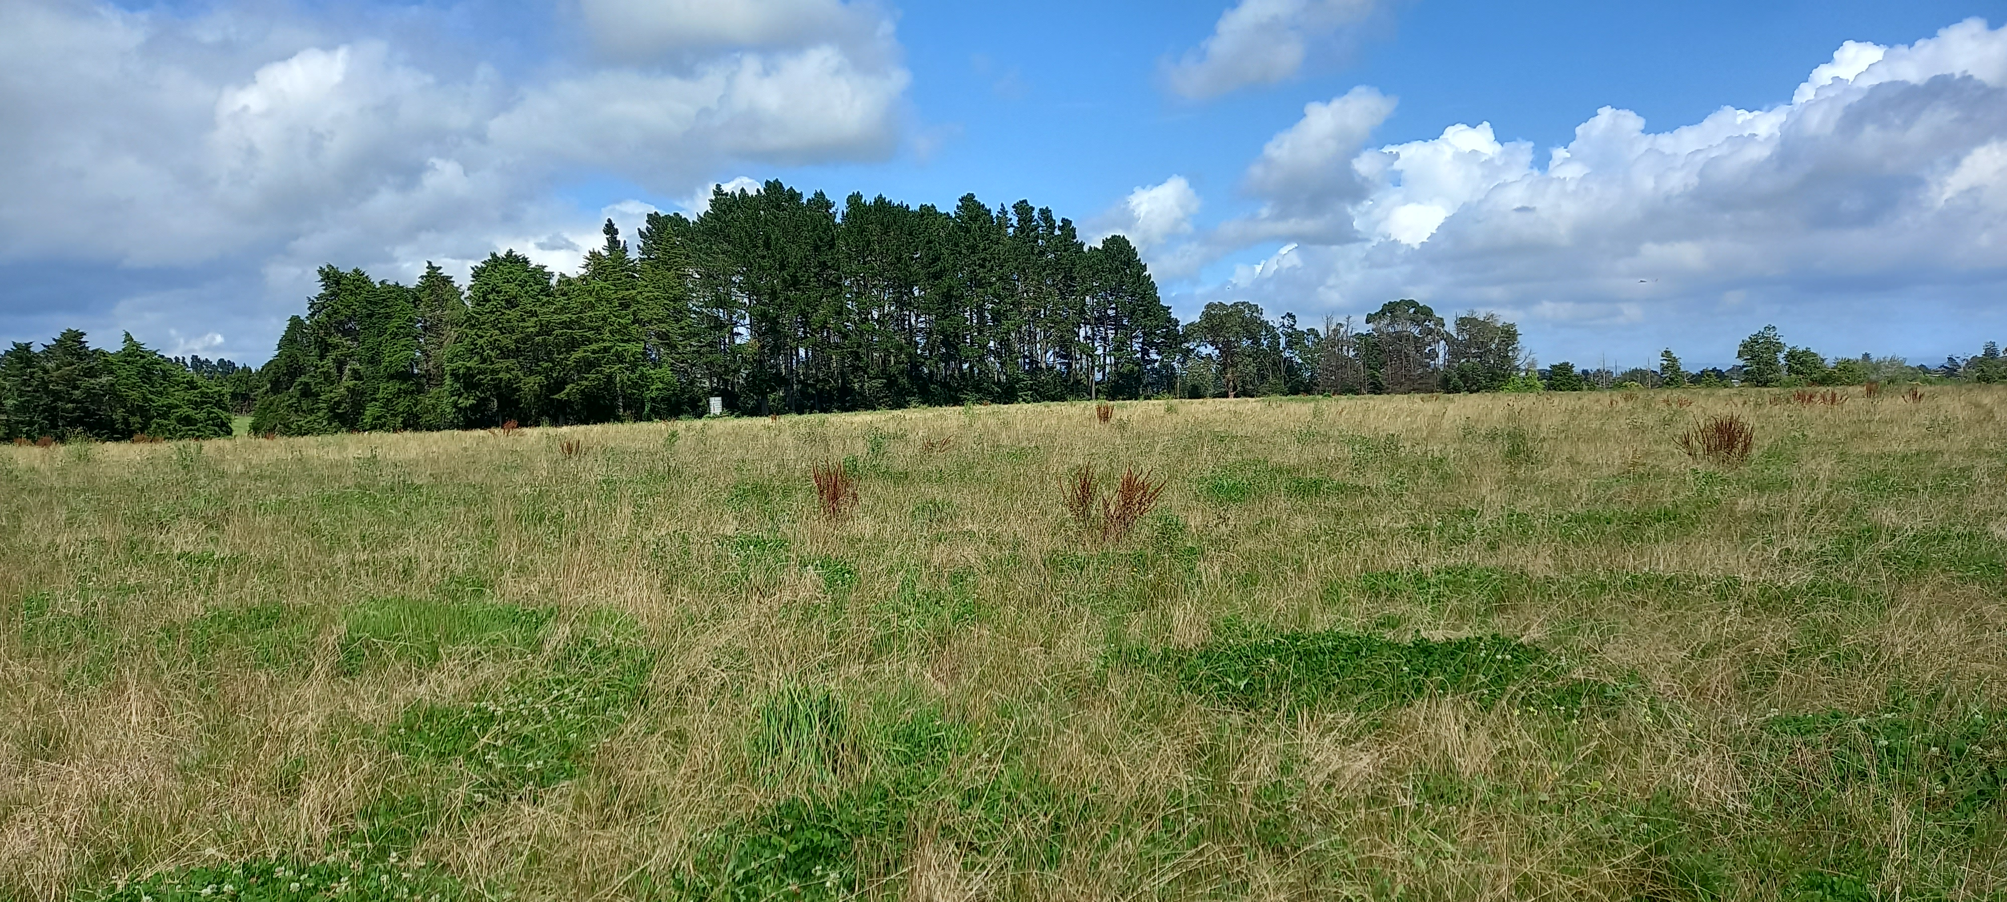

Tuakau Bollard Road
Resource Recovery Centre

Slide 2
Key Dates
Dates | Milestone
27 March 2023 | 10% Concept Designs (up to 3)
28 March to 6 April 2023 | Workshop Concept Designs and Vision Board
5 April to 26 April 2023 | Iwi Engagement
5 April to 26 April 2023 | Stakeholder Workshop (Waikato DC, Community Board)
29 May 2023 | Finalised design/reporting and Rough order Physical works estimate

Slide 3
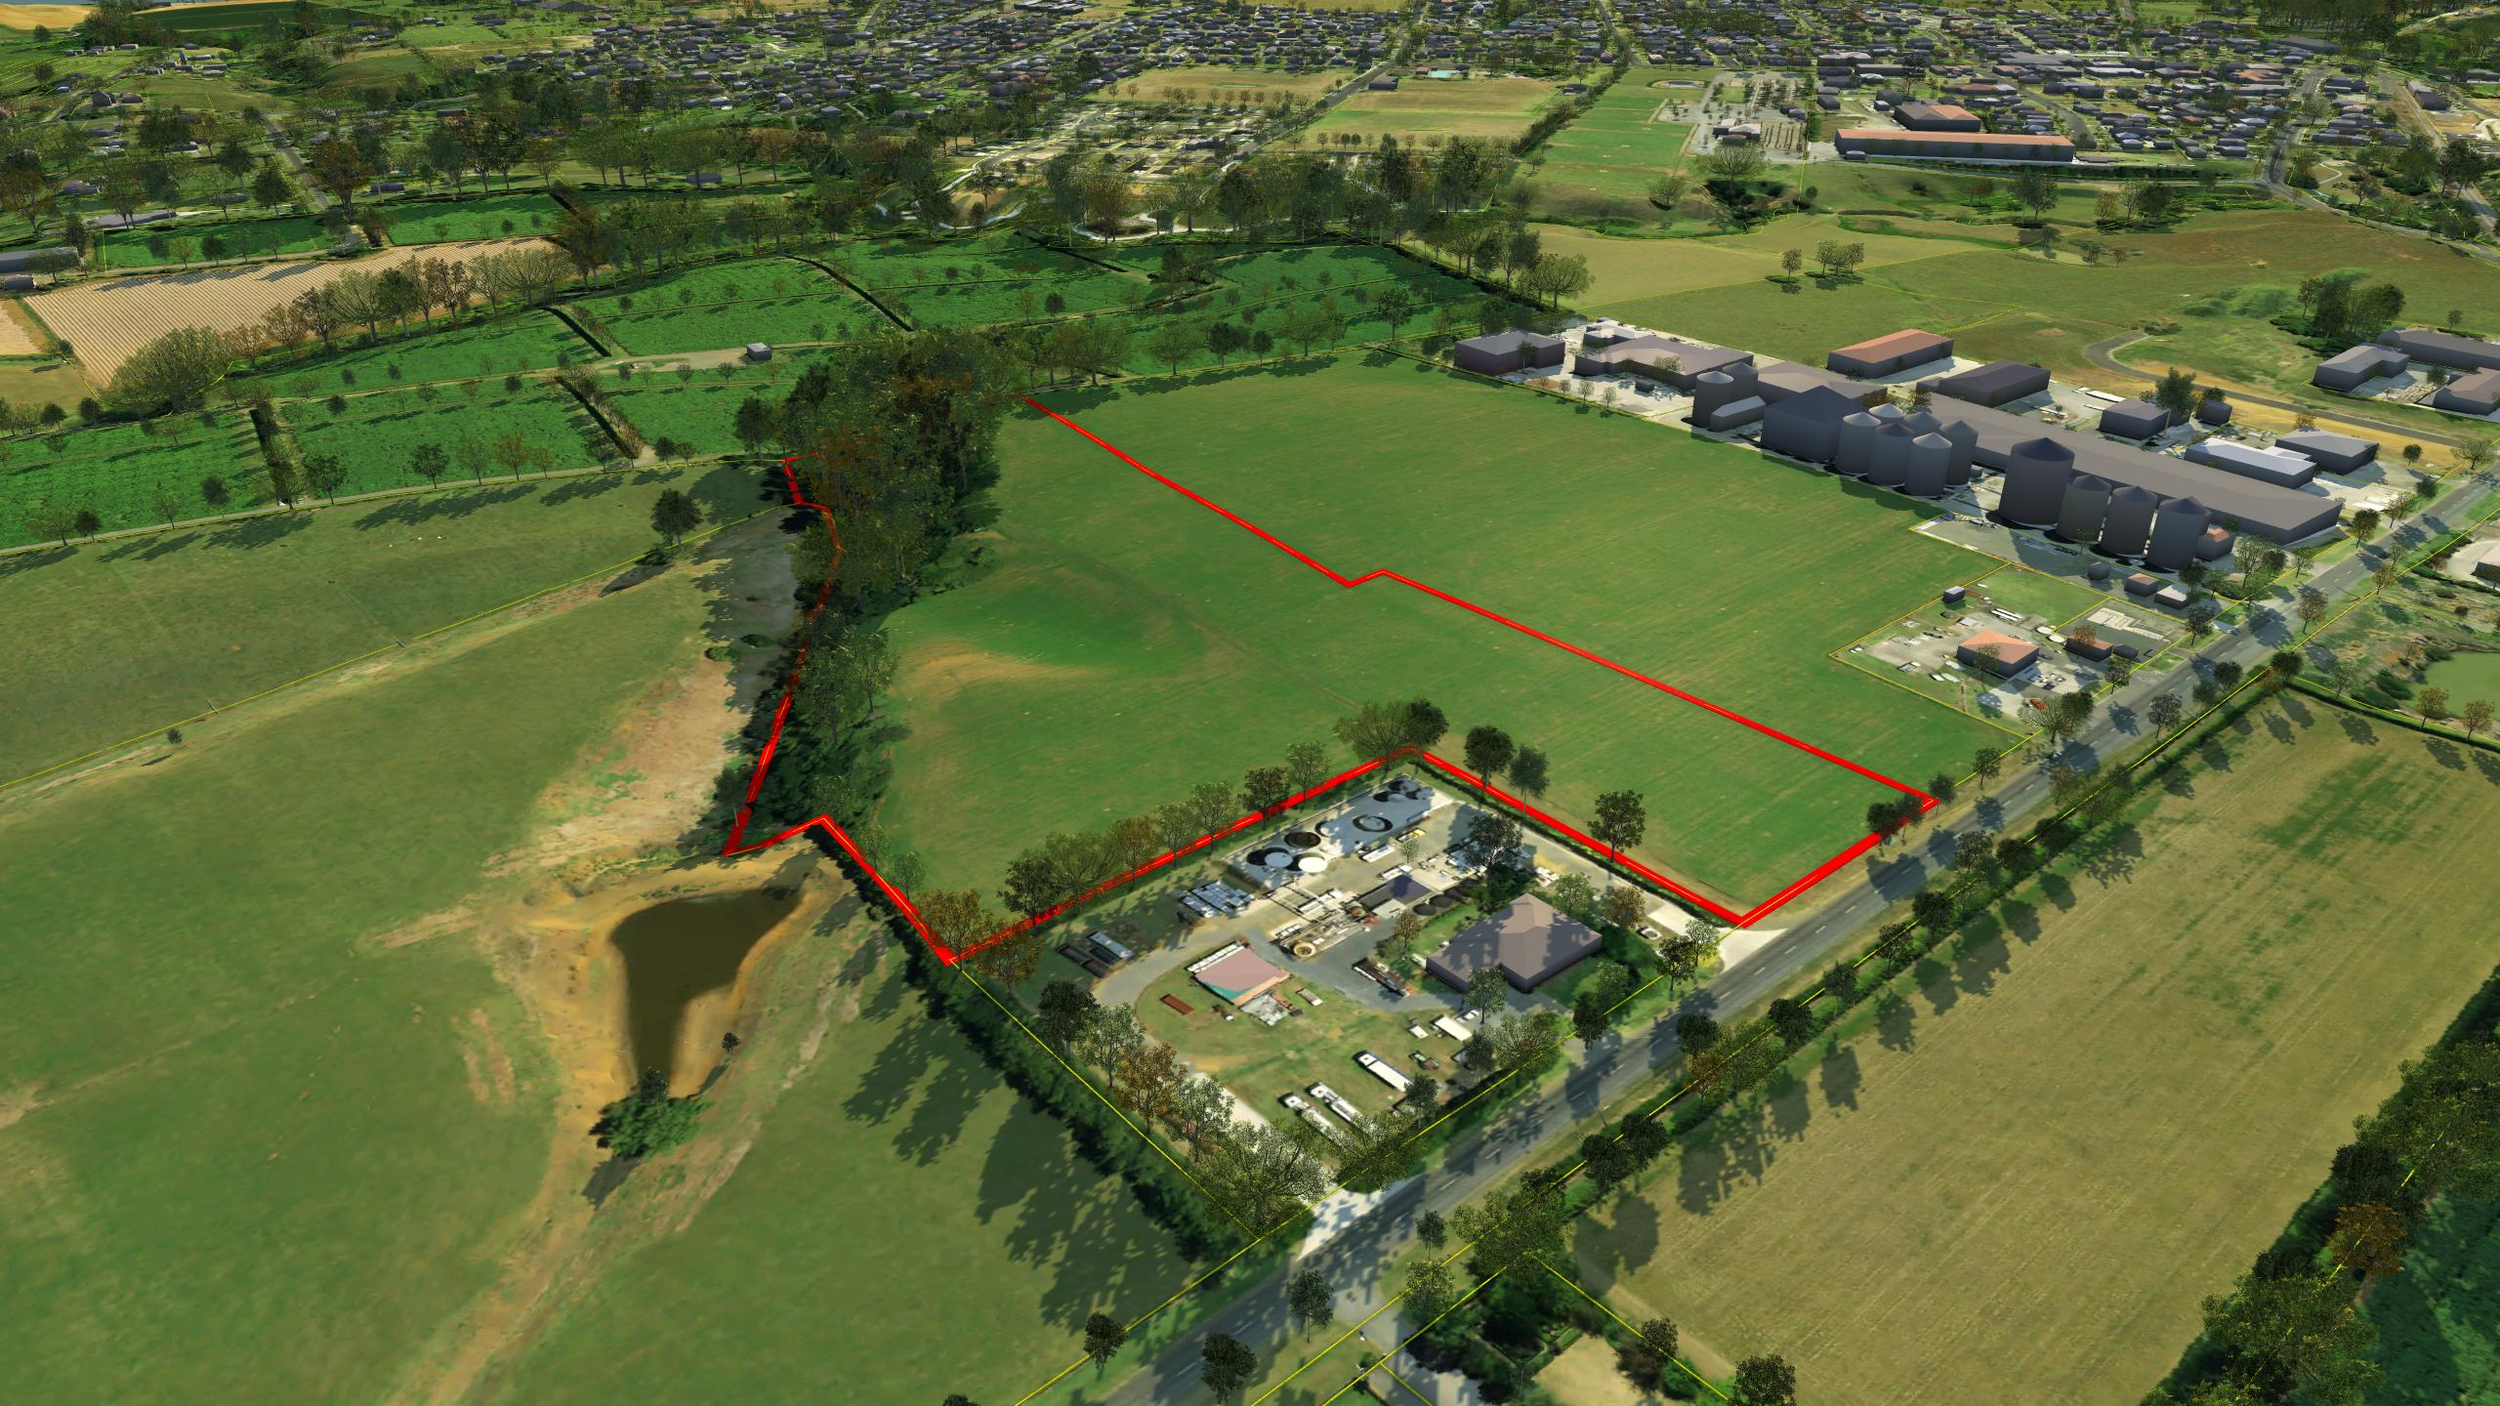
Site Overview
128 Bollard Road, Tuakau
4.32 Hectares

Slide 4
Key objectives
Best Practice:
Maximise diversion from landfill and the value of recovered materials.
Meets community expectations and is easy to use.
Maintain continuous drive-in/drive-out approach with recycling drop-off before landfill.
Ensure recoverable materials have end markets (support circular economy).
Comply with local, state and federal regulations, legislation, guidelines and infrastructure plans.
Optimize traffic flow to separate drop-off vehicles from collection vehicles.
Environmentally and operationally safe.
Economically sustainable (energy and water efficient).
Utilise technology, equipment and advanced systems to improve operational efficiency of the site.
Future ready – capacity to grow over time and adapt to changes in industry

Slide 5
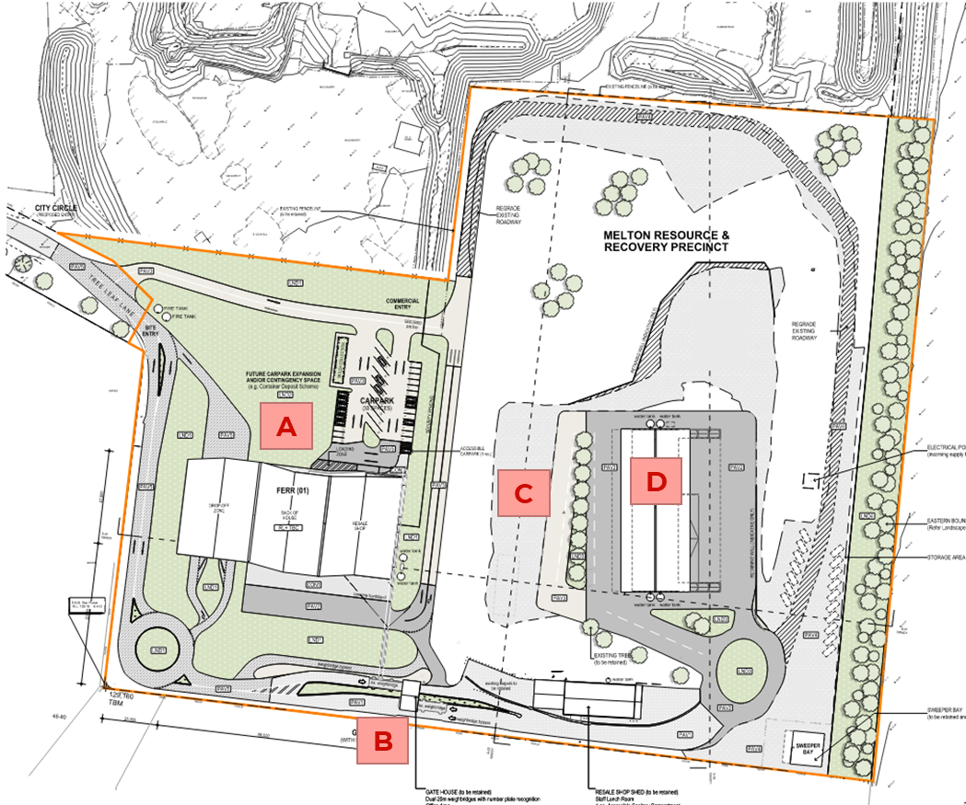
Best Practice Design
Resource Recovery Centres
A Front End Free drop off
Drive through drop off
Safe and dry storage of materials
Resale shop connected to Front End
B Weighbridge
Dual lane weighbridge
Number plate recognition
By pass lane
C C&D / Green Waste Paid drop off
Stockpile pens for concrete, soil, rubble,
Garden waste storage and shredding
D Residual Waste – Paid drop off
Flat floor push pit
Commercial collection separate form domestic drop off

Slide 6
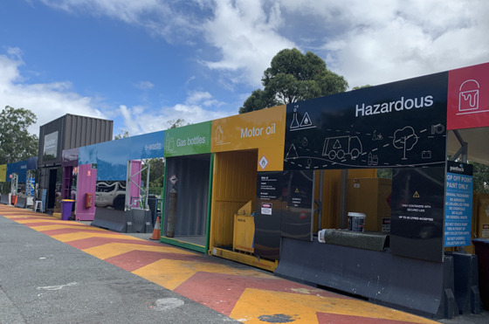
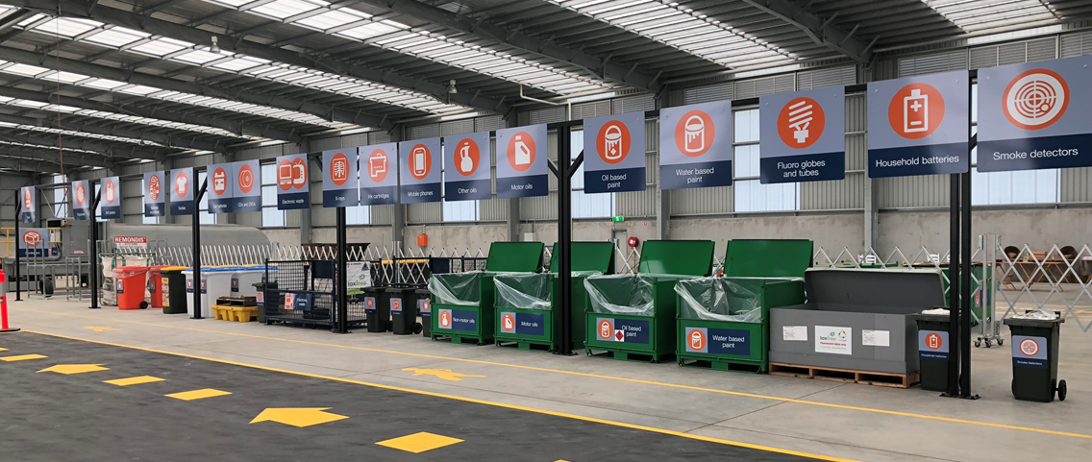
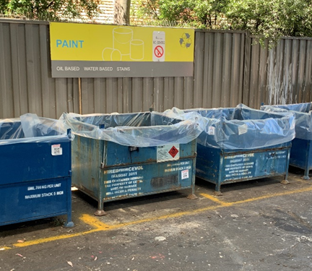
Facility Examples
Front end Free drop off
Drive through facilities:
One way traffic flow
Highly visible signage and pedestrian areas
Dedicated drop-off for free recyclables
Parking bays for cars with trailers
Covered parking and unloading areas

Slide 7
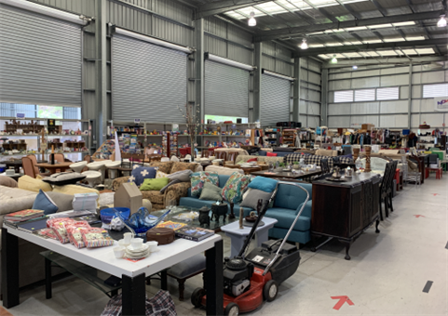
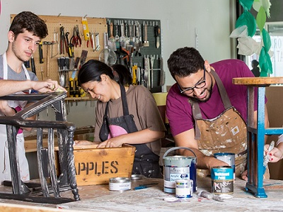
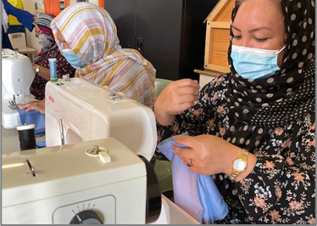
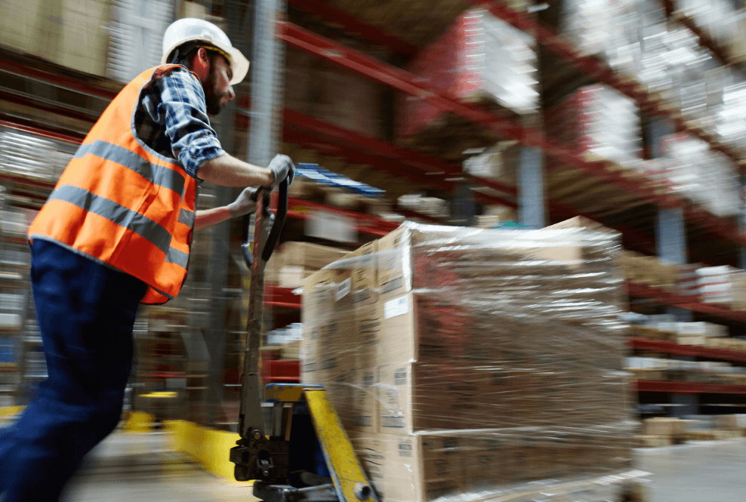
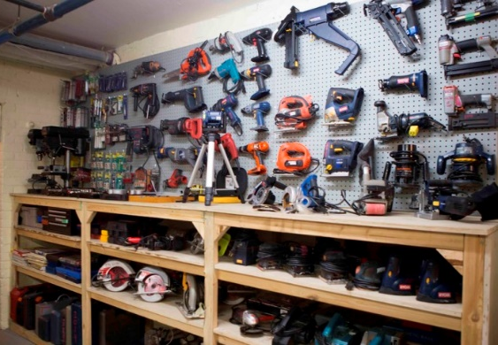
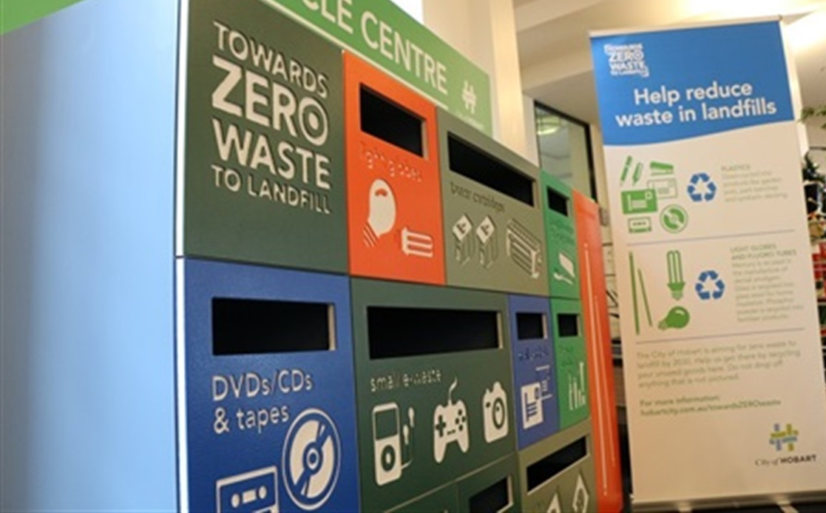
Facility Examples
Resource Recovery
Re-use Shop
Repair Cafe
Micro industries
Employment and Training
Tool Library
Speciality Recycling

Slide 8
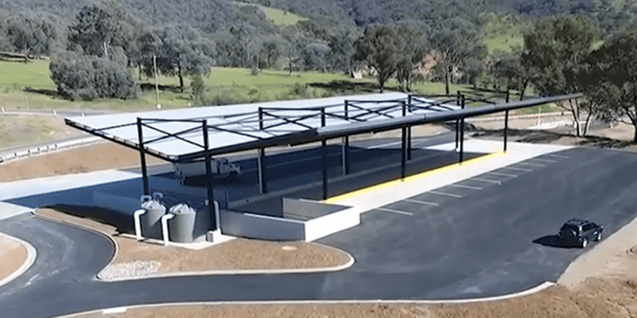
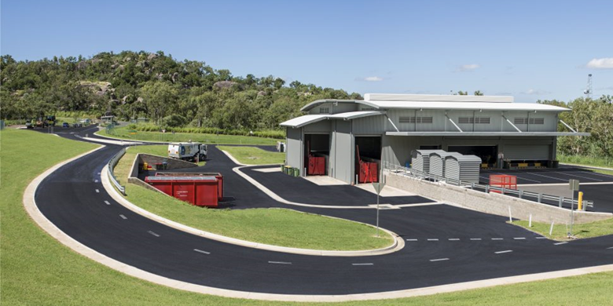
Facility Examples
Transfer Stations
Flat Floor facilities
- Separate Commercial/ Operational and Public Traffic
Split Level facilities
Utilise on site topography
Separate Commercial/ Operational and Public Traffic

Slide 9
Bryan Duncan
Team Leader Transport
Bryan.Duncan@wsp.com
027 538 3186

