Slide 1
Community Facilities Strategy
Councillor Workshop 13 June 2023

Slide 2
Workshop Purpose
Explain project background and provide an update
Receive feedback on CFS structure and facility type visions
Provide information on the ‘next steps’ and discuss proposed consultation phase

Slide 3
Further Feedback
Given the number of facilities that are incorporated in this strategy, we will not have time to discuss each facility in detail.
The focus of this workshop is high-level strategic thinking.
However, we would be very happy to receive information on the uses/needs of community facilities from your local area following this workshop and will write down any items that we need to follow up with.
Please email reserve.planning@waidc.govt.nz

Slide 4
1. Stocktake of Existing Strategic Portfolio
TOTAL 32+ documents
Notes:
On average it take 1.5 years to develop per RMP
On average it takes 1- 1.5 years per strategy
Bylaws and Policies have yet to be reviewed in detail.
Several documents being requested to be brought forward
Red line shows the current year and documents nearing review/out of date
8 Documents currently due for review
Gannt chart of expiry date not scheduled for review

Slide 5
Streamlining Strategies – Reshaping the Document
Why & When
Where & How
What
Strategic Document
Action plan
Implementation
plan
Strategic
Tactical
Operational
AMPs
LTP
Annual Plan
Notes:
This allows the strategic component of the document to remain in perpetuity, without the implementation component compromising its strategic intent
Better flow into LTP preparation and 10 year plan
Clear direction allowing for ‘refresh’ of the tactical & operational faster to respond to our changing communities needs, without being slowed down by a large strategy review.
Sport Waikato is a key contracted relationship (part funded by all local councils). Their focus is purely on sport and recreation, and supporting all opportunities for the community to be active. This relationship helps bridge and connects us with our neighbouring Councils (Hadon our SW rep covers waikato central – WDC, HCC & Waipa). The data and insights of club usage and activity guide our decision making and what we deliver for the community.

Slide 6
CFS Key Project Phases
The key phases of the CFS are:
Research and collation of current knowledge
Discussions with Council staff assess strategic fit within other strategic documents underway, and current issues
Workshop with Councillors
Community, Stakeholder and Iwi Engagement
Workshop with Councillors
Adoption of Strategy

Slide 7
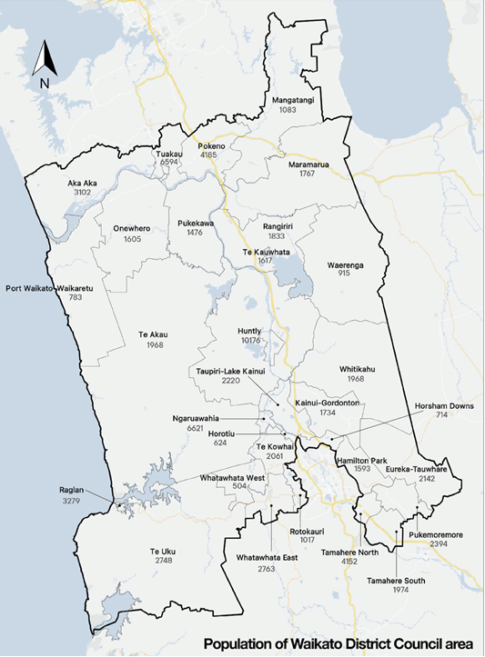
What is the Community Facilities Strategy?
SWAP PHOTO FOR LOCAL PHOTO
The CFS provides strategic direction for Council over the next 20 years. It is also utilised within the strategic decision-making process for regular long-term planning.
This strategy provides a clear direction for community facilities within the Waikato District and places the actions within facility specific Action Plans which can be regularly reviewed in alignment with the CFS.
The CFS will also provide direction for decision making, development and management of our community facilities including tasks such as investment and divestment.

Slide 8
What are Community Facilities?
This Community Facilities Strategy defines community facilities as Council-owned or administered buildings or community lead facilities on Council land, which are operated and maintained for the primary purpose of providing public spaces for community use.

Slide 9
Amenities not included
A facility or place will not be included within the strategy if the facility:
is not a building;
is already covered within another strategy;
is not owned or administered by Waikato DC, unless it is located on Council owned land;
is not operated or maintained for the primary purpose of providing public spaces for community use.

Slide 10
Amenities not included
Open spaces
Playgrounds
Sport fields
Camping grounds
Animal pounds / animal control buildings
Historic heritage buildings (with no public use)
Pensioner housing
Council staff offices

Slide 11
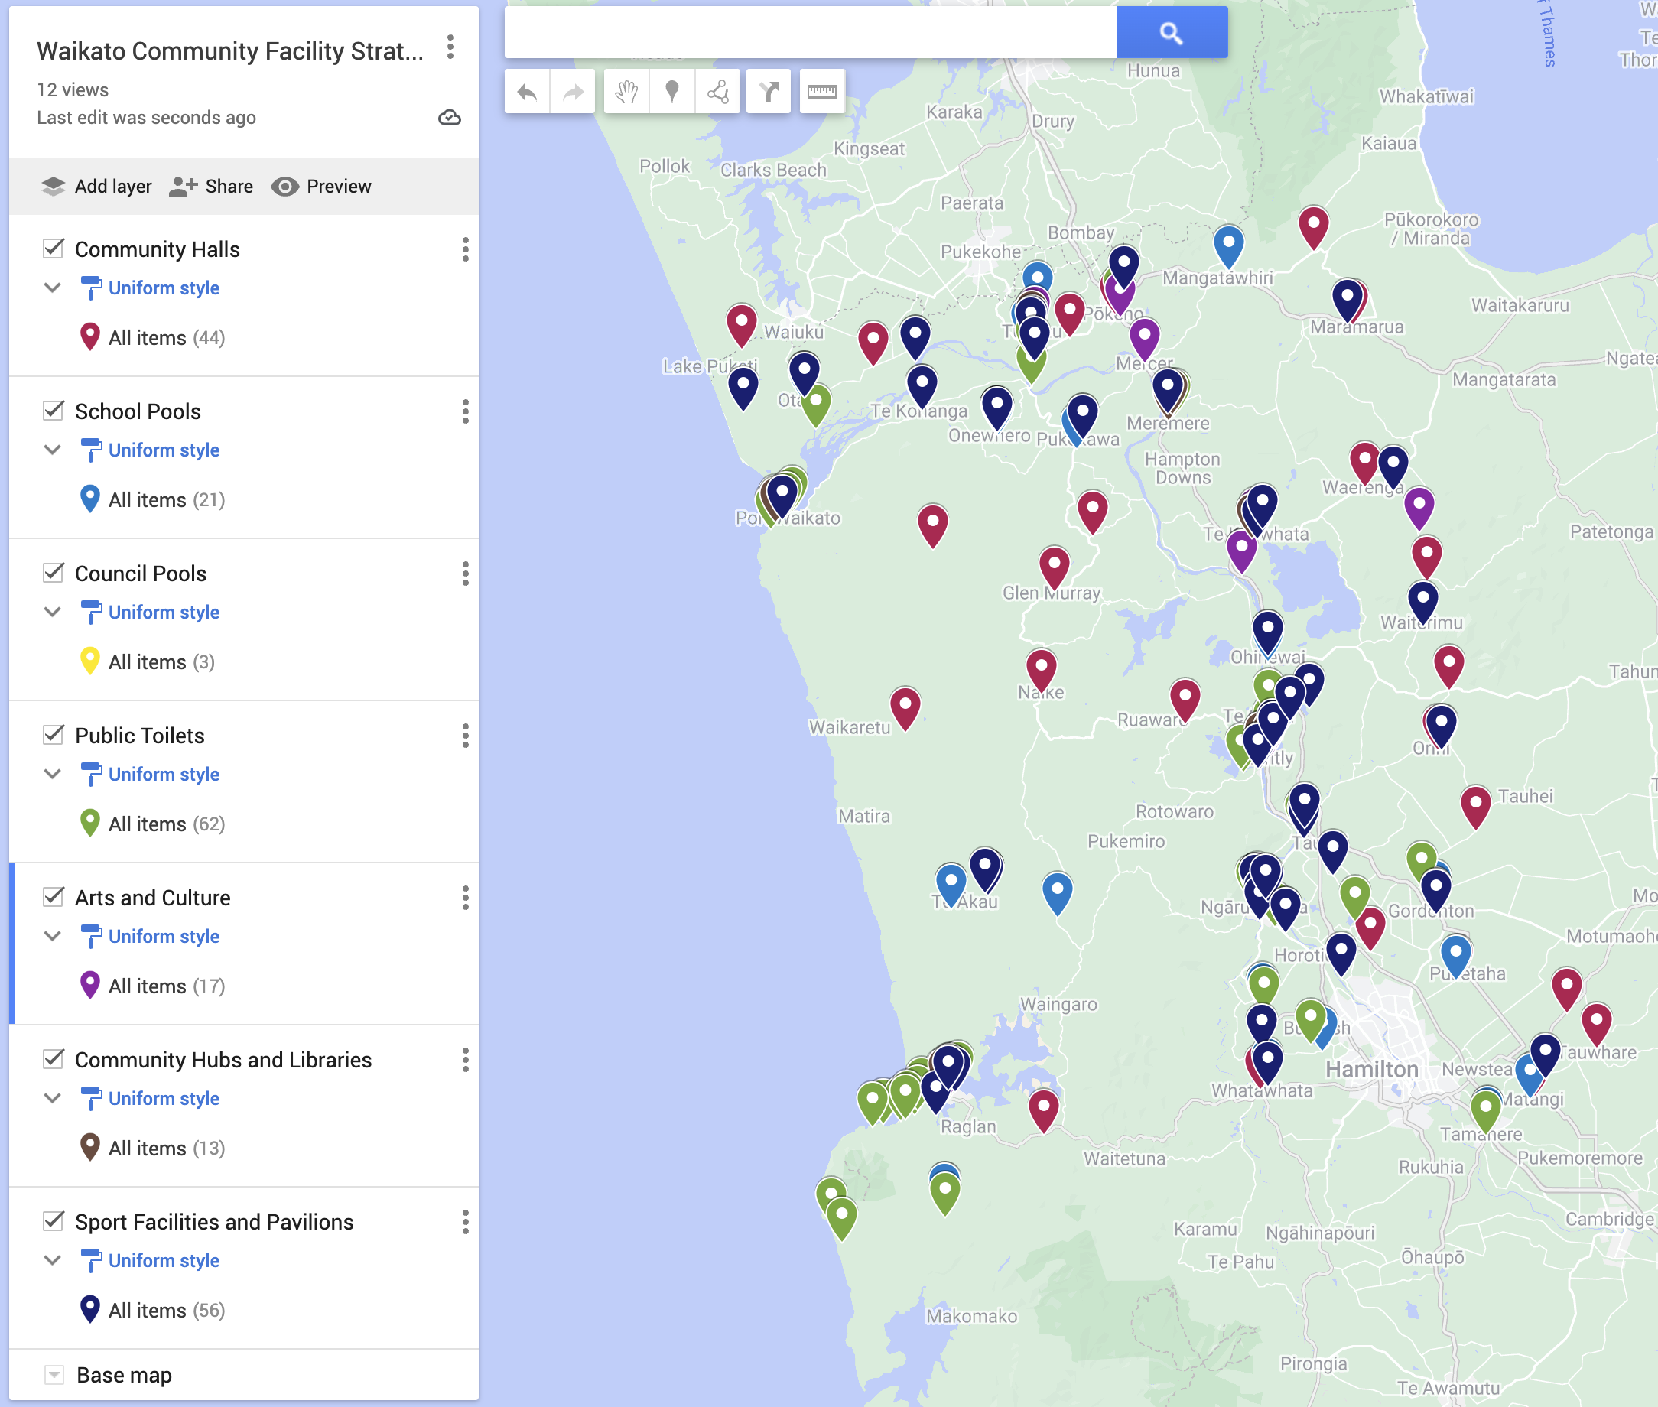
Our Facility Categories
Public Toilets
Pools
Community Halls
Libraries and Community Hubs
Arts and Culture
Sports Facilities and Pavilions

Slide 12
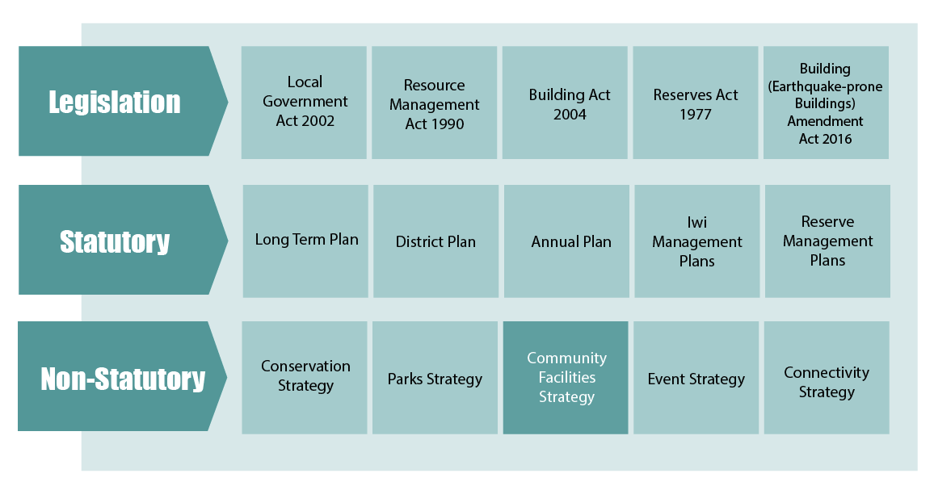
Strategy Structure

Slide 13
Strategy Structure

Slide 14
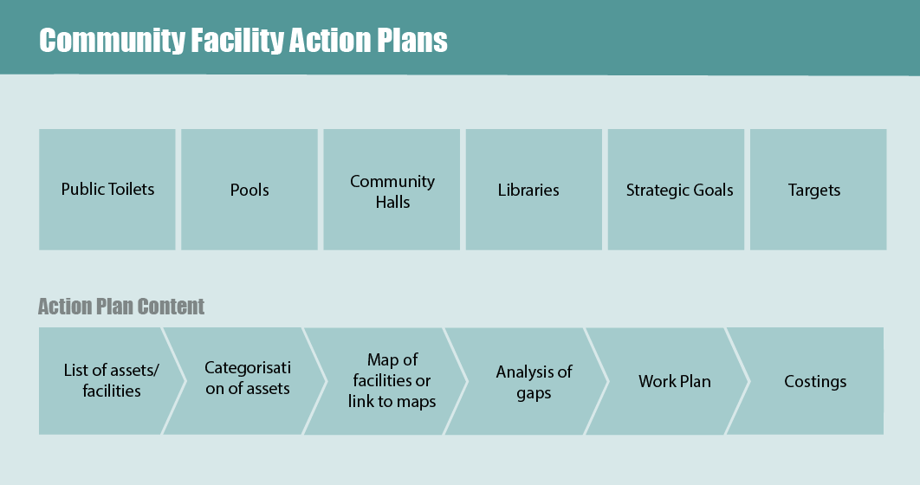
Strategy Structure

Slide 15
Simplified Vision

Slide 16
Map of District

Slide 17
Community Halls
Community halls provided in the Waikato District generally include a large hall space, a kitchen/kitchenette, and toilet facilities. ‘Community halls’ include memorial halls built as a part of government funding to bring communities together after World War II.
The ownership and operational structure of community halls is specific to the district. Waikato District Council owns the community halls and facilitates the gathering of rates payments, and the issuing of these funds to the community hall committees. The funding given to community hall committees is gathered and issued based on the number of rate payers in an area (targeted rate) and the costs estimated to be required to maintain the facility.

Slide 18
Community Halls

Slide 19
Public Toilets
A public toilet can be defined as a toilet that is freely available for the general public to use. Public toilets are primarily toilets delivered, maintained and owned by Public Agencies (in this case the Council).
Waikato District Council currently owns and maintains public toilets within the following spaces:
Roadside
Sports and Recreation facilities
Public Gardens
Cultural facilities
Civic facilities
Neighbourhood areas

Slide 20
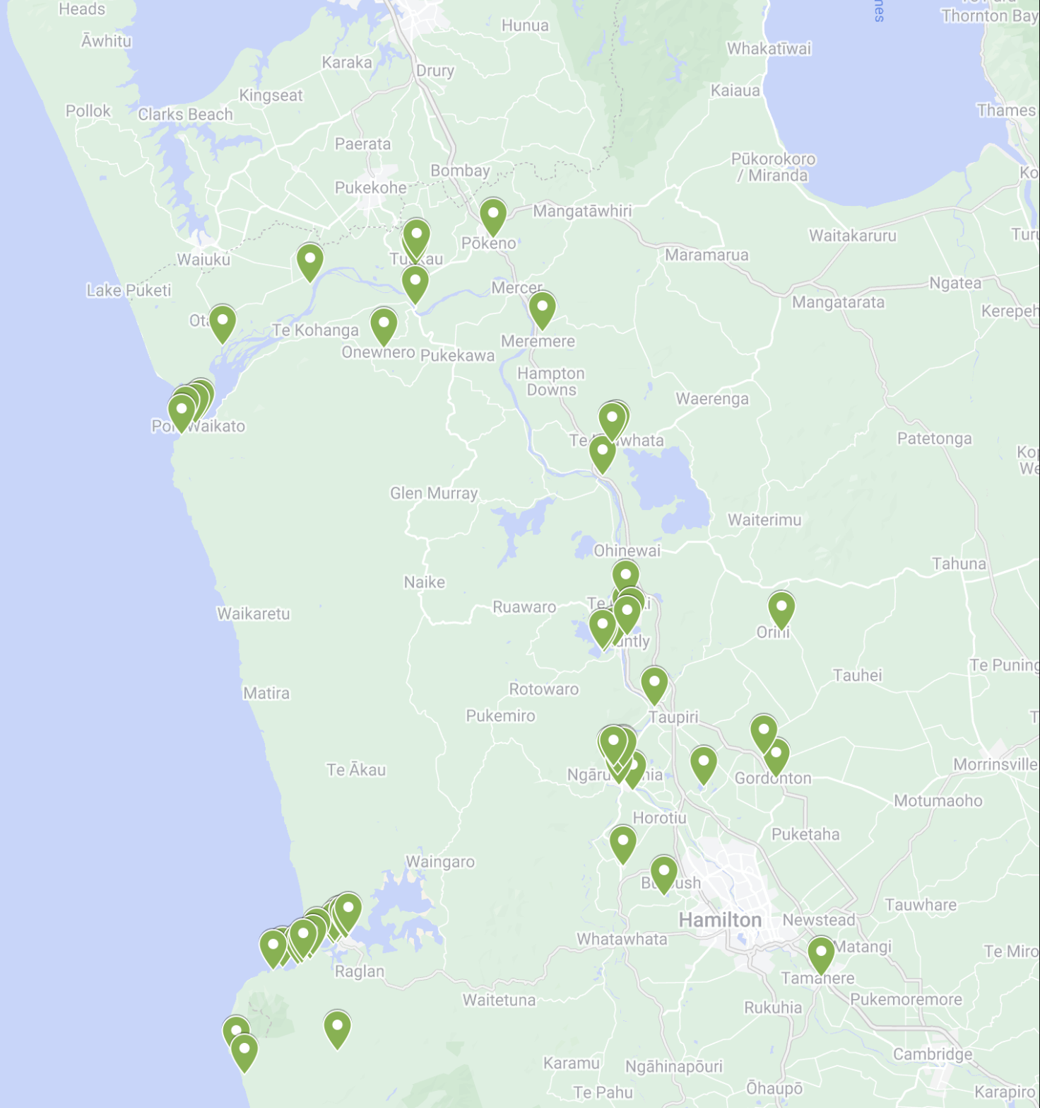
Public Toilets

Slide 21
Aquatic Facilities
The ‘Pools’ category includes all Council-owned and facilitated aquatic facilities within the Waikato District.
There are several types of aquatic facilities:
Outdoor water play
Outdoor pools – cold
Outdoor pool – heated
Outdoor pool – heated and covered
Indoor swimming pool – 25m swimming lane
Local aquatic centre – 25-50m swimming lanes, learn-to-swim pool, sauna/spa pool
Regional aquatic centre – 25m – 50m swimming lanes, learn-to-swim pool, sauna/spa pool, small water play area
National aquatic centre – 25m – 50m swimming lanes, learn-to-swim pool, sauna/spa pool, rehabilitation and disabled access pool, large water play area (both toddler and young children’s areas), and possibly lazy river or hydro slide.

Slide 22
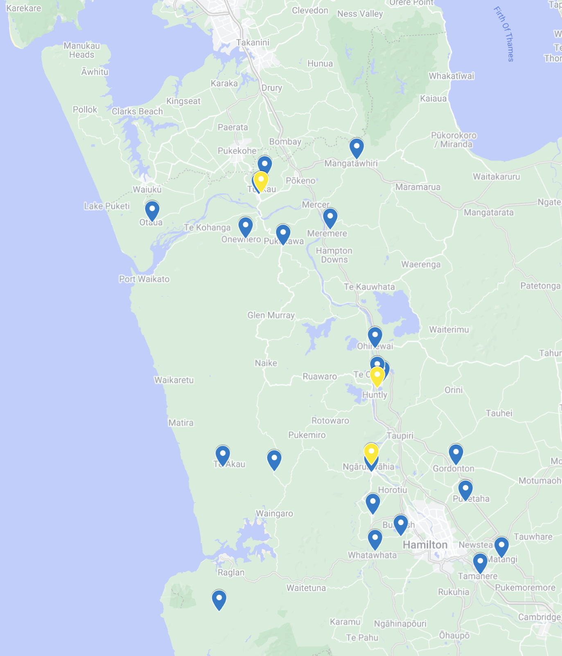
Aquatic Facilities

Slide 23
Libraries and Community Hubs
Libraries and community hubs provided in the Waikato District generally include gathering spaces, information on community events, access to technology, support, and other assets.
Our libraries are facilities that are technology rich, focused on inspiring readers, developing knowledge and skills, connecting communities with ideas and each other and breaking down barriers to enable everyone to access services within the district.
Community hubs are public spaces that bring several community agencies and groups together to offer a range of activities, programs, and services. Community hubs provide the opportunity to increase utilisation of community spaces with services that meet the needs of the local community. They also encourage social interaction as community gathering places. Services included within community hubs include but are not limited to health, recreation, education, and employment.

Slide 24
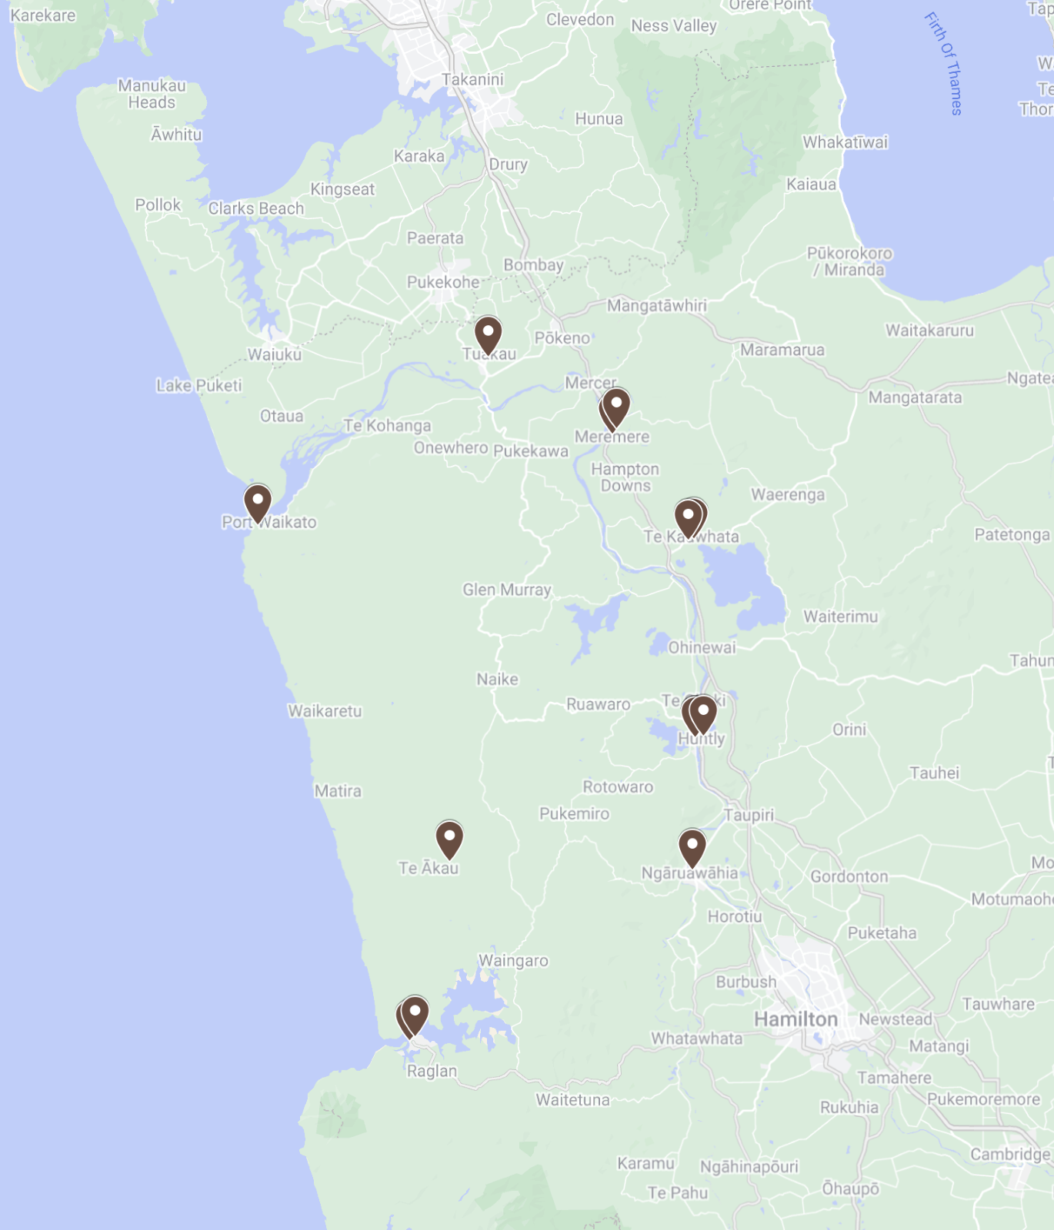
Libraries and Community Hubs

Slide 25
Arts and Culture Facilities
There are a range of community arts and culture facilities within the district either under Council or private/ community ownership.
These facilities provide safe spaces for learning and embracing local culture and identity. These facilities include museums, arts buildings, and historic buildings.
These buildings by nature support the understanding of local history, cultures and traditions and support the development of arts and history in the Waikato District.

Slide 26
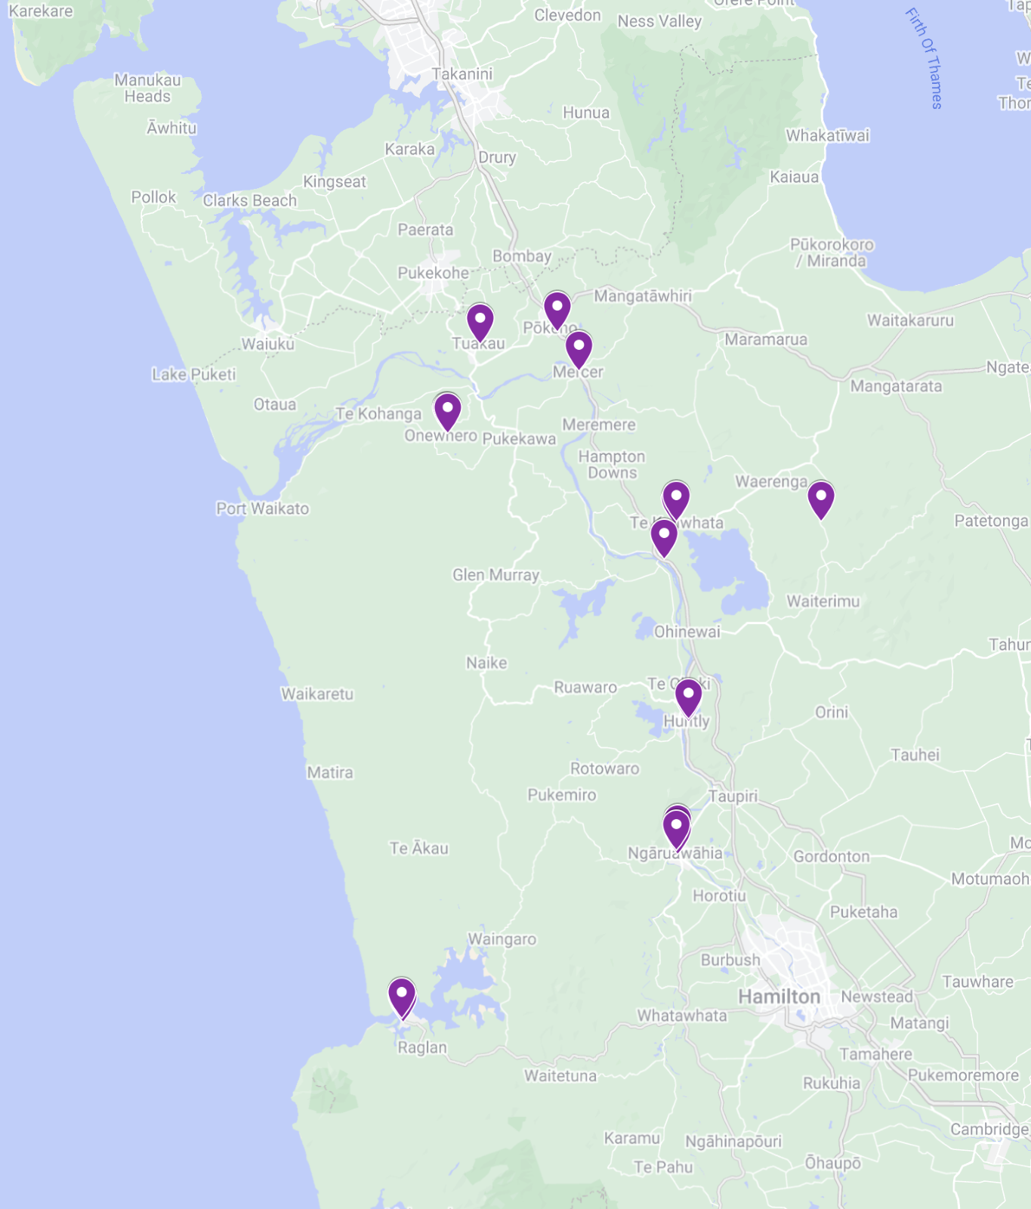
Arts and Culture Facilities

Slide 27
Sport Facilities
Waikato District sport clubs and pavilions are an important part of ensuring our communities stay active and healthy. The facilities that fall into this category serve the prime purpose of catering to a manner of sport and recreation activities within the Waikato District. This includes:
Pavilions
Clubrooms
Grandstands
Gymnasiums
Sport specific storage facilities

Slide 28
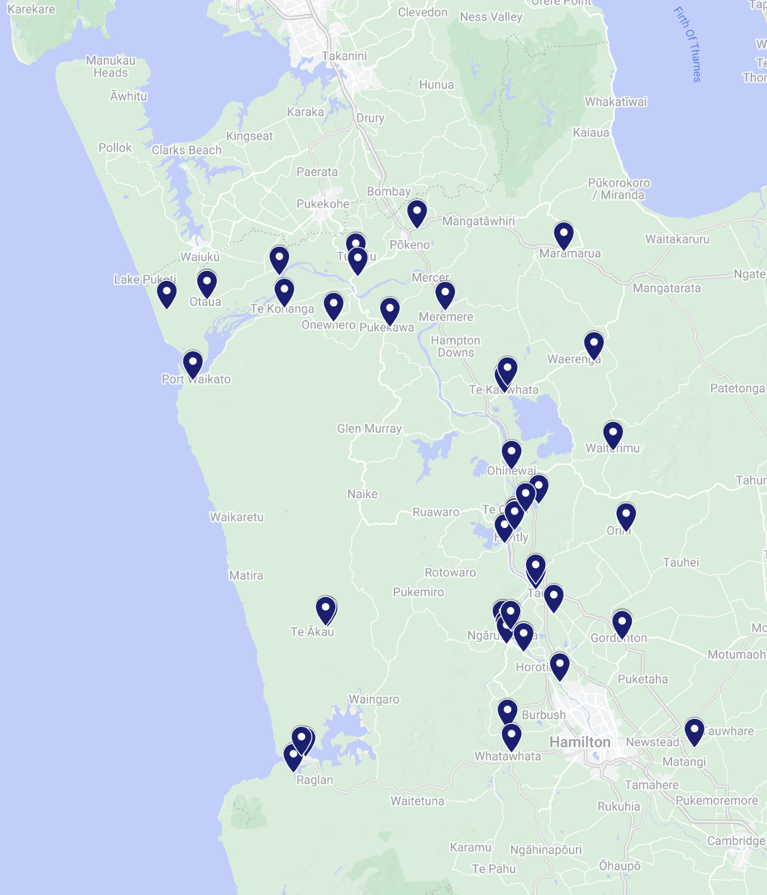
Sport Facilities

Slide 29
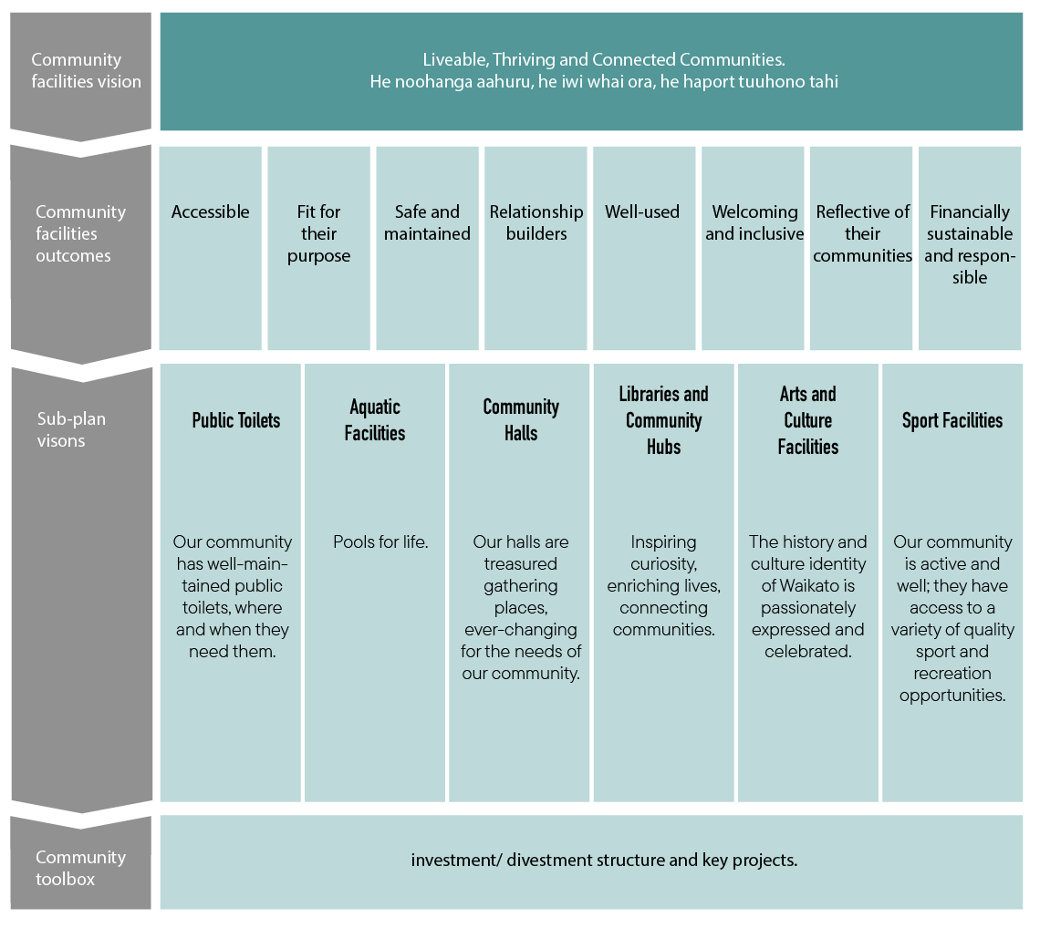
Visions

Slide 30
Questions / Clarifications
Have we captured the correct community outcomes and vision to guide this project?
How do we best recognise the contribution of other facility types which are not Council-owned but provide benefit to the community such as maraes, school swimming pools, or community-owned buildings?
Are there any other related strategies or plans being formed outside of Council that would be useful to know?
Are there any gaps in the strategic document structure?

Slide 31
Next Steps
June
July
August
Prepare information for engagement
Councillor Workshop
September
Alert key stakeholders of upcoming engagement
Begin engagement
Engagement on strategy development - invite feedback
Surveys (online and paper)
Local Drop-in sessions
Engagement closes
Collate feedback and prepare strategy.
Present CFS strategy to Councillors
Engagement on CFS strategy
Prepare for adoption

