Slide 1
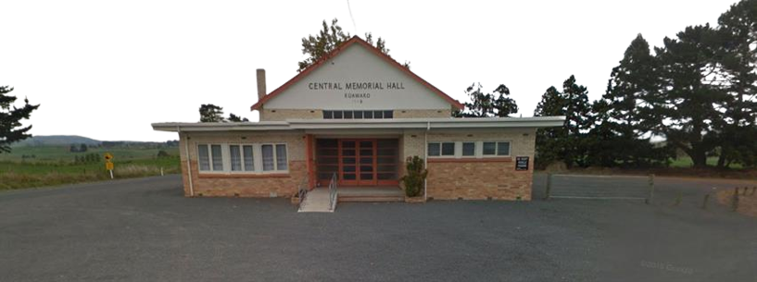
Waikato District Council
Community Halls
Current State & Next Step Recommendations

Slide 2


Community Halls
Our halls are treasured gathering places, ever-changing for the needs of our community.
Our community halls have rich backstories that reflect the communities around them. They provide a place for our local communities to meet, gather, mourn, celebrate and be present with one another.
Our halls are blank slate structures within our network of community facilities, they don’t serve one purpose but many. This is reflected in the diverse range of activities that take place within them.
It is important that as our communities change this is reflected in the activities associated with our community halls. To be a treasured gathering place our community halls should be safe and accessible to all to enjoy.
WDCs Hall portfolio has historically not had a dedicated resource. Since hiring a Halls Officer in 2022 data has been compiled, relationships have been built, and WDC has a much deeper understanding of and connection with our halls. Financially, we only invest in the compliance. This has led to many of our halls falling into disrepair and being no longer fit for our communities.
What this presentation will cover:
⋆ Asset condition | ⋆ Projected community growth | ⋆ Outliers | ⋆ Recommendations

Slide 3
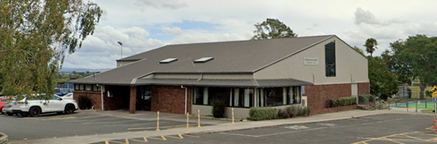
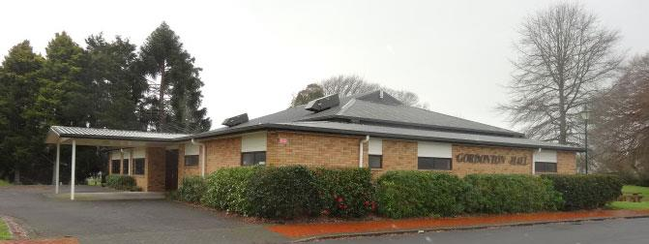
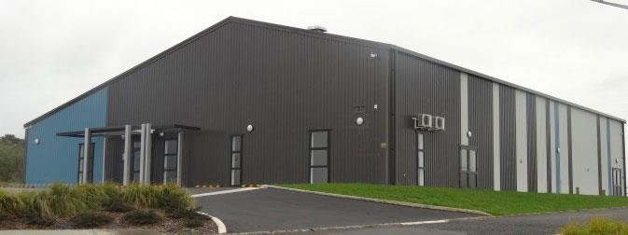
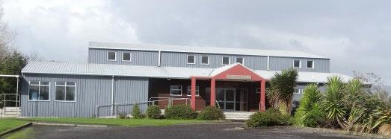
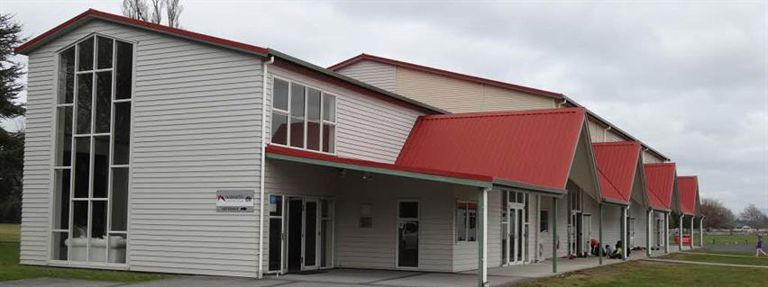
Building Condition Group A
Hall: Year Built: EQ Rating: Ann. TR$: Usage:
Tamahere Community Centre 2006 75% $120,120 High
Te Kowhai Hall 1956 25% $46,350 High
Meremere Hall 2015 $1,002 Med
Gordonton Hall 1998 25% $15,054 High
Eureka Hall 1969 25% $8,855 High
Whitikahu Hall 1938 55% $9,699 Med
Horsham Downs Hall 1987 25% $16,205 High
Matangi Hall 1961 25% $35,430 High
Glen Murray Hall 1955 45% $6,000 Med
Ohinewai Hall 1994 25% $3,408 High
Aka Aka Hall 2002 67% $12,045 High
Whatawhata Community Facility 2023
Usage key: High = weekly or daily
Med = at least fortnightly
Low = less than once per month

Slide 4
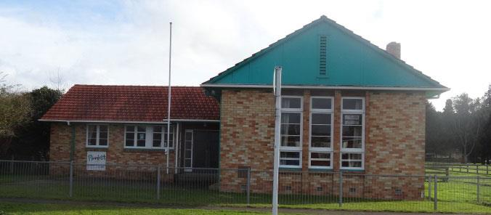
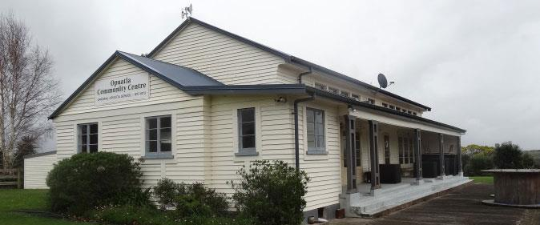
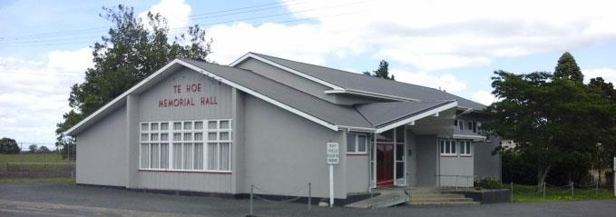
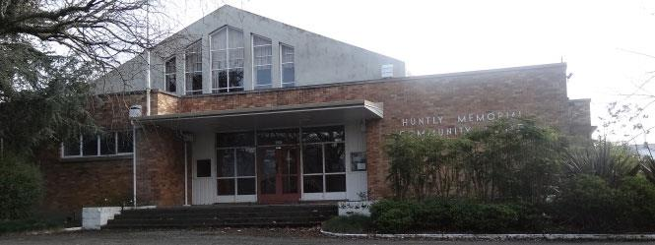
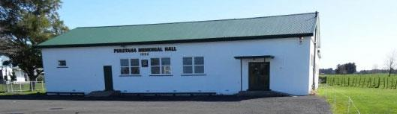
Building Condition Group B
Hall: Year Built: EQ Rating: Ann. TR$: Usage:
Taupiri War Memorial Hall 1952 25% $15,054 High
Tauwhare War Memorial Hall 1953 55% $9,960 Med
Puketaha Hall 1954 55% $13,530 High
Te Hoe Memorial Hall 1950 55% $4,590 Low
Huntly War Memorial Hall 1970 High
Opuatia Hall 1917 69% $3,360 Med
Raglan Town Hall 1927 55% $53,725 High
Te Akau Hall 1930 50% $7,616 Med
Usage key: High = weekly or daily
Med = at least fortnightly
Low = less than once per month

Slide 5
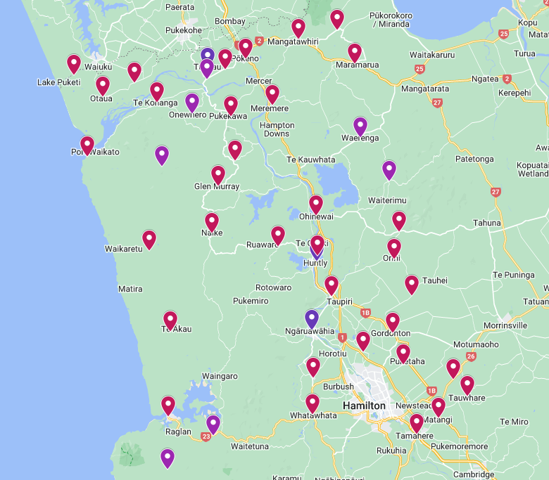
WDC owned
Community managed
WDC owned
WDC managed
Community owned
Community managed
35 Community Halls owned by WDC and managed by volunteer committees.
2.5 Community Halls owned and managed by WDC, plus one hybrid WDC/committee.
7 Community Halls in the district that are community owned and managed.

Slide 6
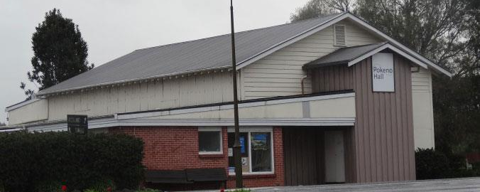
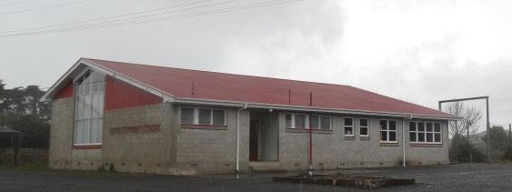
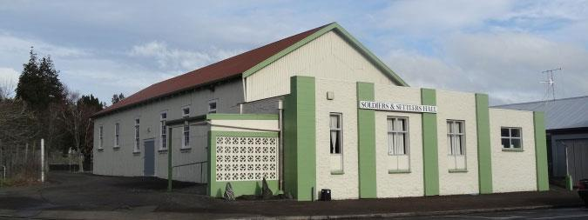
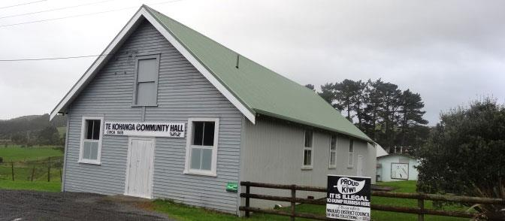
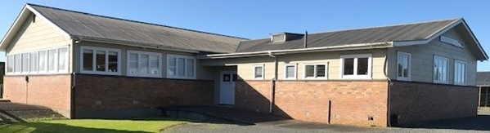
Building Condition Group C
Hall: Year Built: EQ Rating: Ann. TR$: Usage:
Pōkeno Hall 1970 25% $45,747 High
Naike Hall 1965 45% $4,457 Med
Taupiri Soldiers & Settlers Hall 1921 25% $15,024 Med
Te Kohanga Hall 1928 55% $2,673 Med
Otaua Hall 1898 70% $13,530 Med
Pukekawa Hall 1953 69% $19,800 High
Mangatangi Hall 1960 25% $6,624 Med
Usage key: High = weekly or daily
Med = at least fortnightly
Low = less than once per month

Slide 7
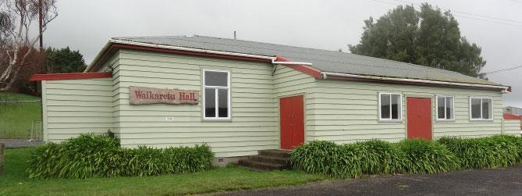
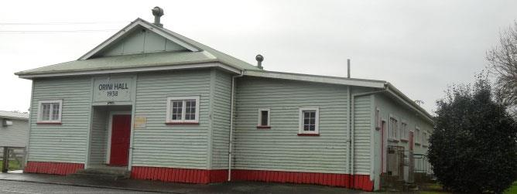
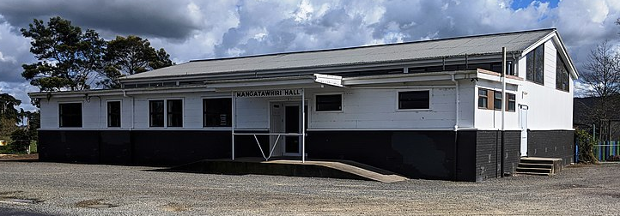
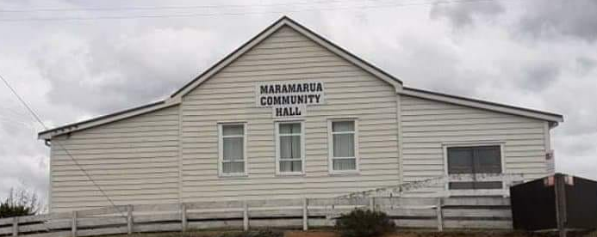
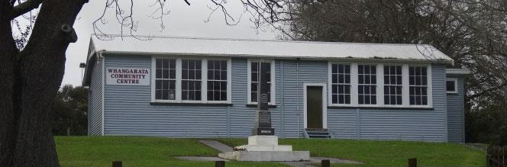
Building Condition Group D
Hall: Year Built: EQ Rating: Ann. TR$: Usage:
Whangarata Hall 1925 55% $4,278 Med
Maramarua Hall 1930 25% $8,664 Med
Orini Hall 1938 60% $5,174 Low
Ruawaro Central Districts Hall 1953 15% $7,163 Low
Mangatawhiri Hall 1960 25% $16,848 High
Waikaretu Hall 1955 60% $1,750 Low
Karioitahi Hall 1930 55% $17,380 High
Usage key: High = weekly or daily
Med = at least fortnightly
Low = less than once per month

Slide 8
Summary of halls condition
Building condition groups have been scored by their CGI rating in the recent Asset Condition Assessments undertaken by SPM (A = best condition, D = worst condition).
Most of the better used/maintained halls are located next to a school.
48% of halls have evidence of mold on ceiling.
27% of halls have staining or sagging on ceiling suggesting a roof leak.
Some halls have well functioning committees who are knowledgable and connected in the community.
Targeted Rate received does not always have a direct correlation with state of building, committee ability and community use has a large impact. Some halls would benefit hugely from an increased TR, others need alternative forms of support, and some are working well independently.
Earthquake rating across the board is low, further investigation is planned to understand the needs of the buildings to bring them up to the threshold of 34% for them to not be considered earthquake prone. Except for Ruawaro, these are Initial Seismic Assessments, and the numbers may change.
All data collected by SPM does not include roof condition. Assessments are planned to investigate the condition of all hall roofs and may change which condition group a hall sits in. Staff can see from site visits that many halls need roof repairs or replacements.

Slide 9
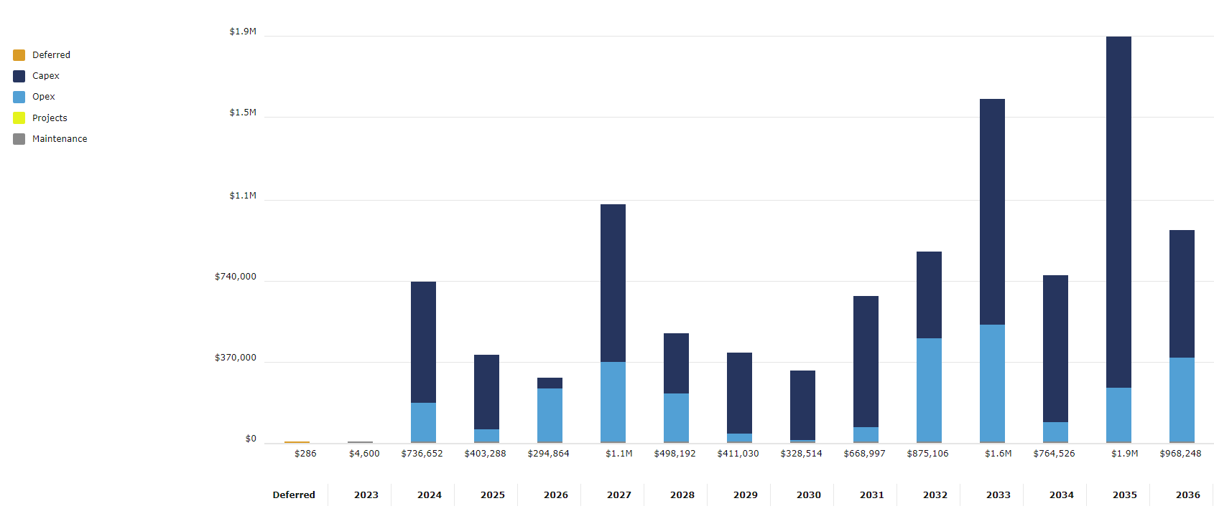
Asset investment needed 2024-2034
On WDC owned Community Halls there is $7.66 million dollars of investment needed to replace current assets like-for-like.
This number is made up of $5.33m in CapEx and $2.26m in OpEx, most of the OpEx is painting and floor finishes.
This figure is inclusive of inflation and is a realistic cost but does not include any work on roofs, asbestos removal, seismic strengthening or comprehensive labour costs.
When this work isn’t completed, the asset deteriorates and can no longer meet the community needs and may need to be closed, demolished or sold.

Slide 10
Projects to be completed
Asbestos surveys to be completed for all halls
Investigations into water supply and condition
Targeted rate and catchment reviews
Civil Defence site identification
Terms of Reference agreement review
Financial reporting templating and auditing
Fire Evacuation Plans completed and approved
Health & Safety documentation
Complete asset condition assessment on roofs
Formalising leases and sub-leases in halls
Notes:
Asbestos – getting 5 or do done at a time is the plan

Slide 11
Hall catchment population growth
Projections as of May 2023 (based on 2018 data)
Hall catchment area | Population 2023 | 10-year population growth by number | 10-year population growth by percentage | Hall catchment area | Population 2023 | 10-year population growth by number | 10-year population growth by percentage
Pokeno | 5049 | 2355 | 44% | Gordonton | 1647 | 52 | 3%
Ohinewai | 297 | 93 | 31% | Tauwhare | 1050 | 22 | 2%
Puketaha | 1054 | 274 | 26% | Port Waikato | 743 | 14 | 2%
Ruawaro | 510 | 112 | 22% | Pukekawa | 1300 | 20 | 2%
Raglan | 4858 | 994 | 20% | Tamahere | 4676 | 69 | 1%
Huntly | 9735 | 1779 | 18% | Aka Aka | 539 | 7 | 1%
Te Kowhai | 2714 | 431 | 16% | Matangi | 3532 | 44 | 1%
Taupiri | 1641 | 232 | 14% | Opuatia | 299 | 1 | 0%
Te Kohanga | 468 | 58 | 12% | Glen Murray | 235 | 0 | 0%
Horsham Downs | 1395 | 105 | 7% | Karioitahi | 206 | 0 | 0%
Mangatawhiri | 857 | 58 | 7% | Te Hoe | 338 | -1 | 0%
Meremere | 624 | 36 | 6% | Waikaretu | 76 | -1 | -1%
Mangatangi | 514 | 27 | 5% | Te Akau | 519 | -7 | -1%
Maramarua | 1034 | 48 | 5% | Naike | 226 | -4 | -2%
Eureka | 722 | 27 | 4% | Whitikahu | 496 | -11 | -2%
Otaua | 523 | 17 | 3% | Orini | 516 | -15 | -3%

Slide 12
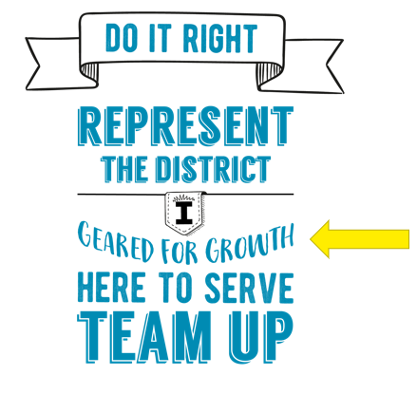
Increased population → increased needs → increased service level
One of WDCs core values under the Do It Right banner is ‘Geared for Growth’. It’s important to look ahead and ensure we are prepared for the change in population over the next 10 years.
Ensuring we’re supporting our community halls to provide for their growing community is aligned with our Strategic Priorities:
Supporting sustainable growth “ensure that economic and residential growth benefits our communities. We will work with you to create a vibrant and active district”
Building relationships “tell our stories, learn from each other, and build a shared sense of belonging”
Community Halls contribute to the WDC vision of ‘Liveable, Thriving and Connected Communities’ by being:
Accessible | Fit for purpose
Safe and maintained | Relationship builders
Well-used | Welcoming and inclusive
Reflective of their communities | Financially sustainable

Slide 13
Our current service level
Community Venues Officer
A fixed term contract of two years for a Community Venues Officer started April 2022.
In 12 months, this role has:
Collated all halls data into one place
Uncovered the level of work required in halls space
Built relationships with hall committees
Visited halls to get a visual assessment of our assets
Attended AGMs across the district
Increased communication in both directions
Assisted hall committees to improve their financial position and strategic direction
Provided Councillors and Council staff with a point of contact for the portfolio
Halls also touch on other teams in the organisation
Zero Harm
Strategic Property
Facilities
Assets
Project Management
Any changes to the current halls portfolio system would influence our human resource needs and is something to keep in mind with potential service level changes.

Slide 14
Level of service considerations
Halls where they’re needed
- Te Kauwhata has the highest projected growth but no community hall.
- Consider the geography and population to ensure all our communities have access to a communal space.
- Consider where population is declining and access to other towns is good to reduce number of halls where they’re not being well utilised.
Compliance
- Stronger support for committees to complete all compliance (H&S, financial reporting etc).
- Planning for preventative maintenance to ensure building compliance is met.
- Stepping in where committees cannot make it work to offer financial support or take over hall. management. Ruawaro Hall has been closed and now under WDC management due to asset condition.
Financial investment
- There is no deprecation reserve to fund renewals.
- Collecting and using a depreciation fund that hall committees can apply to large-scale projects.
- Creating and facilitating 10-year preventative maintenance plans for each hall.
- Revisiting the targeted rate system.
Reimagine the space
- Are other types of facilities more fitting for certain areas.
- Convert/rebuild into community hubs, sports facilities, meeting rooms or expand libraries.

Slide 15
Hall review process & outcome
Portfolio
One size fits all or a customised approach?
Develop an Individual Hall Review Plan (for each Hall)
    Standard template
    Complete data collection
    Covering key building measures, committee capacity, financial position, growth etc
    Assess capacity of renewals to be funded by Targeted Rate
    Identify issues and options
    Review with Hall & Community Committees and Ward Councillor
    Develop a recommended option for Council
    Some halls may enable early decisions, others may take longer

Slide 16
Outcome options
    A
    Retain and continue to support Hall Committee – funding remains through targeted rate.
    B
    Retain and manage by Hall Committee with increased financial and staff support for hall building management and committee.
    C
    Retain and manage by staff funded through targeted or general rate.
    D
    Plan for closure and disposal.

Slide 17


Community Halls
Recommendation Summary
Complete Data Capture with Hall Committees.
Inform Hall Committees of proposed review.
Confirm Community Venues Role as a permanent position to lead this project and retain a high quality and fully engaged relationship with Hall Committees.
Current risks of not taking any action:
Financial – compliance costs remain even when halls aren’t being used, investment required increases as buildings degrade.
Reputational – communities expect to be able to use a well-maintained hall.
Health & Safety – presence of mold and poor water/building quality not being addressed.

Slide 18
Consultation
Due to the connectedness of communities to their local halls and the impact this may have on their rates any changes to how we manage and service our halls portfolio will need to be consulted on.
We anticipate consultation to look like:
Including Hall Committees in the review process
Meeting with Council to discuss options
Community consultation to those in potentially affected hall catchment areas
Final decision from Council based on consultation and staff feedback

Slide 19
Timeline
Capture more data for each hall
Consult with committees
Consult with communities
Make a recomendation
Create schedule of changes/works
With such a large portfolio it is aniticipated that these changes would be implemented over the Long Term Plan
Some projects need to be completed first to provide a full overview of the assets (asbestos, seismic, roofs, water, electrical, carparks).

Slide 20
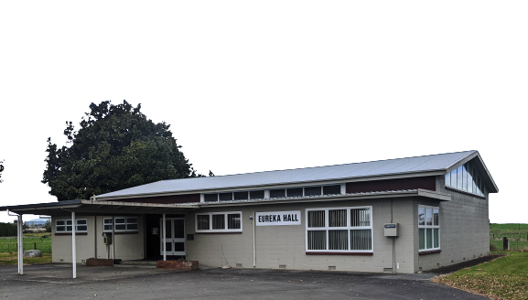
Thank you for your attention.
Any questions?
Presented by Emah Lane
August 2023

