Slide 1
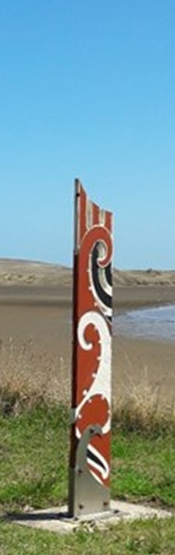
Council Workshop – Port Waikato Coastal Erosion
12.30 - 2.00pm
Wednesday, 21 June 2023
Council Chambers
Jim Ebenhoh, Planning and Policy Mgr
Simon Bendall, Traverse Environmental

Slide 2
Agenda
Karakia
    Pre-2020 Council involvement in Sunset Beach erosion issues
    Port Waikato Resilience Group: history and achievements
    Summary of technical advice received
    Current challenges
    Community initiatives and alternative proposals
      Short presentation from Malcolm Beattie (Surf Lifesaving Club) and Ken Scarlett (Nature Based Solutions) on alternative proposal
    Staff advice re: way forward
    Karakia

Slide 3
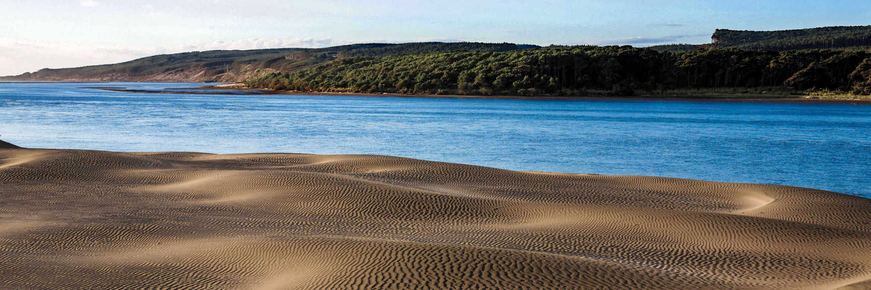
Pre-2020 Council involvement with Sunset Beach erosion

Slide 4
Pre-2020 work
GHD reports in 2014 and 2016
    Advised managed retreat for carpark and hall
    Advised against hard protection structures due to cost, consenting issues, environmental impact, uncertainty re: long-term effectiveness
    Analysed and consulted on alternative carpark and community hall locations
Council decisions in response
    Relocated community hall / SLSC to new Community Hub once trigger point reached
    Carpark stayed in place – no relocation
Notes:
These reports are in Teams folders from previous workshop last week in May on this project

Slide 5
Port Waikato Resilience Group

Slide 6
PWRG: what is it?
Port Waikato Resilience Group set up 2020
    Chaired by Jade McCormack
    Residents & Ratepayers Association
    Iwi and community representatives
    Dept of Conservation
    WRC + WDC staff
Terms of reference include looking at all natural hazards (not just coastal erosion)
Meetings generally held monthly (often online)

Slide 7
Port Waikato Resilience Strategy
 | PWRG Action Plan | Sunset Beach Erosion Response Plan | Port Waikato Resilience Strategy
Planning horizon | 0 to 24 months | 0 to 5 years | 0 - 100 years +
Purpose | Drives projects / actions for responding to immediate natural hazards risks and other community matters in Port Waikato in the short term. | Short term slowing / halting of erosion losses at Sunset Beach to mitigate further serious damage to infrastructure and property from coastal erosion at Port Waikato while a long-term plan is developed | Long term, adaptive plan for responding to natural hazards risks and impacts including the effects of sea level rise
Pre-requisites | Projects must Be able to be rapidly deployed. Respond or be related to a natural hazards issue. Have minimal or no resource consent requirement. Be low cost. Be undertaken on a “no-regrets”” basis. Complement an adaptive planning approach. | Project must: Represent the best practicable option for the short-term response to erosion issues at Sunset Beach Be implemented within reasonable timeframe. Complement an adaptive planning approach. | Projects must: Follow the dynamic adaptive pathways planning approach for coastal hazards as set out in the Ministry for the Environments for guidance for local government

Slide 8
PWRG have achieved the following:
Commissioning reports from eCoast and Nature Based Solutions
Developing a Sunset Beach Interim Erosion Response Plan (IERP)
Agreeing to develop longer-term adaptive management plan (Resilience Strategy)
Endorsing the May 2021 Co-Design Report
Hosting representatives from the Department of Internal Affairs
Addressing issues relating to carpark design, maintenance and function
Arranging for future installation of fixed-camera monitoring
Installation of signage
Installation by community of netting
Notes:
Commissioning a report on Port Waikato coastal hazards and potential options from eCoast, and a report on groundwater issues and potential impact on erosion from Nature Based Solutions, both peer reviewed by Dr Terry Hume
Developing a Sunset Beach Interim Erosion Response Plan (IERP) including potential low-cost, no-consent or consentable short-term options, as well as medium-term options with higher costs or consent requirements
Agreeing to future work on a longer-term adaptive management plan (Resilience Strategy)
Endorsing the May 2021 Co-Design Report for the project, outlining intended deliverables of the various workstreams referred to above
Hosting representatives from the Department of Internal Affairs who summarised central government’s work on natural hazard adaptation.
Addressing issues relating to carpark design, maintenance and function to minimise stormwater runoff
Arranging for future installation of fixed-camera monitoring of beach erosion conditions from various locations
Installation of signage advising people to keep off the eroding sand cliff
Installation by community of netting to help retain sand on the cliff

Slide 9
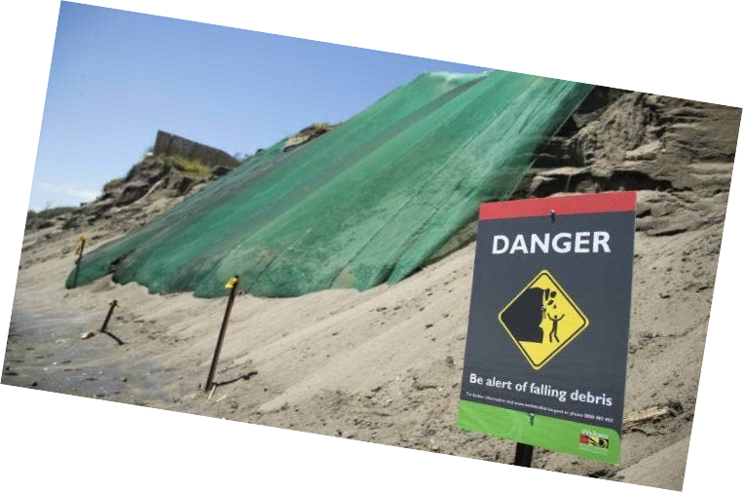
Trialling the transfer of 100 cubic metres of sand
Obtaining quotes for larger amount (1000m3)
Resource consent application for sand push ups.
Peer review of additional proposals
Notes:
Trialling the transfer of 100 cubic metres (m3) of sand from the beach to the base of the cliff face adjoining the Sunset Beach carpark, to see what benefit is provided for what duration
Obtaining quotes for larger amounts of sand transfer (e.g. 1000m3)
Progressing a resource consent application for sand push ups.
Peer review of additional proposals from the community for erosion mitigation works.

Slide 10
PWRG Timeline
2020
March | Port Waikato Community Meetings scheduled to commence, delayed due to COVID-19.
July | Traverse Environmental engaged by WDC
September | PWRG meetings restart following change to COVID-19 restrictions.
2022
January | Tonkin + Taylor Sandbag Feasibility Report Presentation to PWRG
June | eCoast engaged by WDC to prepare documents for Sand Push Up Project Resource Consent Application.
August | Alternative Project Proposal Submitted to the Better Off Fund by Port Waikato Community Members
October | Better Off Fund Application declined
November | eCoast issue Draft Assessment of Environmental Effects Assessment for Beach Push-Ups at Port Waikato for Resource Consent application
 | · Issued to PWRG and Iwi Representatives for review
2021
March | eCoast “An Overview of Coastal Processes and Drivers of Coastal Hazards: Port Waikato” Revision 1 (commissioned by WRC)
July | Hume Consulting Peer Review of eCoast “An Overview of Coastal Processes and Drivers of Coastal Hazards: Port Waikato” Revision 1
August | eCoast “An Overview of Coastal Processes and Drivers of Coastal Hazards: Port Waikato” Revision 2
 | eCoast “Port Waikato Sand Management Options” Report
 | NBS Draft Sunset Beach Erosion Report
September | Hume Consulting Peer Review of eCoast and NBS Reports
October | 100m2 sand push up trial at Sunset Beach completed
 | eCoast “An Overview of Coastal Processes and Drivers of Coastal Hazards: Port Waikato” Revision 3 - FINAL
November | Hume Consulting Presentation of Peer Reviews to PWRG
December | Sea Wall / Sandbag Project Proposal presented to PWRG by NBS
2023
February | Cyclone Gabrielle – Emergency Response and Recovery
March | WDC Port Waikato Community Meeting
 | WDC Meeting with Ngāti Taahinga Representatives

Slide 11
eCoast Report

Slide 12
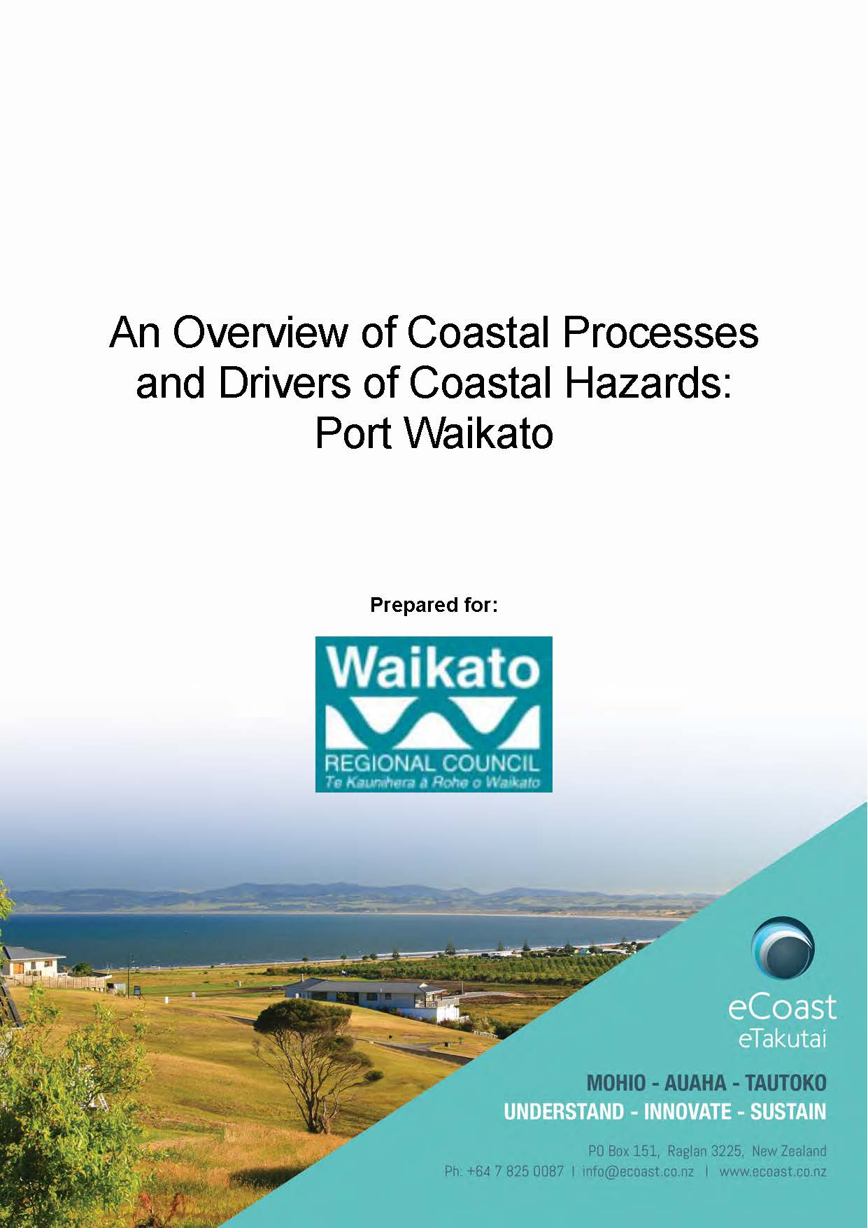
Management options
The eCoast report presents the following specific recommendations for hazard management options at Port:
Re-establishing native dune species
Building brush fascines
Providing for stormwater management
Undertaking sand management
Creating a raised buffer zone
Increase beach space for coastal processes
Notes:
The eCoast report presents the following specific recommendations for hazard management options at Port Waikato (note these recommendations are not limited to erosion mitigation):
Re-establishing native dune species (i.e., spinifex and pingao), once an accretionary phase begins.
Building brush fascines to capture wind-blown sand to increase the sand reservoir and, create a wider beach/buffer; once an accretionary phase begins.
Providing for stormwater management and relocation of stormwater infrastructure.
Undertaking sand management in the form of transferring sand from one part of the spit to another. For example, back-passing material from inside the spit north of Sunset Beach to renourish the beach.
Creating a raised buffer zone along the northern and eastern parts of the township to increase resilience to inundation due to SLR and CC.
Increase beach space for coastal processes – e.g. naturalization of the carpark to provide a wider buffer zone.

Slide 13
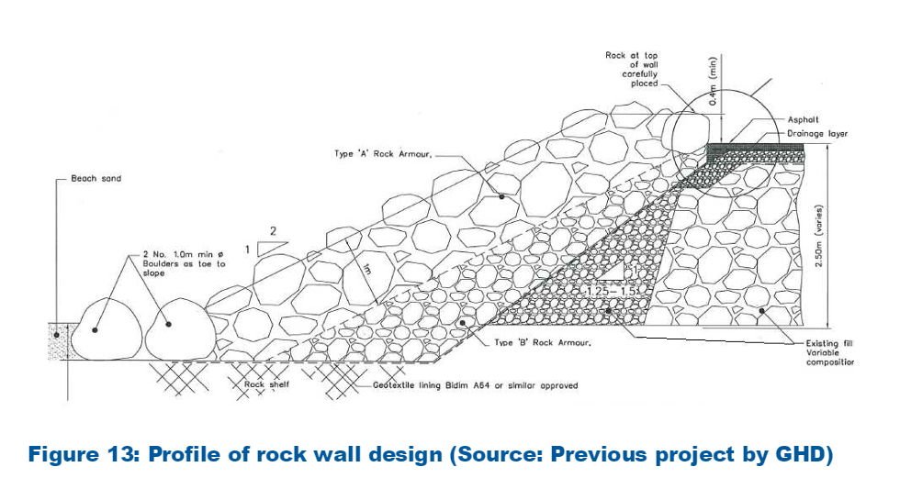
Options involving the placement of a hard structure at Sunset Beach (e.g groynes, rock revetment, sea wall, breakwater etc) are not recommended for the following reasons:
High visual impact and large footprint.
Hard-structure induced beach lowering and end-effect erosion.
Decreased beach accessibility.
Potential health and safety concerns.
Structure influencing nearshore coastal dynamics.
Potential long-term loss of sandy beach.
Very expensive at this site.
Notes:
The report also presents and assesses a range of other management options. Notably, options involving the placement of a hard structure at Sunset Beach (e.g groynes, rock revetment, sea wall, breakwater etc) are not recommended by eCoast, for the following reasons:
High visual impact and large footprint.
Hard-structure induced foreshore and beach lowering due to reflection (rocks are far more reflective than a sloping beach) and end-effect erosion.
Decreased beach accessibility.
Potential health and safety concerns for beach users.
Structure influencing nearshore coastal dynamics.
Potential long-term loss of sandy beach.
Very expensive at this site.

Slide 14
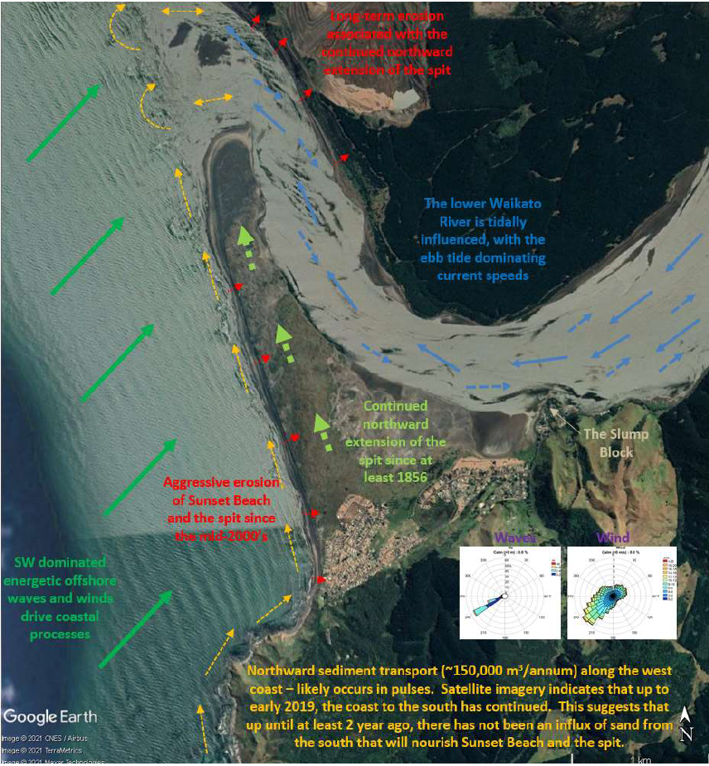
Summary
Highly dynamic and energetic coastal environment.
Lack of supply of new sand into the system from the south.
Recommended actions revolve around soft-engineering and managed retreat.
Hard structures are not recommended due potential negative impacts.
eCoast report summary
Notes:
Sunset Beach at Port Waikato exists in a highly dynamic and energetic coastal environment. The lack of supply of new sand into the system from the south has been identified as the primary driver of erosion.
Recommended actions to respond to these issues revolve around soft-engineering (sand nourishment, planting) and managed retreat. Hard structures are not recommended, due to the high-energy wave environment, the impact of these structures on the environment and the potential exacerbation of erosion such structures cause.

Slide 15
Current challenges
Significant erosion events have occurred episodically in association with storm events including most recently in February 2023 during Cyclone Gabrielle.
These storm events, in combination with weather and tide cycles and a lack of supply of new sand into the coastal system at Port Waikato have contributed to an overall trend of erosion at Sunset Beach.
Beach access has been impacted repeatedly, and multiple private homes have been removed or relocated.
The ongoing erosion has continued to drive community concern, and ongoing calls for Council to take action to respond.
Unfortunately protection options that are affordable, effective and consentable are limited (as per eCoast report)

Slide 16
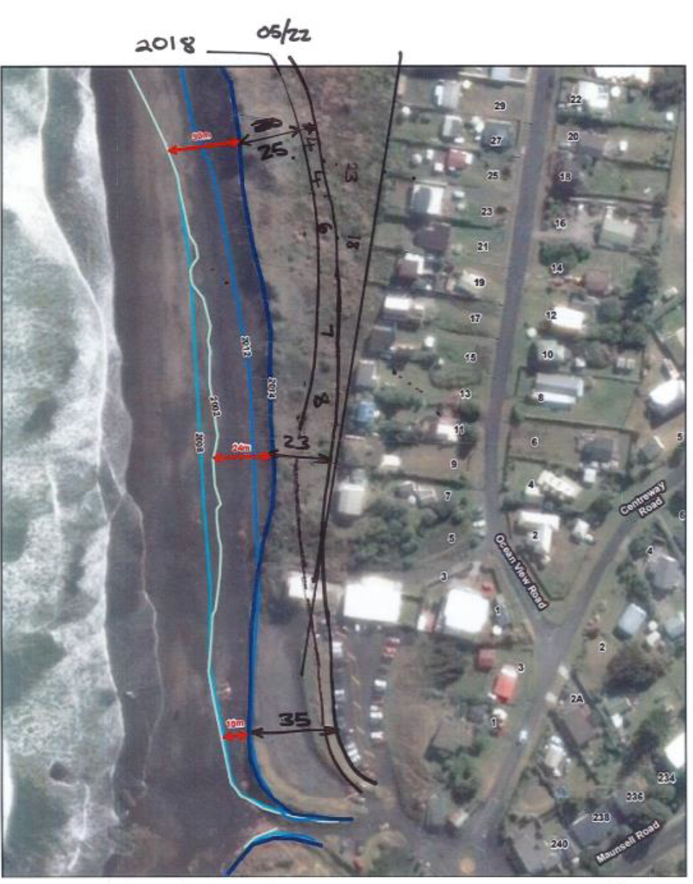
The image to the right was developed by a member of the PWRG to assist with understanding and communicating the impacts of erosion over the last 10 years.
Notes:
The image to the right was developed by a member of the PWRG to assist with understanding and communicating the impacts of erosion over the last 10 years.
The image shows the approximate edge of the dune at various time periods from 2002 to 2022 (the black lines are manual measurements taken by the PWRG member).

Slide 17
Community Initiatives

Slide 18
Alternative Proposals
Alongside the approved work programme of the PWRG, other proposals have been put forward from the community and been discussed by PWRG over the past 2 years.
Sandbags and beach nourishment at Sunset Beach - peer review was not favourable and the proposal was not advanced.
Installation of piles at carpark and sand nourishment to a reinforced edge - application under the Three Water Reform Better Off Funding programme was not successful.
Request to place rocks at the base of the dune using emergency provisions of s.330 of the RMA - not supported by technical advice and may be challenging to retrospectively gain resource consent.
Notes:
Alongside the work of the PWRG, other proposals have been put forward from the community over the past 2 years.
The first proposal was advanced by members of the PWRG for sandbags and beach nourishment at Sunset Beach to combat erosion. Council agreed to cover the costs of an independent technical peer review by T&T. However, the peer review was not favourable and the proposal was not advanced.
The second proposal was for the installation of piles at the edge of the carpark to allow sand nourishment to occur via trucks backing up to a reinforced edge. This proposal was the subject of an application under the Three Water Reform Better Off Funding programme but it was not successful.
The third proposal is a request for Council to place rocks at the base of the dune using the emergency provisions of s.330 of the RMA. While the RMA does allow for emergency works to be done initially, a resource consent must be sought retrospectively. However, this measure is not supported by the technical advice received by Council to date and may be challenging to retrospectively gain resource consent as a result.
The advice from eCoast is that a hard structure / rock revetment is not recommended for this location, given the potential for edge effects (where erosion is increased where the rock structure ends), increased erosion of the beach in front of the rocks due to wave refraction, impacts on natural character, and other considerations.

Slide 19
Malcolm Beattie and Ken Scarlett: current alternative proposal(s)
Video below plus discussion
https://www.youtube.com/watch?v=mtAV_7CiJ54

Slide 20
Proposed Way Forward

Slide 21
Staff advice on way forward (for discussion)
Do not invoke Emergency Works provisions of RMA due to technical advice and retrospective consenting issues
Do not invest in hard protection structures in accordance with peer reviewed technical advice received
Secure resource consent for larger-scale sand push ups (underway) – with implementation to be funded privately or via targeted rate
Continue to promote planting / wind-blown sand trapping
Continue to develop long-term resilience strategy (adaptive management plan) for Port Waikato, Raglan and wider (previous workshop and upcoming report to S&W)
Strengthen communication – Community / Mana Whenua / Watercare / Councils / Coast Care / DOC etc (next slide)
Notes:
Do not invoke Emergency Works provisions of RMA due to technical advice and retrospective consenting issues
Do not invest in hard protection structures in accordance with peer reviewed technical advice received
Secure resource consent for larger-scale sand push ups (underway) – with implementation to be funded privately or via targeted rate
Continue to promote planting / wind-blown sand trapping
Continue to develop long-term resilience strategy (adaptive management plan) for Port Waikato, Raglan and wider (previous workshop and upcoming report to S&W)
Strengthen communication – Community / Mana Whenua / Watercare / Councils / Coast Care / DOC etc (next slide)

Slide 22
RECOMMENDED KEY MESSAGES
Coastal erosion at Sunset Beach is mainly driven by the amount of sand being delivered into the coastal system from the south
We are currently in a severe erosion phase, with little sand supply over the past 2-3 years
Independent technical advice tells us that hard structures (rocks, sandbags, etc) are not suitable for this environment and risk making things worse
Managed retreat may be our only medium to long term solution for properties and assets affected by erosion
Council is restricted in what it can spend ratepayer money on but will do what it can to support technically robust solutions to buy time
Notes:
Coastal erosion at Sunset Beach is mainly driven by the amount of sand being delivered into the coastal system from the south
We are currently in a severe erosion phase, with little sand supply over the past 2-3 years
Independent technical advice tells us that hard structures (rocks, sandbags, etc) are not suitable for this environment and risk making things worse
Managed retreat may be our only medium to long term solution for properties and assets affected by erosion
Council is restricted in what it can spend ratepayer money on but will do what it can to support technically robust solutions to buy time

Slide 23
Recommended communication tools
Infographic / Flow chart – clearly explain situation and reasons for Council position – supported by short video
Public open information session(s)
Dedicated website / page with reports, summary information etc on Port Waikato erosion and resilience – include forum for feedback?
Direct advice and support for properties potentially facing retreat / relocation – clarity required on what Council can do (see next slide)
Onsite signage to communicate erosion issue – causes and options etc.
Regular e-newsletter providing erosion update
Notes:
Infographic / Flow chart – clearly explain situation and reasons for Council position – supported by short video
Public open information session(s)
Dedicated website / page with reports, summary information etc on Port Waikato erosion and resilience – include forum for feedback?
Direct advice and support for properties potentially facing retreat / relocation – clarity required on what Council can do (see next slide)
Onsite signage to communicate erosion issue – causes and options etc.
Regular e-newsletter providing erosion update

Slide 24
Managed Retreat
It is not managed retreat when erosion takes away a road / house / reserve without replacement or relocation – this could be seen as abandonment
Given limited viable options to respond directly to erosion, Staff recommend additional work to look at how Council can support and implement managed retreat within current legislation / LTP / policy etc
Can we develop something practical for Waikato District that can be implemented and provide our communities with greater clarity and options?
Legislation is coming – but outcomes are unclear, timing may be too late
Notes:
It is not managed retreat when erosion takes away a road / house / reserve without replacement or relocation – this could be seen as abandonment
Given limited viable options to respond directly to erosion, Staff recommend additional work to look at how Council can support and implement managed retreat within current legislation / LTP / policy etc
Can we develop something practical for Waikato District that can be implemented and provide our communities with greater clarity and options?
Legislation is coming – but outcomes are unclear, timing may be too late

Slide 27
Public Excluded

Slide 28
Closing & next steps…

