Slide 1
Development Contributions Policy Review – Setting the Scope
Council Workshop – 20 June 2023

Slide 2
Intro / Purpose and Objectives of the Workshop
Review of the Development Contributions Policy is required by legislation, and best practice links the review cycle to the LTP planning timeframes.
Following a workshop with the Development Agreements Committee, staff are seeking input and feedback from Council to set the scope of review and prioritise the options that staff have identified.

Slide 3
Development Contributions 101
The purpose of the DC policy is to:
a) Ensure that new development contributes fairly to the funding of Council’s infrastructure;
b) Establish a policy framework for the calculation and application of development contributions;
c) Set development contribution levies at a level which enables the provision of infrastructure to accommodate growth and delivers on strategic outcomes.

Slide 4
Development Contributions 101
Waikato district has experienced significant growth over the past decade which is forecast to continue across the District.
Over the next decade a large proportion of this additional growth (approximately 75%) is forecasted to be in the District’s towns and villages.
This growth comes with challenges, particularly around how to fund the infrastructure to support this growth.
A range of funding sources is available to Council including rates, grants, subsidies and development contributions.
Development Contributions are a tool to help fund the growth portion of Council’s Capital Works.
Council’s position is that “growth funds growth”, however, a balance point must be struck in order to help fund what is needed, while also enabling development to happen.

Slide 5
Where the DC Policy sits within the Council framework
Community Outcomes
(In the LTP, based on the four Wellbeings)
Strategic Priorities
(aiming to bring about the Community Outcomes)
AMPs and Work Programmes/Plans
(aiming to bring about the Strategic Priorities)
Development Contributions Policy
(one of the funding sources)

Slide 6
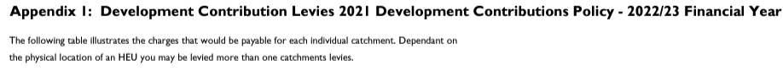
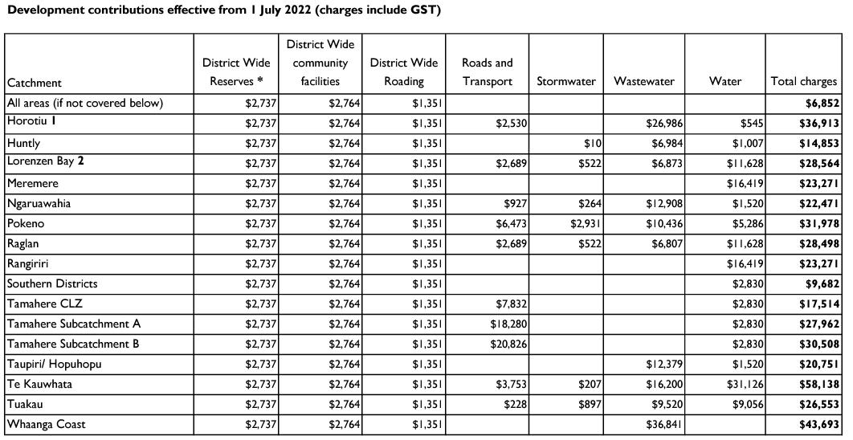
How we apply the policy

Slide 7
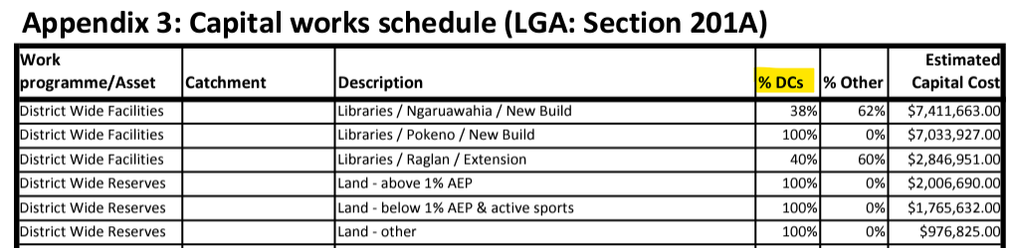
How we apply the policy

Slide 8
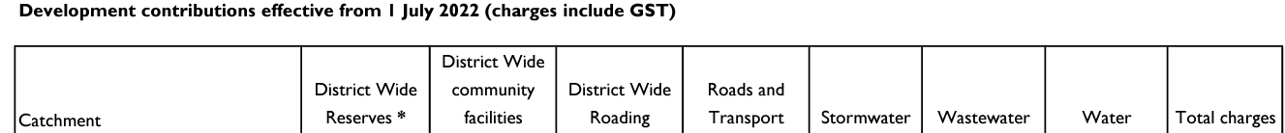
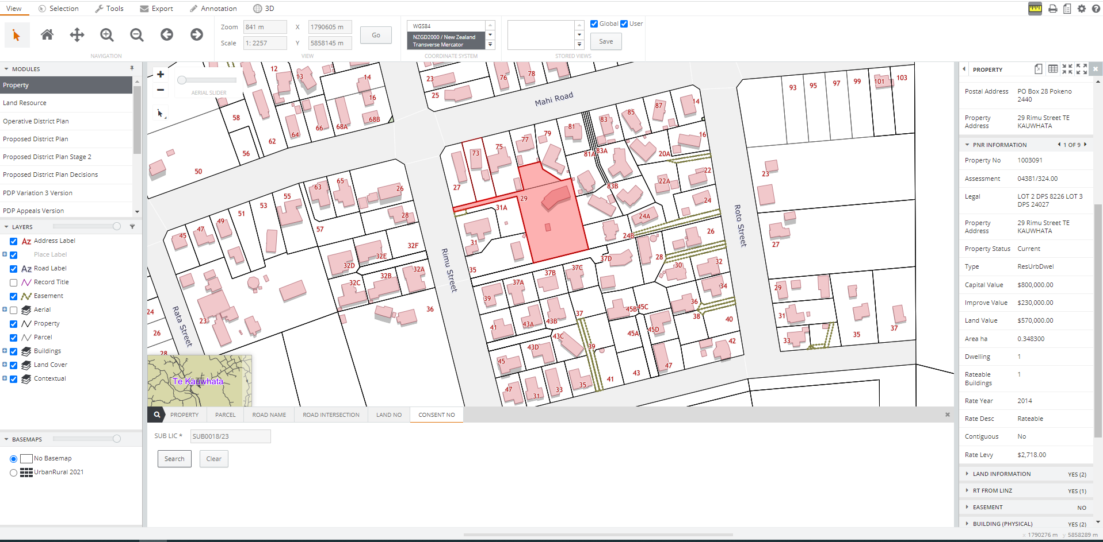

Slide 9
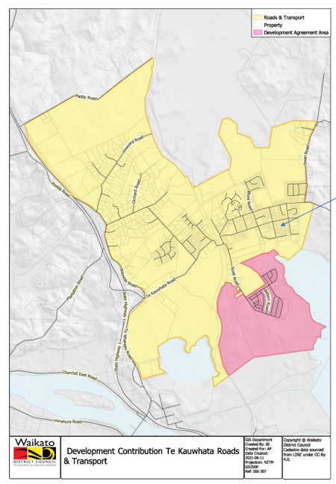
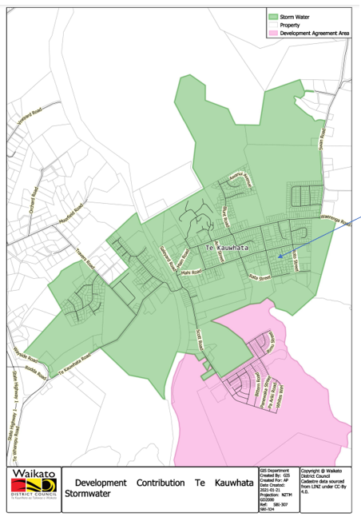

Slide 10
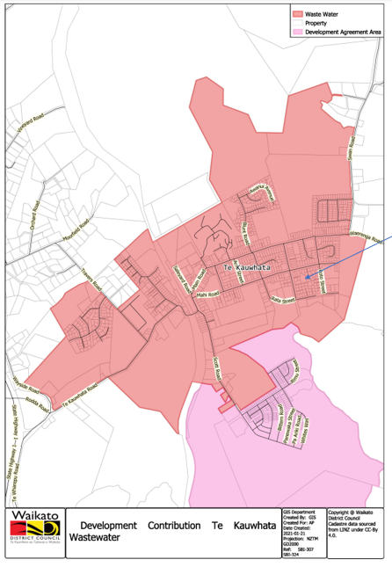
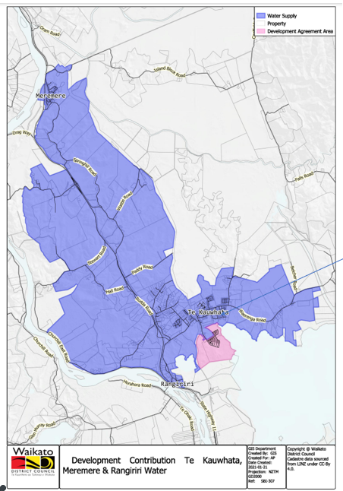

Slide 11
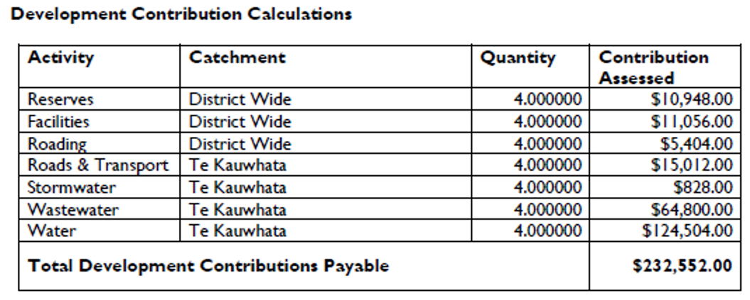

Slide 12
Drivers for a review of the DC Policy
Council is required by the LGA to review its DC policy at least once every three years (or more frequently if deemed necessary).
Such reviews may be triggered by, and will take into account, the following factors:
a) any changes to the significant assumptions underlying the development contributions policy
b) any changes in the capital works programme for growth
c) any significant changes in the costs of labour, construction or technology
d) any changes in the expected nature, scale, location or timing of development
e) any changes that require new or significant modelling of the networks
f) any changes to the District Plan
g) the regular reviews of the Funding and Financial Policies, and the LTP
h) any other matters the council considers relevant.

Slide 13
The outcome of these drivers on the current review
Council need to review our DC policy to:
Meet our legislative requirements;
Address the rezoning coming as a result of the PDP;
To update the Capital Works which will be defined as part of the LTP;
Update the Levies and Catchment Maps for the Capital Works.
The following are initial options for the scope of the review.

Slide 14
Option 1 - Things we need to change – The “Must Do”
Fix minor errors/pain points in the current policy.
Match any legislative updates.
Update schedules and catchment maps, based on LTP changes (incorporate PDP rezonings).
Consider Three Waters legislation and ongoing changes in this area.

Slide 15
Option 2 - Things we want to change – The “Should Do”
Would include the action points from Option 1; and
Minor scale changes to policy wording
Retirement Villages
Defer DCs until building consent in the policy
Codifying the 0.26 roading charge
Avoids need for administrative Development Agreements
Minor Dwellings assessments
Reviewing the half HEU approach
Reformat the policy
Implement DIA Guidance on best practice format

Slide 16
Option 3 - Things it is possible to change – The “Could Do”
Option 3 would include the action points from Options 1 and 2; and
“Blue Sky Thinking” policy considerations
Council could explore options to use the DC Policy as a tool to change behavior / further meet its Community Outcomes and Strategic Priorities.
The options would need consideration of:
Pros
Cons
Costs
Viability (including longevity in the face of reform)

Slide 17
Options Recap
Option 1 - Things we need to change – The “Must Do”
Option 2 - Things we want to change – The “Should Do”
Option 3 - Things it is possible to change – The “Could Do”

Slide 18
Reality of implementing these items
These have to be measured against the different constraints that apply to each potential option.
These include:
Staff time and capacity
Legislative options
Potential use of consultants (and subsequent costs)
Impacts on ratepayers

Slide 19
Staff Recommendations – “Building the Package”
Staff are recommending OPTION 2 as the best option for this review of the Development Contributions Policy.
That is: the must-dos plus minor scale changes to the policy wording.
Staff propose seeking funding in the next AMP/LTP to investigate
2 or 3 of the “Blue Sky” options (next slide), in preparation for the
2027 DC Policy review.
By the time of the 2027 policy review:
Waters reform will be a lot more settled/certain, in terms of its impact on the collection of DCs and Council operations.
Economic situation is more likely to have settled (inflation/cost of living/interest rates)

Slide 20
Option 3 - Expanded
Ideas include:
Wholesale review of methodology (e.g. HEUs vs Floor Size vs Number of Rooms)
Incentivising affordable housing (WHI initiative)
Enabling Papakaainga housing
Enabling social housing
Incentivise development of employment land
CBD revitilisation
Incentivise density where it is sensible
Discounts for Charities / Marae / Sports Clubs
Incentivise /reward water sensitive urban design (Blueprint initiative)

Slide 21
WDC Community Outcomes
Cultural
‘’We celebrate all cultures. We treasure our diverse communities, and acknowledge our cultural rights and obligations. We honour, understand and implement Te Tiriti o Waitangi and acknowledge the relationship with mana whenua of our district.
Economic
“We champion sustainable growth in our local economy. We support local enterprise and encourage innovation and socio-economic prosperity for all, while managing regulatory processes to protect and promote our unique district. We acknowledge our rural and Maaori economies as key contributors to our district’s prosperity and sustainability.”
Environmental
“We want waterways which are healthy and create connections. We protect and enhance our soils, water and native biodiversity and take care of our Taiao (natural environment) for the health and wellbeing of our people, our communities and for future generations.
Social
Our communities are connected, safe, accessible and resilient. We put community wellbeing at the heart of our decisions, and we embrace partnerships to get things done to improve people’s lives

Slide 22
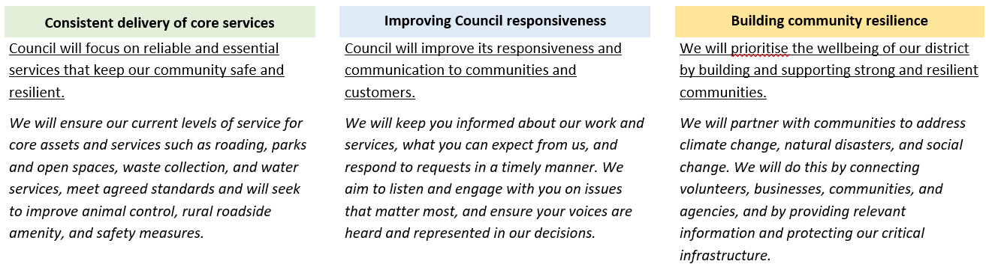
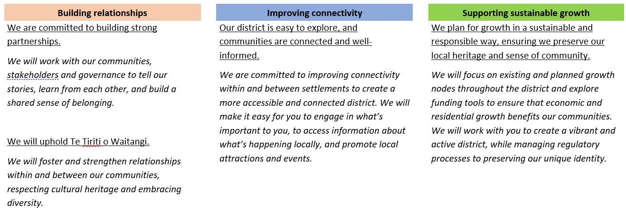
WDC Strategic Priorities

Slide 23
Discussion Time
Potential Options | Staff Ratings | Councillor Ratings
Review methodology | Very Low
Affordable housing | Low
Papakaainga housing | Medium
Social housing | Low
Employment land | Medium
CBD revitilisation | Medium
Directing density (3x3 Housing) | Medium
Charities / Marae / Sports Clubs | Medium
Water sensitive urban design | Low

Slide 24
Discussions / Questions
Feedback from DAC:
Cr P. Thompson - question around accessibility to public facilities for/in rural development
Alison Diaz - Other climate considerations, e.g. eco builds, ev charging
Cr Keir – more work is needed in investigating other funding streams / mechanisms
Cr Patterson – would be more effective to use changes in our consenting process(es) to shift costs for developers, rather than incentives through DCP

