Slide 1
Waikato District Council
Future of Severely Affected Land (FOSAL)
Jim Ebenhoh and Reece Turner, 5 Dec 2024

Slide 2
Agenda
What is FOSAL?
What is the difference between FOSAL and Stickers?
What have other councils down?
What could be the costs?
Potential Government Buyout Framework
Non-Buyout Options
Discussion / Questions

Slide 3
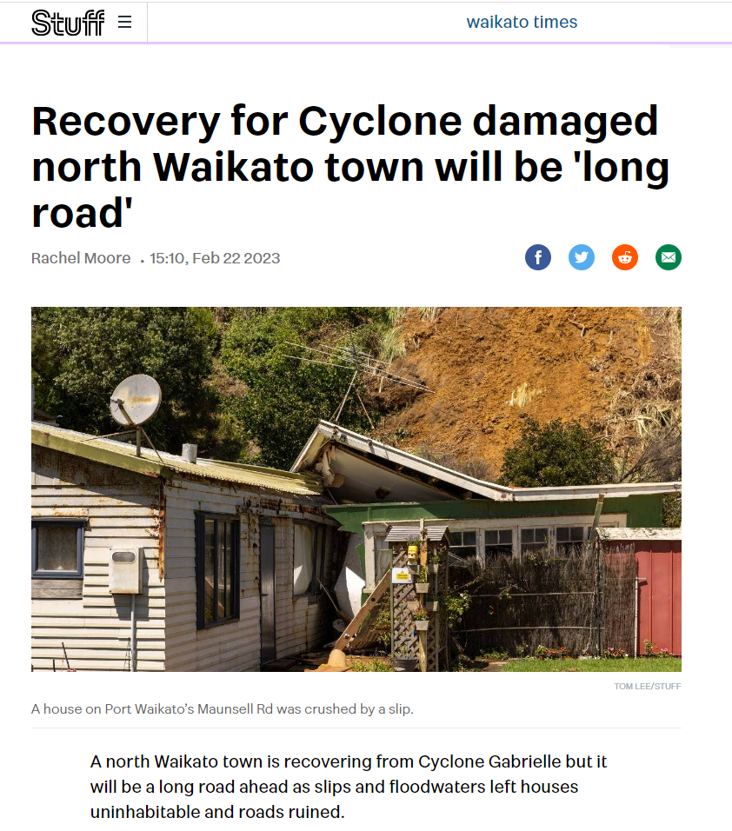
What is FOSAL?
“Future of Severely Affected Land”
Specific to damage from Cyclone Gabrielle and related storm events
An optional buy out process which council can undertake alongside government to buy back “Category 3” homes that face intolerable risk with no practicable mitigation options.

Slide 4
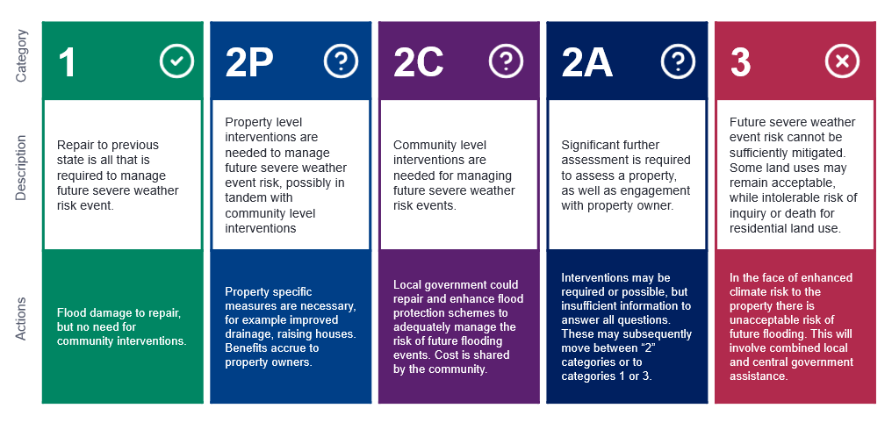
RISK CATEGORISATION FRAMWORK
Notes:
Note: categories 2P and 2C require some intervention to mitigate risk.
Category 3 is where risk cannot be practicably mitigated
Example used is flooding, but can also apply to landslip / instability

Slide 5
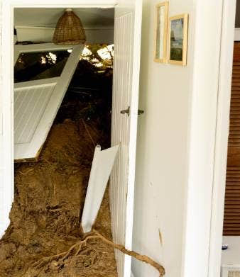
What is a
Red / Yellow Sticker?
Yellow Sticker
A yellow sticker means that access to your building is restricted, and it cannot be used, or you cannot enter except under supervision for a limited time or on essential business. It also means part or all the building may have sustained moderate damage, or some areas of the building, neighboring buildings, or land instability pose a significant risk.
Red Sticker
A red sticker means entry is prohibited. Your building may pose a significant risk to you, the public, health and wellbeing. The risk could be from the building itself, from adjacent buildings or from land instability.

Slide 6
What are the difference between a placard / sticker and FOSAL?
In brief: immediate safety risk (state of building / property NOW indicated by stickers) vs future risk (FOSAL)
The placarding process and the risk categorisation are two different and independent processes – the colour of a sticker doesn’t determine a property’s risk category.
Rapid building assessments were used to assign stickers. These assessments determine whether a building is safe to occupy and if it poses a safety risk to others based on the current state of the building and / or land.
Stickers indicate a building’s level of safety and whether people can be in it. Only authorised officials can place, change or remove them. A white placard means there are no access restrictions, a yellow placard means access is restricted, and a red placard means access is prohibited.
FOSAL’s property risk categorisation process assesses properties based on the likelihood of impacts and risk to life during future severe weather events.

Slide 7
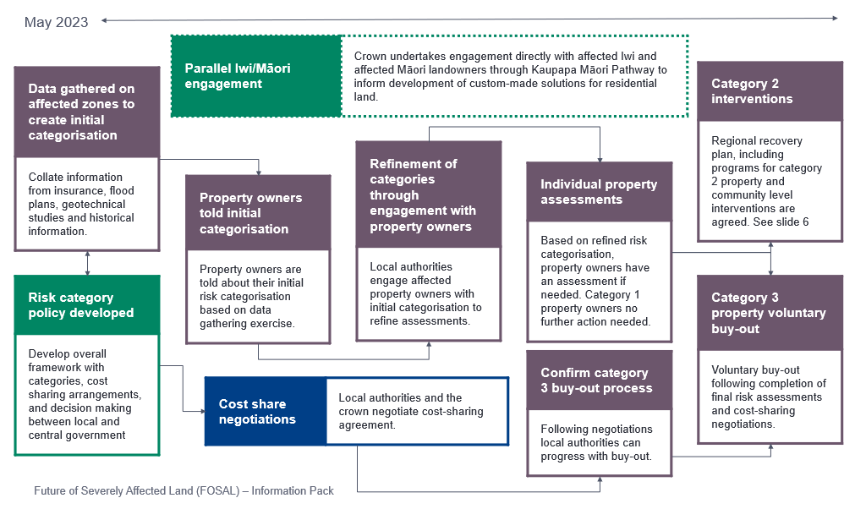
FOSAL PROCESS
Source: Department of Prime Minister & Cabinet

Slide 8
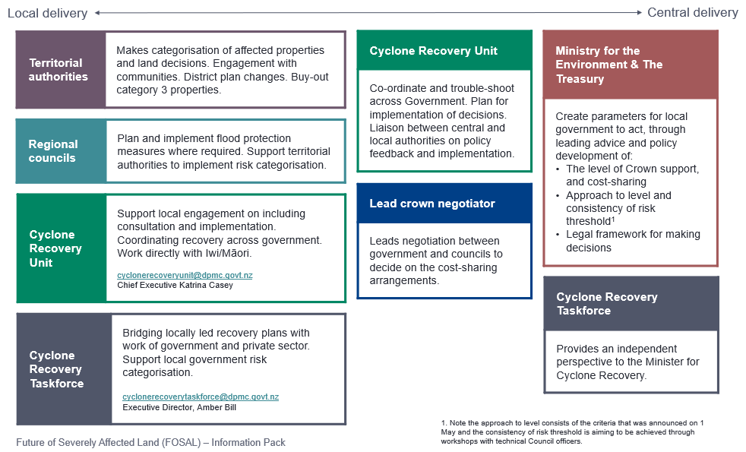
ROLES and RESPONSIBILITIES

Slide 9
What have we done so far?
Tonkin & Taylor have assessed those properties that were affected in the North Island Severe Weather Events.
The assessment tool used was in line with Auckland City Council (insert link to doc)

Slide 10
What have other councils done?
Hawkes Bay / Tairawhiti councils have agreed to a 50/50 buy out package for Category 3 homes
Hawkes Bay / Tairawhiti councils have created a policy that specifies that this is not a commitment from council to fund additional buys outs due to future weather events
Auckland City Council has agreed to a 50/50 buy out package for Category 3 homes
Auckland City Council have determined that if the cost of mitigations to Category 2 homes are higher than 25% of the property CV then the house will be reclassified as Category 3.
Northland councils and Tauranga City Council have not made a decision on classification as yet.

Slide 11
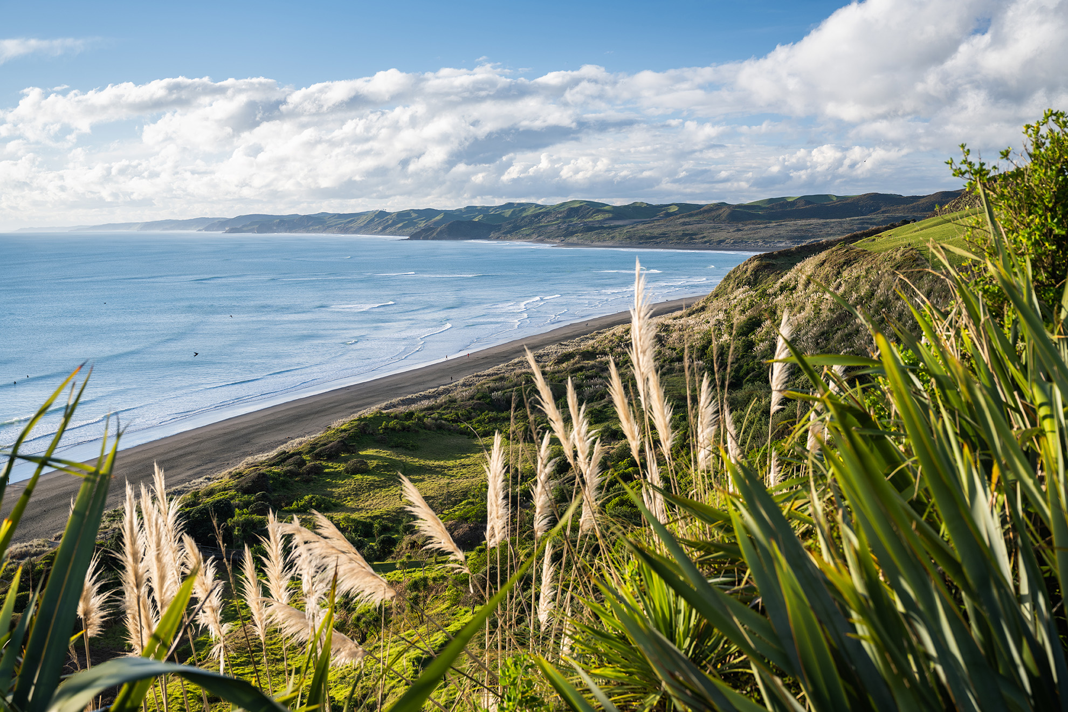
Homes Categories
(T&T preliminary assessment)
Category 2P (35 Homes)
201, 199, 197, 195, 193, 191, 189, 187, 185, 183, 181, 179, 177, 175, 173, 171, 169, 167, 165, 163, 161, 159, 157, 155, 139a, 137a, 131, 129, 123, 115B, 81, 77 Maunsell Road and 17, 15, 13 Tuakau Bridge - Port Waikato Road
Category 3 (1 Home)
207 Maunsell Road - could be downgraded to 2p following an assessment but large amounts of debris could come down and little space to attenuate debris

Slide 12
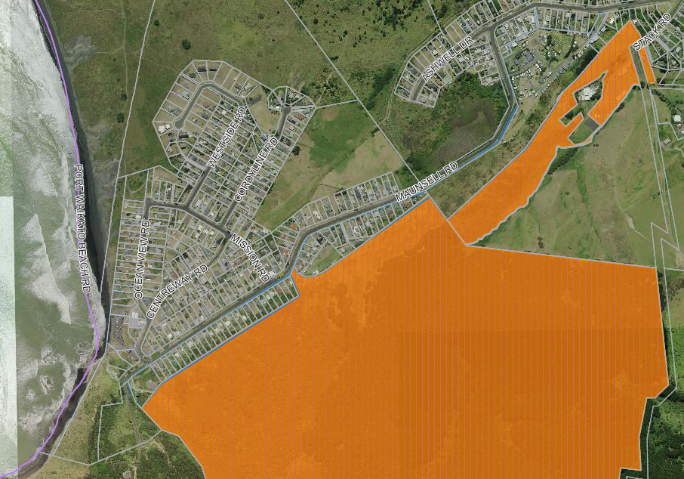
AFFECTED
AREA

Slide 13
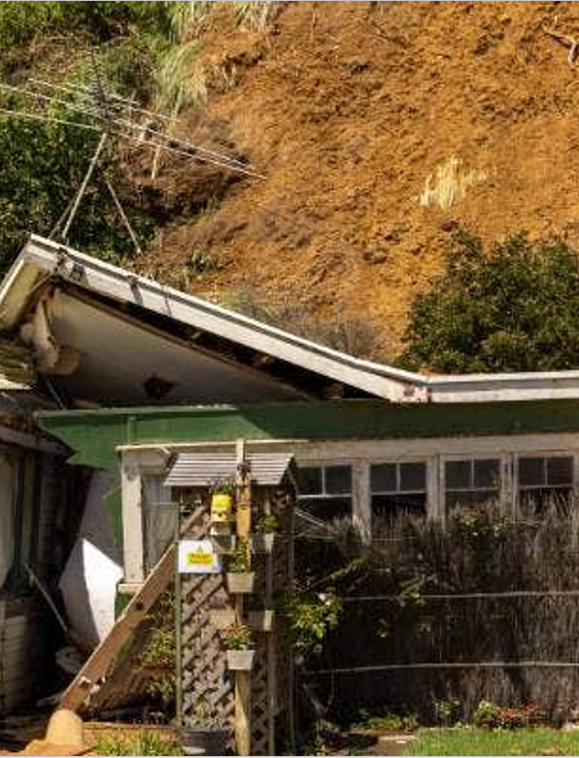
Property Values
Category 2P Homes (35)
$19,600,000
Category 3 Homes (1)
$600,000
Red Sticker Homes (4)
$1,435,000
Yellow Sticker Homes (4)
$4,200,000

Slide 14
Pros and Cons of Buy Out
Pros:
Complete removal of risk to property
No cost to property owner
Cons:
Administrative burden including agreeing valuation and actioning buy out
Increased staffing levels support the Recovery Team to delivery buyout process
Precedent / pressure for Category 2 to be reclassified as Category 3
Council would cover the cost to removal of property

Slide 15
What about Category 2?
Consider Auckland approach of reclassifying as Category 3 (and potential buyout) if costs are above (say) 25% of CV
Or contribute in some way to necessary repairs / mitigation?
Need to understand role / scope of insurance coverage
Precedent / cost issues

Slide 16




