Slide 1
Waikato District Council
Review of the Gambling Venues Policy 2021
23 April 2024

Slide 2
Purpose of Workshop
Provide information on and seek feedback from Council on the review of the Gambling Venues Policy 2021.

Slide 3
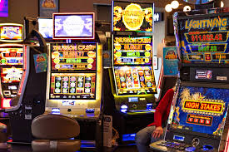
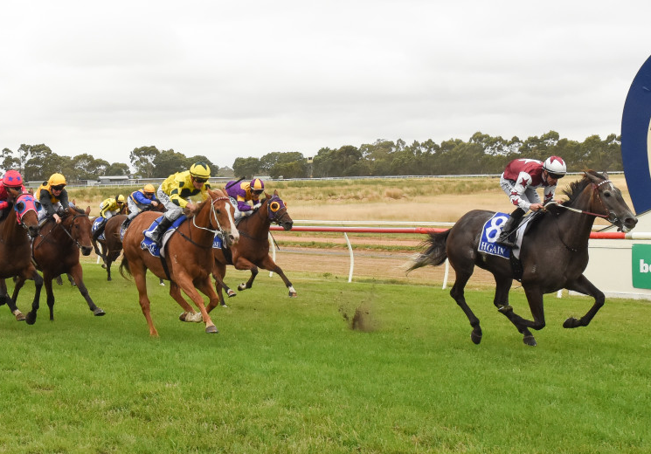
Background
Council must adopt a policy on Class 4 Gambling.
Class 4 Gambling is pokies and slot machines.
Council must also adopt a policy on standalone venues TABs.
The policy is made under the Gambling Act 2003 and Racing Industry Act 2020.

Slide 4
Class 4 Gambling Venues policy
No further class 4 venues.
Sinking lid policy.
Maximum number of gaming machines per venue is nine. NB: This max applied from Sept 2003, premises registered before then could have up to 18 machines.
Merging of two venues with class 4 licenses is allowed.
Total number of machines must be five-sixths the combined number of two class 4 licenses.
Maximum number is 18 when merging.
Relocation is supported if improvements are for the purposes of the primary venue activity.

Slide 5
TAB Venues Policy
Council will consider applications to establish TAB venues.
Council has discretion.
Only permitted in zones which allow commercial activities.

Slide 6
How has this policy been applied?
Gambling Venues Policy
No applications for relocations or merger.
TAB venues policy
No applications for standalone TABs.
No standalone TABs in the Waikato currently.
Rarely used policy.

Slide 7
How does our policy compare?
Review of:
Waikato District Council
Waipa District Council
Matamata-Piako District Council
Hauraki District Council
Hamilton City Council
Auckland Council
Thames-Coromandel District Council
Policy | Comparison
Sinking Lid Policy | Yes, for 4/7 policies
Caps on maximum number of machines | Yes, for 4/7 polices
Relocations (with conditions) | Yes, for 5/7 policies
Mergers permitted | Yes, for 6/7 policies

Slide 8
Class 4 Gambling Spend Comparison
Council | Average spend per person in 2023
Waikato District | $122
Hamilton City | $154
Waipa District | $169
Auckland | $180
Matamata-Piako District | $194
Hauraki District | $268
Thames-Coromandel District | $358

Slide 9
Social impact of Gambling
Legal requirement.
The number of venues and machines has decreased slightly.
Expenditure:
$9.8 million spent in 2019
10.834 spent in 2023
$2.3 to $2.6 billion spent per year in NZ
 | 2021 | 2024
Number of Class 4 venues | 18 | 17
Number of Class 4 machines | 233 | 227

Slide 10
Social benefits of Gambling
Entertainment, social interaction and employment.
In 2022, grants totalling $3,426,232 were made in the Waikato District.
$1,942,260 granted to sport in 2022.

Slide 11
Social costs of Gambling
Problem gambling.
4.5% of New Zealand experience gambling harm.
12 out of the 17 venues are located within areas with a deprivation index of 9.
Maaori, Pacific peoples, and people on lower incomes continue to disproportionately experience gambling harm.
Initiatives in place to support and manage gambling harm.

Slide 12
Options
No changes to the Policy (recommended by staff).
Amend Policy, moving to a “capped machine” policy, rather than a sinking lid, and retain the existing relocation clauses in the new policy.
Amend the Policy, by moving to a “gold-standard sinking lid” approach – removing the merger and relocation clauses.

Slide 13
Next steps
18 June Policy and Regulatory Committee: Approval to consult
June / July 2024: Consultation
September 2024: Hearings and deliberations
October 2024: Adoption

