Slide 1
Waikato District Council
Formally adopting the Sustainable Development Goals (SDGs)

Slide 2
Overview
Brief overview of the SDGs
Relevance to WDC
Links to what WDC is currently doing
Formally adopting the SDGs & Opportunities

Slide 3

Sustainable Development Goals (SDGs)

Slide 4

The 2030 Agenda for Sustainable Development adopted in 2015 by all UN Member States
At the heart of the this are the SDGs, comprised of 17 goals.
A call to action to end poverty and inequality, protect the planet, and ensure that all people enjoy health, justice and prosperity.
Poverty and other deprivations be simultaneously addressed by strategies that improve health and education, reduce inequality, and provide economic opportunities– whilst also addressing climate change.
What are the SDGs?

Slide 5


Slide 6
Leave no one behind is the defining principle of the agenda, a shared promise to work collectively to ensure everyone prospers.
However, this pledge is now in danger.
Halfway to 2030, delivery of the SDGs is in jeopardy. Under current trends:
  For the 140 targets with data available, half of these targets are moderately or severely off track
  By 2030, 575 million will still be living in extreme poverty
  It will take 286 years to close gender gaps in legal protection and removal of discriminatory laws
  By 2030, 2 billion people will continue to rely on polluting fuels and technologies
  An extra 25 years to halt deforestation is needed
  (Source: UN SDG Progress Report 2023)
Progress so far

Slide 7

Relevance to WDC

Slide 8
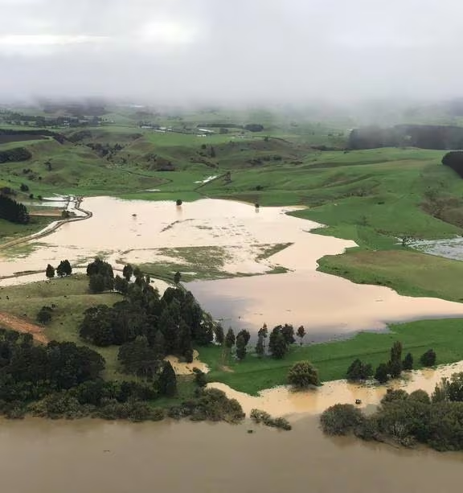
Localisation of SDGs
Whilst the SDGs are global, their achievement depends on the ability to make them a reality in cities, towns, and regions.
Localising requires giving a leading role to local governments and communities to become the catalysts for change necessary for global achievement of the goals.
Translating the SDGs into a local context and defining, implementing, and monitoring local actions and strategies.

Slide 9
Links between the SDGs and work WDC is currently doing
See attachment 1 to memo

Slide 10
Formally adopting the SDGs
A clear signal by Council of their commitment to sustainability and living up to our commitment for ‘liveable, thriving and connected communities’
A framework for guiding Council’s strategies, policies, functions and initiatives and align with the national and global agenda for sustainable development
Links exist within Council’s current work and overall approach towards sustainability
Significant gaps in data are impeding monitoring and thus progress of realising the SDGs
  68% of environment-related SDG indicators cannot be measured due to lack of data
  Only 33% of the data for 104 SDG indicators related to gender is available in OECD countries
  In 2020, over half the SDGs in the Asia-Pacific region could not be measured due to data scarcity
Accurate and up-to-date data is critical for decision makers, allowing identification of areas that need improvement, to track progress and make informed decisions.
Without robust data and monitoring, the poorest and most vulnerable are at risk

Slide 11
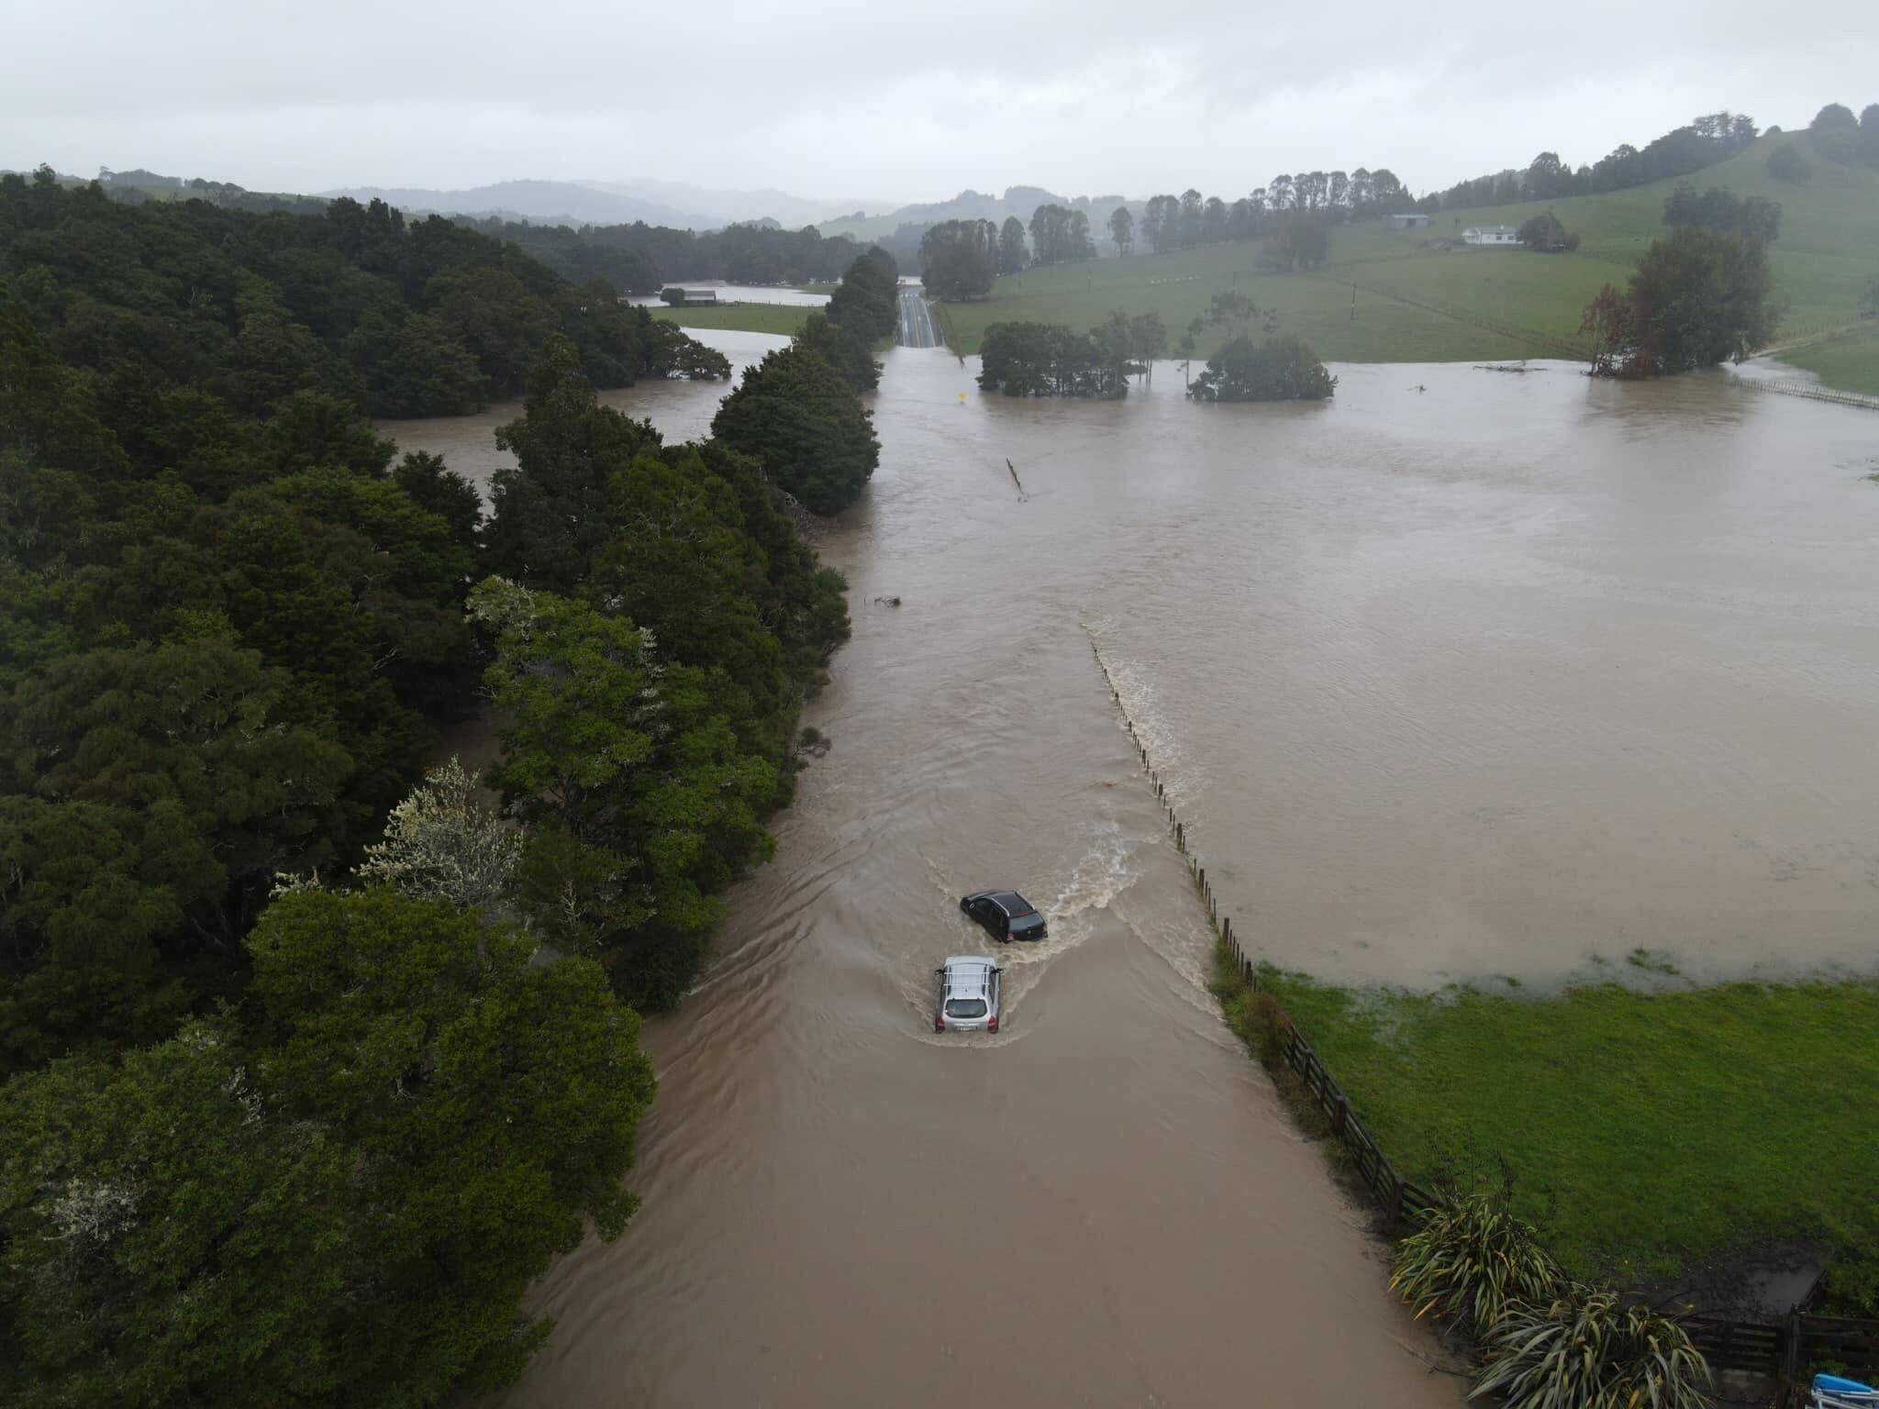
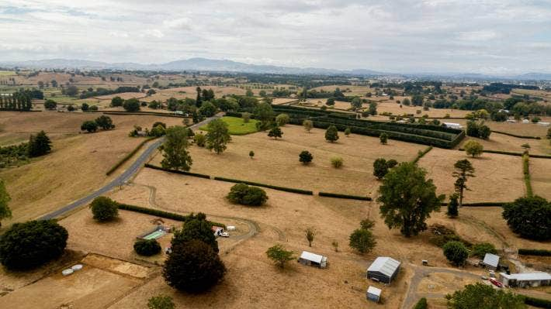
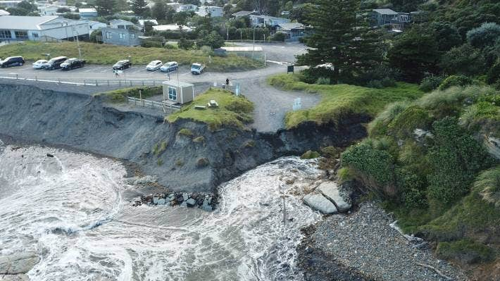
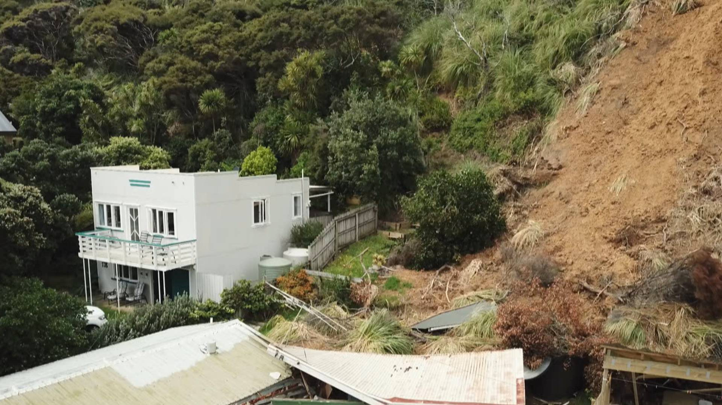

Slide 12
Opportunities
Incorporate/assess SDGs into Climate reporting and monitoring. Such data then able to inform National (and subsequently Global) progress
Refine the SDGs for the local context- relate each goal to the Waikato District and what sustainable development looks like for us
Example- Bristol One City Plan: Localised each SDG to the city refining the goal and targets to the specific context (https://www.bristolonecity.com/wp-content/uploads/2019/02/One-City-Plan-Goals-and-the-UN-Sustainable-Development-Goals.pdf)
Collaboration with key partners to realise the 2030 Agenda

Slide 13




Initial Presentation to Councilors
Report to Sustainability and Wellbeing Committee
Implement and Monitor
- Workshop with the elected members
- Introduction to the SDGs, links to what Council is doing
- Report to the S & W Committee recommending formal adoption by Council
- Identify relevant goals, gap analysis (what we are/are not doing), identify and then prioritise gaps
- Refine targets and indicators, report on progress

Slide 14


Slide 15
Questions?

