Slide 1
Simplifying public transport funding
Regional rates and investment approach
Waikato District Council 31 January 2024

Slide 2
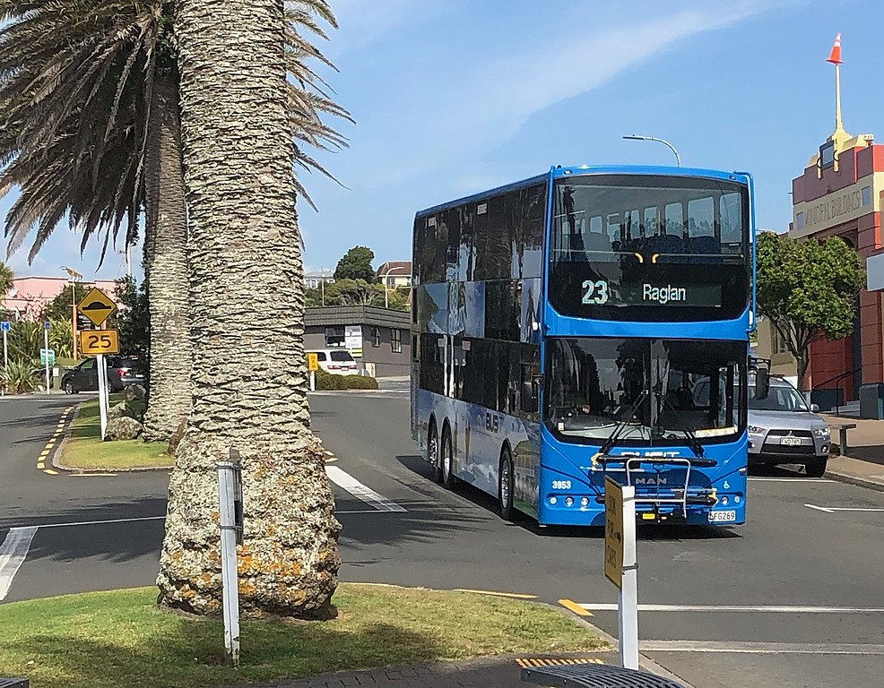
Contents
Scope
Why?
Rating options?
Protecting local voices in public transport.

Slide 3
Objective
To simplify and streamline the Waikato Region’s approach to public transport investment:
  Making it easier to implement the Regional Public Transport Plan and Metro Spatial Plan Transport Programme
  Improving integration of services.
  Increasing flexibility.
  Speeding up decision-making.
  Reducing financial and contractual risks to councils.

Slide 4
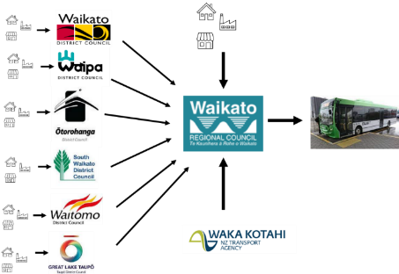



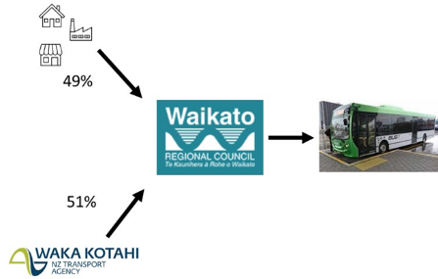

Current Waikato approach
Typical NZ approach

Slide 5
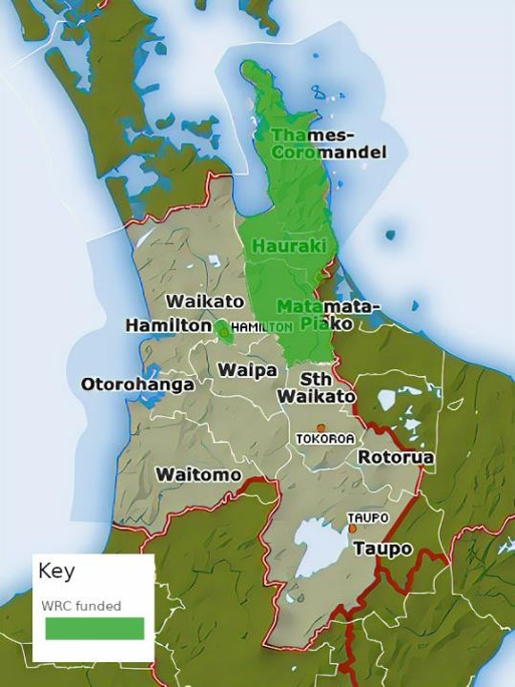
Areas currently rated and funded by WRC
Hamilton City
Hauraki District
Matamata-Piako District
Thames Coromandel District
Notes:
In some of the Region Waikato RC already funds public transport.
It has been long-standing in Hamilton City, and from 1 July 2022 in Hauraki, Matamata Piako, and Thames Coromandel.

Slide 6
We’re looking at the ‘local share’ of net cost
100%
User/fares (20%)
Public (80%)
Rates (49%)
Total cost of service (gross cost)
NLTF vs Local funding
NLTF (51%)
User vs public pays

Slide 7
Why?
Take you through some examples

Slide 8

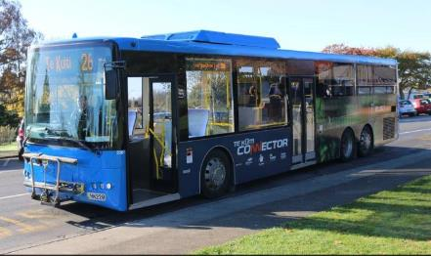

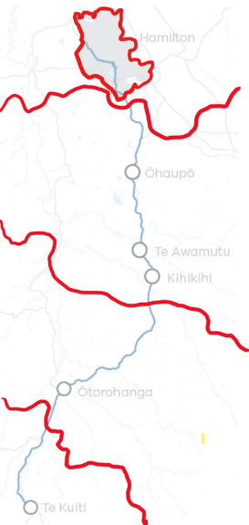






Case Study
Te Kūiti Connector
1 daily return service
8 x funding partners
Notes:
Coordinating Regional Council and Land Transport Management Fund investment is already a significant challenge – particularly when new, or trial services are involved. Adding the need to coordinate Territorial Authority investment amplifies this complexity and introduces new challenges.
As the Region’s network expands, more ‘connector’ services cross district and regional boundaries, and we look more proactively to other partners to fund and benefit from public transport, the system become excessively complex and unwieldy.
Without change, an example of the kinds of deals we will need to make more of is the South Waikato Connector:
The South Waikato Connector runs from Te Kuiti in the Waitomo District to Hamilton, running through Otorohanga, Waipa, Waikato Districts.
The service is funded by the Waikato Regional Council, Waitomo District Council, Ōtorohanga District Council, Waipā District Council and South Waikato District Council, as well as tertiary providers The University of Waikato and Wintec and Waka Kotahi New Zealand Transport Agency.
The concept had been around for a while, but it came about opportunistically, through strong advocacy from Waitomo District Council, coincidental alignment between all 8 funders and a concerted effort from WRC staff to take the opportunity when it arose.
While broad collaborations are valuable, the need to establish and maintain eight funding sources in order to deliver a once-daily connection is excessive. It was good timing and a concerted effort that put in it in place. But, it has a high ongoing administrative costs (8 x funders) and is vulnerable to changes in funding from any of the eight investors.

Slide 9
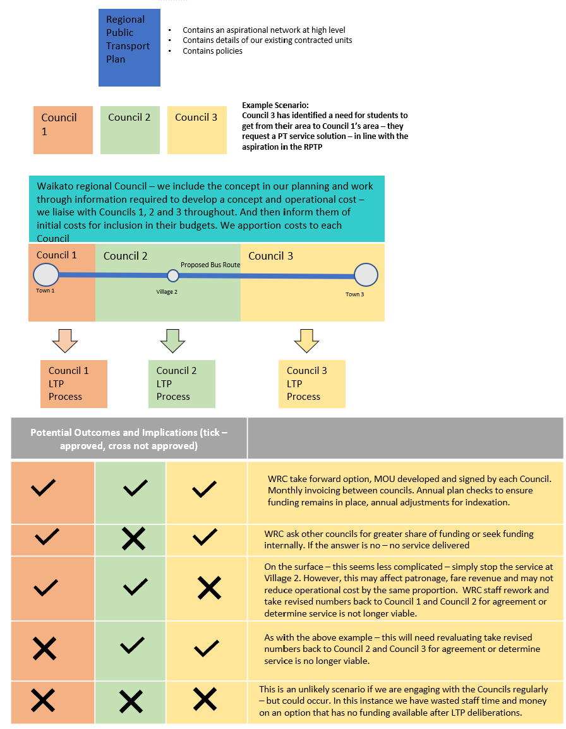

Slide 10
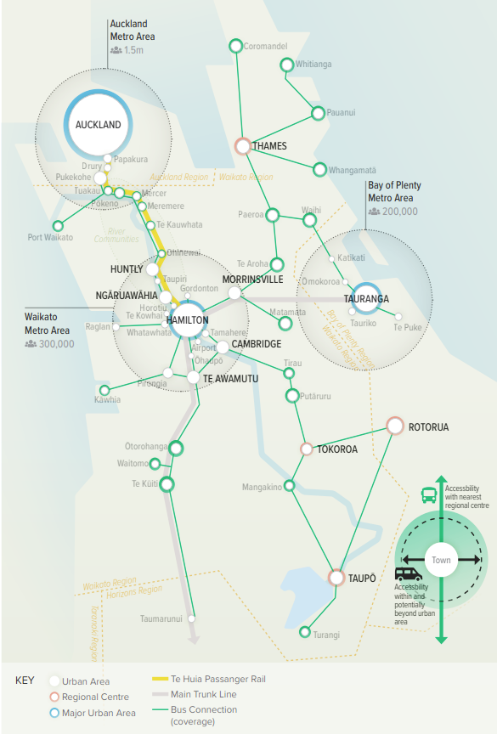
Waikato Regional Public Transport Plan – indicative future network
Relying on this type of arrangement will make it harder to achieve and sustain a regional network
Notes:
Inter-regional services, have additional complexities - they must have support across regional, not just territorial boundaries.
Further, as pressures on the public transport allocation of the National Land Transport fund go unresolved, the council will need to continue to look to less conventional partners in the public and private sectors who see value in investing in public transport.
In the neighbouring regions of Auckland, Bay of Plenty, Horizons and Taranaki, the regional council is responsible for collecting rates for public transport.
Unless the Waikato simplifies its funding model along similar lines, this will remain a barrier to improving public transport in the Waikato.

Slide 11
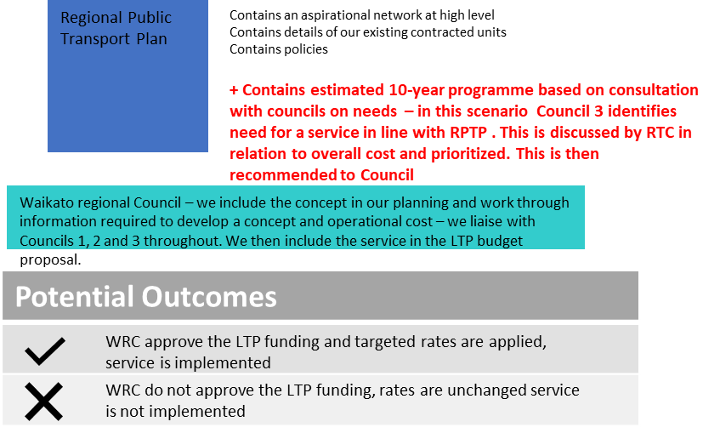
LOCAL VOICE INCORPORATED INTO RPTP

Slide 12
Current Public Transport Use
We also want to change the model to better reflect the benefits of PT, including those related to some existing behaviour
Eg in Tamahere – parents drop off children on the edge of the city to catch services in to school
The Hospital is now being recommended to use the Rotokauri hub and Glenview Hub as informal Park and Ride
High volumes of sub division and growth on the edges of HCC mean that lots more people rely on efficient networks in the city to access, shopping, healthcare, employment and social opportunities. The reduction in traffic as a result of bus users is likley to have significant benefits to every person that travels into Hamilton or surrounds even drivers.

Slide 13
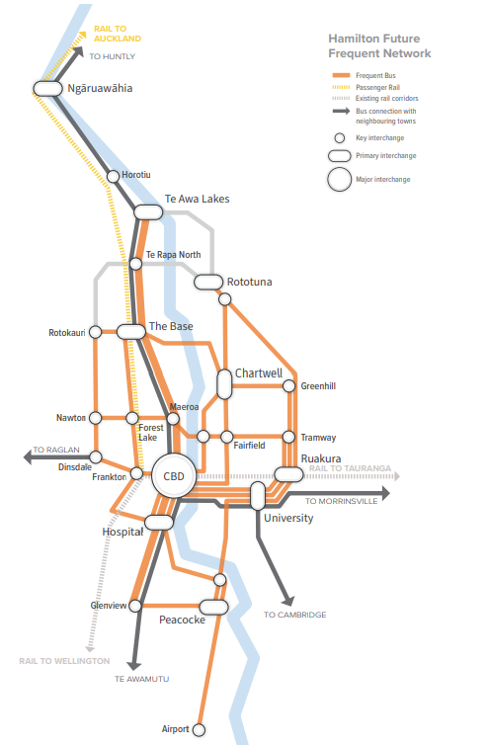
And future investment
This looks at significant improvements including 10 minute frequency services that will connect Ngaruwahia/Horotiu, areas around the airport to each other on fast services that bypass traffic. This will mean that somebody living in Horotiu can get to the CBD in 15 minutes by bus or to future jobs at the Airport in 25-30 mins.
Equally those living in peri urban locations will be able to drive to the edges of the main towns – park up and jump on a bus – or drop of dependents etc…

Slide 14
In summary, new regional funding has the potential to:
Improve efficiency.
Support flexibility, innovation and responsiveness.
Better enable inter-district and inter-regional services.
Reduce financial and contractual risk to TAs and WRC.
Improve resilience.
Enable investment in strategic public transport infrastructure.
Improve equity of funding obligations.
Notes:
As well as being complicated and administratively inefficient (the need to establish and maintain funding deeds, transfer funding between councils, duplicate reporting for financial transparency etc) the current approach makes it very difficult to respond to local needs – introduce trials and move resources about. A recent example is that the ending of the FLEX Airport connection trial should release a vehicle that could be used to trial a demand responsive services elsewhere – but because the funding is ring-fenced and the operator's contract is for the Hamilton area this is much easier said than done.
The model also creates risks both for Territorial Authorities and the WRC.
For TAs, this system means that when there are adjustments in the costs of services territorial authorities are required to increase their funding to maintain service levels, but have little visibility and no control over the commercial terms of the contracts that WRC holds with bus operators.
It also means that, where there are services that cross district council boundaries, if one council withdraws funding, they will need to cover this additional cost.
When it comes to establishing a new services, there is no ability to compel a neighbouring TA to fund a services who could choose to hold-out resulting in the service being either blocked or them becoming a free rider.
The Regional Council also carries significant financial and contractual risks under this model that can only partially be mitigated by way of funding deeds. Contacts for public transport are between the Regional Council and the Operators. They typically range for a period of between 6 and 12 year, with a previous standard term for bus contracts being 9 years.
These contracts include mechanisms to adjust the contract value throughout their life for inflation – this is known as indexation and are also subject to other movements as new technology, labour laws or worker pay expectations shift that are negotiated as required. While the contracts can commit the Regional Council to adjust its funding levels in order to maintain services, it does not have direct control over a TAs rating and funding for these services – especially through multiple elections and Long Term Plan cycles.
Because of the Regional Council’s scale relative to most TAs and strength of its balance sheet – the Regional Council can better withstand revenue and costs shocks by using its balance sheet and reserves to smooth out short-term fluctuations. This was important during COVID-19 where fare revenue fell sharply while the government increased bus driver wage expectations outside of normal council funding cycles.
In the medium-term, a regional rate could be used to fund strategic PT infrastructure that benefits multiple districts – like park n’ ride facilities, busways and mass transit.
A regionalised funding model doesn’t mean that every needs to pays the same. Councils already use rating differentials, targeted rates and other tools to make sure that rates are spread a fairly as possible.

Slide 15
How?
How did we develop the options for rating?

Slide 16
Desirable characteristics
Fairness:
Costs can be allocated between direct and indirect beneficiaries.
Ease of administration:
Minimise administrative burden.
Enabling integrated planning and operation:
Avoids barriers and creates opportunities for integrated planning and delivery of the network.
Flexibility:
Enables the reallocation of funds between services during an LTP.
Infrastructure enabled:
Could accommodate funding infrastructure in the future.
Factors that informed the options. Some options are better at doing some things than others.
Notes:
Informed by the Local Government Act and to address the issues with the current funding system, there are some characteristics that we would want to see in a replacement system and that have informed the options being consulted on.
Some of these things are in tension with one another.
For example, we want a model that fairly distributes the cost of public transport, but we also want a system that is easy to understand and as simple as possible to administer.

Slide 17
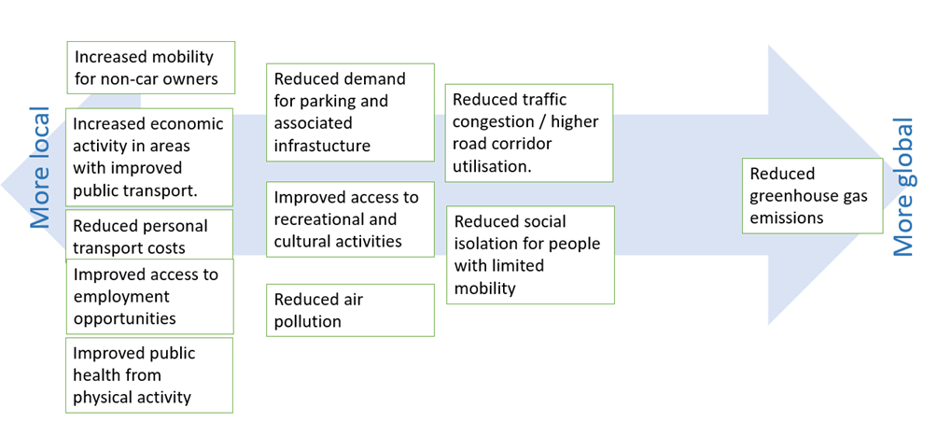
Benefits range from very local, immediate and individual to global, public and inter-generational

Slide 18
Assumptions across all options
All numbers are per annum, indicative & conservatively high – there is around $3m net of LCLR funding in Year 2 (this would be close to a third on top of our continuous programme)
Direct access is walking distance ~800m
Indirect access is bike/scoot/drive to connect ~5km
The ‘Metro area’ is the area covered by the Metro Spatial Plan Transport Programme Business Case.
PT IS ALREADY RATED IN SOME WAY BY THE DISTRICT – SO UNDER THE CURRENT MODEL WAIKATO DISTRICT WILL BE RATING IN LINE WITH THE COSTS SET OUT IN OUR MODEL.
This is a more transparent approach as the rating for PT will be identified in the Regional Council bill.

Slide 19
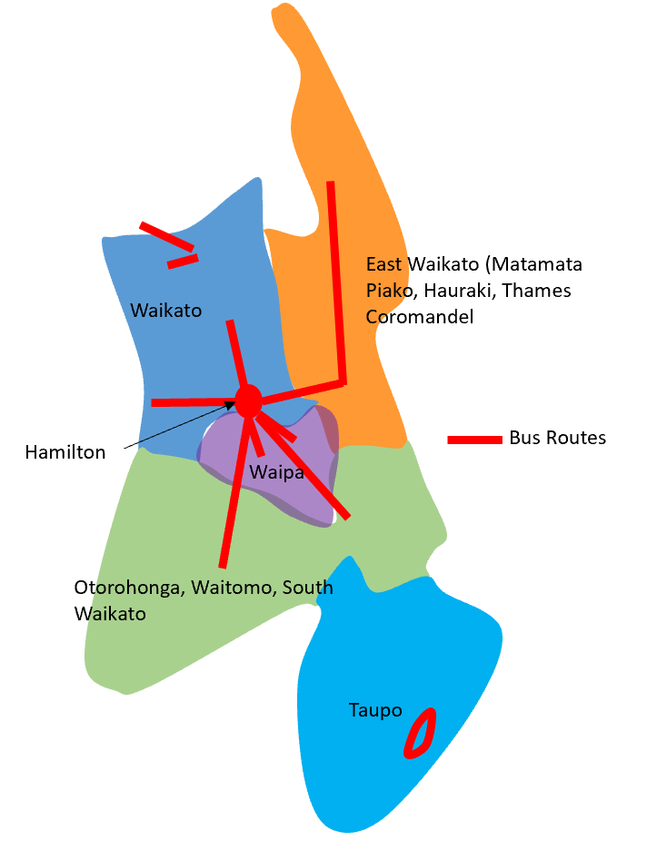
Option 1 – Step 1: Cost Allocation
Cost allocation undertaken by routes
Allocating those costs to the areas served
Costs are allocated by district and level of service

Slide 20
Option 1 – Step 2: Benefit Allocation
Need to identify who benefits and therefore who pays
Separation between properties with access to services based on distance (800m) = direct benefit 80% of costs
Properties outside 5km = indirect benefit 20% of costs

Slide 21
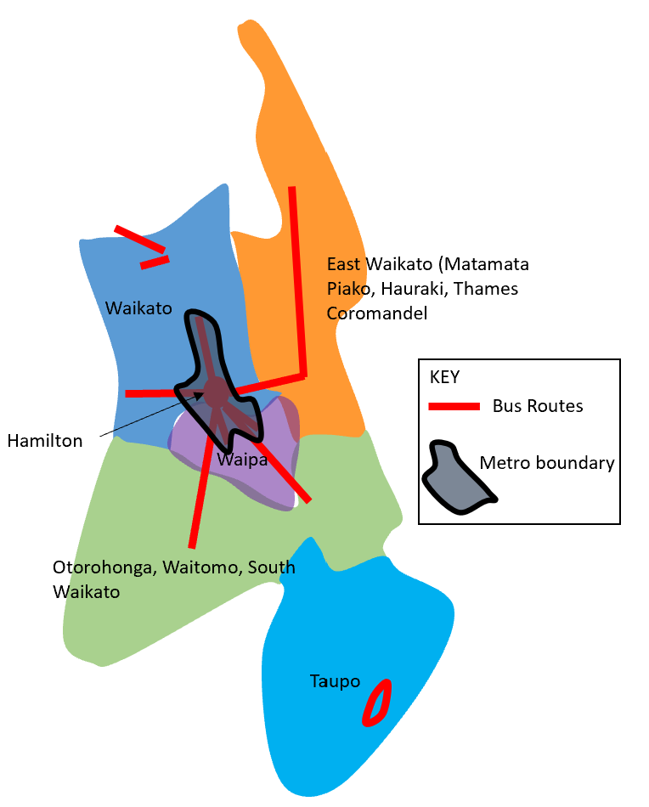
Option 2 – Step 1: Cost Allocation
Metro costs are separated from other areas
Cost is spread among all properties within the metro area

Slide 22
Option 2 – Step 2: Benefit Allocation
Within metro area no differentiation between properties within 5km
Acknowledges network benefits to all users including drivers
Outside metro area, 80% direct recovery – properties within 5km, 20% indirect across district.

Slide 23
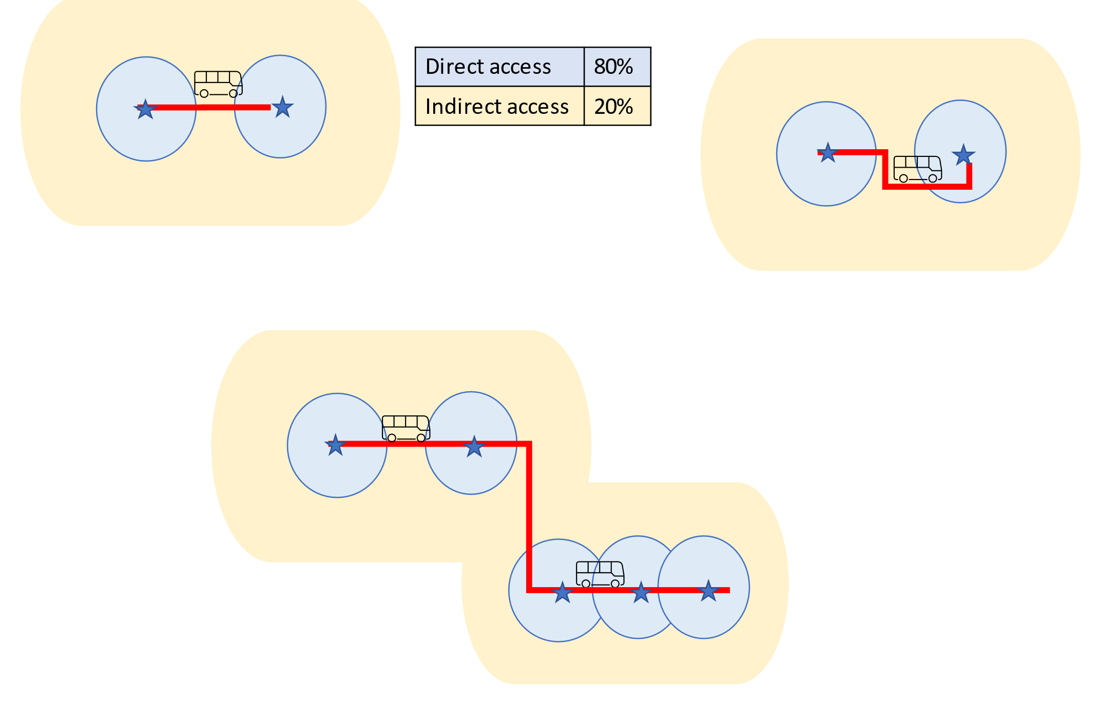
Option 1
80 % targeted to areas with direct access
20 % targeted to areas with indirect access

Slide 24
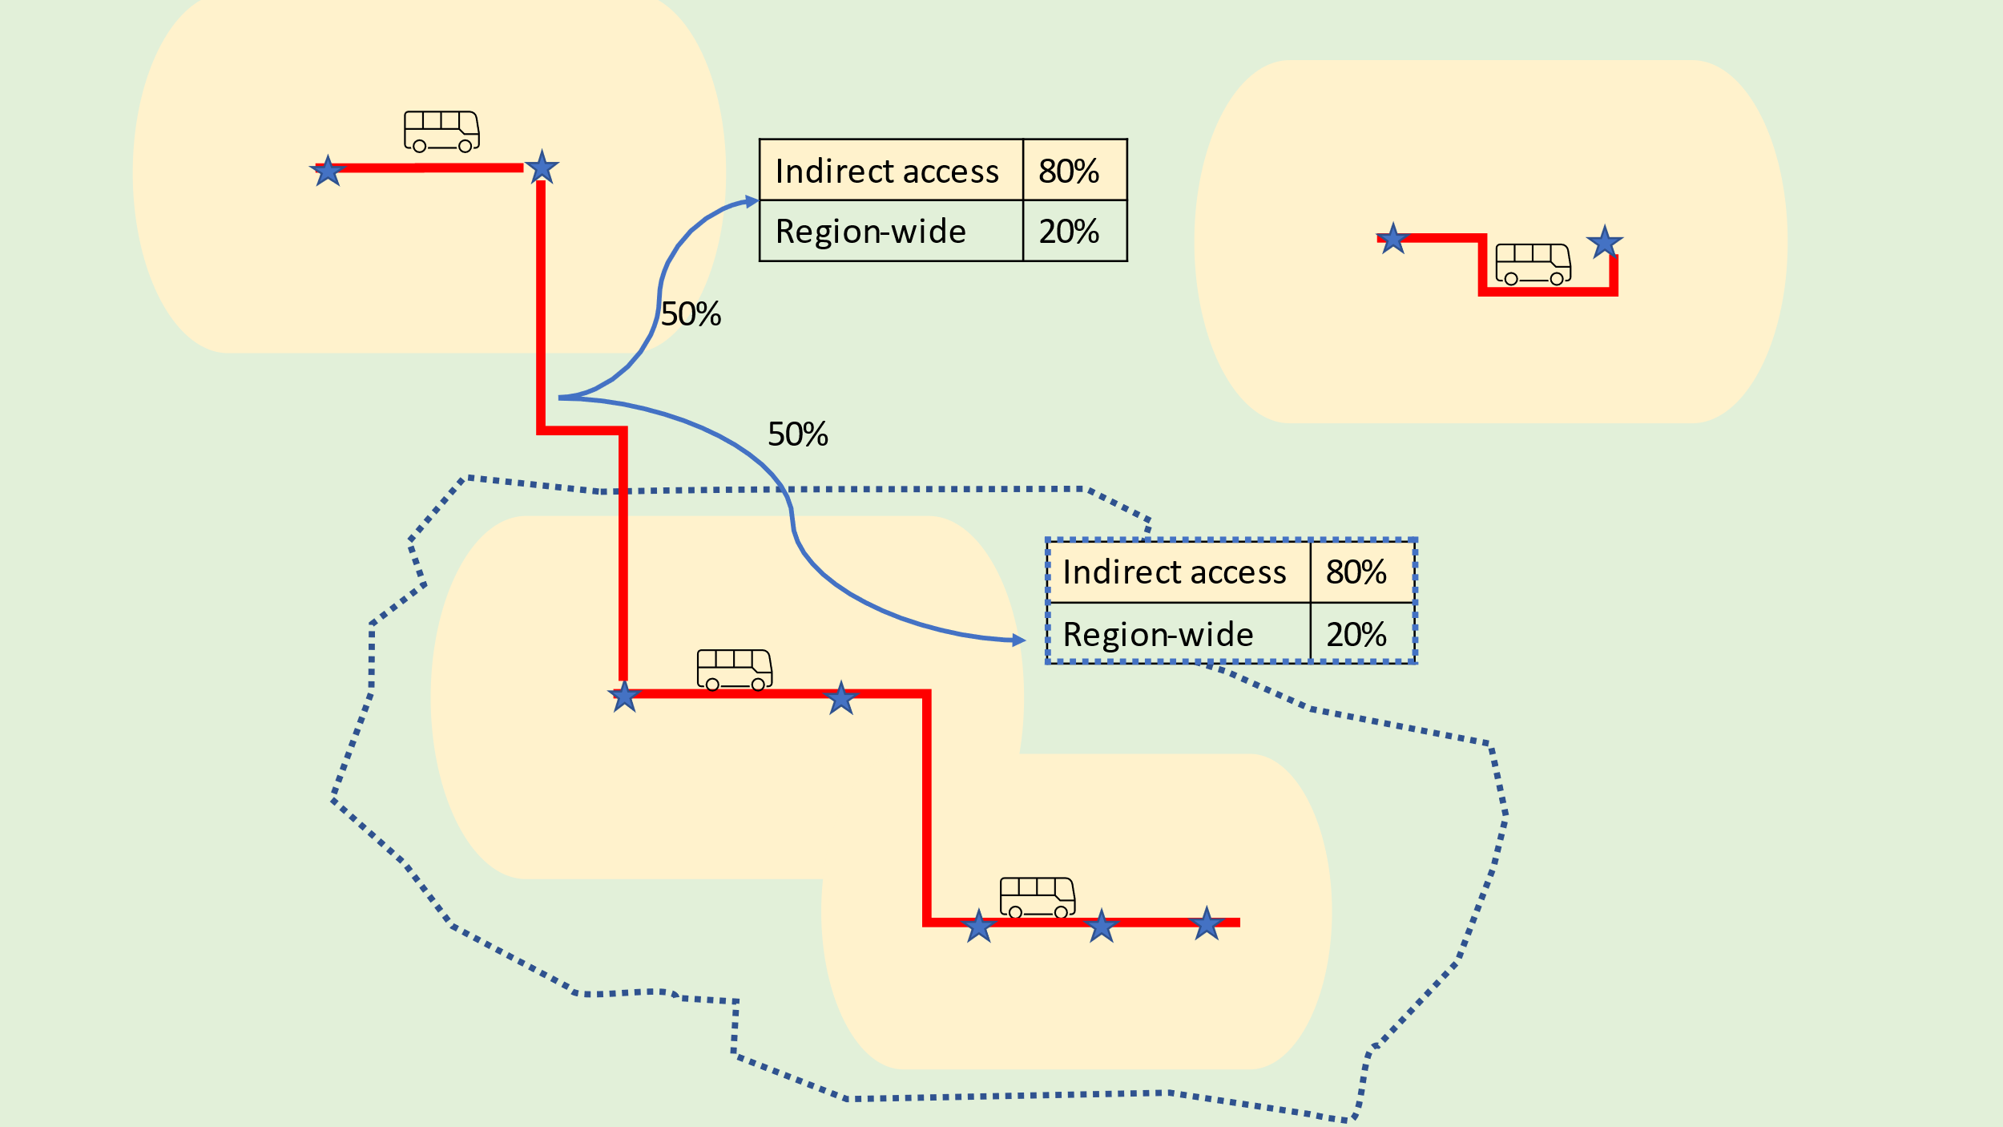
Option 2
(preferred)
80 % targeted to areas with direct + indirect access (yellow areas)
20% regional benefit
Hamilton/Waikato metro-area ring-fenced. (all properties in here pay the same)

Slide 25
How does each approach affect the rating profile?
Notes:
This is the main example used in the council paper – it helps to demonstrate that direct cost application sees significant increases in rating for PT, the metro option would see that increase only in areas where there are metro services, outside of the metro regional service costs are spread over the people within 5km and the District. In the metro defined area the number of services that can be accessed will be higher and therefore the ratings will be higher. So people lib=ving on the edge of Hamilton will pay more than people living in rural locations with limited services.

Slide 26
Raglan example
For a property in Raglan within 800m of a Bus Stop, CV $2m
CV/$100k
STATUS QUO | OPTION 1 | OPTION 2 | Under Option 1, the cost of Waikato services is spread over the TLA, this means that Raglan properties would pay the same as those in Huntly and Pokeno. Under the metro approach, services going to into Hamilton from the metro area (including Huntly, Te Kowhai, Tamahere etc are paid for through property in the Metro area. This leaves Raglan paying for more rural services along with Pokeno
Walk up 800m | 800m walk up | Within 5km
UNKNOWN RATED LOCALLY | $42.35 | $3.46
For a property worth $2m
STATUS QUO | OPTION 1 | OPTION 2
Walk up 800m | 800m walk up | Within 5km
UNKNOWN RATED LOCALLY | $847.02 | $69.10

Slide 27
Summary assessment of options against desired characteristics of a funding policy?
 | Fairness | Ease of administration | Enabling integration | Flexibility | Infrastructure enabled
Option 1 | Medium | High | Medium | Medium | Medium
Option 2 | High | Medium | High | High | High
Notes:
Options 1: Most simple option – two rating differentials also makes this easy to administer. Also flexible – but only within areas that already have direct or indirect access – e.g. new rural trials would be difficult to prioritise.
Option 2: Probably the most fair option – where the investment comes from the areas that are best serviced by public transport, while recognising that all public transport has region-wide benefits. The most complex of the options with the metro-area being treated separately. Regional integration still enabled because of region-wide coverage. Still fairly flexible, but limited ability to move resource between metro and non-metro areas. The best option for future strategic infrastructure funding (e.g. rapid transit, park n’ ride etc, priority measures etc) as costs most closely connected to area of benefit.

Slide 28
The local voice
How public transport investment will be decided

Slide 29
The legal basis
Regional Councils and Unitary Authorities:
  Eligible for investment from the National Land Transport Fund.
  Responsible for preparing the Regional Public Transport Plan.
  Responsible for procuring public transport services.
  Can own public transport assets.
  Can run public transport services.
To be eligible for NLTF investment services must be identified in a Regional Public Transport Plan.
Land Transport Management Act 2002
Having a role in deciding what is in the RPTP is critical.

Slide 30
Who decides what goes in the plan?
Regional PT Plan
Waikato Regional Council
WRC has delegated to:
Regional Transport Committee
- overall responsibility for the RPTP.
- preparing, reviewing and consulting on the RPTP
- recommending significant changes to the RPTP to WRC.
Future Proof PT Subcommittee
- making non-significant change to the PT Plan.
- Advising the RTC on RPTP as it relates to the Future Proof sub-region.
Regional Transport Committee
Future Proof Public Transport Subcommittee
Non-significant changes
Plan reviews and significant changes
Notes:
There are two committees who are responsible for this:
The Future Proof Public Transport Subcommittee for Waipa, Waikato, Matamata Piako Districts and Hamilton City – as well as the accountability function, the committee has the ability to make minor variations to the plan, e.g. a changes in a bus route, timetables or trial service.
For the rest of the Region and with over-all responsibility for the RPTP is the Regional Transport Committee (RTC). Wile it acts on advice of the Future Proof PT Subcommittee for that part of the region, it is also the channel for preparing, reviewing and making any significant changes to the RPTP that get recommended to the Regional Council.
Shifting responsibility out of a core Regional Council committee and into these joint committees where power is shared with Territorial Authorities is unique to the Waikato and ensures that TAs have a real say over public transport in their areas – even if responsibility for funding it is transferred to the Regional Council.
The three-yearly cycle of reviewing the PT Plan gives regular opportunities to advocate for new services or major changes and service priorities. While it may not seem very often, it can take over 12 months for a services to go from an early concept, be consulted on with the community, timetabled, contracted and implemented. These long lead times can be frustrating, but these can be large multi-year contracts that need to be publicly contested, and where operators will often need to buy vehicles, establish depots, hire and train staff.
Any changes that increase costs need to be reflected in WRC budgets and rating through their Long Term Plan or by way of changed through an Annual Plan. Despite this, the size of the total public transport expenditure means that there can be some flexibility outside of Long Term Plans and Annual Plans. This is enhanced by pooling investment through a regionalised approach rather than having investment ring-fenced district by district.

Slide 31
What’s next?

Slide 32
Some uncertainty in the short term
Government is updating Government Policy Statement on Land Transport (to be released some time early 2024) – until then some uncertainty over:
  NLTF PT Investment levels.
  Criteria for NLTF investment.
  This will lead to uncertainty over a large proportion of the net budget going into the LTP

Slide 33
Long Term Plan Consultations
WRC currently confirming consultation questions for LTP 2024-34:
  Whether to rate for and fund PT Regionally.
  Preferred option
TAs to signal through Long Term Plan consultation (except HCC, HDC, MPDC, TCDC:
  WRC is considering taking on rating and funding PT regionally
  Therefore – TA funding of PT may no longer be required.
Implementation from year 2 (2025) – allowing for more certainty of investment required and some detail to be fleshed out.

Slide 34
Thank you
Sarah Loynes, Manager Transport Policy and Programmes
sarah.loynes@waikatoregion.govt.nz
Nigel King, Team Leader Transport Policy and Programmes
nigel.king@waikatoregion.govt.nz

Slide 35


