Slide 1

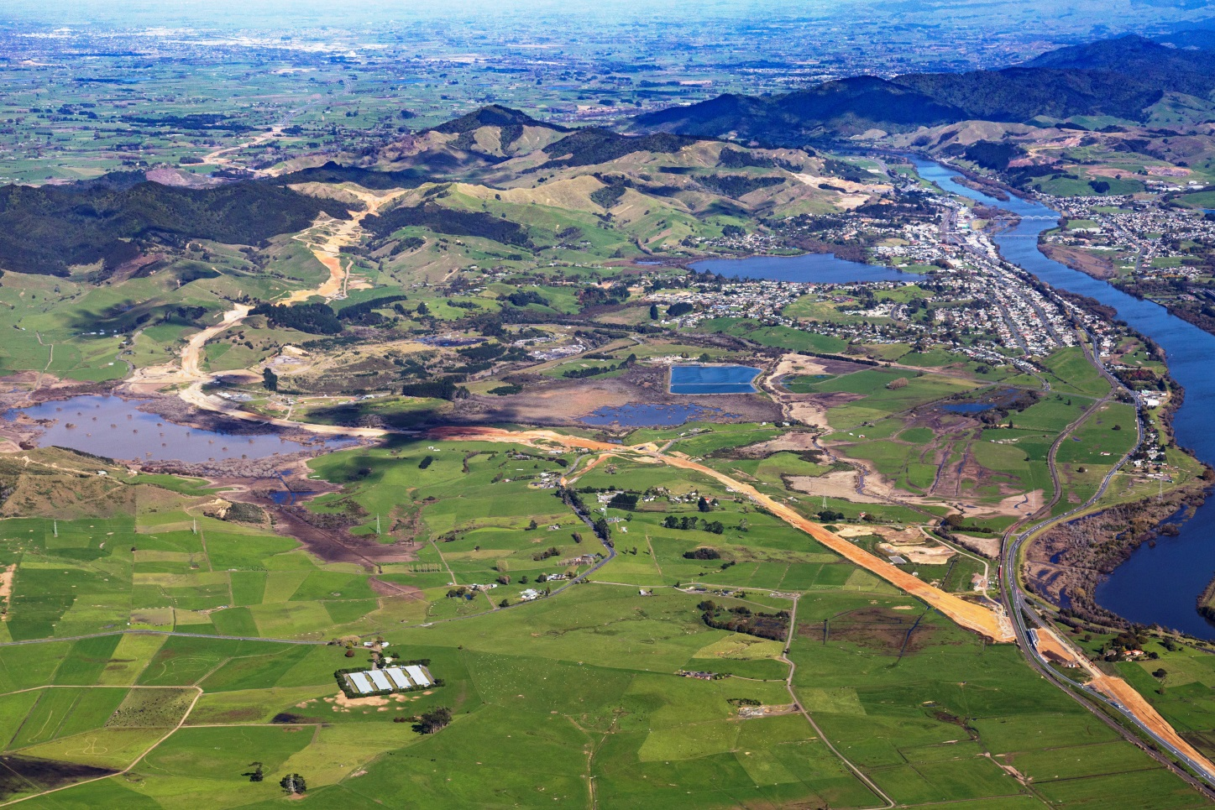
Expressway update
Infrastructure Committee, Waikato District Council
Peter Simcock, Portfolio Manager, Project Delivery
September 2017

Slide 2
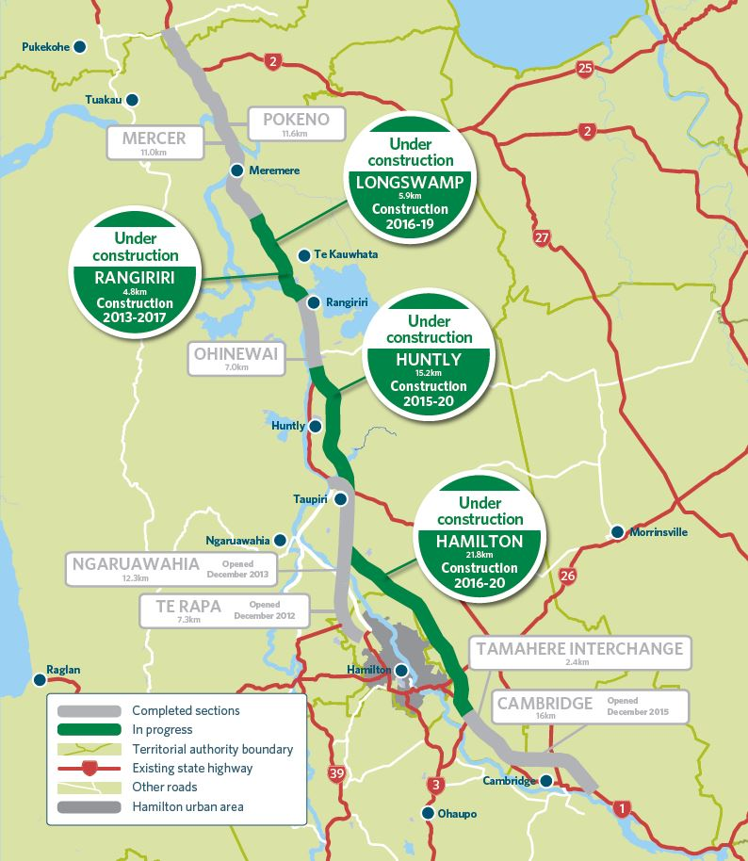
Waikato Expressway update
First 3 sections complete – Te Rapa, Ngaruawahia, Cambridge
Last 4 sections under construction – Longswamp, Rangiriri, Huntly and Hamilton
Completion date for final section (Hamilton) 2020
All 7 sections pass through Waikato District

Slide 3
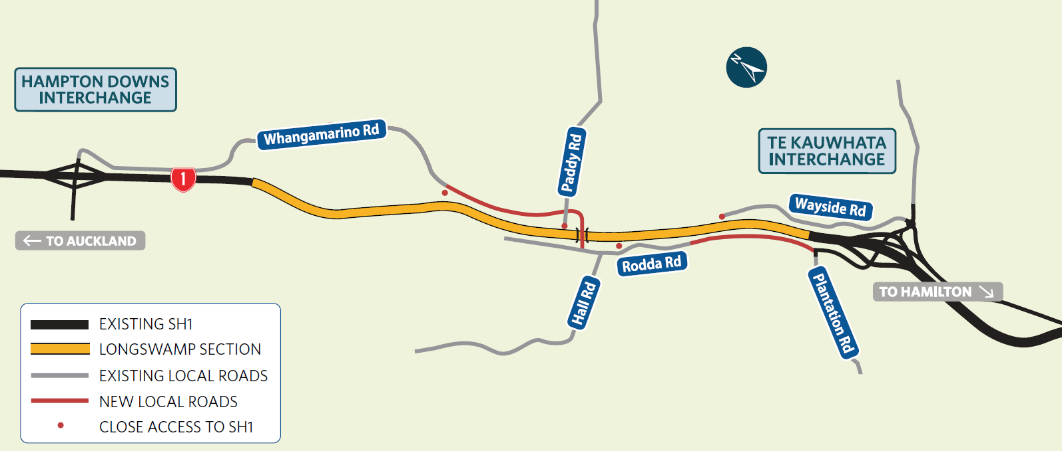
Expressway update: section by section
Longswamp
5.9km section under construction after sod-turning late last year
Downer NZ
Early work in northern half until Rangiriri section complete
Big focus on managing traffic through site – 24,000-plus vehicles a day
Construction completion early 2019

Slide 4
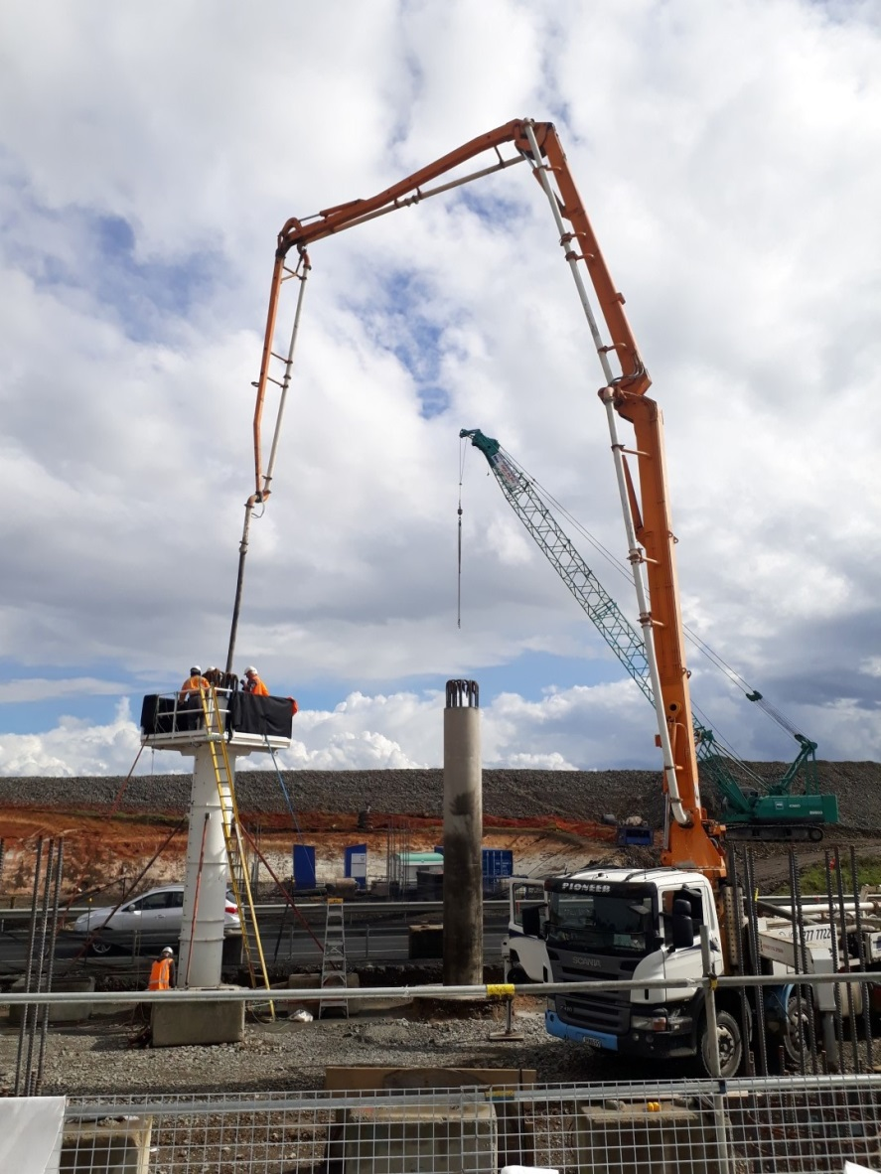
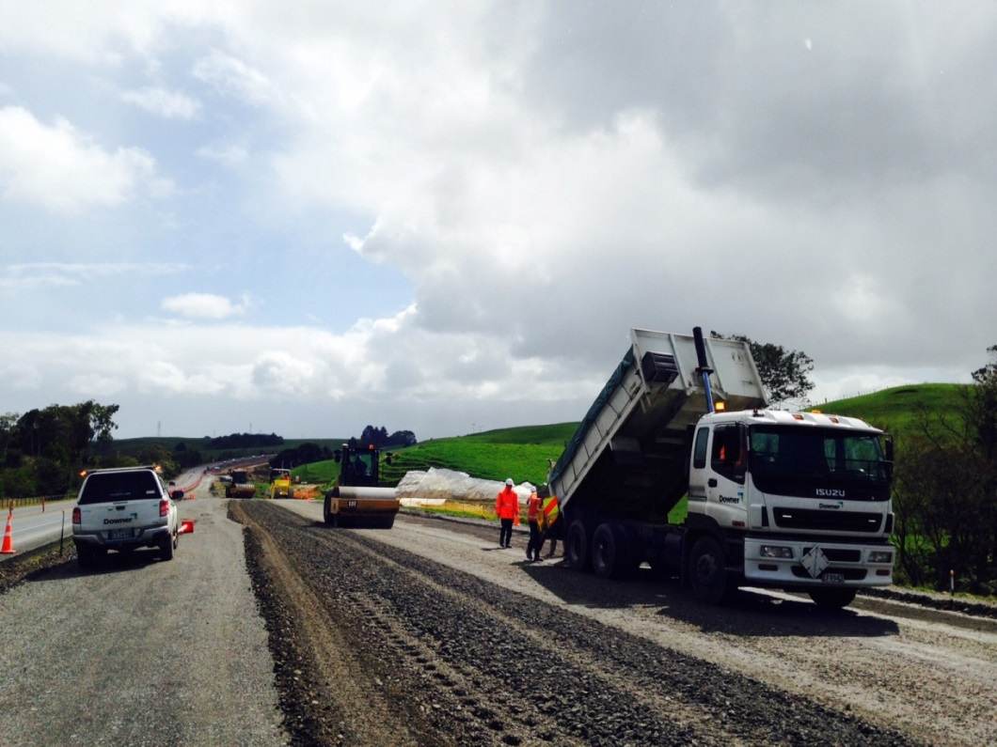
Waikato Expressway update
Longswamp
Working on south-bound lanes first, from Hampton Downs to Paddy Road, including building a new overbridge between Paddy Road and Hall Road.

Slide 5
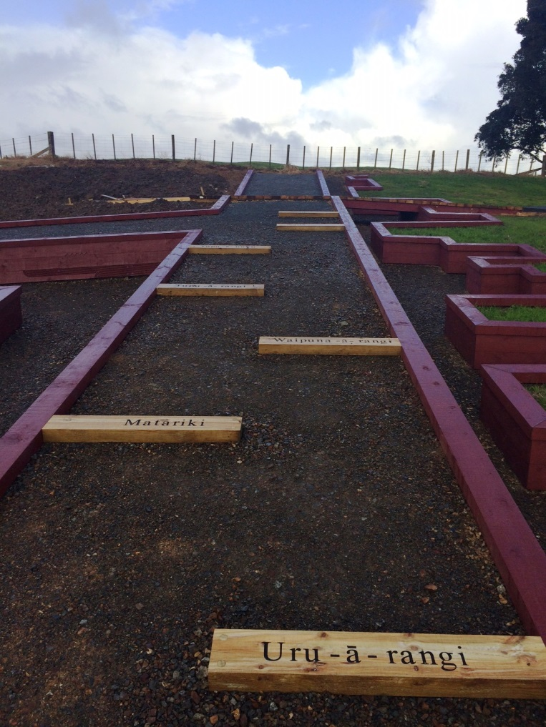
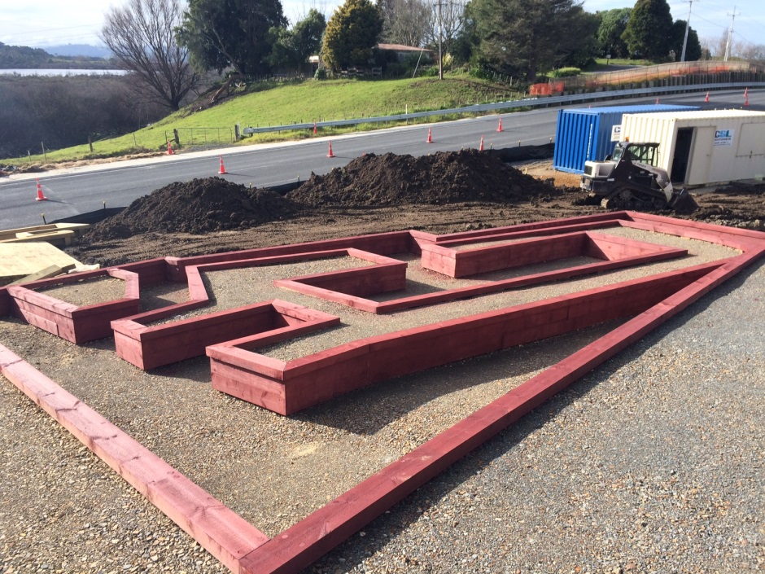
Waikato Expressway update
Rangiriri
Main alignment opened to four lanes and 100km/h at Easter.
Pa reinterpretation works continue, wet winter hasn’t helped progress.

Slide 6
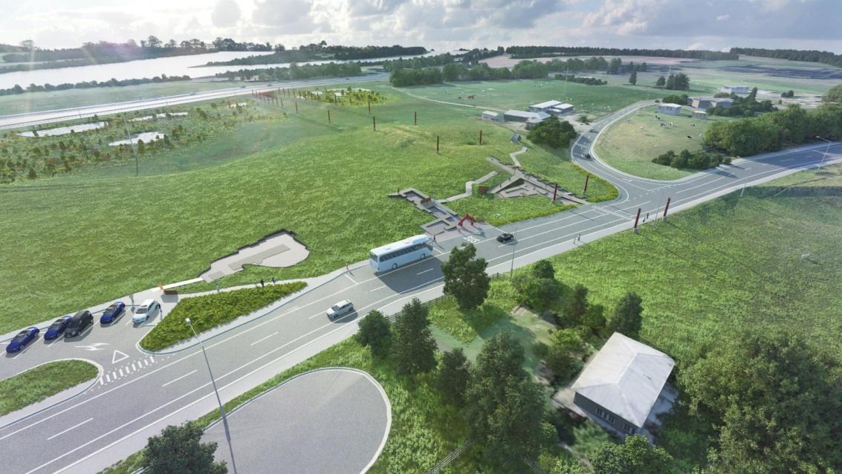
Waikato Expressway update
Rangiriri
Planning for a public event to mark completion of the roading project and the pa reinterpretation before the end of the year.

Slide 7
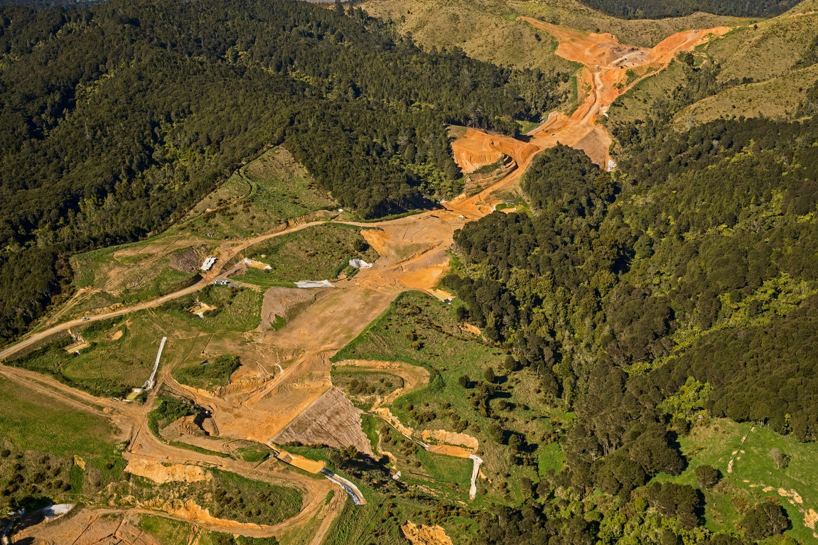
Waikato Expressway update
Huntly
Season No 3 for earth-works about to get under way.
Last summer saw 1.8 million cubic metres moved, just short of 2 million target, due to poor weather.
This summer’s target is 1.2 million cubic metres.
Johnson’s Valley looking south towards the Taupiri Pass

Slide 8
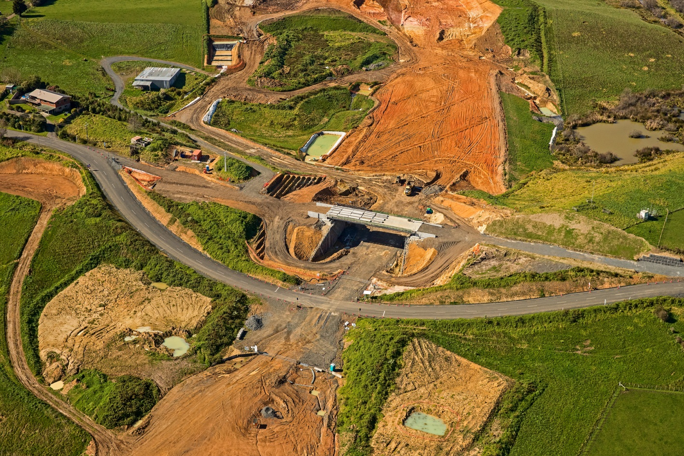
Waikato Expressway update
Huntly
Winter focus has been bridge building, with 7 of the 9 bridges under way.
Ralph Road bridge will be the first to be open to the public, before the end of 2017.
Last 2 bridges at McVie Road and Orini Road will begin before the end of the year.
Ralph Road overbridge

Slide 9
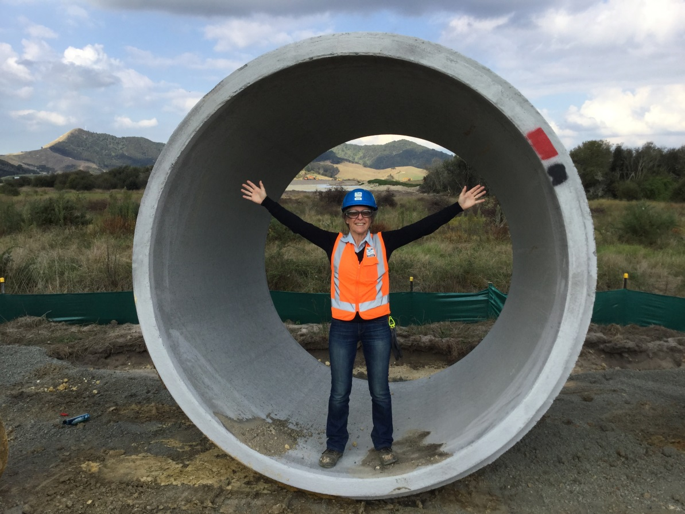
Waikato Expressway update
Huntly
It’s farewell to Trish Viall, who has been Stakeholder Liaison Manager at Huntly since construction began. Trish has taken up a role with a project closer to her home in west Auckland.
Lorraine Dunmall is the new Huntly Project Stakeholder Liaison Manager, she took up the role on 13 September.
It’s farewell to Trish Viall

Slide 10
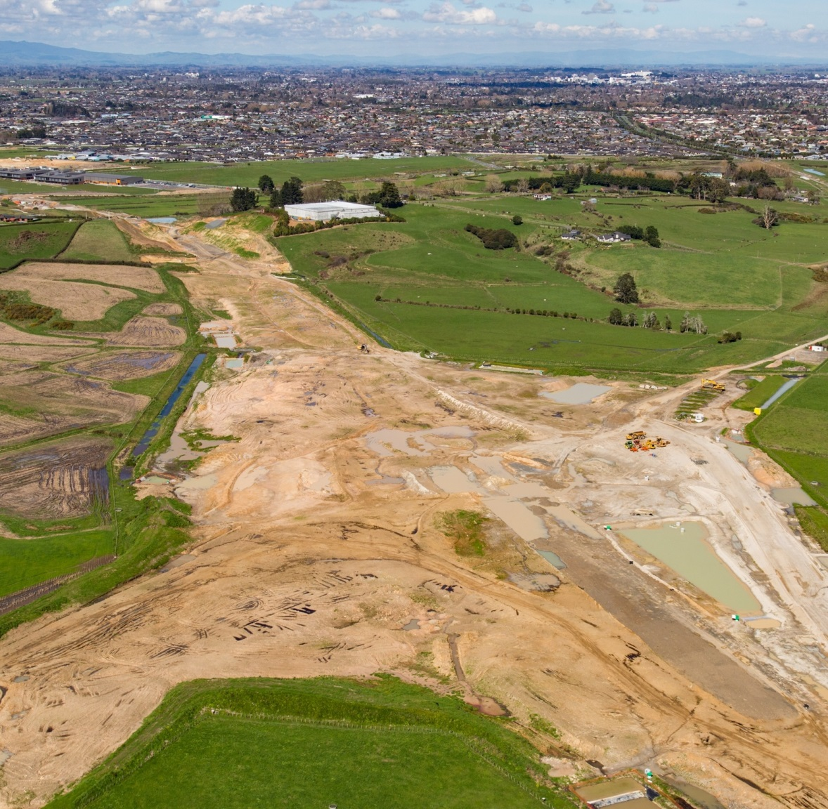
Waikato Expressway update
Hamilton
Gearing up for Season 2 of earthworks beginning 1 October.
Key earthworks season, with target of 2 million cubic metres moved. There will be earthworks activities the full length of the site.
Focus will be on culvert installation and embankment construction.
15 earthworks teams and more than 100 items of plant will be used this season.

Slide 11
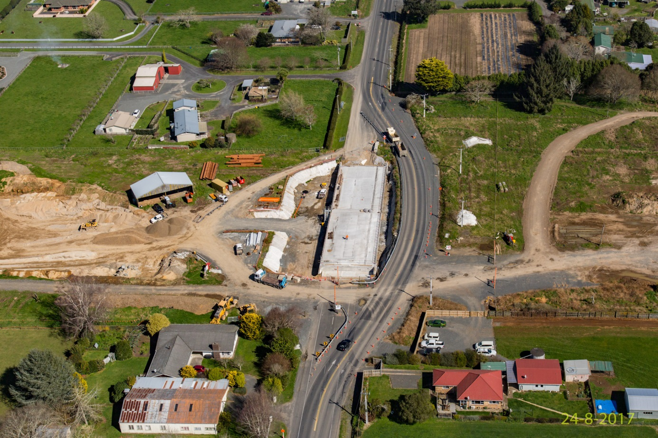
Waikato Expressway update
Hamilton – 14 of the 16 bridges under construction this year
Winter has seen bridge building activity the length of the site.
Morrinsville Rd bridge to open in October, Gordonton Rd in December, Matangi Rd in February 2018.
Many of the section’s bridges are being built on the ground, with the expressway to be excavated underneath.
Morrinsville Road overbridge

Slide 12
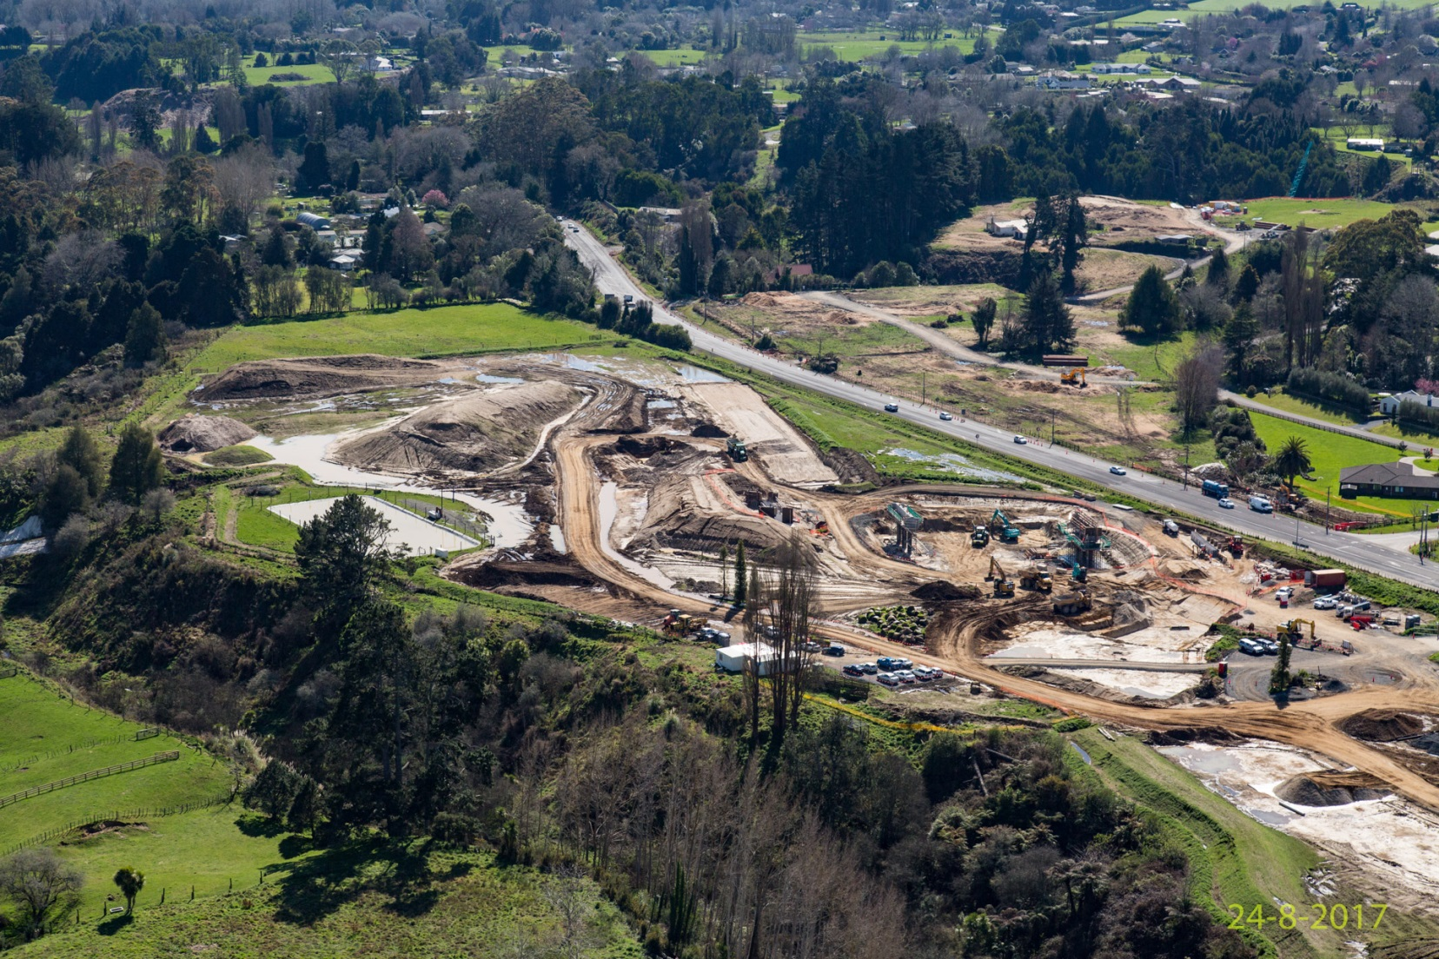
Waikato Expressway update
Hamilton
SH1 at Tamahere, Southern Interchange

Slide 13
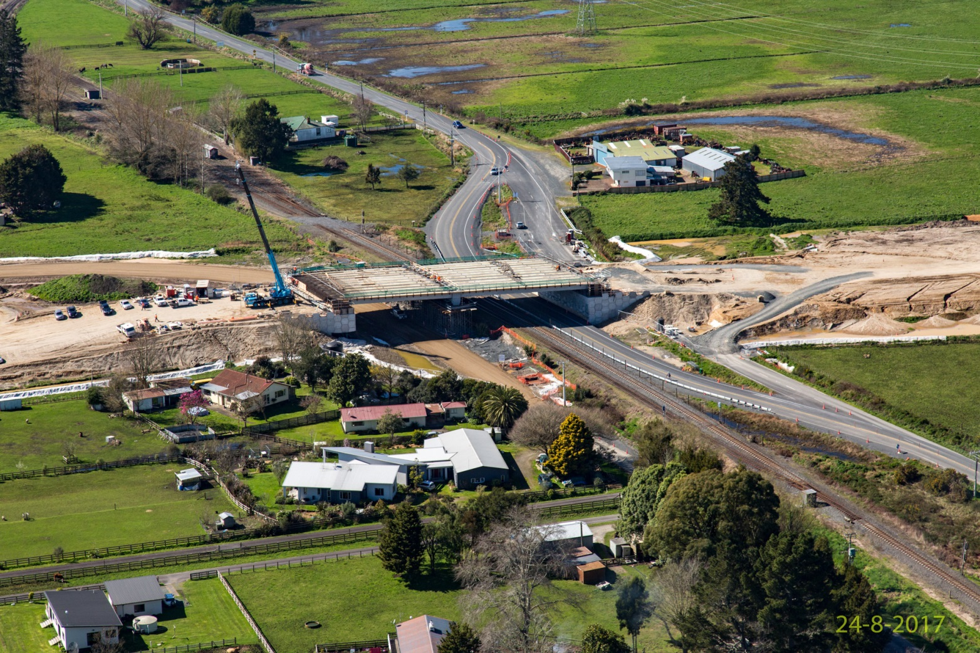
Waikato Expressway update
Hamilton
East Coast Main Trunk-Ruakura Road bridge

Slide 14
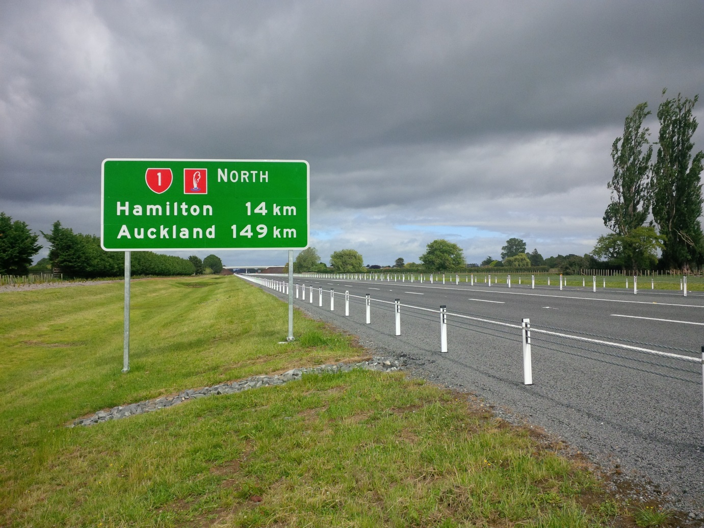
Waikato Expressway update
Cambridge
Final work happening over the next month, some surfacing, line marking and ATP (rumble strip) installation.
Consultation starts this week on raising the speed limit of the Cambridge Section to 110km/h. Seeking feedback until 25 October.

Slide 15
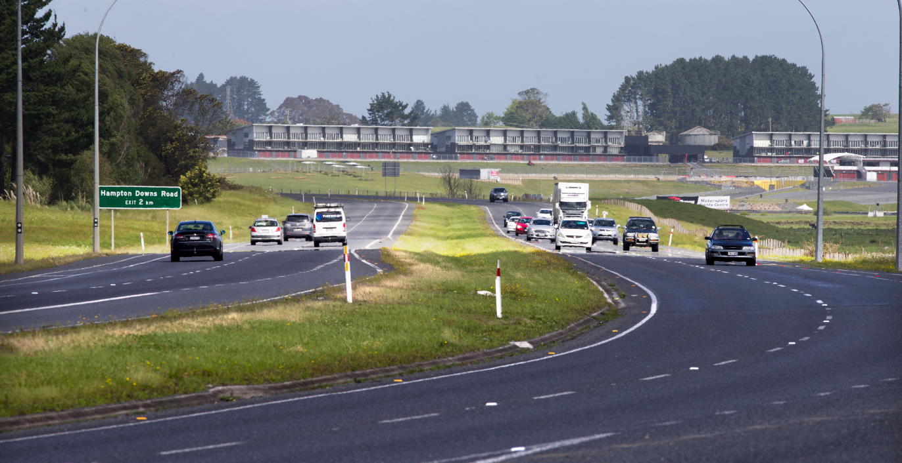
Waikato Expressway update
SH1 barrier in-fill north Waikato
Ensuring SH1 from Hampton Downs to Auckland is safe system compliant by installing median and side barriers and ATP strips.
Complete by the end of 2017.

Slide 16
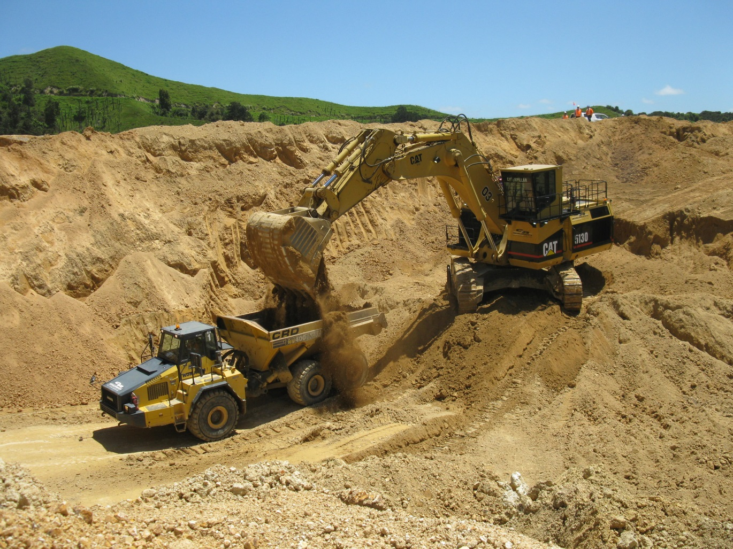
Waikato Expressway update
Any questions?
www.nzta.govt.nz/waikatoexpressway or
www.facebook.com/waikatoexpressway
Huntly section earthworks
Further information

