Slide 1


Slide 2


Slide 3
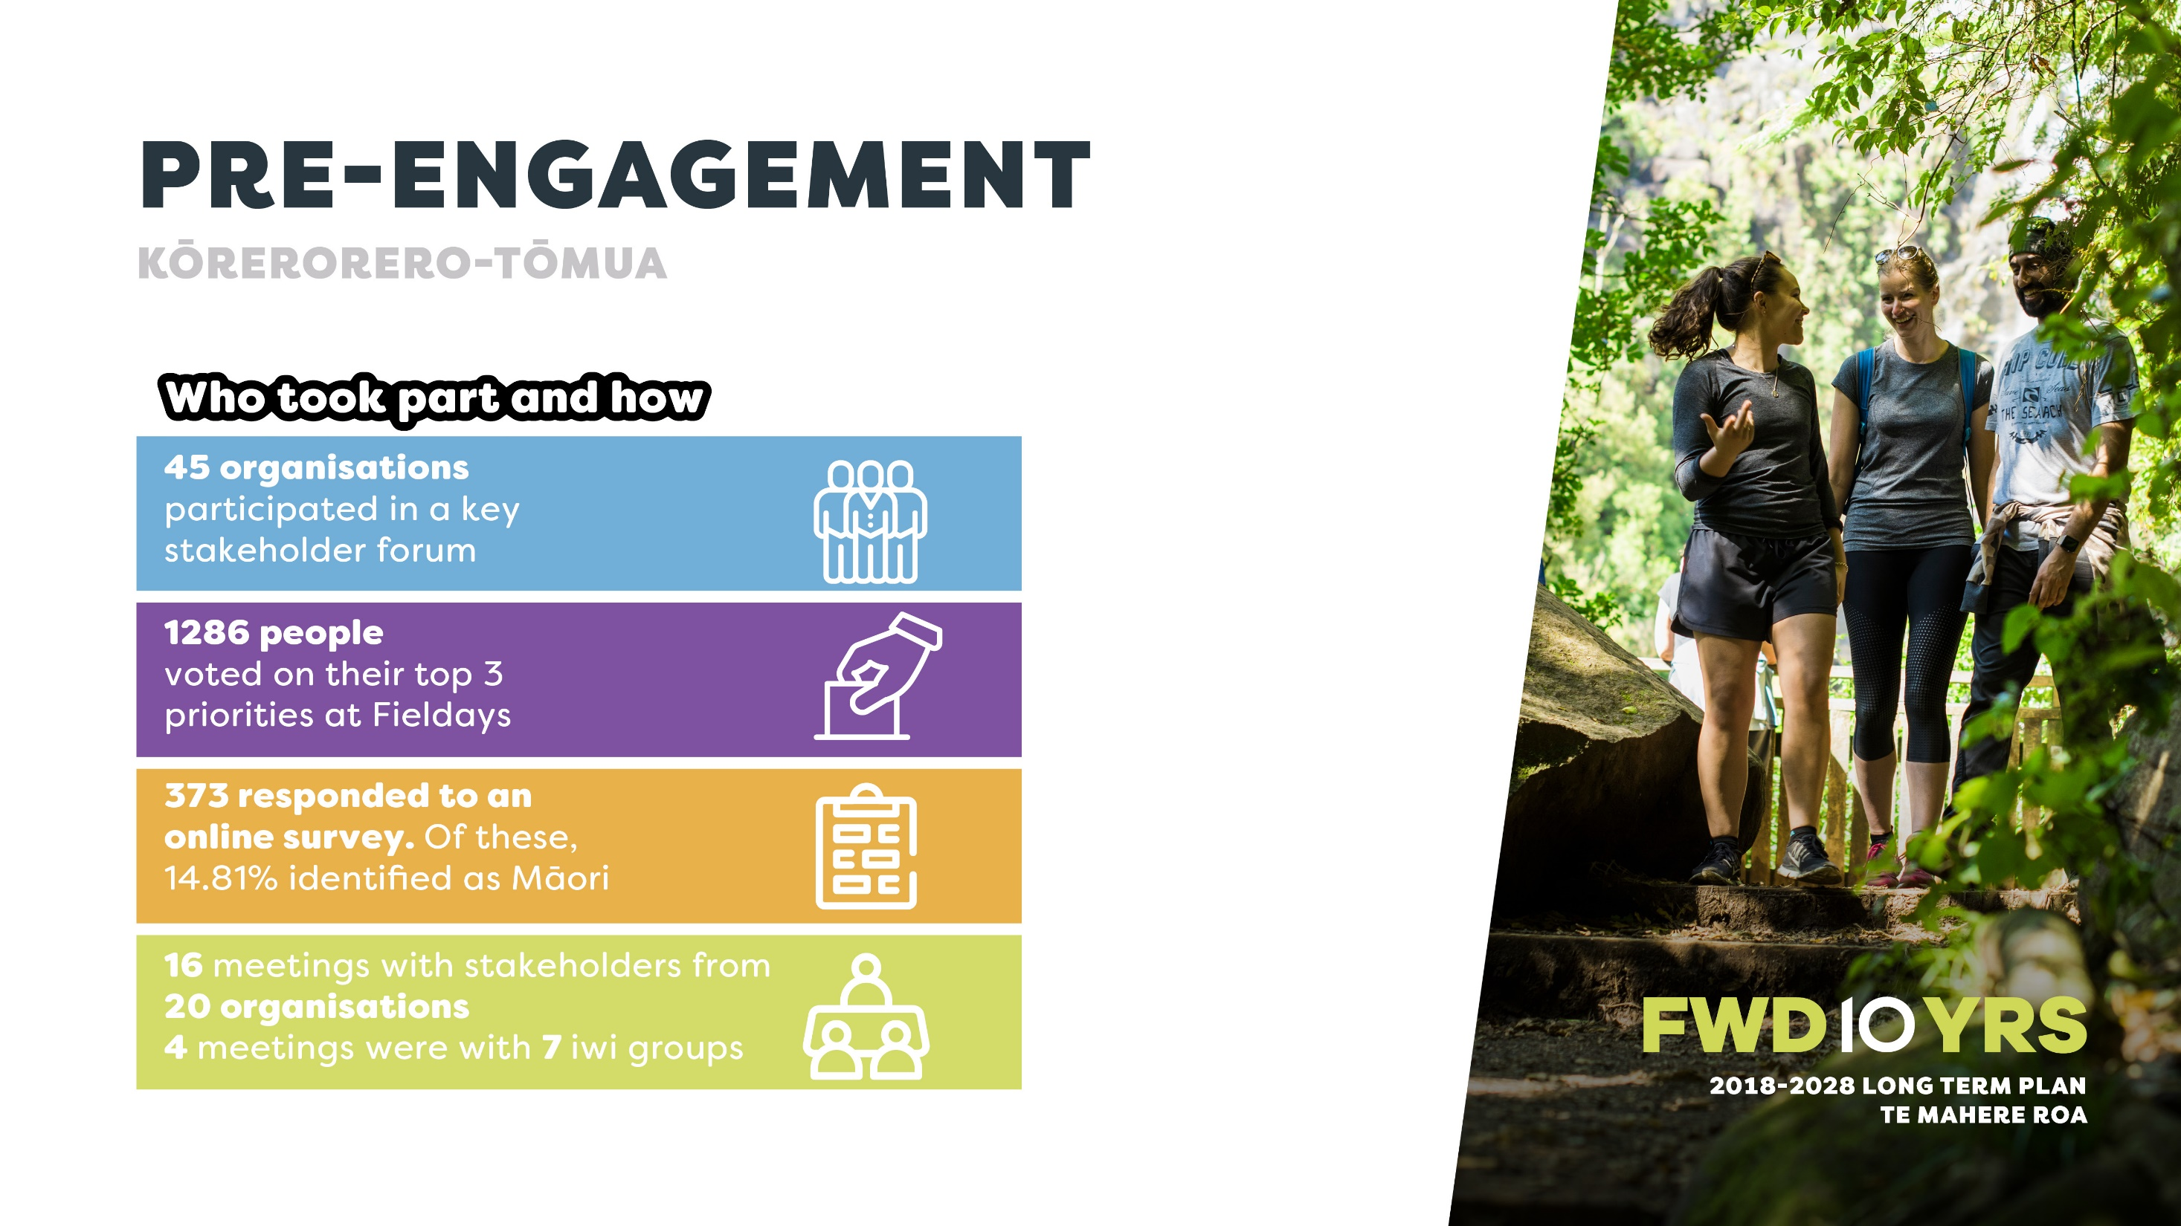

Slide 4
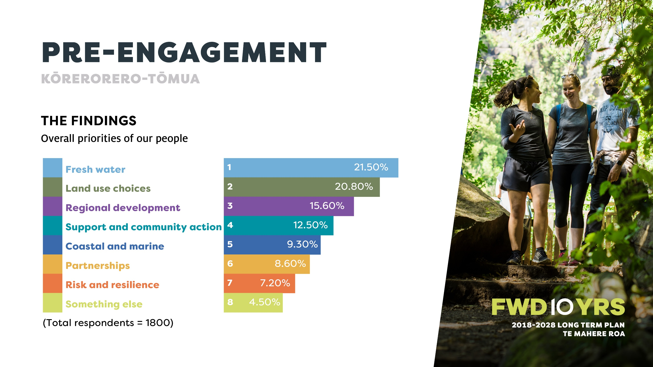

Slide 5


Slide 6


Slide 7
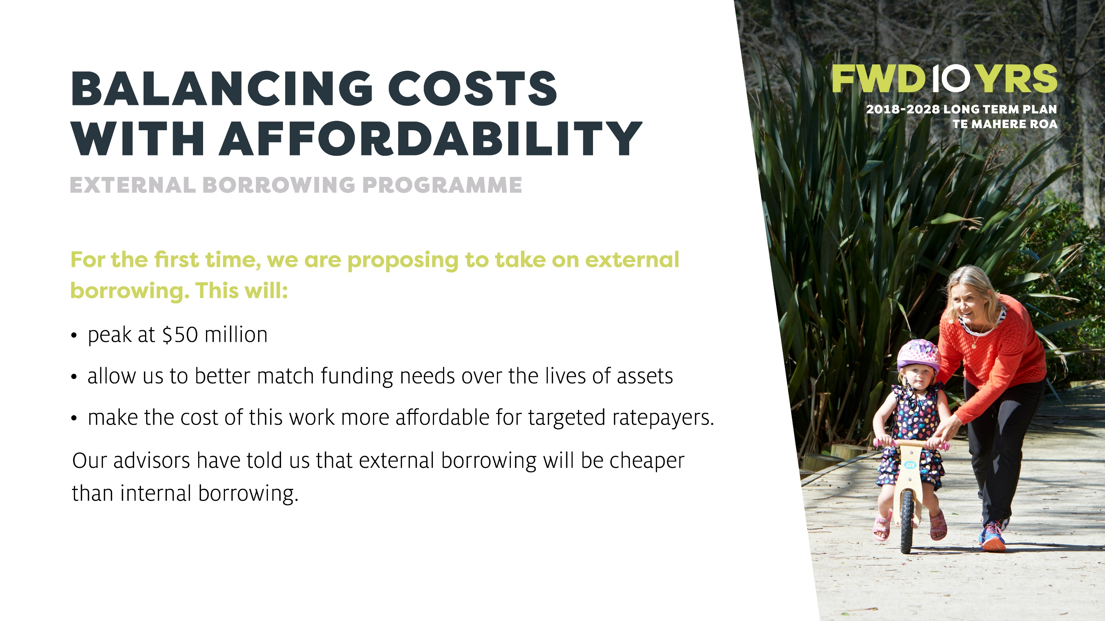

Slide 8
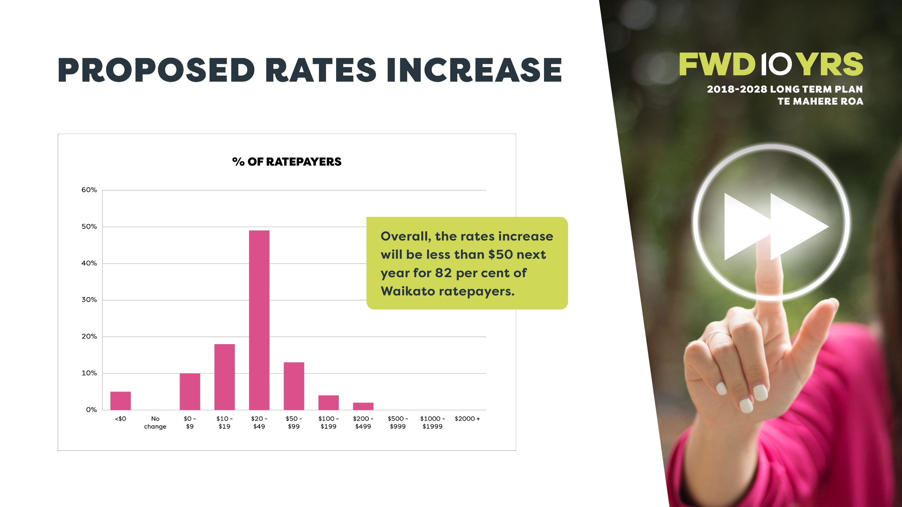

Slide 9
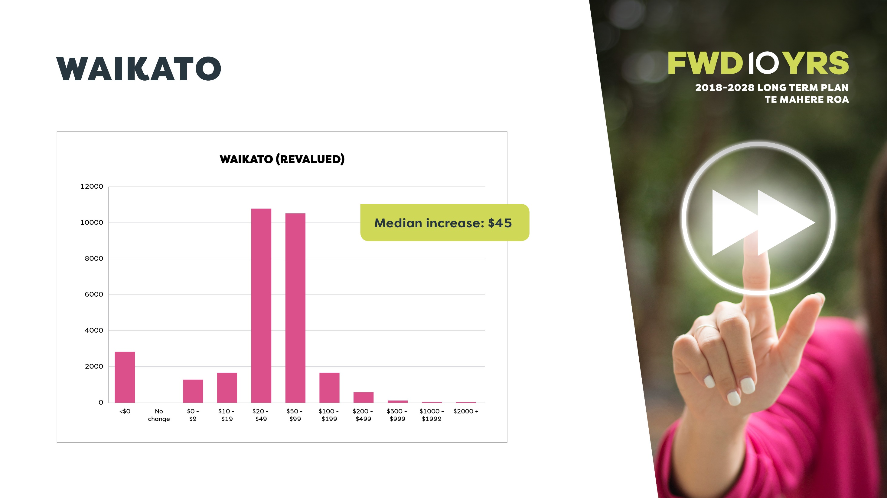

Slide 10
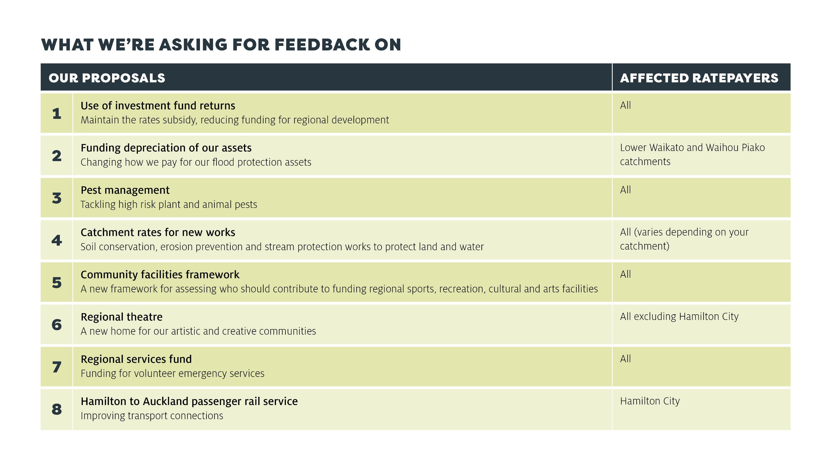

Slide 11
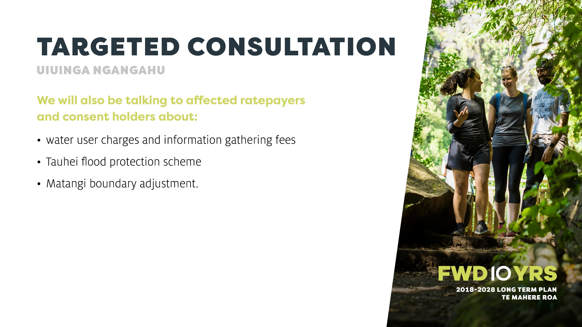

Slide 12
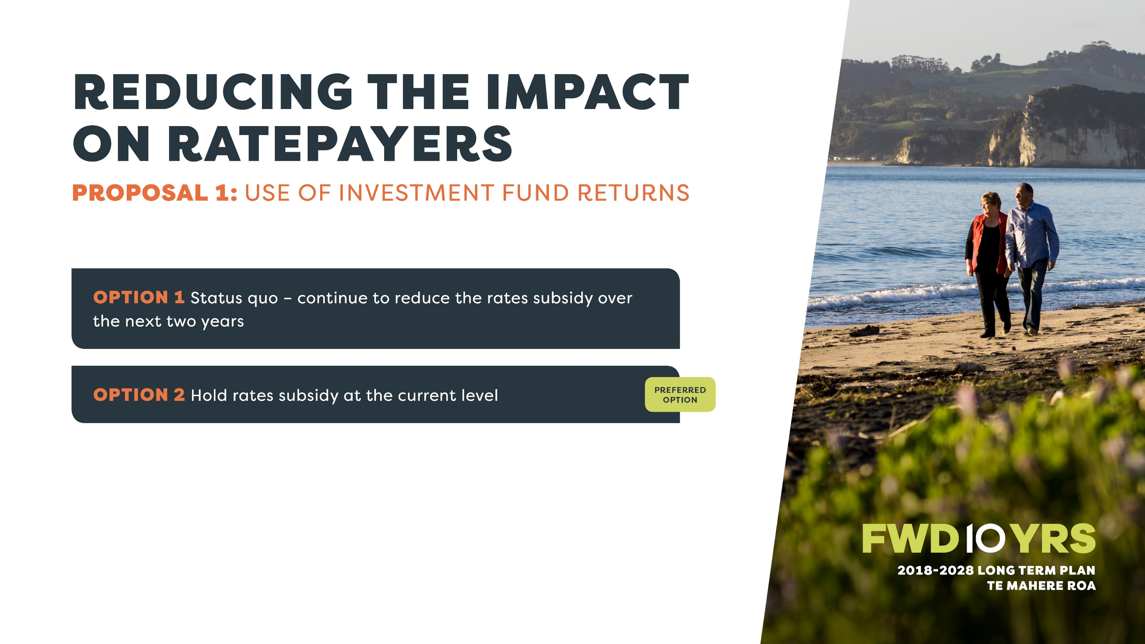

Slide 13
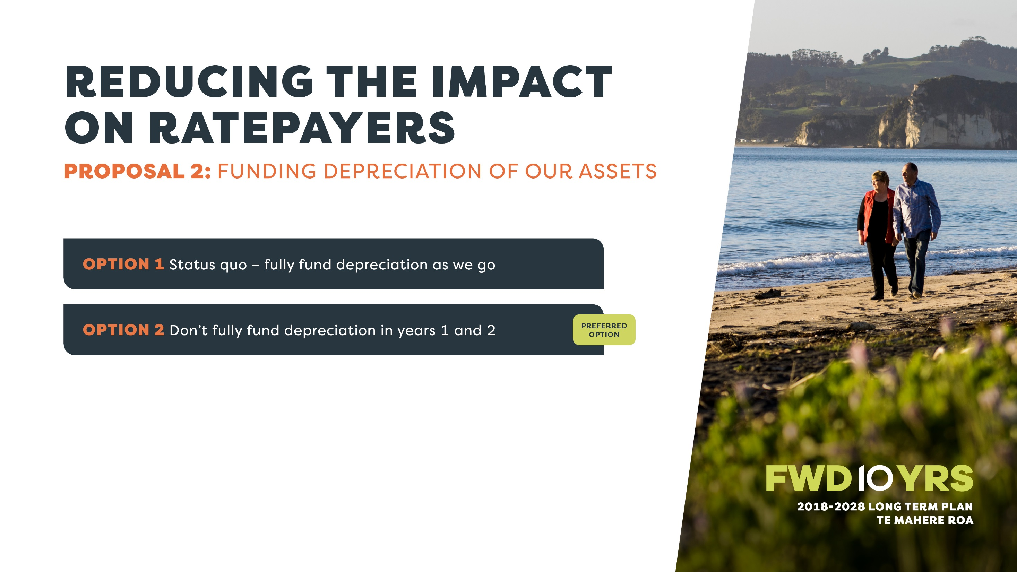

Slide 14
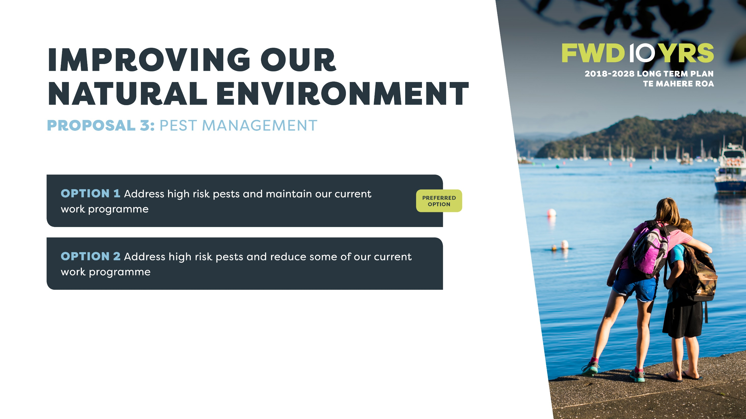

Slide 15
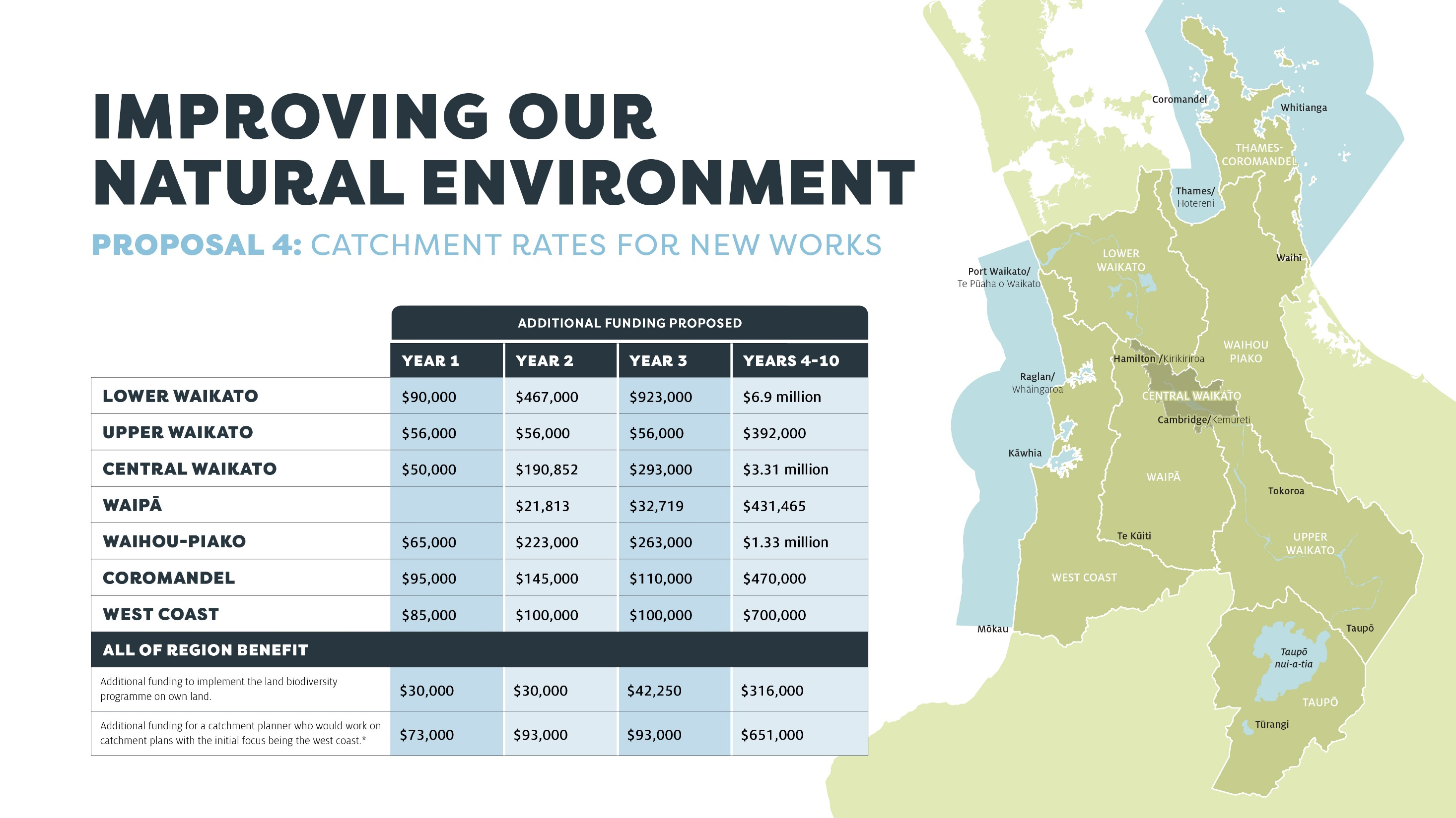

Slide 16
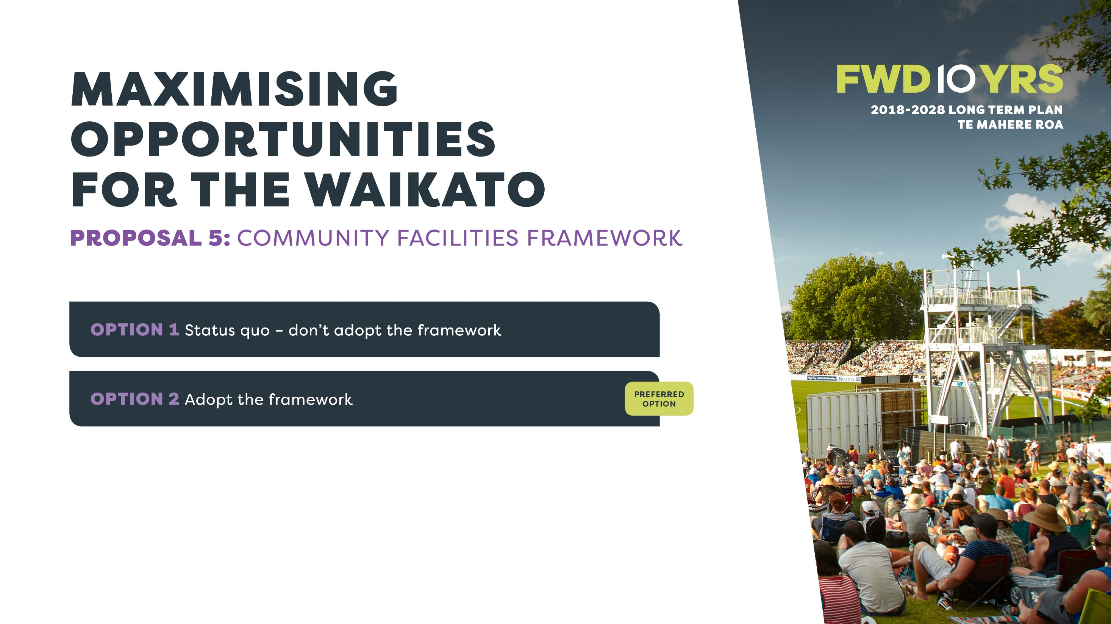

Slide 17
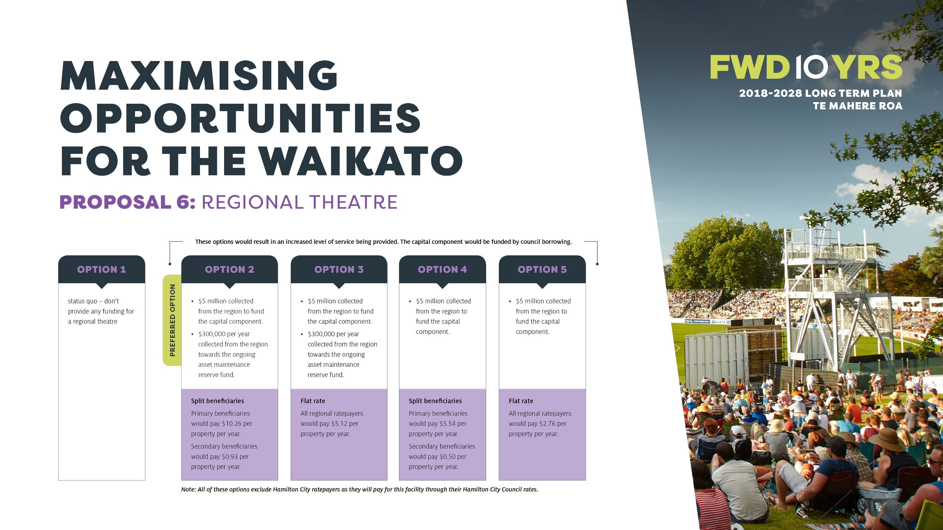

Slide 18
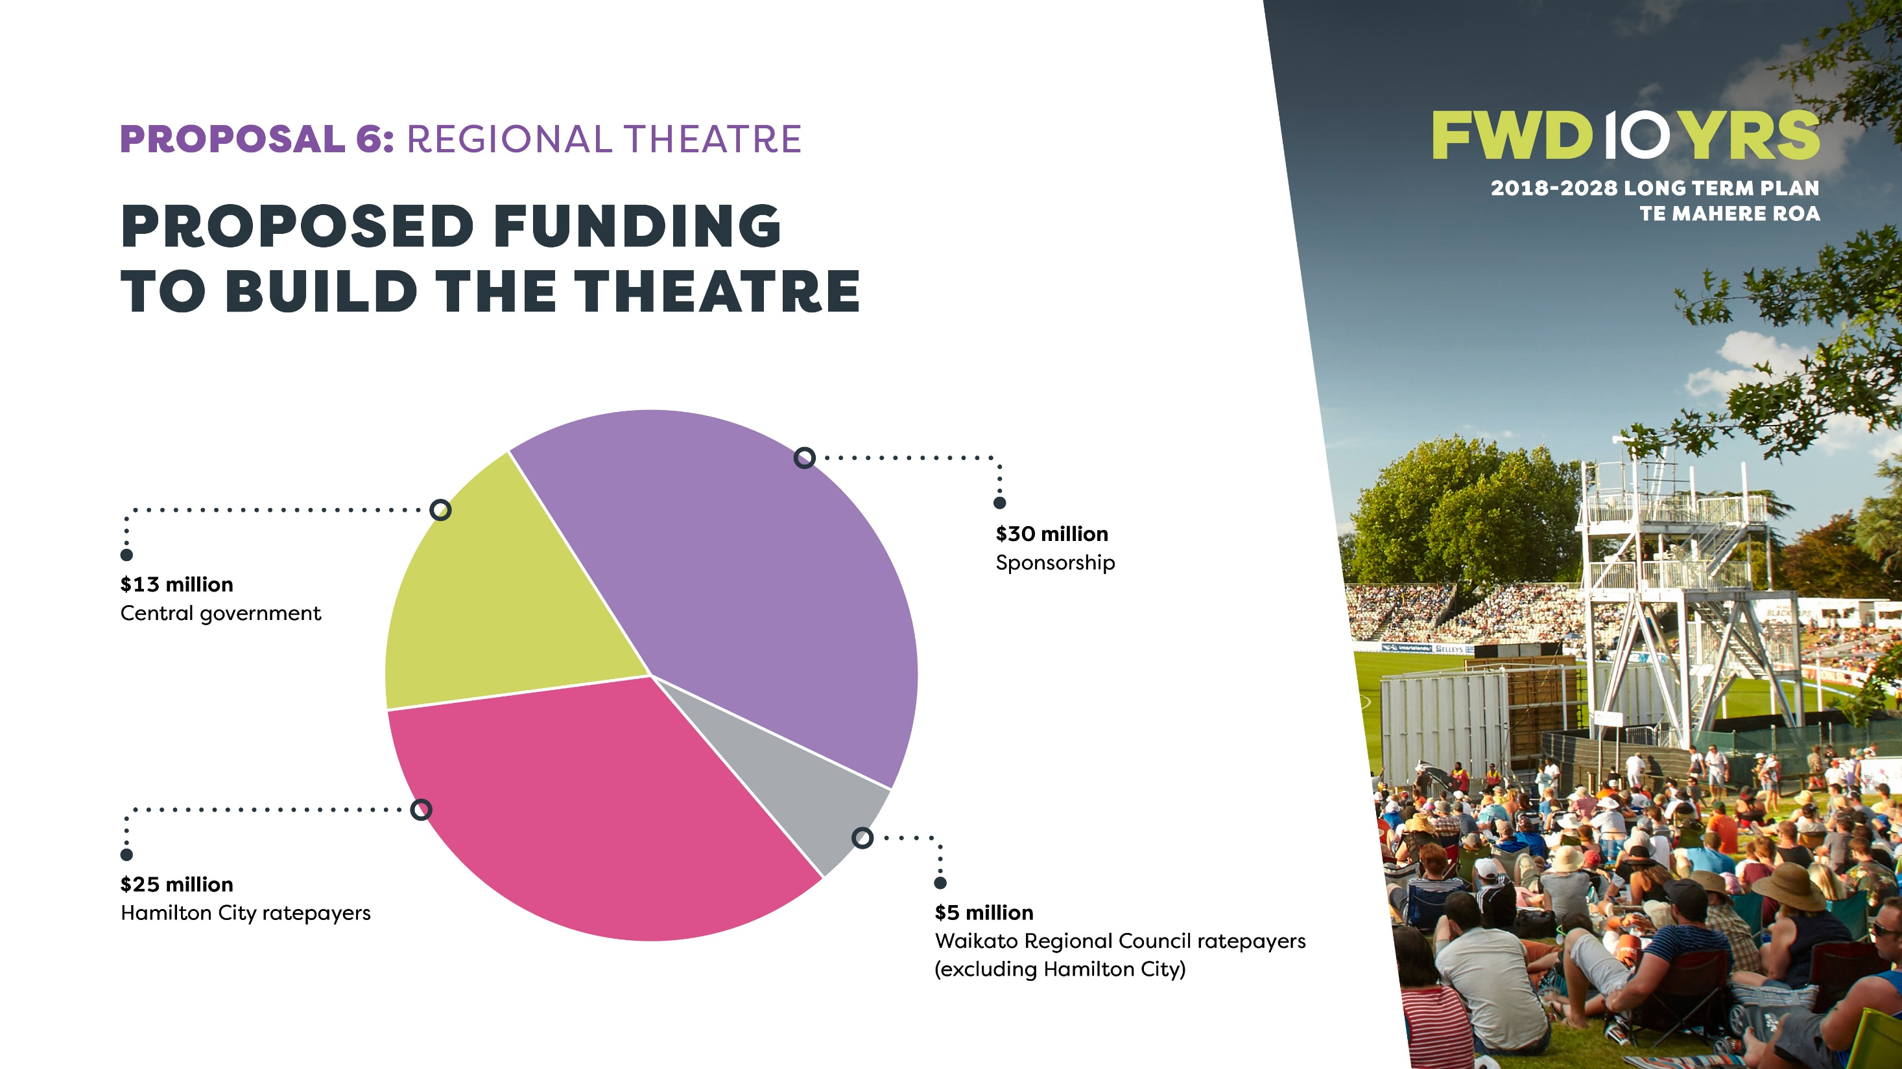

Slide 19
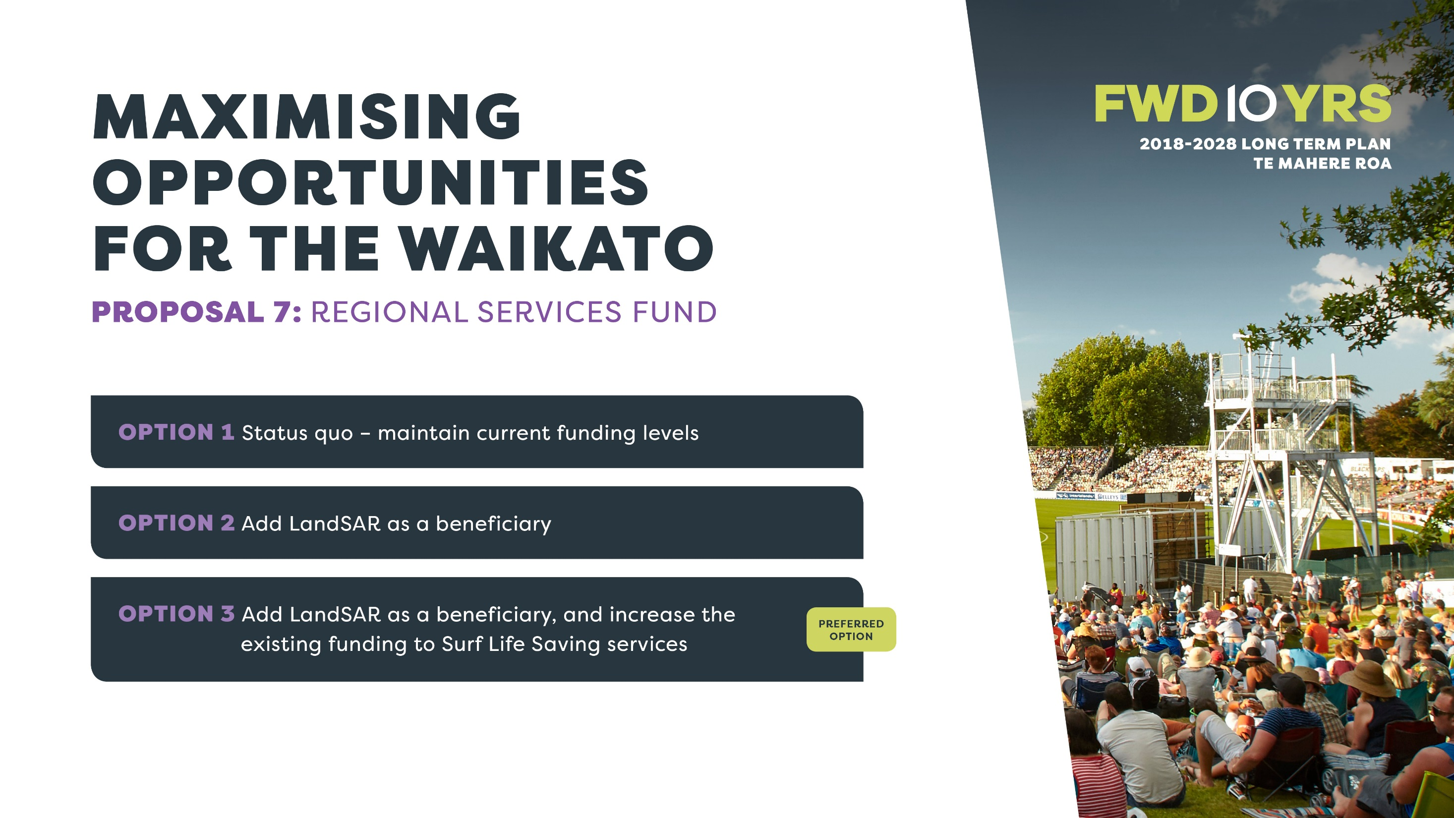

Slide 20
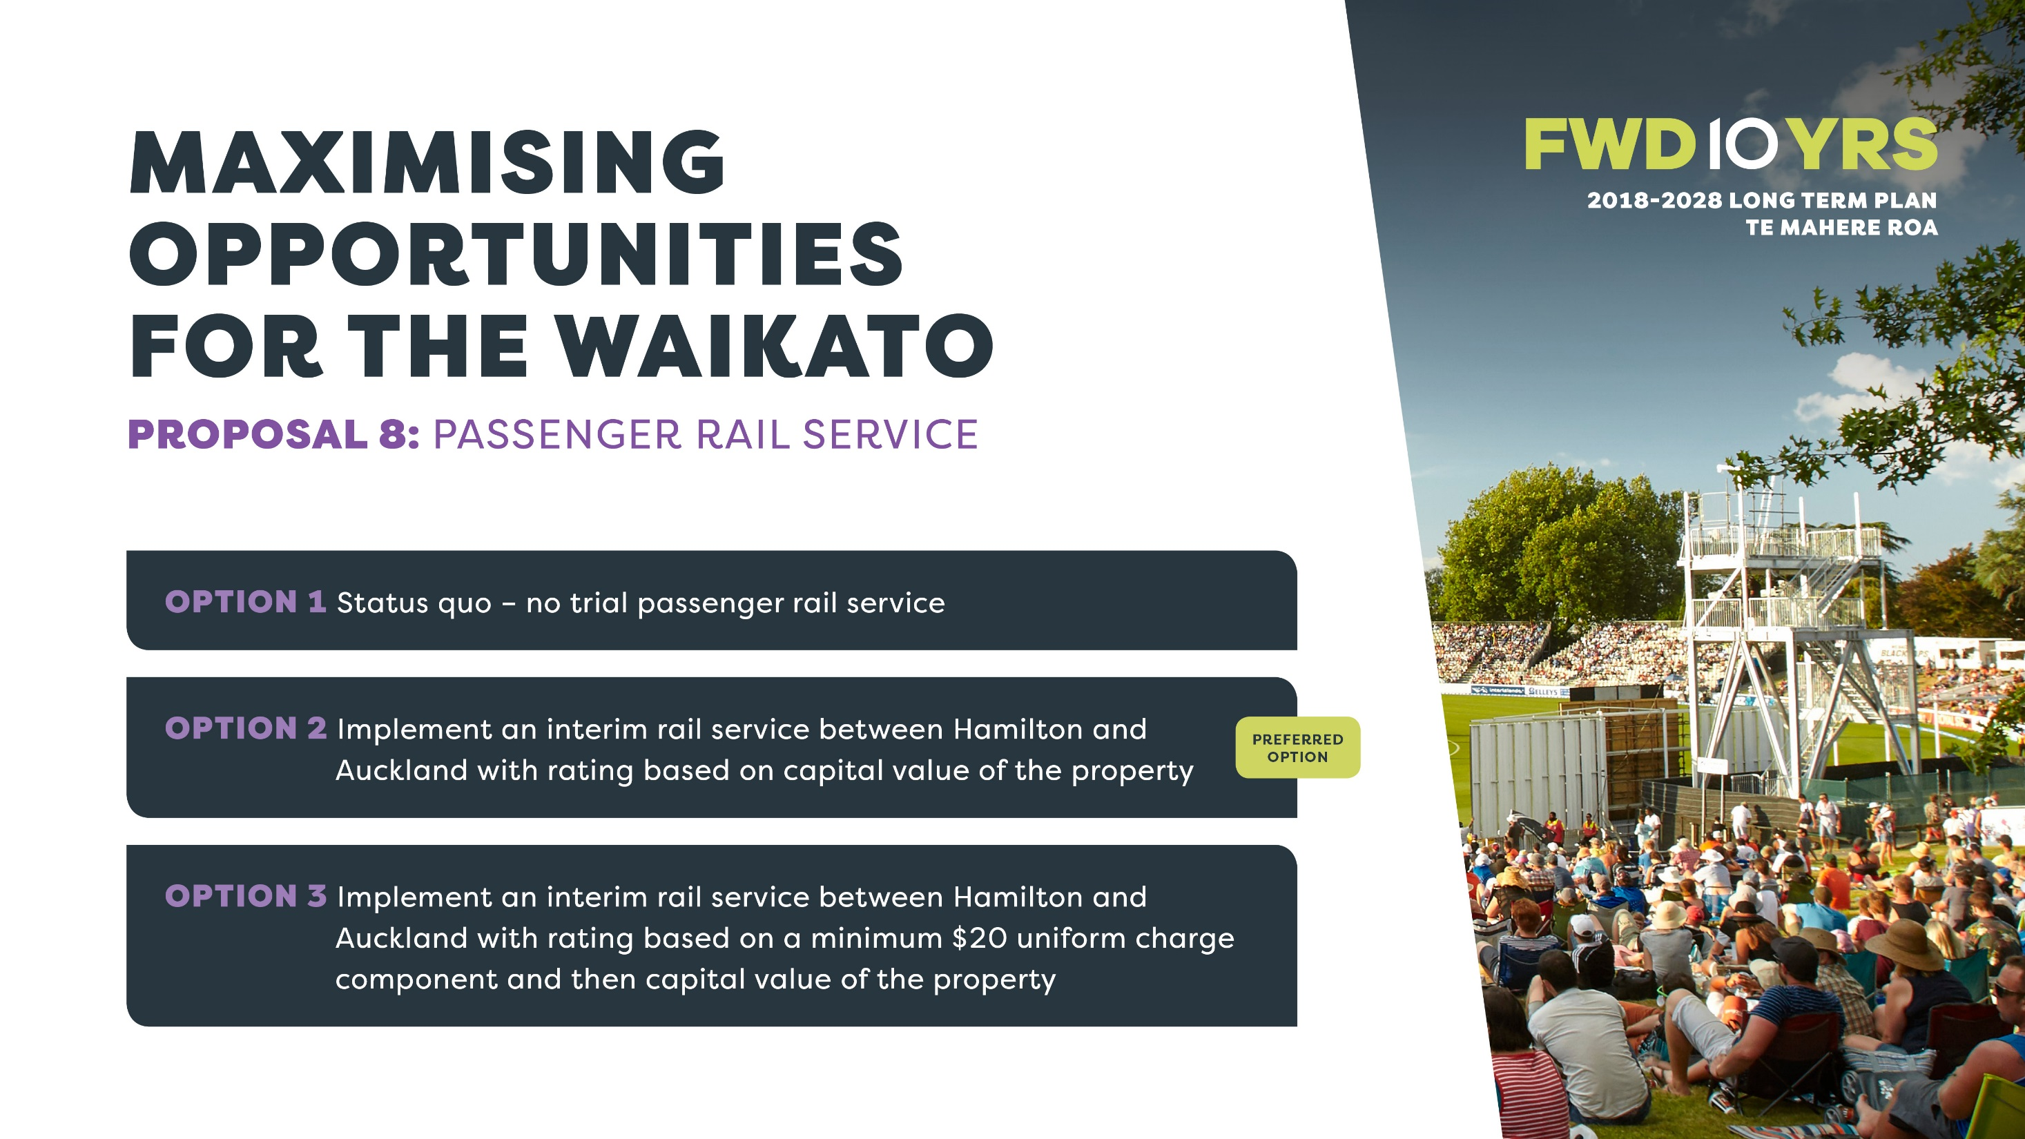

Slide 21
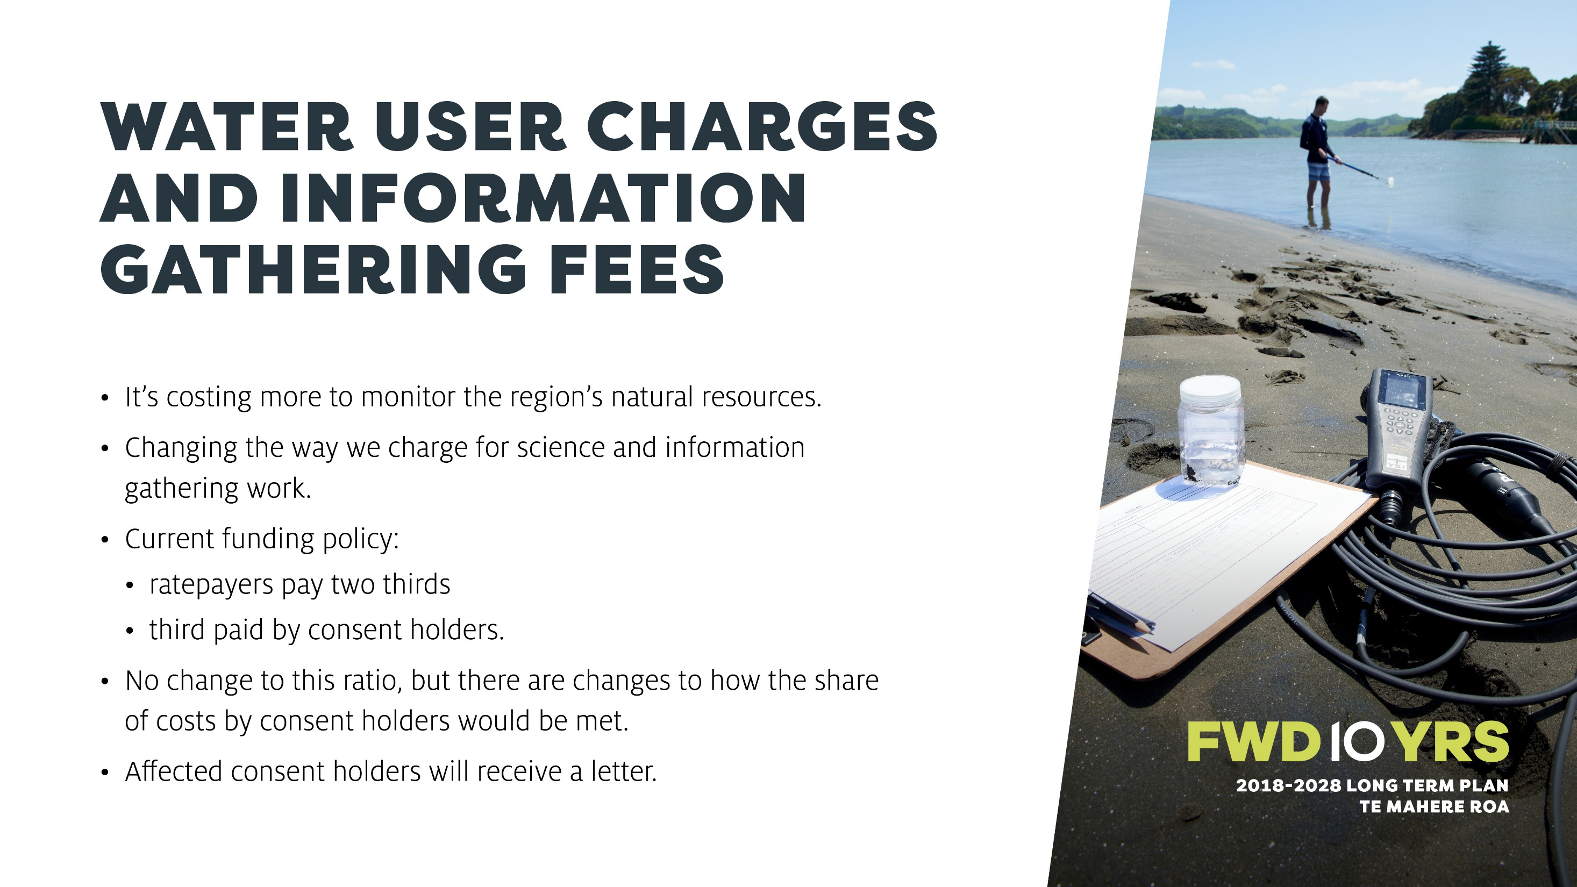

Slide 22


Slide 23
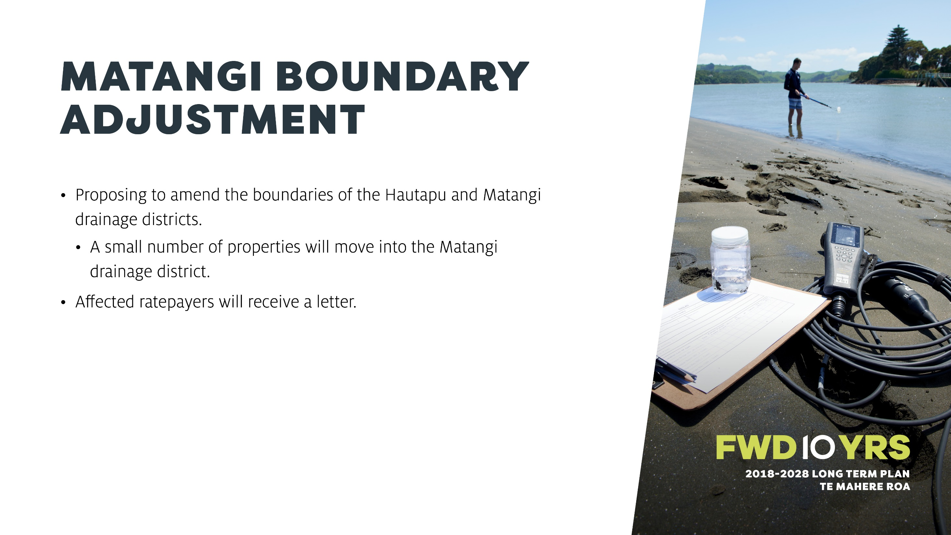

Slide 24
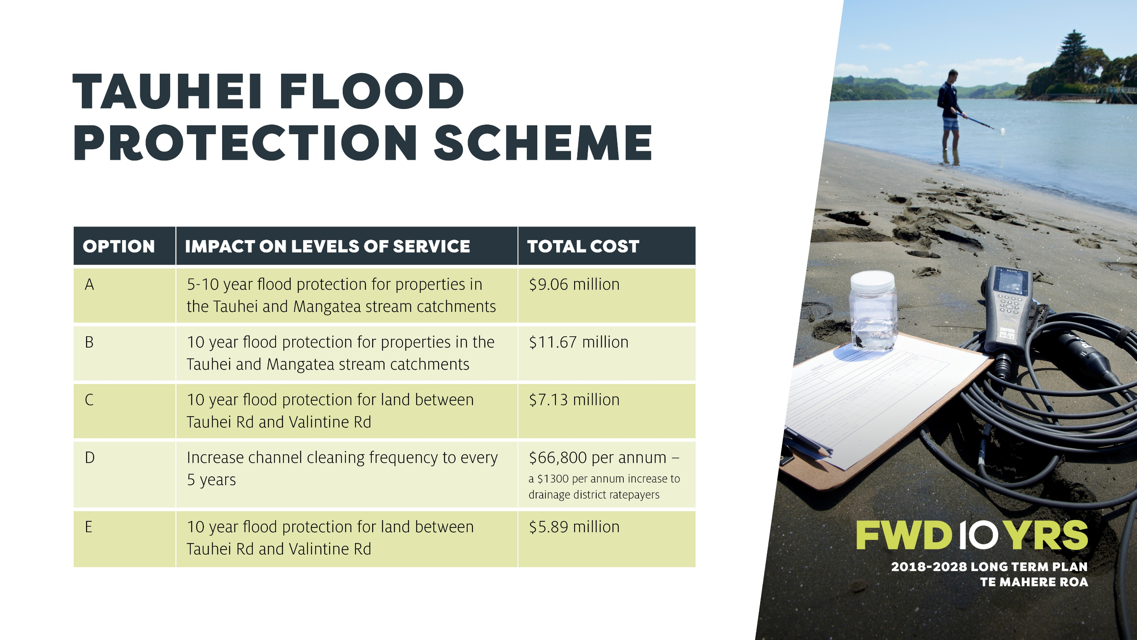

Slide 25
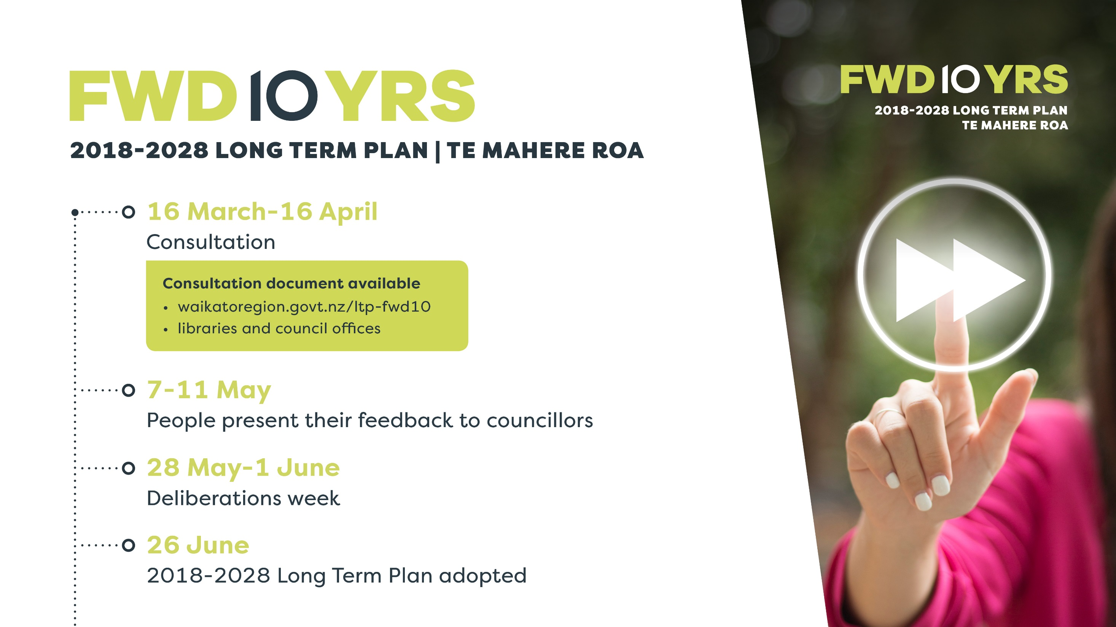

Slide 26
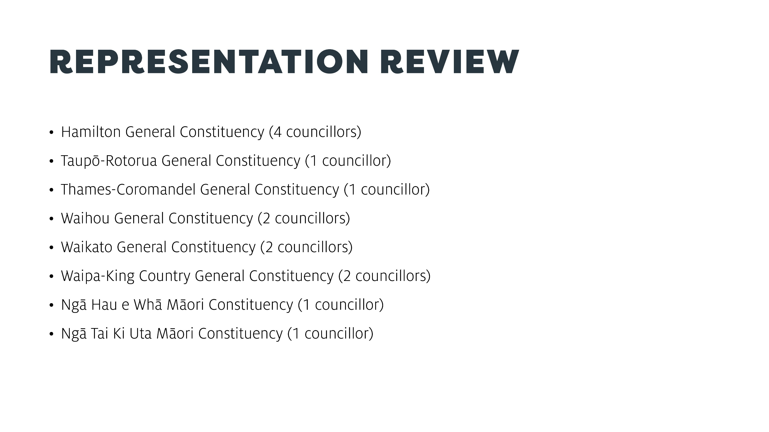

Slide 27
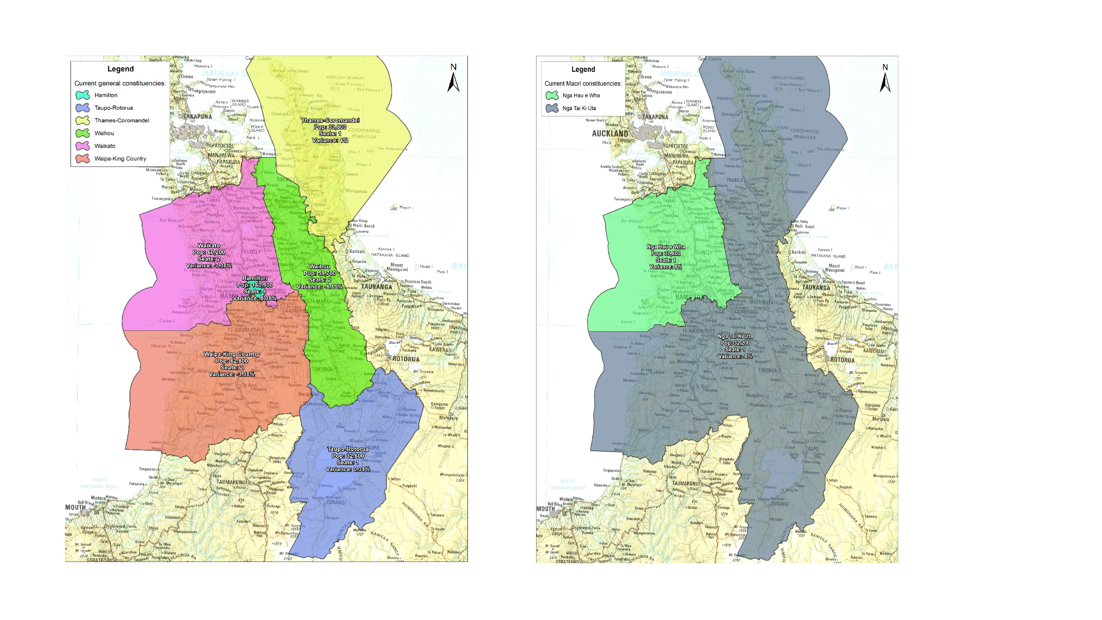

Slide 28
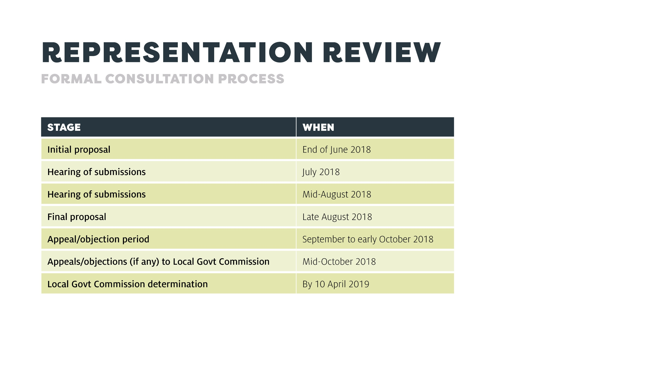

Slide 29
Passenger Transport Update
Andrew Wilson, PT Manager
Waikato Regional Council

Slide 30
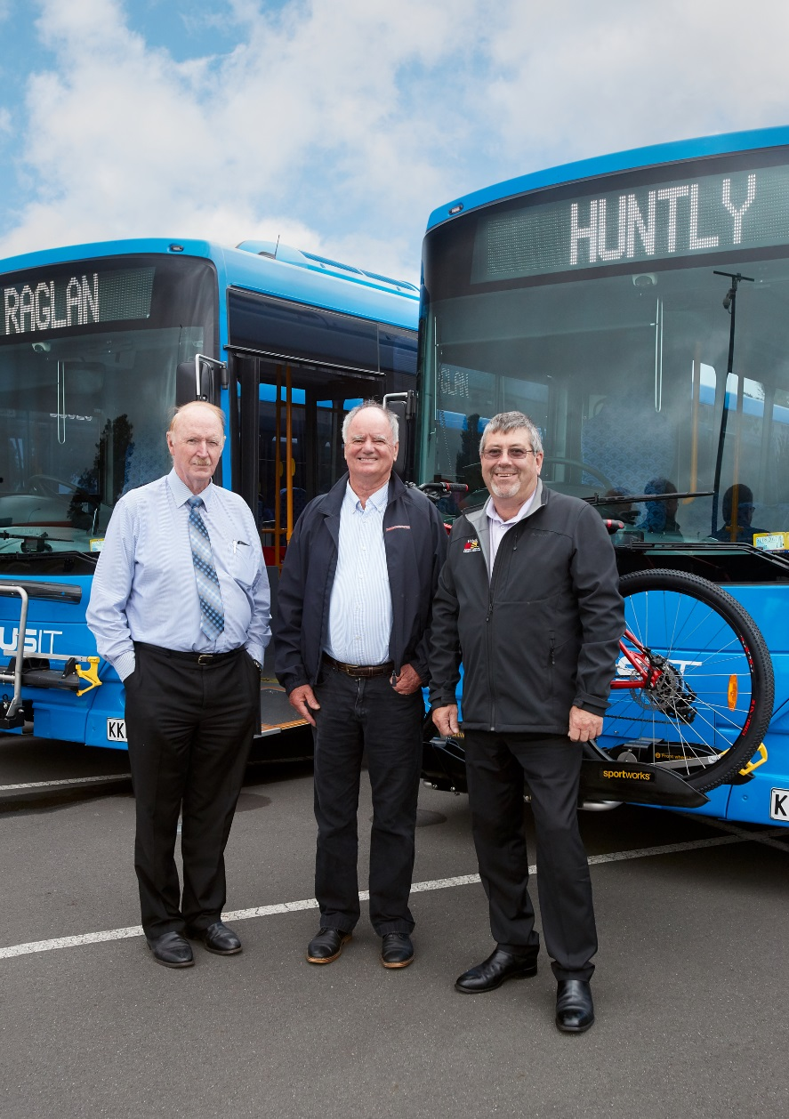
PT Services
Hamilton / Huntly
Patronage: 250,000 p/a
Change: +2.2%
Hamilton / Raglan
Patronage: 65,000 p/a
Change: +7.7%

Slide 31
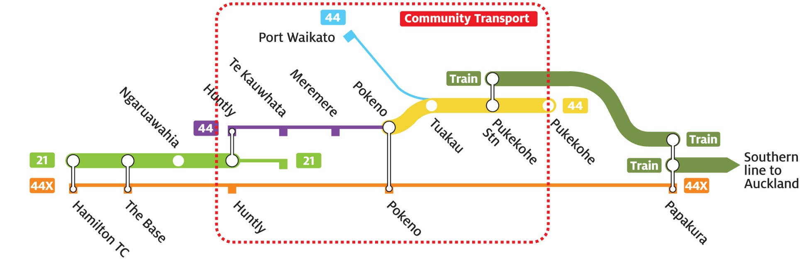
Planned Improvements
Auckland
Hamilton

Slide 32

Fare Review
Objective
Prep for new ticketing system, and;
To ensure the system is:
  Simple for customers and simple to administer
  Reflective of the costs of running the service
  Affordable for funders and users
  Supports increased use of public transport

Slide 33
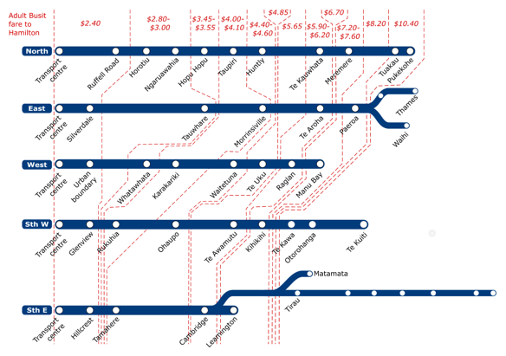

Fare Review

Slide 34
Fare Review
Changes
  Implement a zonal fare structure
  Extend free passengers transfers all services (smartcards only)
  Remove free passenger transfers with cash tickets
  Increase cash premium from 30% to 40%
  Introduce daily and weekly fare capping
  Standardise discount at 30% off the standard a smartcard fare

Slide 35
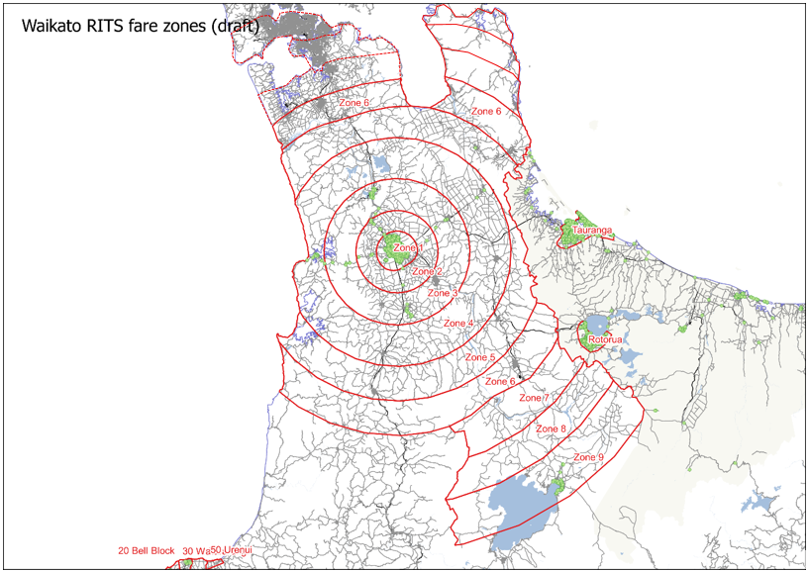
Fare Review
Implement a zonal structure
Zones Travelled | Single Trip Fares
 | Smartcard
 | Standard | Concession (includes child fares)
City Zone | $2.40 | $1.68
1 zone (outside of city) | $1.80 | $1.26
2 zones | $2.90 | $2.03
3 zones | $4.00 | $2.80
4 zones | $5.60 | $3.92
5 zones | $7.80 | $5.46
6 zones | $10.00 | $7.00
7 zones | $12.20 | $8.54
8 zones | $14.40 | $10.08
9 zones | $16.60 | $11.62

Slide 36
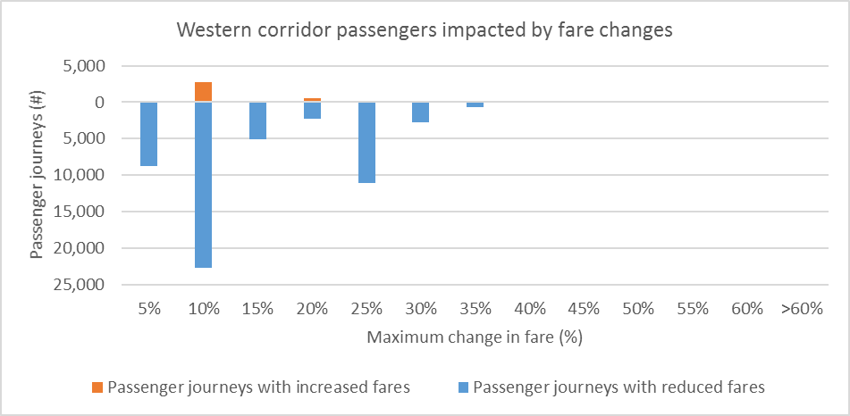
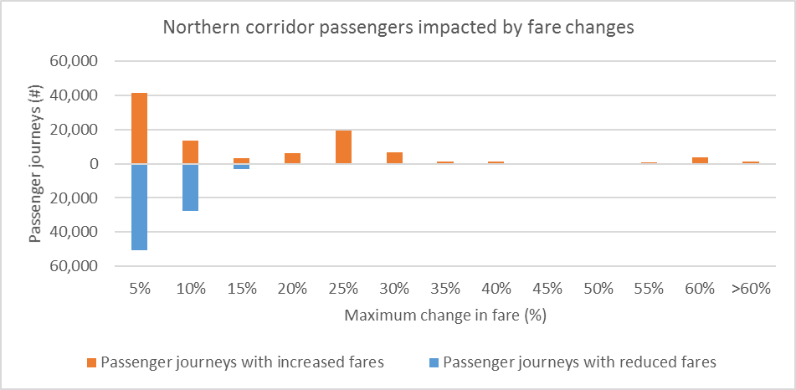
Fare Review
Zonal structure – Fare Changes
Raglan Fare Changes
Huntly Fare Changes

Slide 37

Fare Review
Zonal structure – Revenue & Subsidy Change

Slide 38

Fare Review
Zonal structure – Patronage Change

Slide 39
PT Funding
Total Cost
Funded By
$
Passengers
Subsidy Split
Public Subsidy
NZTA 51%
Local Split
District
Local Split
Ham
Local Share 49 %
DC 49 %
RC 24.5%
DC 24.5%

Slide 40


