Slide 1
PT Plan Workshop
26 June 2018

Slide 2
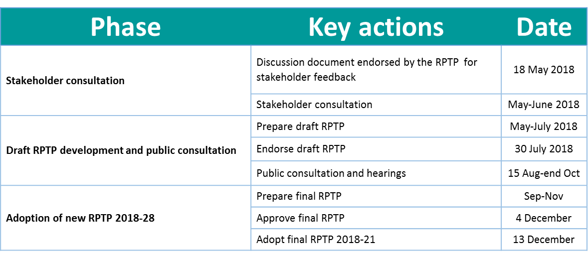

Slide 3






Governance – PT Plan Development Committee
Cr Russ Rimmington (Chair)
Cr Hugh Vercoe (Deputy Chair)
Cr Dave Macpherson
Cr Leo Tooman
Cr Toby Adams
Cr Dynes Fulton
Cr Grahame Webber with Cr Judy Bannon as alternate
Andrew McKillop
Megan Kettle
Cole O’Keefe

Slide 4
PT Plan Review
Overarching objective:
To ensure our transport system:
provides capacity for population growth and economic development
enables people to participate, particularly transport disadvantaged
makes our cities and towns more livable
is affordable for users and funders

Slide 5
Problem 1:
High population growth and increasing dependency on cars is causing congestion in our towns and city.
Problem 2:
Lack of suitable transport options is limiting access to essential services and employment.
Problem 3:
Poor perceptions and journey experiences are a barrier to growing public transport patronage.

Slide 6
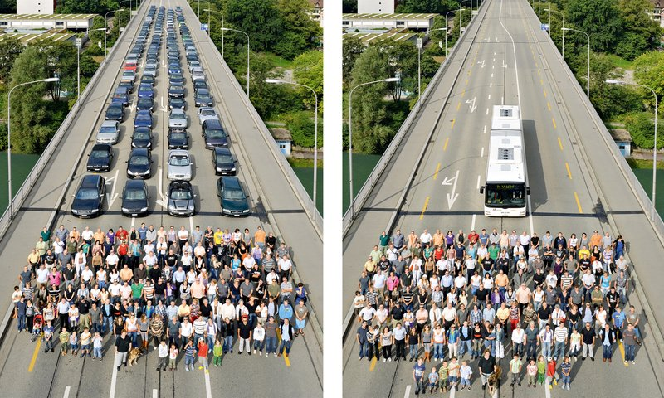
Population growth
+
Lots of cars
=
Congestion
Longer travel times
Economic constraints
Expensive infrastructure
Sprawling urban areas
Notes:
Linear growth grows by the same amount in each time
Exponential growth – the larger the population the faster is grows
Logistic Growth – exponential growth that is constrained

Slide 7
Population Growth
Notes:
Simple way to put exponential growth into context
Rule of 70
Doubling period does not depend on baseline population number
Depends percentage growth rate

Slide 8
Population Growth
How long does it take for a population to double in size?
“Doubling Period”
Notes:
Simple way to put exponential growth into context
Rule of 70
Doubling period does not depend on baseline population number
Depends percentage growth rate

Slide 9
NZ Population
Dec | 1858 | 115,461
Mar | 1874 | 344,985
Apr | 1891 | 668,652
Apr | 1921 | 1,271,667
Apr | 1961 | 2,414,985
Mar | 2018 | 4,871,300
16
17
30
40
57
1860 | 0.15
1870 | 0.3 | 100% | 10 | 10.0%
1890 | 0.6 | 100% | 20 | 5.0%
1920 | 1.2 | 100% | 30 | 3.3%
1960 | 2.4 | 100% | 40 | 2.5%
2018 | 4.8 | 100% | 58 | 1.7%
2064 | 9.6 | 100% | 46 | 1.5%
Time
2088 | 9.6 | 100% | 70 | 1
2065 |  |  | 47 | 1.5
2053 |  |  | 35 | 2
2041 |  |  | 23 | 3
35
2053?
2%

Slide 10
NZ Population
Dec | 1858 | 115,461
Mar | 1874 | 344,985
Apr | 1891 | 668,652
Apr | 1921 | 1,271,667
Apr | 1961 | 2,414,985
Mar | 2018 | 4,871,300
16
17
30
40
57
1860 | 0.15
1870 | 0.3 | 100% | 10 | 10.0%
1890 | 0.6 | 100% | 20 | 5.0%
1920 | 1.2 | 100% | 30 | 3.3%
1960 | 2.4 | 100% | 40 | 2.5%
2018 | 4.8 | 100% | 58 | 1.7%
2064 | 9.6 | 100% | 46 | 1.5%
0.15M
1860
Time
2088 | 9.6 | 100% | 70 | 1
2065 |  |  | 47 | 1.5
2053 |  |  | 35 | 2
2041 |  |  | 23 | 3
35
2053?
2%

Slide 11
NZ Population
Dec | 1858 | 115,461
Mar | 1874 | 344,985
Apr | 1891 | 668,652
Apr | 1921 | 1,271,667
Apr | 1961 | 2,414,985
Mar | 2018 | 4,871,300
16
17
30
40
57
1860 | 0.15
1870 | 0.3 | 100% | 10 | 10.0%
1890 | 0.6 | 100% | 20 | 5.0%
1920 | 1.2 | 100% | 30 | 3.3%
1960 | 2.4 | 100% | 40 | 2.5%
2018 | 4.8 | 100% | 58 | 1.7%
2064 | 9.6 | 100% | 46 | 1.5%
0.15M
0.3M
1860
1870
Time
2088 | 9.6 | 100% | 70 | 1
2065 |  |  | 47 | 1.5
2053 |  |  | 35 | 2
2041 |  |  | 23 | 3
35
2053?
2%

Slide 12
NZ Population
0.6M
0.15M
0.3M
1860
1870
1890
Time

Slide 13
NZ Population
1.2M
0.6M
0.15M
0.3M
1860
1870
1890
1920
Time

Slide 14
NZ Population
2.4M
1.2M
0.6M
0.15M
0.3M
1860
1870
1890
1920
1960
Time

Slide 15
NZ Population
Today
4.8M
2.4M
1.2M
0.6M
0.15M
0.3M
1860
1870
1890
1920
1960
2018
Time

Slide 16
NZ Population
Today
“Doubling Period”
4.8M
57
years
2.4M
40
years
30
years
1.2M
16
years
17
years
0.6M
0.15M
0.3M
1860
1870
1890
1920
1960
2018
Time

Slide 17
NZ Population
Today
“Doubling Period”
Could population double again?
If so, when?
4.8M
57
years
2.4M
40
years
30
years
1.2M
16
years
17
years
0.6M
0.15M
0.3M
1860
1870
1890
1920
1960
2018
Time

Slide 18
NZ Population
9.6M
Today
70
years
4.8M
57
years
2.4M
40
years
30
years
1.2M
16
years
17
years
0.6M
0.15M
0.3M
1860
1870
1890
1920
1960
2018
2088
1%
Time

Slide 19
NZ Population
9.6M
9.6M
Today
35
years
4.8M
57
years
2.4M
40
years
30
years
1.2M
16
years
17
years
0.6M
0.15M
0.3M
1860
1870
1890
1920
1960
2018
2053
2%
2088
1%
Time

Slide 20
NZ Population
9.6M
9.6M
9.6M
Today
23
years
4.8M
57
years
2.4M
40
years
30
years
1.2M
16
years
17
years
0.6M
0.15M
0.3M
1860
1870
1890
1920
1960
2018
2041
3%
2053
2%
2088
1%
Time

Slide 21
NZ Population
9.6M
9.6M
9.6M
Today
40 – 50?
years
4.8M
57
years
2.4M
40
years
30
years
1.2M
16
years
17
years
0.6M
0.15M
0.3M
1860
1870
1890
1920
1960
2018
2041
3%
2053
2%
2088
1%
Time

Slide 22
20 year | 5 year
1.9% | 2.6% | Auckland
1.8% | 2.4% | Hamilton
1.7% | 2.6% | Waikato DC
1.6% | 2.1% | Waipa DC
0.7% | 1.3% | Matamata-Piako DC
Waikato District Population
Today
74K
1860
1870
1890
1920
1960
2018
Time

Slide 23
20 year | 5 year
1.9% | 2.6% | Auckland
1.8% | 2.4% | Hamilton
1.7% | 2.6% | Waikato DC
1.6% | 2.1% | Waipa DC
0.7% | 1.3% | Matamata-Piako DC
Waikato District Population
Today
74K
Could population double again?
If so, when?
1860
1870
1890
1920
1960
2018
Time

Slide 24
20 year | 5 year
1.9% | 2.6% | Auckland
1.8% | 2.4% | Hamilton
1.7% | 2.6% | Waikato DC
1.6% | 2.1% | Waipa DC
0.7% | 1.3% | Matamata-Piako DC
Waikato District Population
Today
74K
Could population double again?
If so, when?
Any year on year growth rate above 0% will result in population doubling
1860
1870
1890
1920
1960
2018
Time

Slide 25
20 year | 5 year
1.9% | 2.6% | Auckland
1.8% | 2.4% | Hamilton
1.7% | 2.6% | Waikato DC
1.6% | 2.1% | Waipa DC
0.7% | 1.3% | Matamata-Piako DC
Waikato District Population
Today
 | Waikato DC | Auckland
20 year average | 1.7% | 1.9%
5 year average | 2.2% | 2.3%
2017 vs 2016 | 3.4% | 2.6%
74K
Could population double again?
If so, when?
Any year on year growth rate above 0% will result in population doubling
1860
1870
1890
1920
1960
2018
Time

Slide 26
20 year | 5 year
1.9% | 2.6% | Auckland
1.8% | 2.4% | Hamilton
1.7% | 2.6% | Waikato DC
1.6% | 2.1% | Waipa DC
0.7% | 1.3% | Matamata-Piako DC
Waikato District Population
148K
Today
 | Waikato DC | Auckland
20 year average | 1.7% | 1.9%
5 year average | 2.2% | 2.3%
2017 vs 2016 | 3.4% | 2.6%
74K
41
years
1860
1870
1890
1920
1960
2018
2059
1.7%
Time

Slide 27
20 year | 5 year
1.9% | 2.6% | Auckland
1.8% | 2.4% | Hamilton
1.7% | 2.6% | Waikato DC
1.6% | 2.1% | Waipa DC
0.7% | 1.3% | Matamata-Piako DC
41
years
Waikato District Population
148K
148K
Today
 | Waikato DC | Auckland
20 year average | 1.7% | 1.9%
5 year average | 2.2% | 2.3%
2017 vs 2016 | 3.4% | 2.6%
30
years
74K
1860
1870
1890
1920
1960
2018
2048
2.2%
2059
1.7%
Time

Slide 28
20 year | 5 year
1.9% | 2.6% | Auckland
1.8% | 2.4% | Hamilton
1.7% | 2.6% | Waikato DC
1.6% | 2.1% | Waipa DC
0.7% | 1.3% | Matamata-Piako DC
30
years
41
years
Waikato District Population
148K
148K
Today
 | Waikato DC | Auckland
20 year average | 1.7% | 1.9%
5 year average | 2.2% | 2.3%
2017 vs 2016 | 3.4% | 2.6%
74K
1860
1870
1890
1920
1960
2018
2048
2.2%
2059
1.7%
Time

Slide 29
20 year | 5 year
1.9% | 2.6% | Auckland
1.8% | 2.4% | Hamilton
1.7% | 2.6% | Waikato DC
1.6% | 2.1% | Waipa DC
0.7% | 1.3% | Matamata-Piako DC
30
years
41
years
Waikato District Population
148K
148K
Today
 | Waikato DC | Auckland
20 year average | 1.7% | 1.9%
5 year average | 2.2% | 2.3%
2017 vs 2016 | 3.4% | 2.6%
74K
1860
1870
1890
1920
1960
2018
2048
2.2%
2059
1.7%
Time

Slide 30
20 year | 5 year
1.9% | 2.6% | Auckland
1.8% | 2.4% | Hamilton
1.7% | 2.6% | Waikato DC
1.6% | 2.1% | Waipa DC
0.7% | 1.3% | Matamata-Piako DC
30
years
41
years
Waikato District Population
148K
148K
Today
 | Waikato DC | Auckland
20 year average | 1.7% | 1.9%
5 year average | 2.2% | 2.3%
2017 vs 2016 | 3.4% | 2.6%
74K
1860
1870
1890
1920
1960
2018
2048
2.2%
2059
1.7%
Time

Slide 31
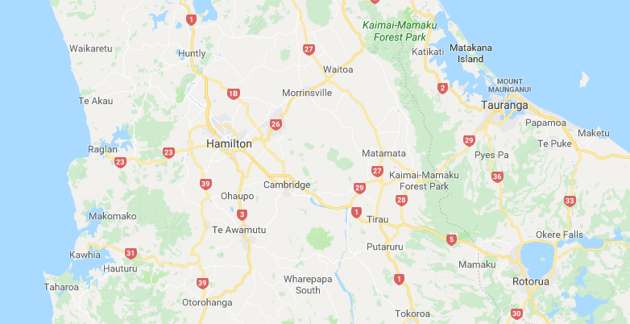
165,000

Slide 32
165,000
124,000

Slide 33
289,440

Slide 34
289,440
177,760

Slide 35
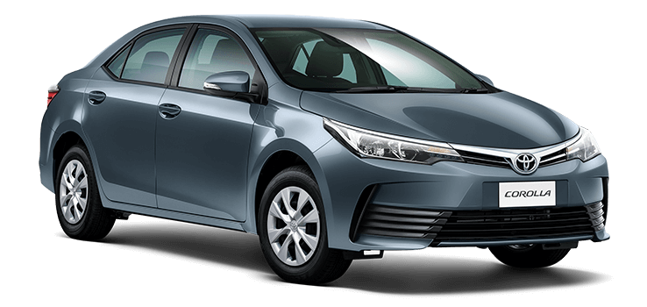
More people
=
More cars

Slide 36
People | 4,871,300
Vehicles | 5,132,787
More vehicles then people
2018 in NZ

Slide 37
People | 4,871,300
Vehicles | 5,132,787
More vehicles then people
Car / vans / trucks / motorcycles | 4,233,833
People that can drive (16 years +) | 3,845,800
2018 in NZ

Slide 38
People | 4,871,300
Vehicles | 5,132,787
More vehicles then people
Car / vans / trucks / motorcycles | 4,233,833
People that can drive (16 years +) | 3,845,800
Space occupied (all parked) | 6,000 hectares
Space dedicated to vehicles | Motorways Roads Driveways On-street parks Of-street parks Parking buildings Manoeuvring Ect…….
2018 in NZ

Slide 39
People |  | +77,400 | +1.6%
Car / vans / trucks / motorcycles |  | +163,617 | +4%
2017 vs 2018

Slide 40
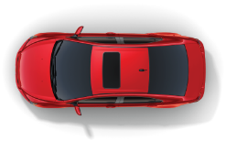

Slide 41



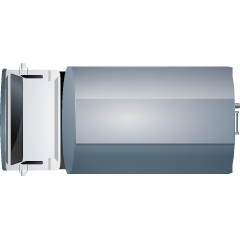
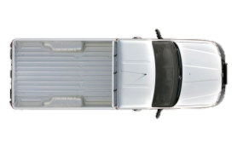
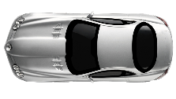
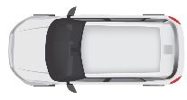

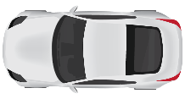
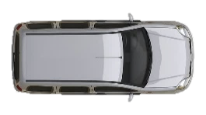
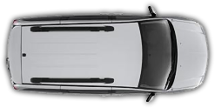
Perfect
Conditions
&
Perfect Drivers
1900 / hour
2470 / hour
1.3 per car

Slide 42
Perfect
Conditions
&
Perfect Drivers
Congested Conditions
&
Human Drivers
1900 / hour
700 / hour
2470 / hour
910 / hour
1.3 per car

Slide 43
Perfect
Conditions
&
Perfect Drivers
Congested Conditions
&
Human Drivers
Demand exceeds available space
Rat running
People change time of travel
Use different modes
People and business move away
1900 / hour
700 / hour
2470 / hour
910 / hour
1.3 per car

Slide 44
Perfect
Conditions
&
Perfect Drivers
Saturated Conditions
&
Human Drivers
Increase road capacity
3800 / hour
1400 / hour
4940 / hour
1820 / hour
1.3 per car

Slide 45
Perfect
Conditions
&
Perfect Drivers
Saturated Conditions
&
Human Drivers
Increase road capacity
Works well for awhile, but….
3800 / hour
1400 / hour
2940 / hour
1820 / hour
1.3 per car

Slide 46
Perfect
Conditions
&
Perfect Drivers
Congested Conditions
&
Human Drivers
Rat runners come back
People change time of travel, again
Use other modes less
People and business move in
Population growth
3800 / hour
1400 / hour
2940 / hour
1820 / hour
1.3 per car

Slide 47
Perfect
Conditions
&
Perfect Drivers
Congested Conditions
&
Human Drivers
More Cars
More Roads
More Congestion
3800 / hour
1400 / hour
2470 / hour
1820 / hour
1.3 per car

Slide 48
Te Rapa and
Ngaruawahia
Sections
Hamilton CBD
4 laning
Rangiriri
SH2 Interchange
Drury
SH20 Manukau
Auckland Central

Slide 49
Te Rapa and
Ngaruawahia
Sections
Hamilton CBD
4 laning
Rangiriri
SH2 Interchange
Drury
SH20 Manukau
Auckland Central
40,987vpd in 2008

Slide 50
Te Rapa and
Ngaruawahia
Sections
Hamilton CBD
4 laning
Rangiriri
SH2 Interchange
Drury
SH20 Manukau
Auckland Central
40,987vpd in 2008
42,554vpd in 2012

Slide 51
Te Rapa and
Ngaruawahia
Sections
Hamilton CBD
4 laning
Rangiriri
SH2 Interchange
Drury
SH20 Manukau
Auckland Central
40,987vpd in 2008
42,554vpd in 2012
50,700vpd in 2016

Slide 52
Te Rapa and
Ngaruawahia
Sections
Hamilton CBD
4 laning
Rangiriri
SH2 Interchange
Drury
SH20 Manukau
Auckland Central
40,987vpd in 2008
42,554vpd in 2012
50,700vpd in 2016
Queue at Drury gets more than 1km closer to Hamilton every year
10km in 9 years

Slide 53
Notes:
Linear growth grows by the same amount in each time
Exponential growth – the larger the population the faster is grows
Logistic Growth – exponential growth that is constrained

Slide 54

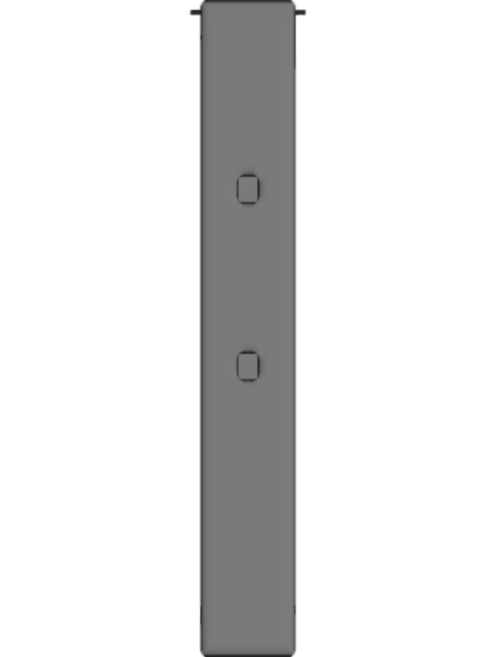
1900 / hour
100 / hour
2470 / hour
4000 - 9000 / hour
1.3 per car
40 per bus
BUS
LANE

Slide 55
1900 / hour
100 / hour
4000 - 9000 / hour
Use space more efficiently to enable capacity for growth
2470 / hour
1.3 per car
40 per bus
BUS
LANE

Slide 56
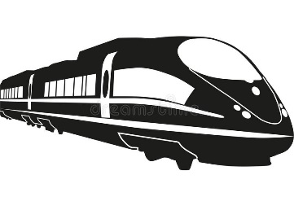









Active Modes
Goods and Trades
Most Liveable
Mass Transit
PT & Ridesharing
Private Car
Least Liveable
Priority

Slide 57
Problem 2
Lack of suitable transport
=
Isolation
Poor health
Lower education
Employment constraints
Welfare dependency

Slide 58


Slide 59
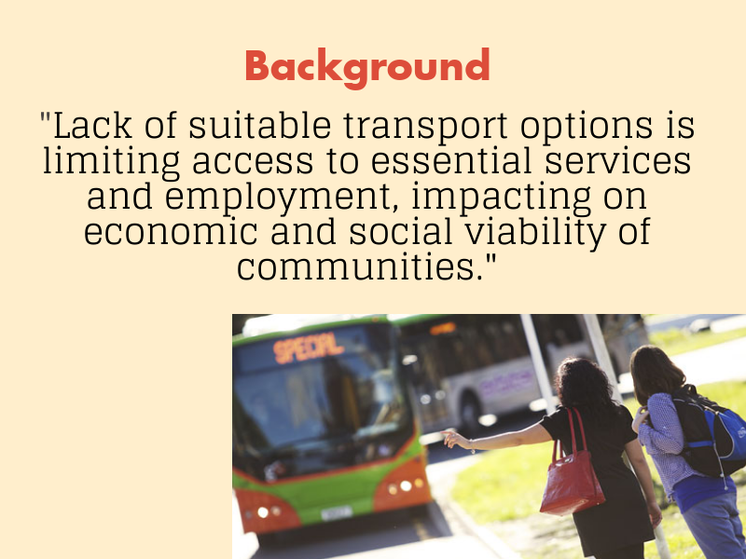

Slide 60
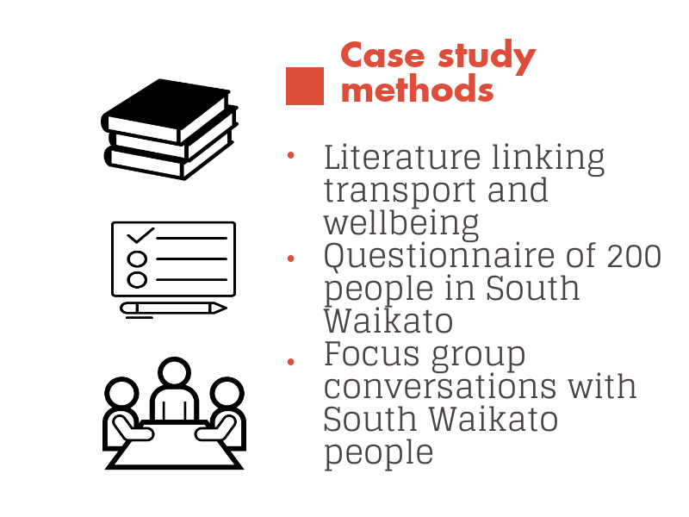

Slide 61
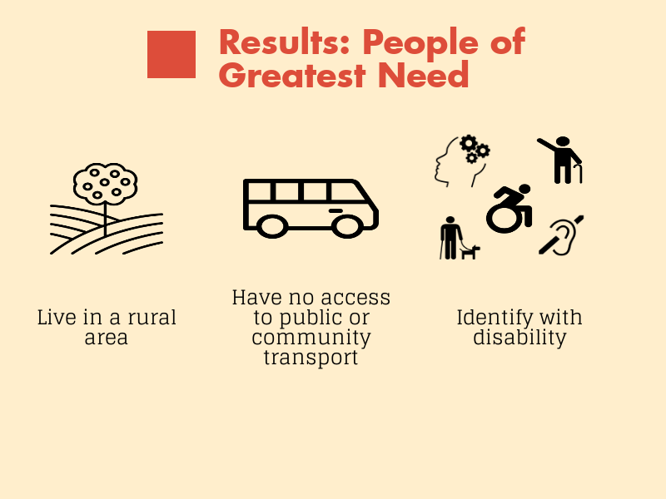

Slide 62
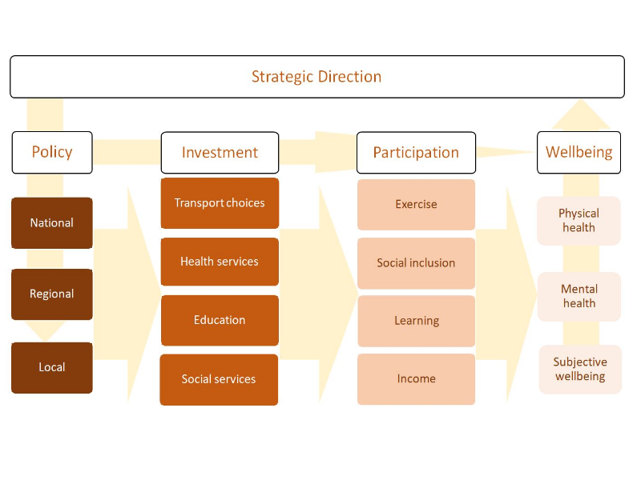

Slide 63
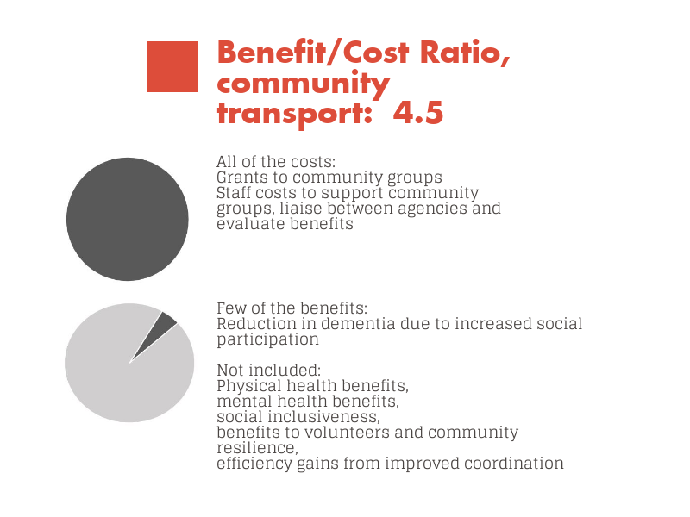

Slide 64
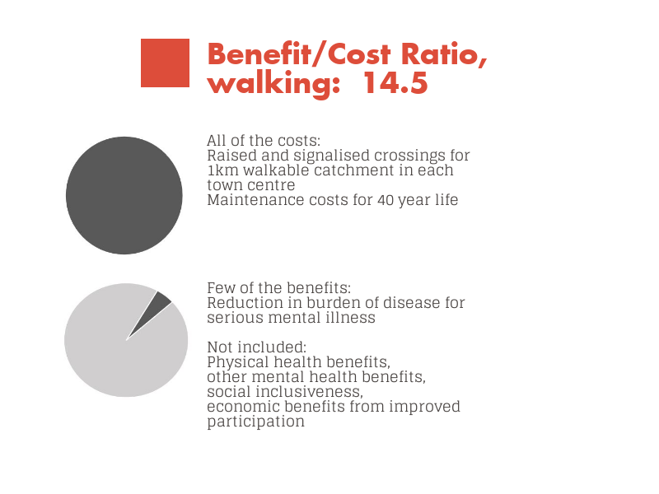

Slide 65
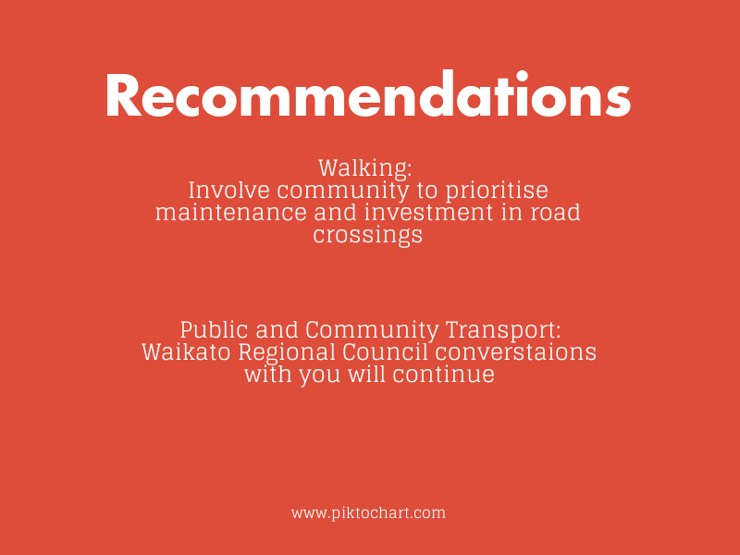

Slide 66







Customer
Transport Options
Lowest Cost
Cost
Highest Cost
Community Transport
Bike Share
Public bus / train / ferry
Public rideshare
Commercial rideshare
Private hire
Rental

Slide 67











Customer
Transport Options
Lowest Cost
Cost
Highest Cost
Community Transport
Bike Share
Public bus / train / ferry
Public rideshare
Commercial rideshare
Private hire
Rental

Slide 68

Customer
Choice Platform
Transport Options
Lowest Cost
Cost
Highest Cost
Community Transport
Bike Share
Public bus / train / ferry
Public rideshare
Commercial rideshare
Private hire
Rental

Slide 69







Customer
Choice Platform
Transport Options
Lowest Cost
Cost
Highest Cost
Community Transport
Bike Share
Public bus / train / ferry
Public rideshare
Commercial rideshare
Private hire
Rental

Slide 70

Customer
Role
Partner
with
others
Choice Platform
Transport Options
Lowest Cost
Cost
Highest Cost
Community Transport
Bike Share
Public bus / train / ferry
Public rideshare
Commercial rideshare
Private hire
Rental

Slide 71
Customer
Role
Partner
with
others
Choice Platform
Transport Options
Lowest Cost
Cost
Highest Cost
Deliver
Community Transport
Bike Share
Public bus / train / ferry
Public rideshare
Commercial rideshare
Private hire
Rental

Slide 72
Customer
Role
Partner
with
others
Choice Platform
Transport Options
Lowest Cost
Cost
Highest Cost
Support
others
Deliver
Community Transport
Bike Share
Public bus / train / ferry
Public rideshare
Commercial rideshare
Private hire
Rental

Slide 73
Problem 3
Poor journey experience
=
Barrier to use
Reduced value for money spent
Opportunity cost

Slide 74
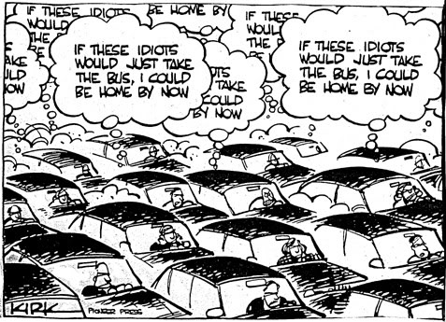
Value Proposition

Slide 75
Value Proposition
BUS
LANE

Slide 76



Traditional Bus Service
Other Passenger
Other Passenger
Fixed Route
Origin
Destination

Slide 77

Ridesharing
Other Passenger
Other Passenger
Fixed Route
Origin
Destination
Other Passenger
Ride Share
Other Passenger
Other Passenger

Slide 78


Ridesharing
Origin
Destination
Other Passenger
Ride Share
Other Passenger

Slide 79

Ridesharing
Origin
Destination
Other Passenger
Ride Share
Other Passenger

Slide 80

Journey Experience

Slide 81



Slide 82


Slide 83




Slide 84
Service Info
Stops
Buses
Satisfied
Neutral
Dissatisfied
92%
4%
4%

Slide 85
Service Info
Stops
Buses
Satisfied
Neutral
Dissatisfied
92%
4%
4%
Service Disruption Info
Satisfied
Neutral
Dissatisfied
55%
15%
30%

Slide 86
Service Info
Stops
Buses
Satisfied
Neutral
Dissatisfied
92%
4%
4%
Satisfied
Neutral
Dissatisfied
20%
14%
66%
Service Disruption Info
Satisfied
Neutral
Dissatisfied
55%
15%
30%

Slide 87
Service Info
Stops
Buses
Satisfied
Neutral
Dissatisfied
92%
4%
4%
Satisfied
Neutral
Dissatisfied
20%
14%
66%
Satisfied
Neutral
Dissatisfied
92%
4%
4%
Service Disruption Info
Satisfied
Neutral
Dissatisfied
55%
15%
30%

Slide 88
Service Info
Stops
Buses
Satisfied
Neutral
Dissatisfied
92%
4%
4%
Satisfied
Neutral
Dissatisfied
92%
4%
4%
?
Satisfied
Neutral
Dissatisfied
20%
14%
66%
Service Disruption Info
Satisfied
Neutral
Dissatisfied
55%
15%
30%

Slide 89
So, what are we going to do?

Slide 90
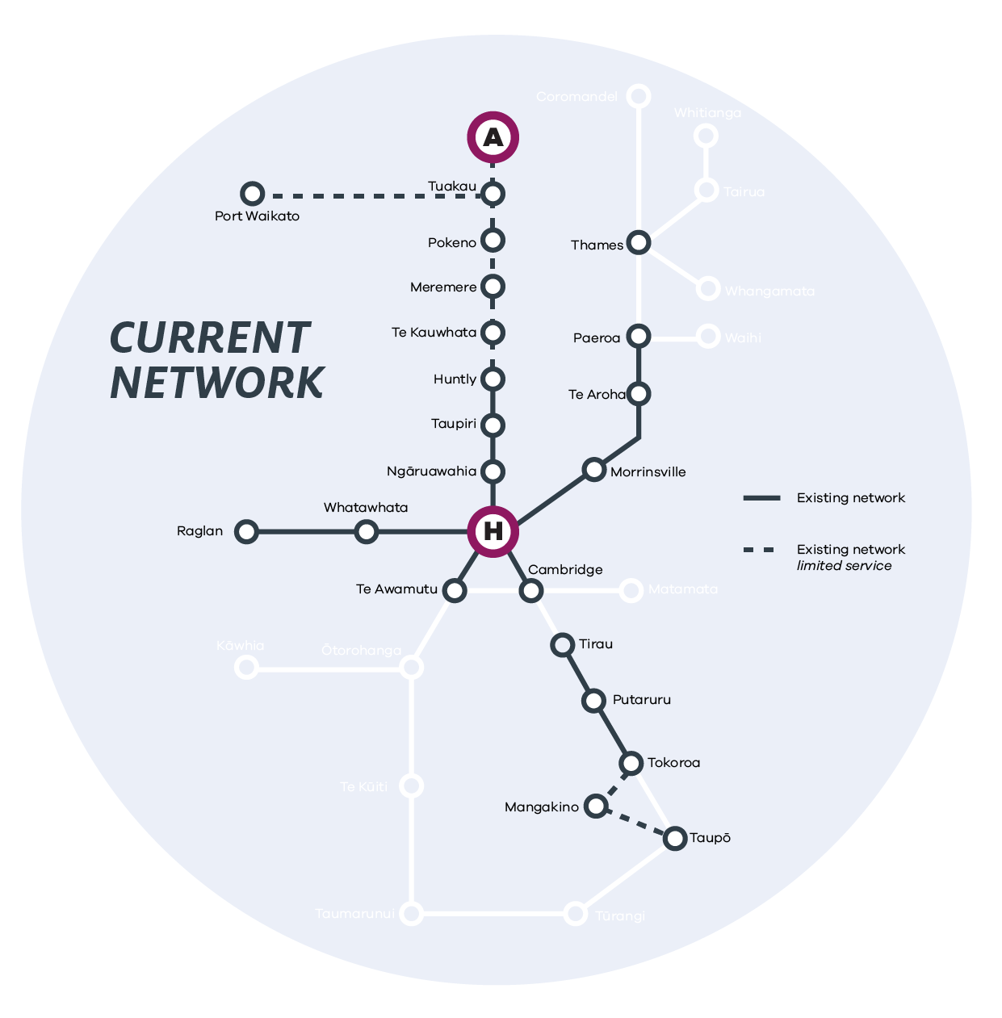

Slide 91
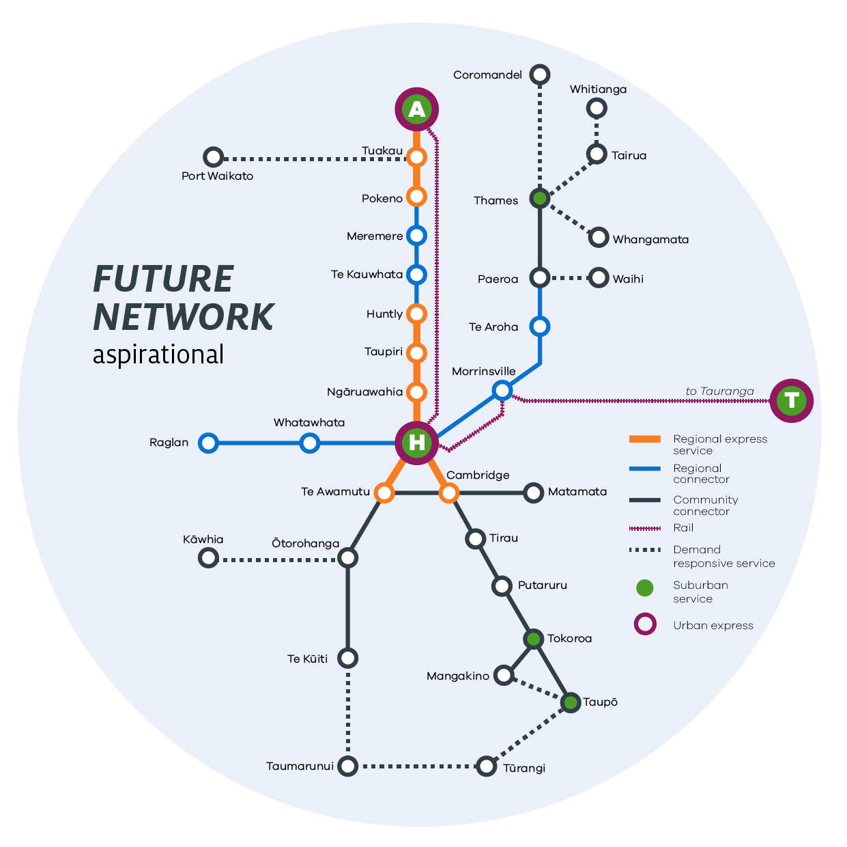

Slide 92
Customer
Role
Partner
with
others
Choice Platform
Transport Options
Lowest Cost
Cost
Highest Cost
Support
others
Deliver
Community Transport
Bike Share
Public bus / train / ferry
Public rideshare
Commercial rideshare
Private hire
Rental

Slide 93
Provide a greater value proposition
BUS
LANE

Slide 94
Develop more flexible PT solutions
Origin
Destination
Other Passenger
Ride Share
Other Passenger

Slide 95
Journey Experience
Service Info
Stops
Buses
Satisfied
Neutral
Dissatisfied
92%
4%
4%
Satisfied
Neutral
Dissatisfied
20%
14%
66%
Service Disruption Info
Satisfied
Neutral
Dissatisfied
55%
15%
30%

Slide 96
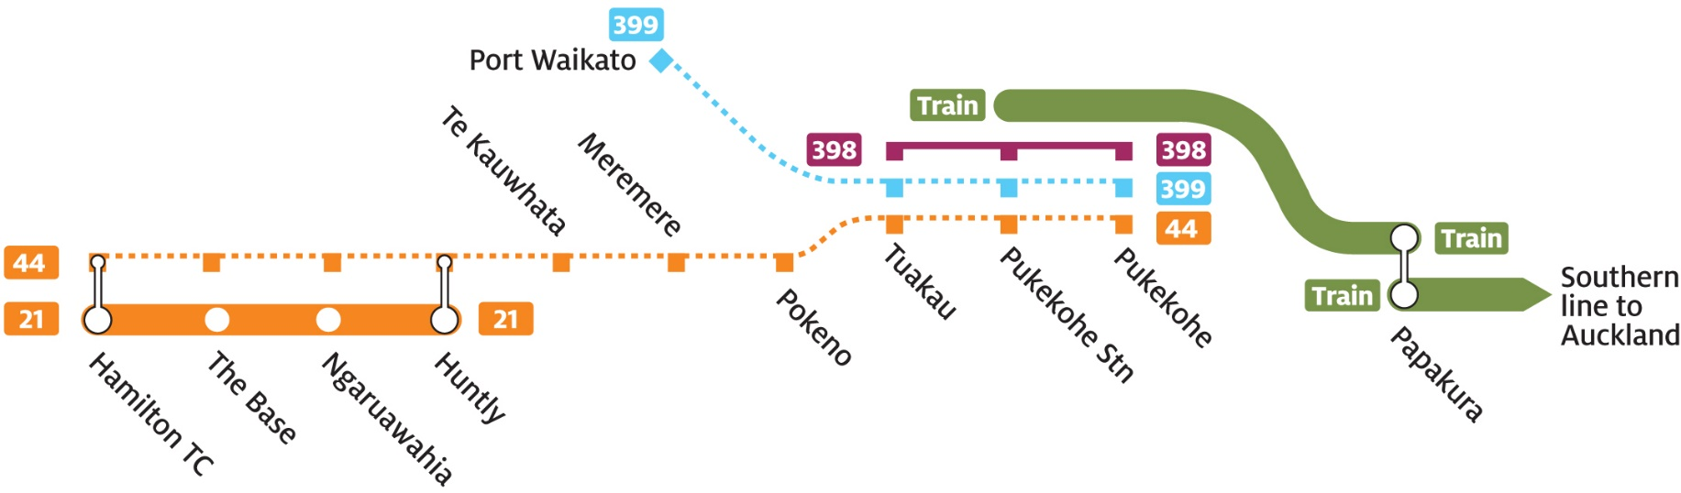
Existing Services
Auckland
Hamilton
Notes:
Bus Route 44: Hamilton – Pukekohe: Provides an inter-peak return trip between Hamilton and Pukekohe every second Thursday.
Bus Route 398: Tuakau – Pukekohe: Provides a daily commuter service departing Tuakau in the morning and returning from Pukekohe in the evening, plus an inter-peak return trip on Wednesdays.
Bus Route 399: Port Waikato – Pukekohe: Provides two inter-peak return trips between Pukekohe and Port Waikato every Thursday.
Bus Route 21: Northern Connector: Provides a regular bus service between Huntly and Hamilton, with 30-minute peak and 60-minute off-peak frequency. Operates between 6am and 9pm weekdays and 8am to 6pm weekends.
Train: Pukekohe – Auckland: Provides a regular train service between Pukekohe and Auckland (transfer required at Papakura), with a 20-minute peak and 60-minute off-peak frequency. Operates between 5am and 11pm weekdays and 6.30am to10pm weekends.

Slide 97
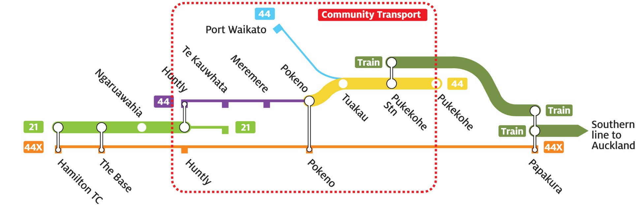
Planned Services
Auckland
Hamilton
Notes:
Pocono to Pukekohe - Regular bus service between Pokeno & Pukekohe via Tuakau weekdays and weekends. Designed to integrate with train services to Auckland.
Huntly to Pukekohe - Daily of peak return service between Huntly and Pukekohe via north Waikato towns Monday to Friday, providing community connectivity and broader access to essential services.
Te Kauwhata to Hamilton – existing Huntly bus service extended to Te Kauwhata for one return trip during peak periods on weekdays, providing access to employment, education and social opportunities
Hamilton, Huntly, Pokeno to Papakura Express Service – Weekday commuter bus service intended to provide fast and direct access between Hamilton City, north Waikato towns and Auckland.
Port Waikato to Pukekohe – options include retaining the existing once a week service, or replacing the timetabled bus with a community transport option.
Community Transport Initiatives – Managed and operated by the community memebers, typically highly flexible and adept at meeting specific community needs

Slide 98
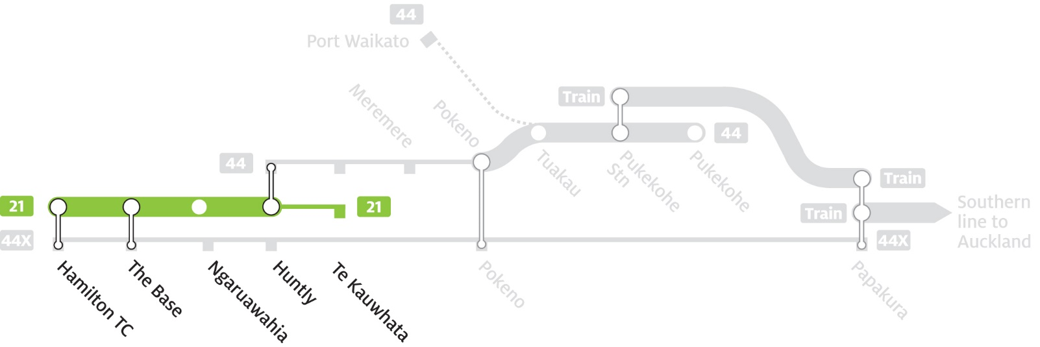
Planned Services
Hamilton
Auckland
Daily return trip Monday to Friday
Leave Te Kauwhata at 7am and return from Hamilton 5:25pm
Estimated travel time1.2 hours each way
Enables access to employment, education, health care and social opportunities

Slide 99
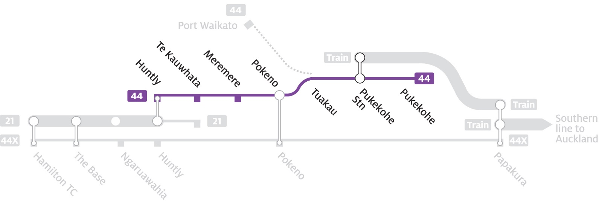
Planned Services
Hamilton
Auckland
Daily return trip Monday to Friday
Leave Huntly at 9am and return from Pukekohe at 1.30pm
Estimated travel time 1.5 hours each way
Enables community connectivity between towns and broader access to essential services and social opportunities

Slide 100
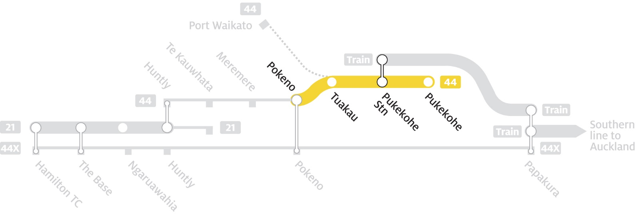
Planned Services
Hamilton
Auckland
Weekdays
40-min peak and 2 hourly off-peak – 6am to 8pm
Weekends
2 hourly all day - 7am to 8pm

Slide 101

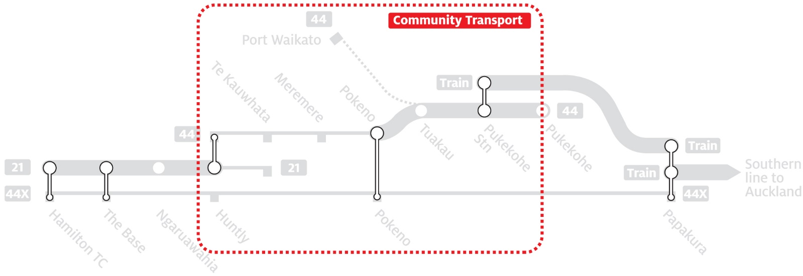
Planned Services
Hamilton
Auckland
Community based transport
A charitable trust is set up and a basic business plan developed
A community vehicle (car/van) is procured by the trust
The vehicle is operated by local community volunteers
Passengers will contact the trust (usually by phone) to book travel
Successfully implemented elsewhere in NZ - requires local champion

Slide 102
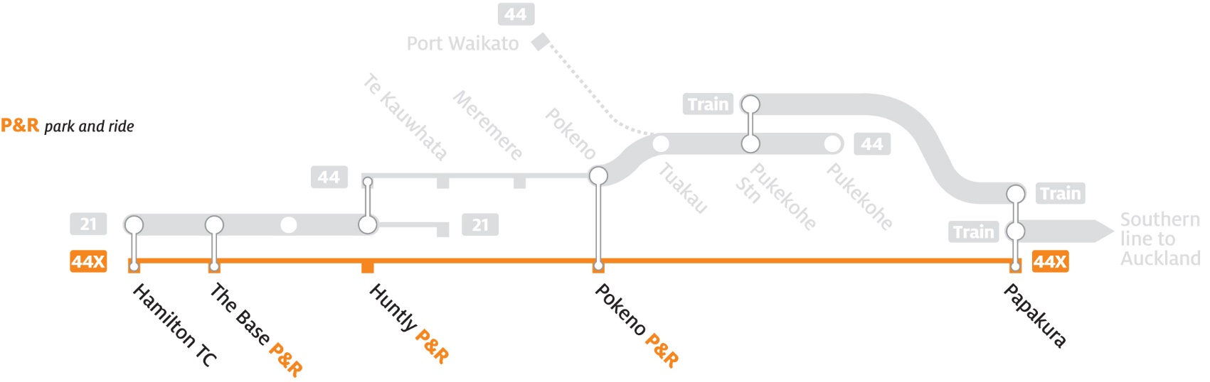
Proposed Services
Hamilton
Auckland
Tuakau

Slide 103
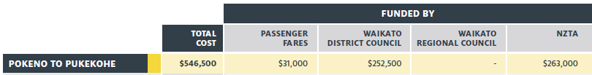

Slide 104
PT Funding
Total Cost
Funded By
$
Passengers
Subsidy Split
Public Subsidy
NZTA 51%
Local Split
District
Local Split
Ham
Local Share 49 %
DC 49 %
RC 24.5%
DC 24.5%
Notes:
Image on the right currently outlines services that WRC currently contracts for.

Slide 105
Thank you

