Slide 1
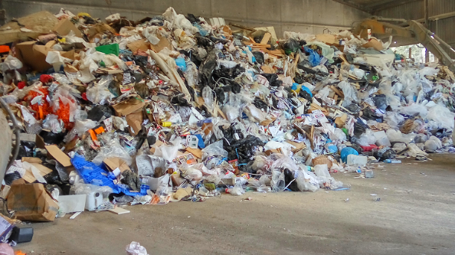
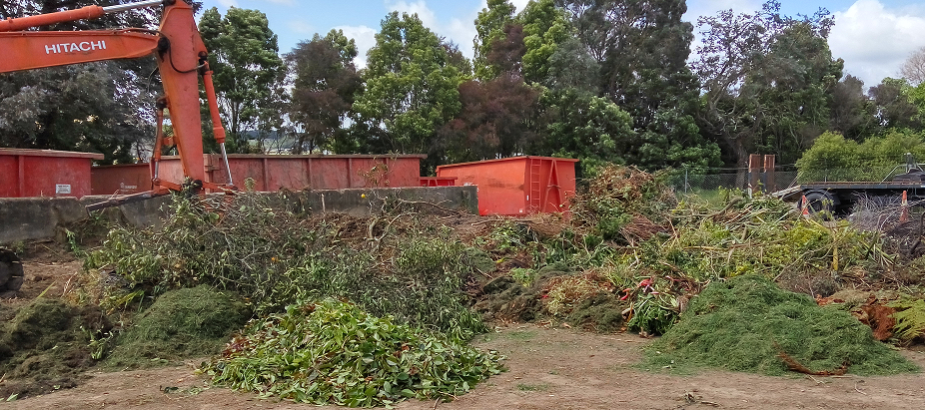
WAIKATO DISTRICT COUNCIL 2018 Proposed WASTE MANAGEMENT & MINIMISATION PLAN

Slide 2
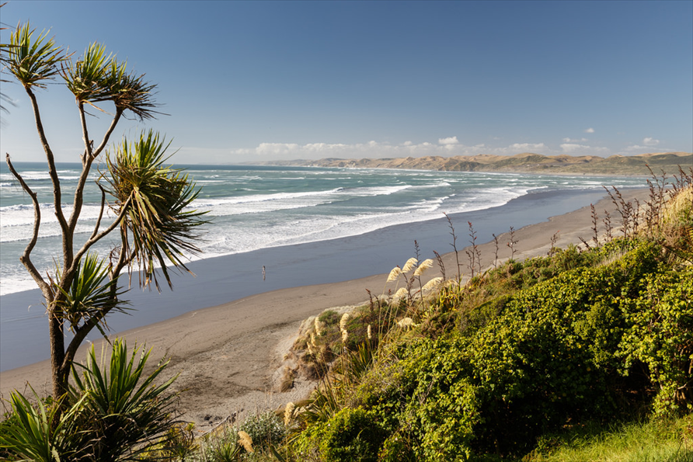
WHAT IS A WASTE ASSESSMENT?
The waste assessment establishes the planning foundations for the waste management and minimisation plan (WMMP) by describing the waste situation,
setting the vision,
goals objectives and targets for the district,
developing options for meeting future demand.
A waste assessment is a legislative obligation.

Slide 3
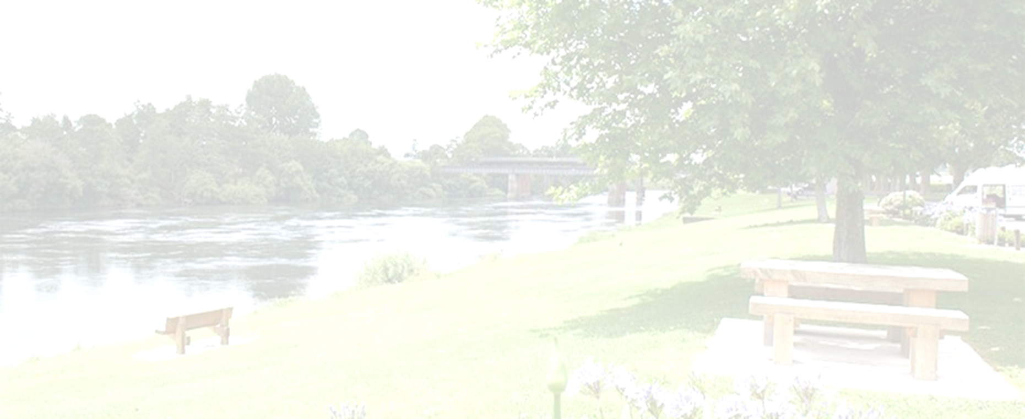
WHAT DOES THE WASTE ASSESSMENT TELL US?
In the 2016/2017 year:
Waikato District generated an estimated 235,844 tonnes of waste (landfill + diverted + on-farm)
About 52,182 tonnes of waste went to landfill - an average of 750kg per person.
Per capita waste to landfill volumes seem to have increased by approximately 47% compared to 2012 (Note: this is all waste, council and private, compared between 2012 and 2017)
An estimated 112,662 tonnes of rural (on-farm) waste was estimated to be generated in the District (47% of waste). This is based on national data rather than surveying WDC farms (take a pinch of salt).
An estimated 71,000 tonnes of material was diverted from landfill (e.g. through reuse, recycling or composting). This equated to around 1,020 kg diversion per person.

Slide 4
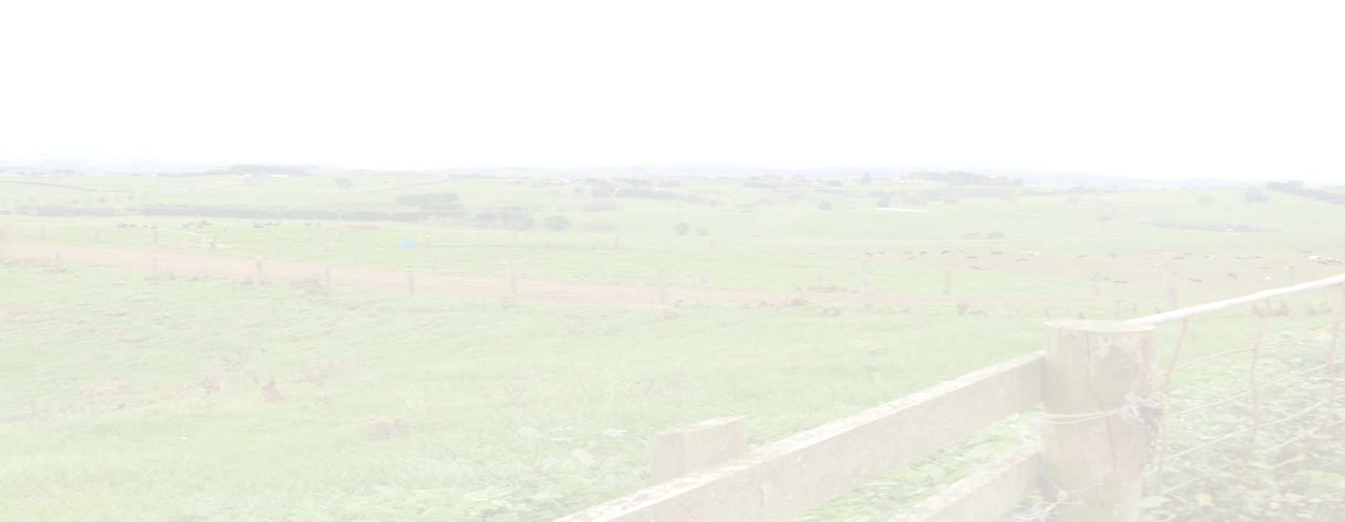
A NOTE ABOUT DATA ISSUES!
Private operators and facilities do not have to provide us with information on their activities
Some have provided information; some have not
Some information is good; some is not
BUT – the information we have for this WMMP is much better than the information we had in 2012
2012: Less information + low quality information = underestimated 2012 tonnages

Slide 5
WHAT IS A WASTE MANAGEMENT AND MINIMISATION PLAN?
The Waste Minimisation Act 2008 require territorial authorities to prepare waste management and minimisation plans (WMMPs).
The plans have to be reviewed every six years.
Requirements for WMMPs are set out in section 43 and 44 of the Waste Minimisation Act 2008.
Waste levy funding will be withheld if a council does not have a current WMMP in place (approx. $255,184 p.a)
Notes:
- Surya to discuss why Waters team is doing this – consider Research aspect – Seen by GMs that this is the best fit;

Slide 6
VISION
Zero waste and resource recovery are an integral part
of our community

Slide 7
WHAT DOES ZERO WASTE ACTUALLY MEAN?
‘Zero Waste’ is a philosophy encouraging the redesign of products to so they can be reused, repaired and recycled.
Zero waste endeavors to eliminate the volume and toxicity of waste and materials, conserve and recover all resources, and not burn or bury them.
It is a goal that is ethical, economical, efficient and visionary, to guide people in changing their lifestyles and practices to copy cycles that can be seen in nature, where all discarded materials are designed to become resources for others to use

Slide 8
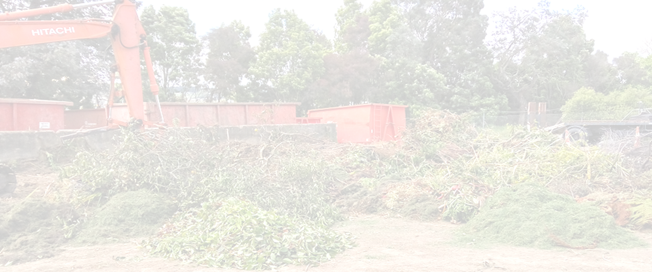
OBJECTIVES
Objectives are short-term outcomes
Waste management practices manage social, cultural, economic, health and environmental impacts of waste
Waste diversion is increasing and waste to landfill is decreasing
Our communities are actively engaging in waste avoidance and minimization; and becoming ‘zero-waste communities’
Partnerships with others to achieve efficient and sustainable waste minimisation and management, including joint working and co-operation with territorial and regional councils, and central government
Contributing to the national discussion advocating for effective product stewardship and a bottle deposit scheme

Slide 9
TARGETS
Targets
By 2024, decrease the tonnes/capita/annum of refuse to and (i.e. total refuse disposed of via landfill and/or on-farm waste) from the Waikato District by 5% compared to 2016-17
By 2024, increase the tonnes/capita/annum of diverted material from the Waikato District by 10% compared to 2016-17
By 2024, reduce the per capita kerbside rubbish to landfill by 5% compared to 2016-17
By 2024, increase per capita kerbside diverted material by 10% compared to 2016-17

Slide 10
ACTIVITIES 2018-2024
As well as continuing kerbside and other council services (such as litter and illegal dumping), proposed activities include:
a review of waste services and behaviour change programmes to bring them into alignment with the WMMP
the development of new recycling centres (similar to Raglan)
the introduction of a Solid Waste Bylaw and a waste operator licensing system
improved internal mechanisms for the collection of waste information
greater co-operation with other councils in the region; and with Mana Whenua, community groups and the private sector
advocating for greater central government leadership on waste issues such as the introduction of mandatory product stewardship and a container deposit scheme

Slide 11
HOW WILL WE FUND THE ACTIVITIES?
Council receive, based on population, a share of national waste levy funds from the Ministry for the Environment. At the current rate of $10 per tonne our council’s share of waste levy funding will be approximately $255,184 per annum.
The WMA requires that all waste levy funding be spent on matters to promote waste minimisation and in accordance with their WMMP.
Some activities may require funding through targeted rates or through joint funding with central government or the community.
All major initiatives will come back to council for approval once the detailed analysis and business cases have been prepared. Potential expenditure will be included in the LTP.

Slide 12
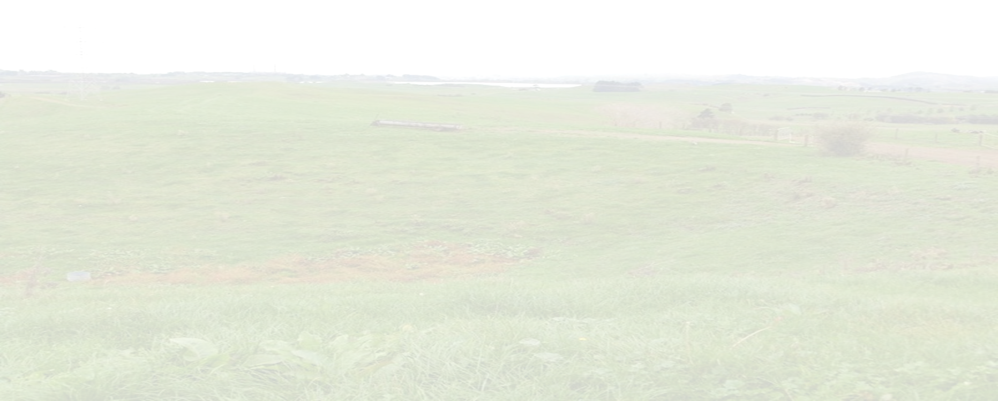
Wrap up – Where to from here
23 April – 23 May 2018 Public Consultation
13 June 2018 Hearing
27 June 2018 Adopt WMMP

