Slide 1
SH1 Papakura to Bombay project
Onewhero–Tuakau Community Board – 20 July 2020

Slide 2
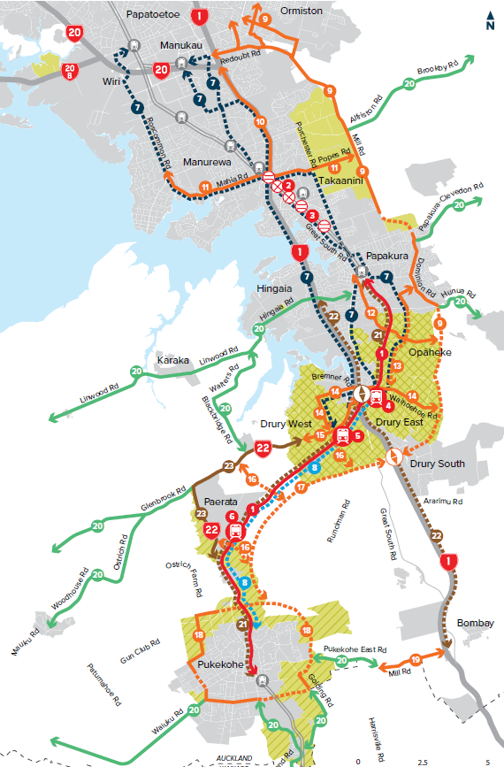
Strategic context
Auckland Transport Alignment Project 2018
Indicative Strategic Transport Network July 2019
SH1 Papakura to Bombay an early project in this 30-year plan.

Slide 3
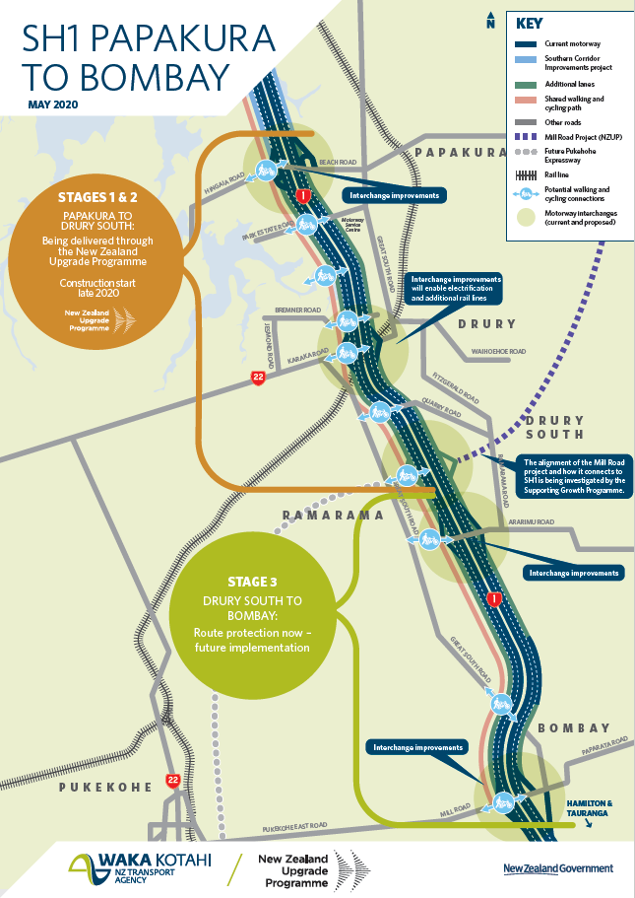
Project overview
Stage 1: Papakura to Drury includes:
An additional (third) lane in each direction
Interchange improvements
A shared walking and cycling path along the northbound side
Improved local road connections
Wide shoulders to future-proof for public transport services.
Stage 2: Drury to new Drury South interchange, similar features
Stage 3: Drury South to Bombay, route protection only
Delivery of Stages 1 & 2 through NZ Upgrade Programme (NZUP) announced 29 January 2020.

Slide 4
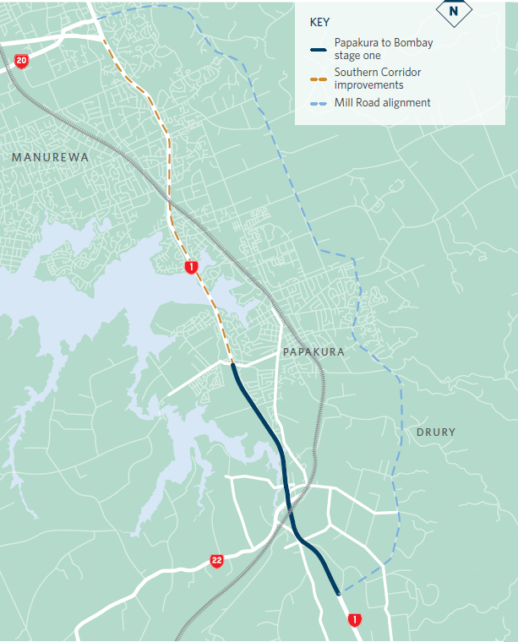
Wider context
Interface with other NZUP projects:
Papakura to Pukekohe electrification
Drury rail stations
Mill Road Project
Supporting Growth Programme
Drury local
Future Pukekohe expressway
SH22 safety improvements
Hamilton – Auckland passenger rail service
COVID-19 Recovery (Fast-track Consenting) Bill

Slide 5
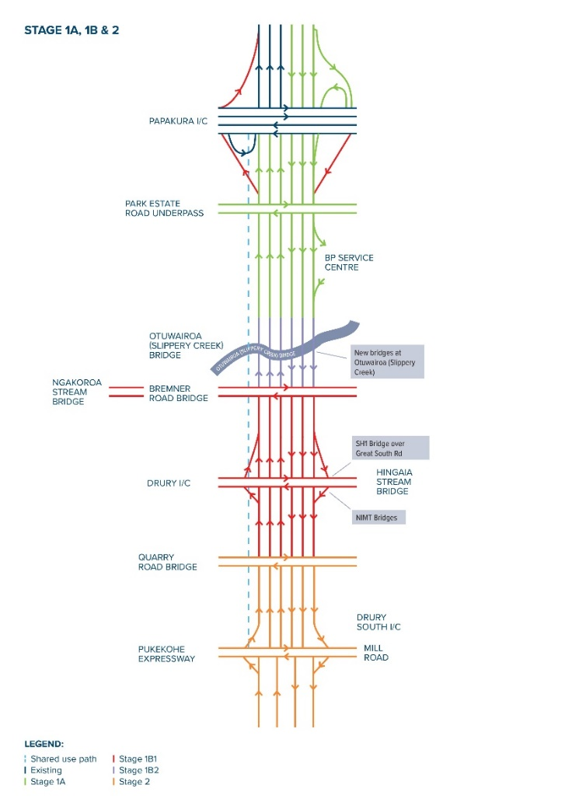
Planning stages
Stage 1A (green - Papakura to BP service centre works within existing designation)
consent lodged Dec 2019, granted Jun 2020
Stage 1B-1 (red - Drury interchange) lodgement late 2020
Stage 1B-2 (grey - Otūwairoa/Slippery Creek) lodgement TBC
Stage 2 (orange - Drury South) lodgement early 2021
Stage 3 (Drury South to Bombay) lodgement late 2021 – route protection only

Slide 6
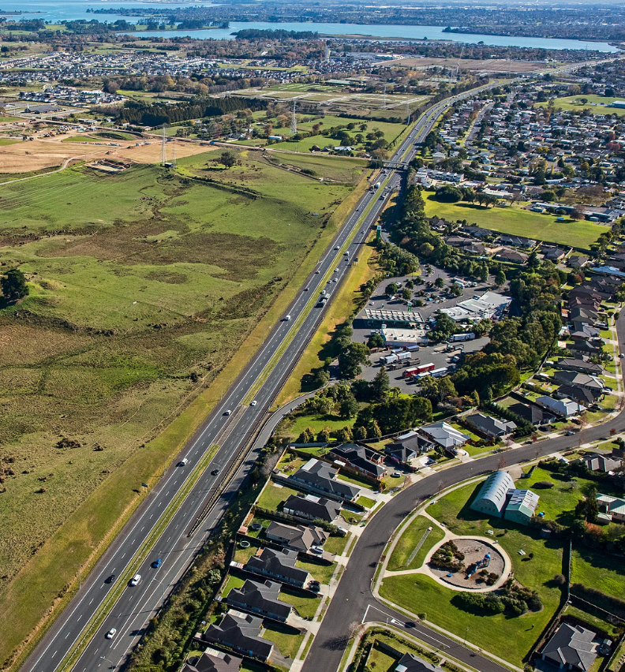
Programme update
Stage 1A – Advanced Notice closed on 3 June 2020
Tender process – Registrations of Interest to be released in July 2020
Stage 1A construction to be awarded to successful tenderer Q4 2020
Construction to start by end of 2020
Construction of Stages 1 & 2 complete by end 2025 *

Slide 7
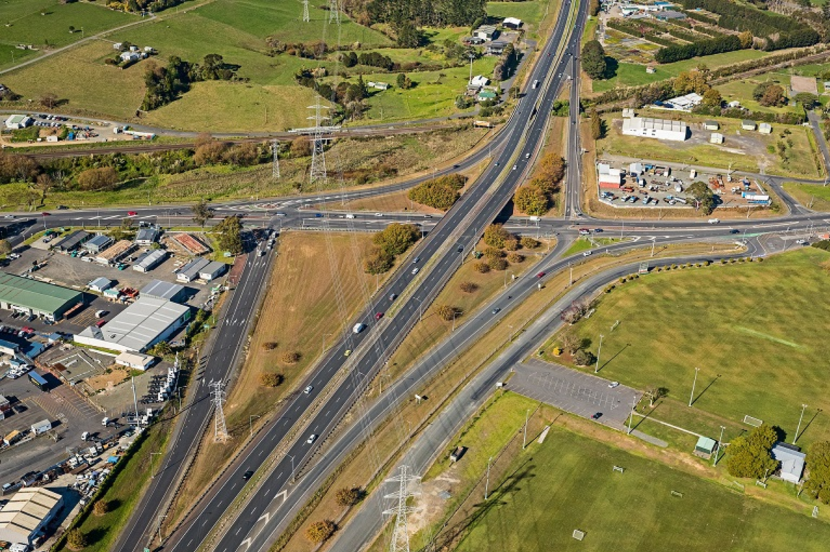
Design update
Drury interchange, three options being considered:
Eastern offline option
Western offline option
Online option
Interface with KiwiRail and numerous utilities
Ground investigations at interchange started early July
Detailed design underway to Drury South

Slide 8
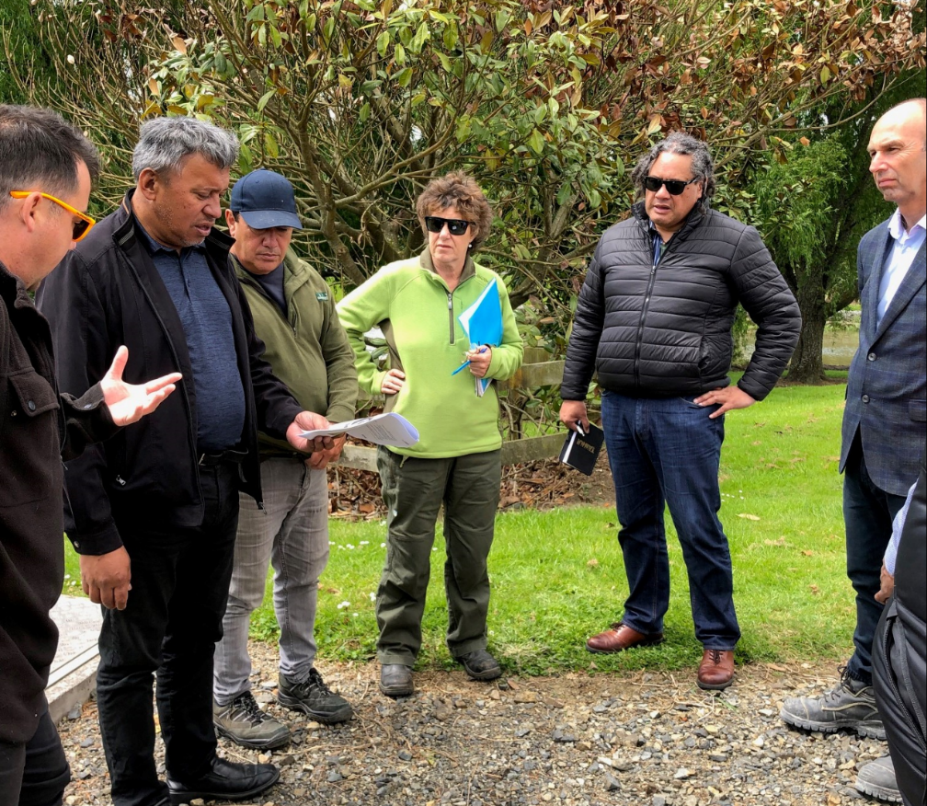
Engagement activities
Affected landowners engagement ongoing:
mid-late 2019
late Aug-Sept 2020
Public engagement ~Oct 2020
Project neighbours re condition surveys and noise walls (pre-construction)
Local boards/OTCB
Key stakeholders/utilities
Mana whenua engagement

Slide 9
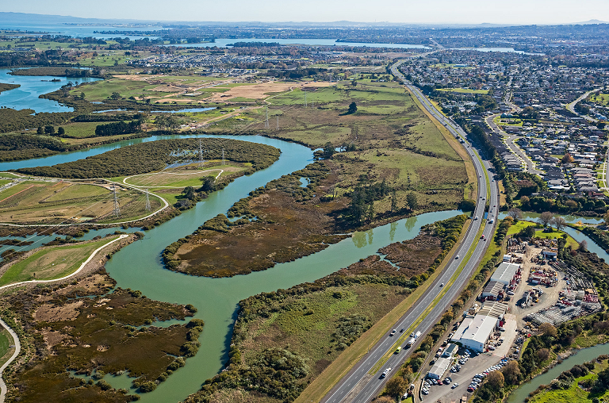
Questions?

Slide 10
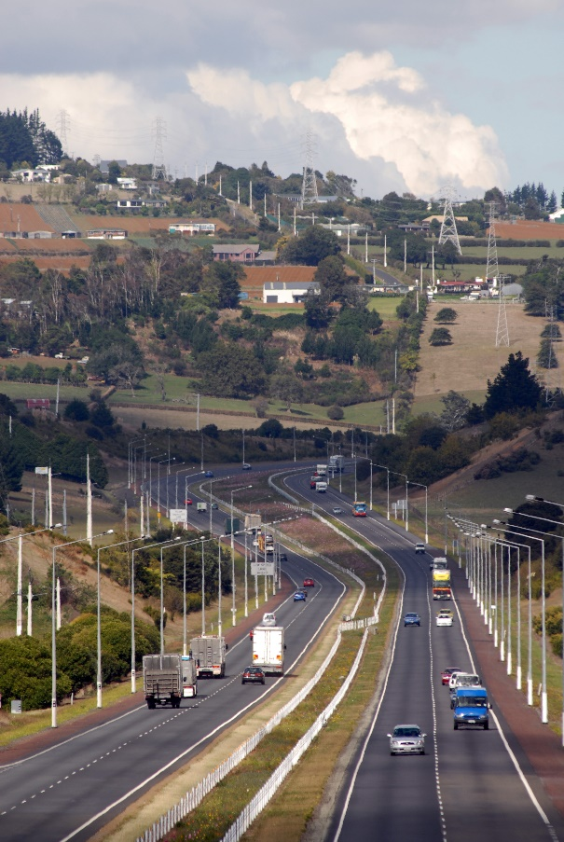
SH1 Papakura to Bombay project contacts
Email: p2b@nzta.govt.nz
Website: www.nzta.govt.nz/p2b
0800 741 722 (0800 SH1 P2B)

