Slide 1
Speed Limit bylaw hearing 3 Feb 2020
Waikato District Council
Submission regarding Rotokauri Rd, Laxon Rd, Duck Rd
Steve Griffiths

Slide 2
Rotokauri Rd, Duck Rd, Laxon Rd Speed Limits
Overall the community supports the proposed reduction of speed limit changes from 100 KM/hr.
Highlight today - Rotokauri Rd from the 70 KM zone west of the Rotokauri School through to Duck Rd intersection, through to Laxon Rd.
As part of the submission last year I canvased a most of the residence along Rotokauri, Laxon and Duck Roads (south)who have signed a Petition to Waikato District Council to lower the speed limit to 70 / 80 KM.
The overwhelming majority of petition suggest 70 KM/hr for very good reasons…..

Slide 3
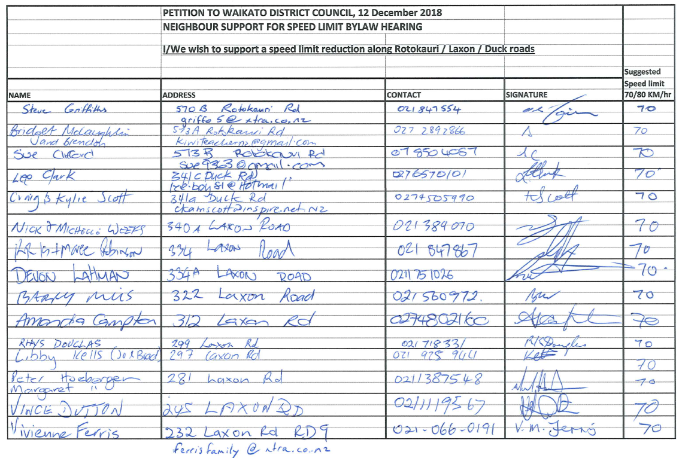

Slide 4
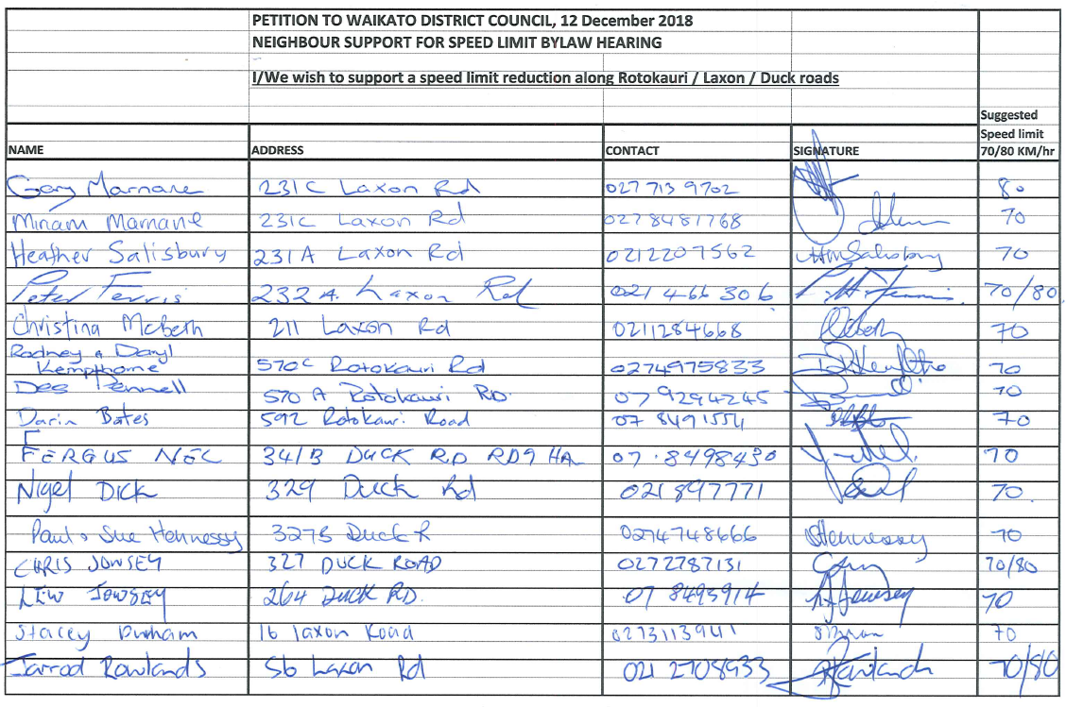

Slide 5
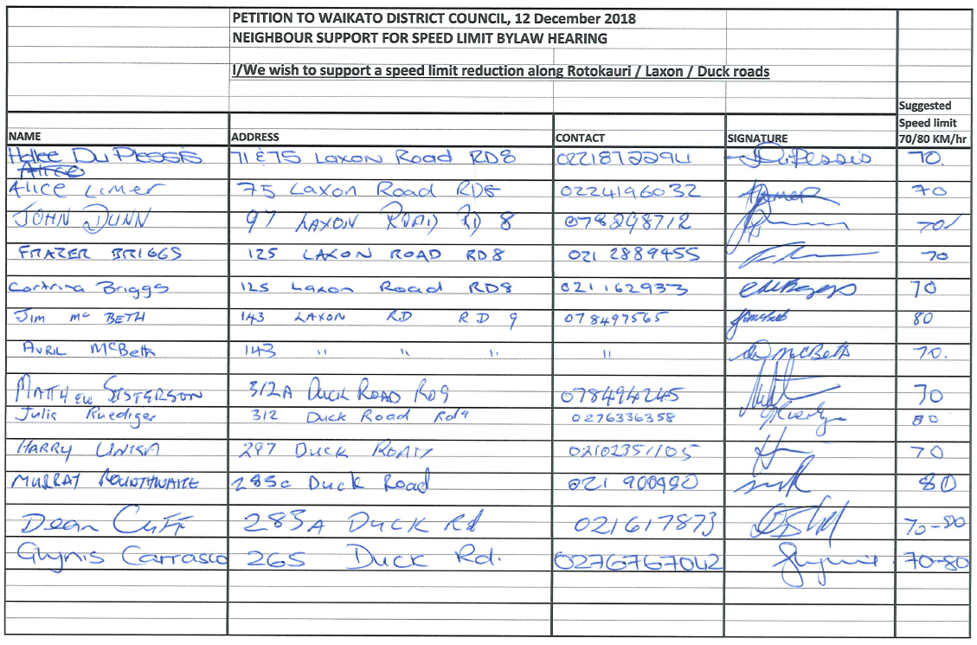

Slide 6
Community Feedback…..
It is impossible to drive safely above 80 KM on these roads, the majority of submissions suggest 70 KM/hr….why ?
High concern for residence with both the Duck Rd and SH 39 intersection
Locals have noticed more heavy vehicle - truck movements, not enough room. Road is not wide enough.
Locals have noticed more aggressive behaviour (tailgating) when turning into driveways.
Not enough space for foot traffic. A few close calls with teenage walkers waiting for bus.
Many incidents have not been reported with cars leaving the road and having to be pulled out of ditches and paddocks.

Slide 7
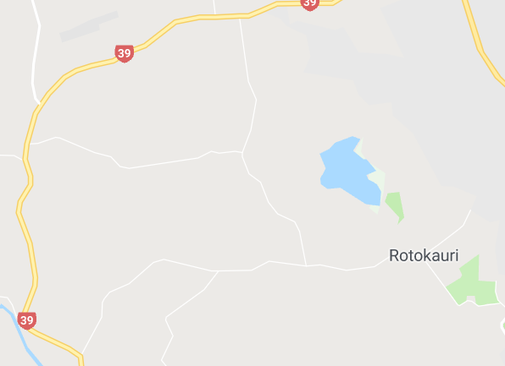

Slide 8
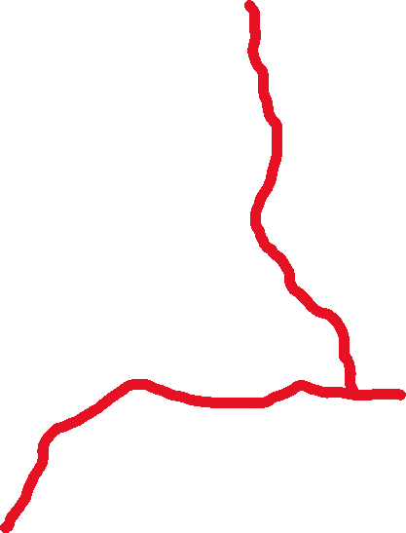
Duck Rd
Laxon Rd
Rotokauri Rd

Slide 9


Duck Rd Intersection
Laxon / 39 Intersection

Slide 10
Rotokauri Rd, Duck Rd, Laxon Rd Speed Limits
Rotokauri / Laxon / Duck Rds are becoming an alternative route from Raglan, Whatawhata and TeKowhai
Rotokauri / Laxon Rds are being used as a Truck Haulage route due to increased development
Laxon Rd is deteriorating, becoming uneven & developing pot holes etc with a number of complaints to council.
Rotokauri / Laxon / Duck roads is considered a residential / lifestyle rural road which is narrow with no shoulder / verge areas and is not even close to the standard of an alternative route.
There are four yellow recommended speed signs along Laxon due to tight corners i.e. 65 KM, 65 KM, 45 KM, 75 KM

Slide 11
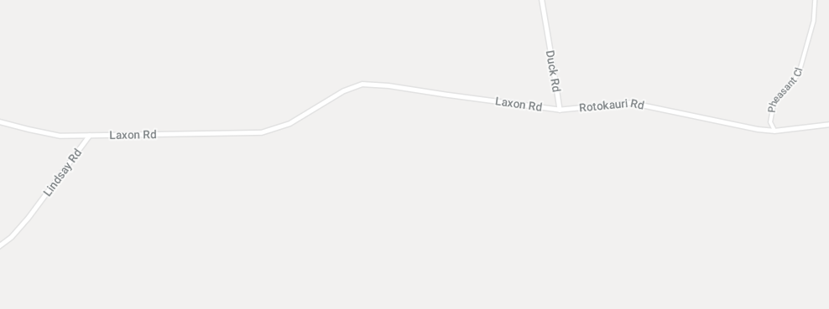


Slide 12
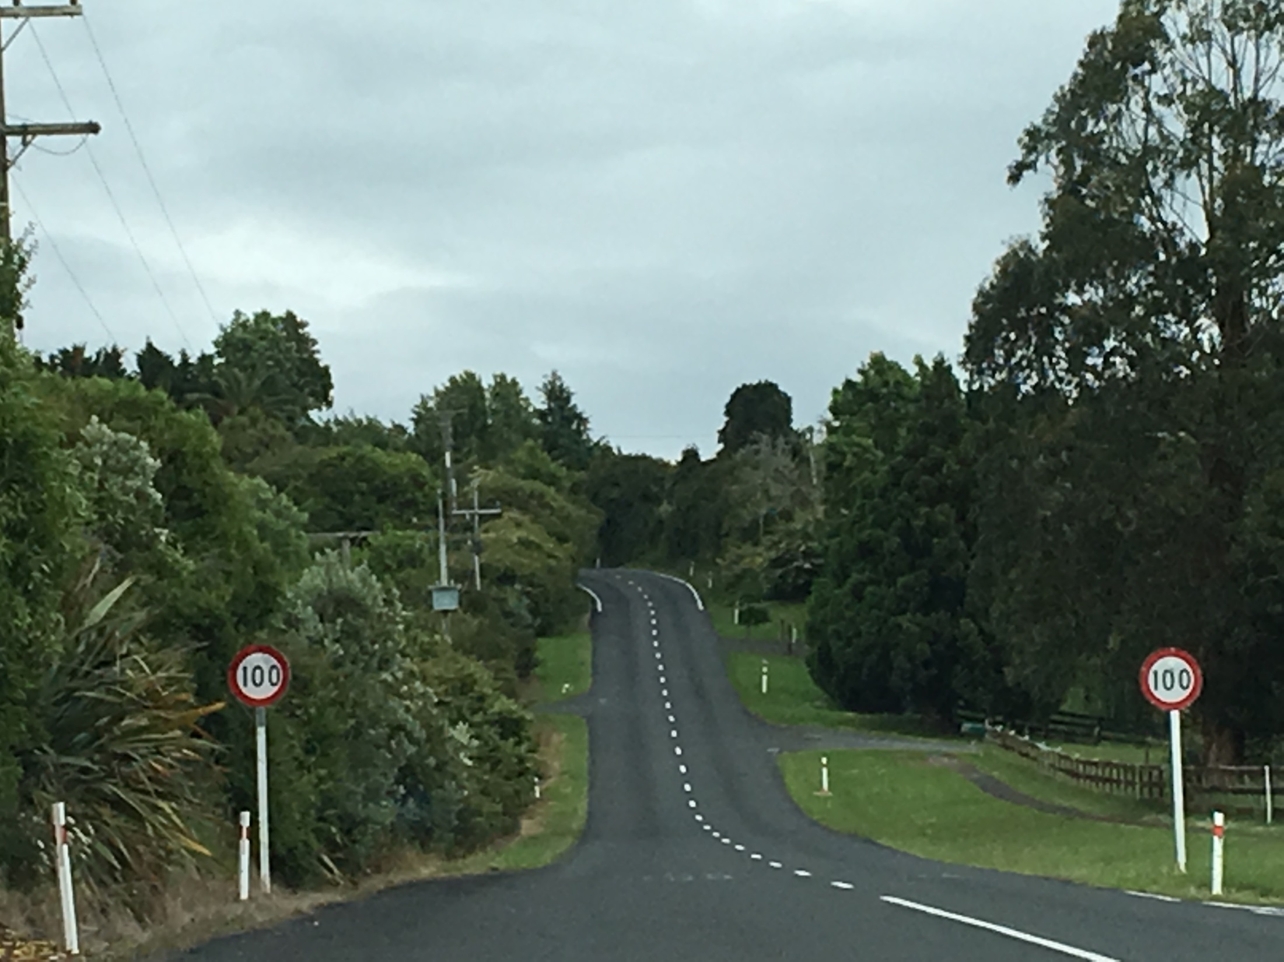

Slide 13
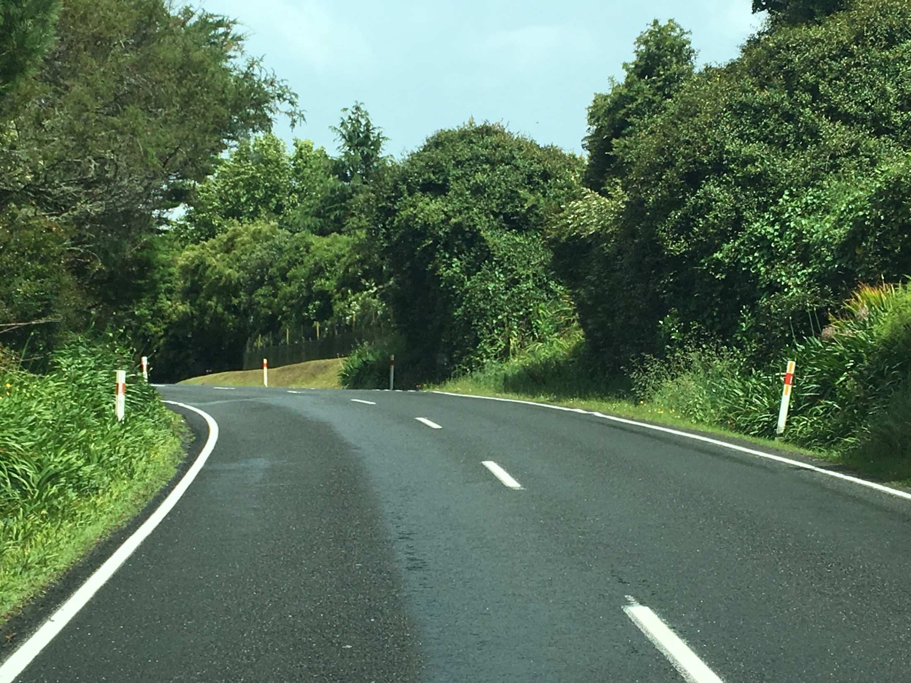

Slide 14
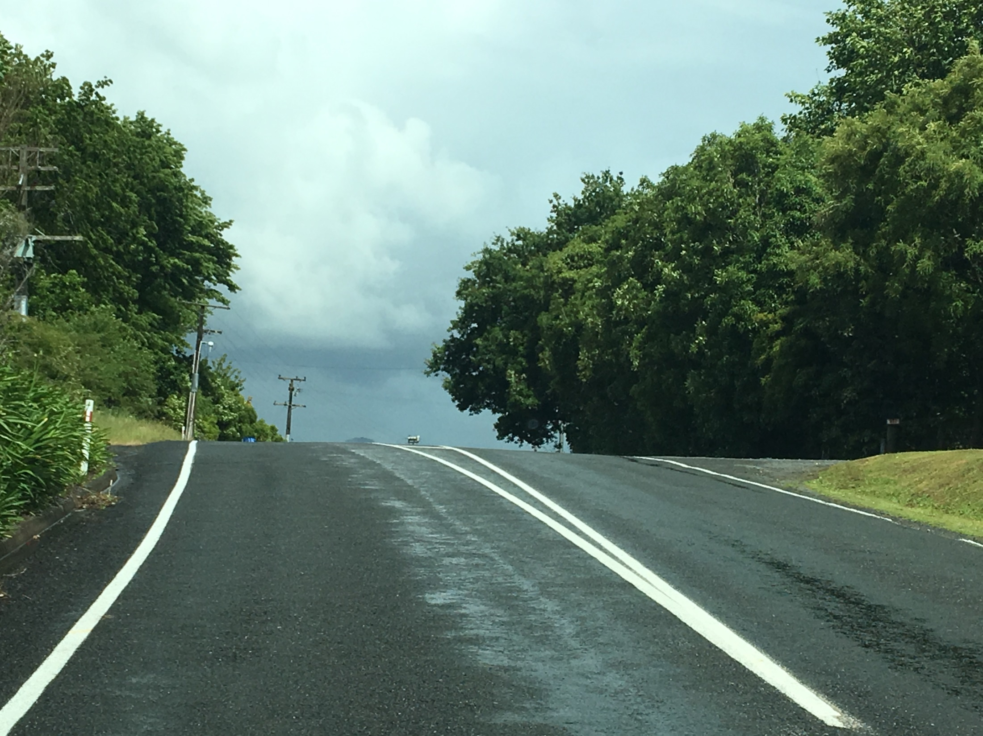

Slide 15
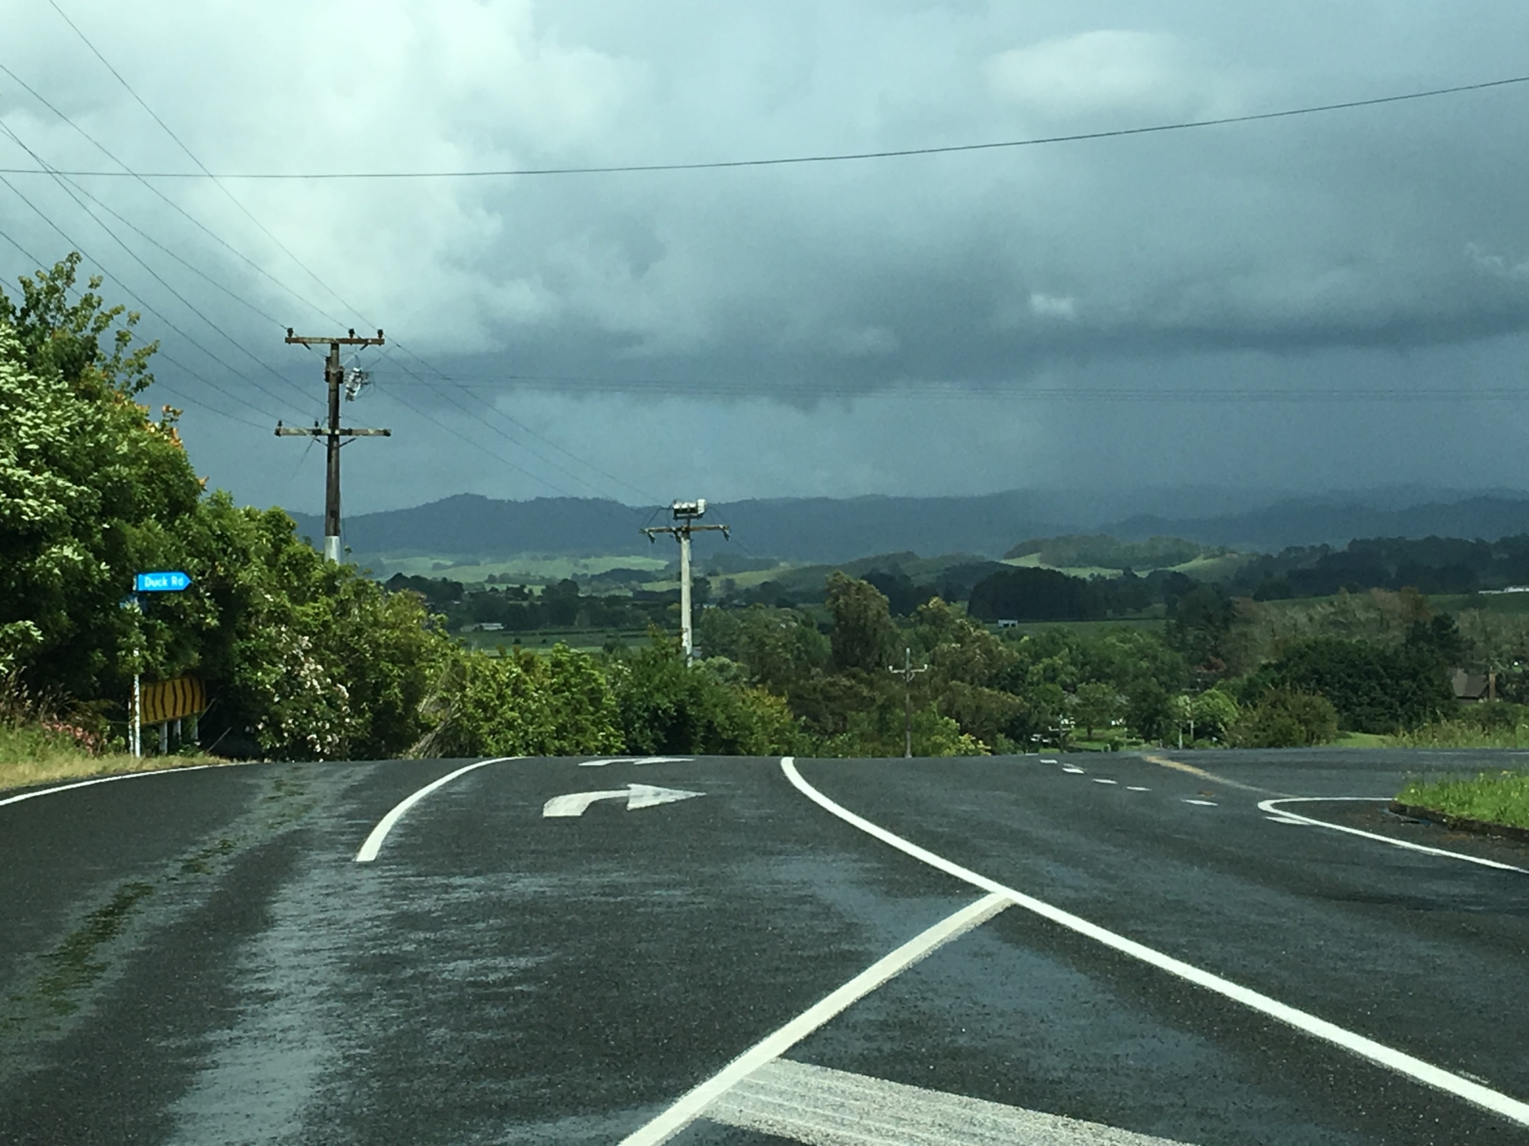

Slide 16
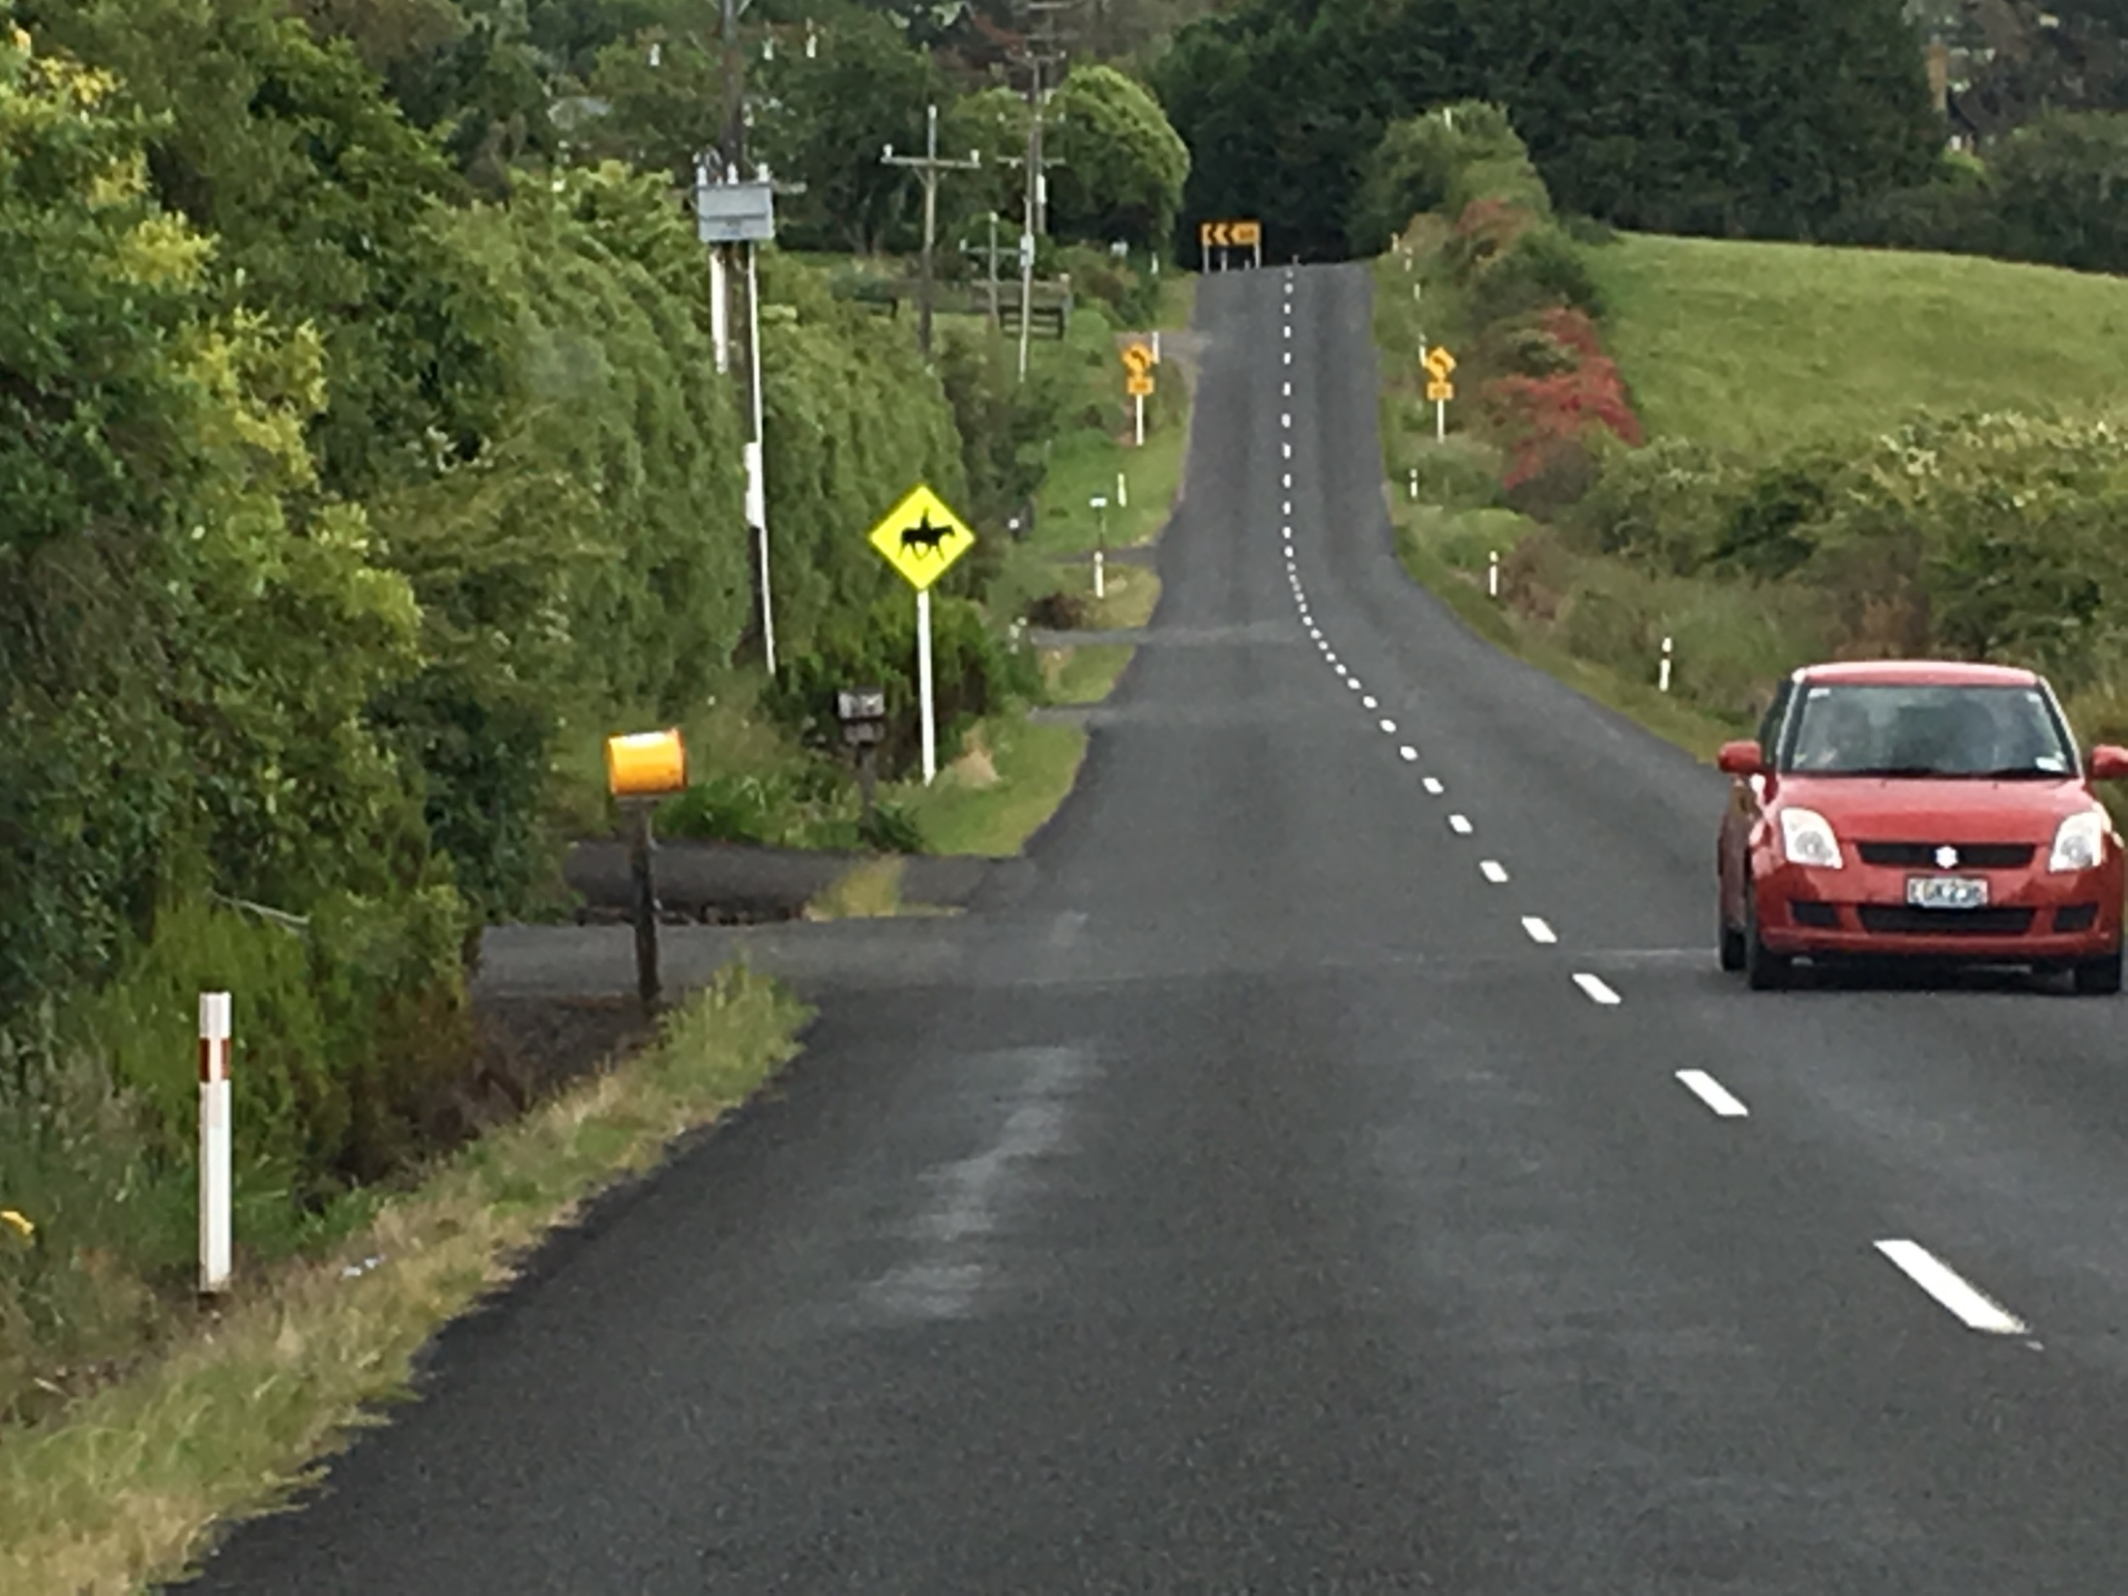

Slide 17
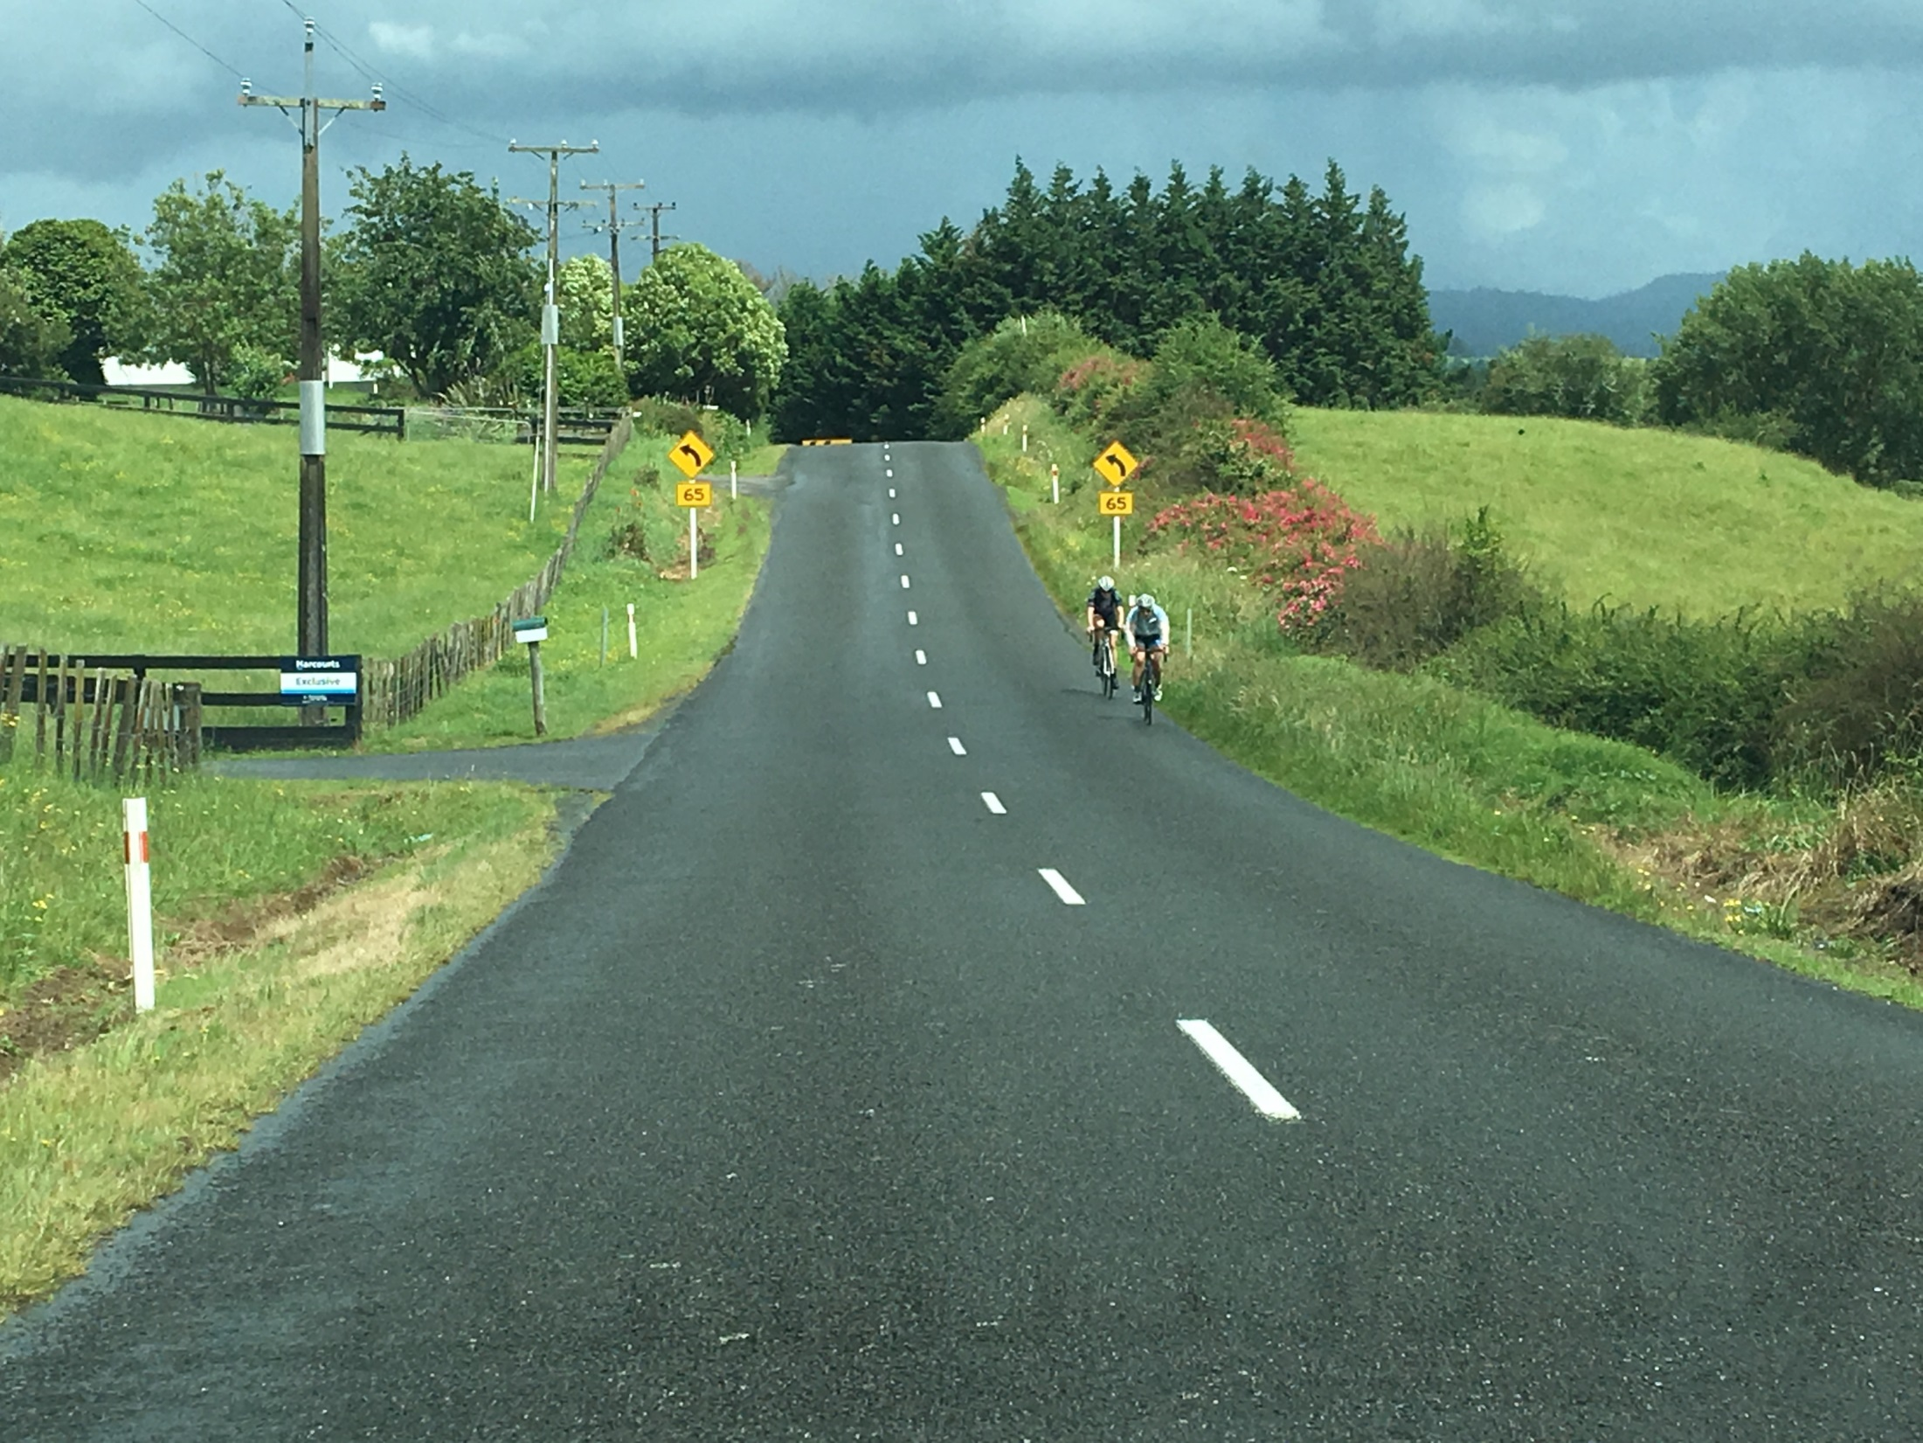

Slide 18
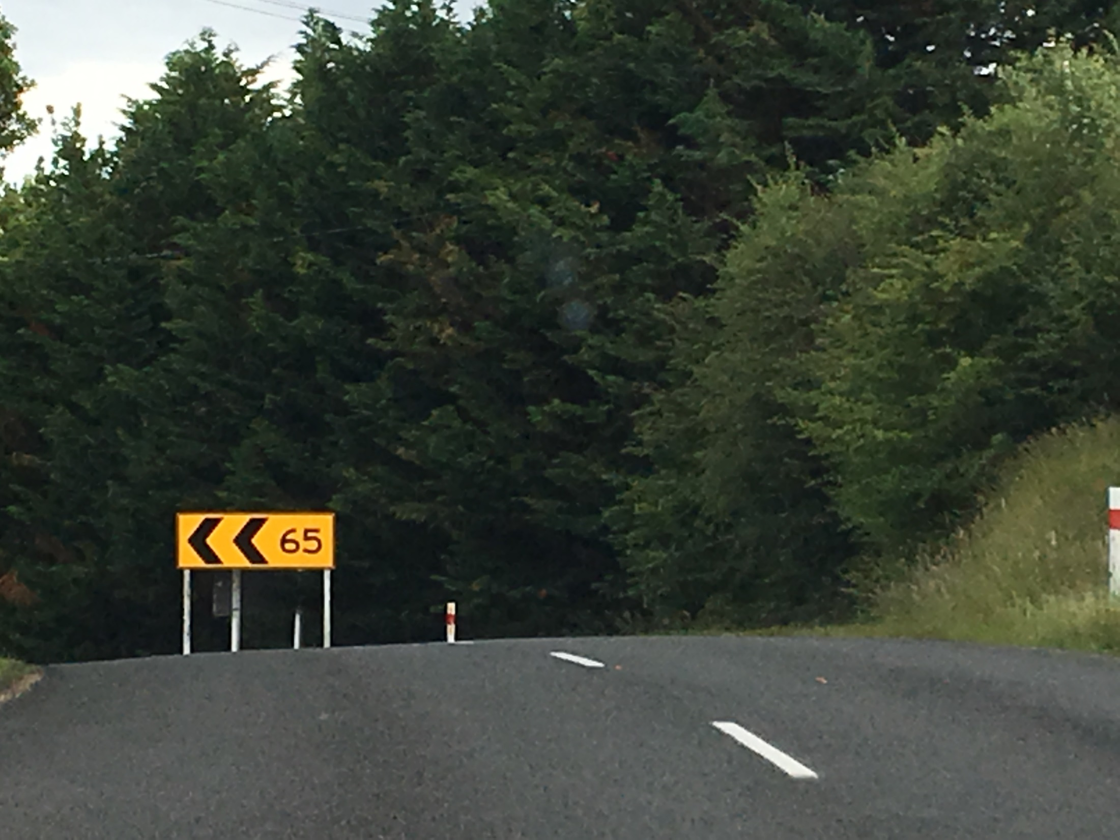

Slide 19
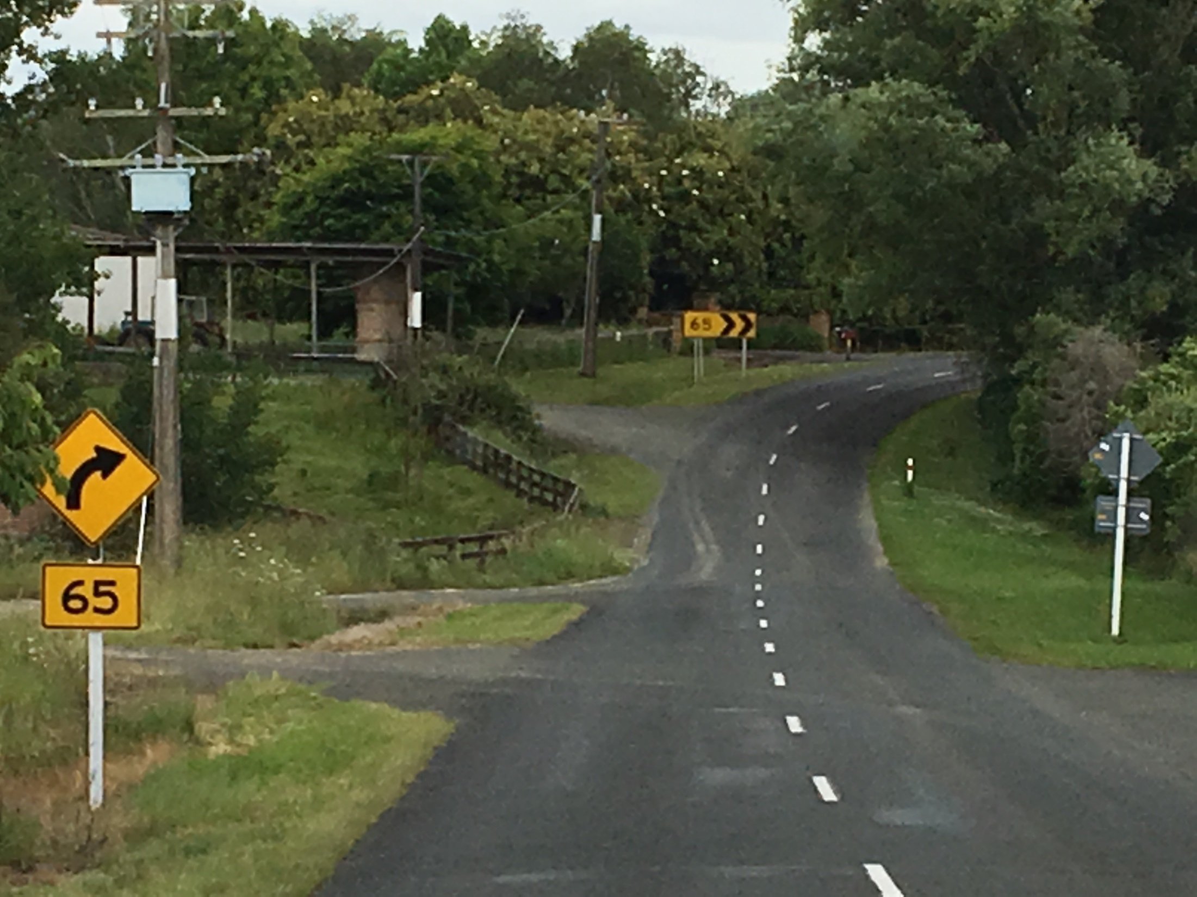

Slide 20
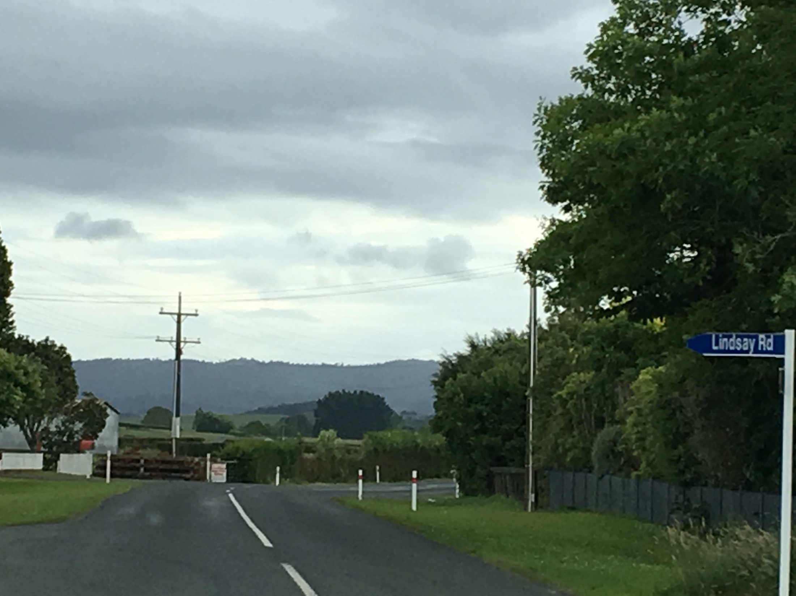

Slide 21
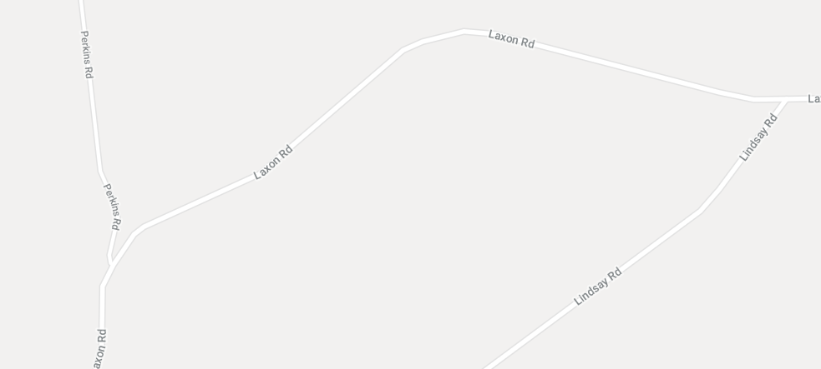
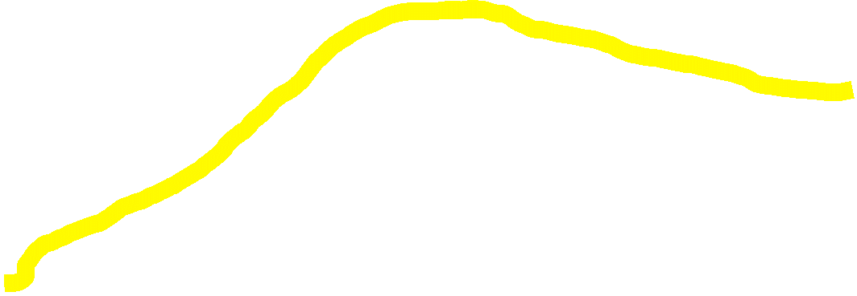

Slide 22
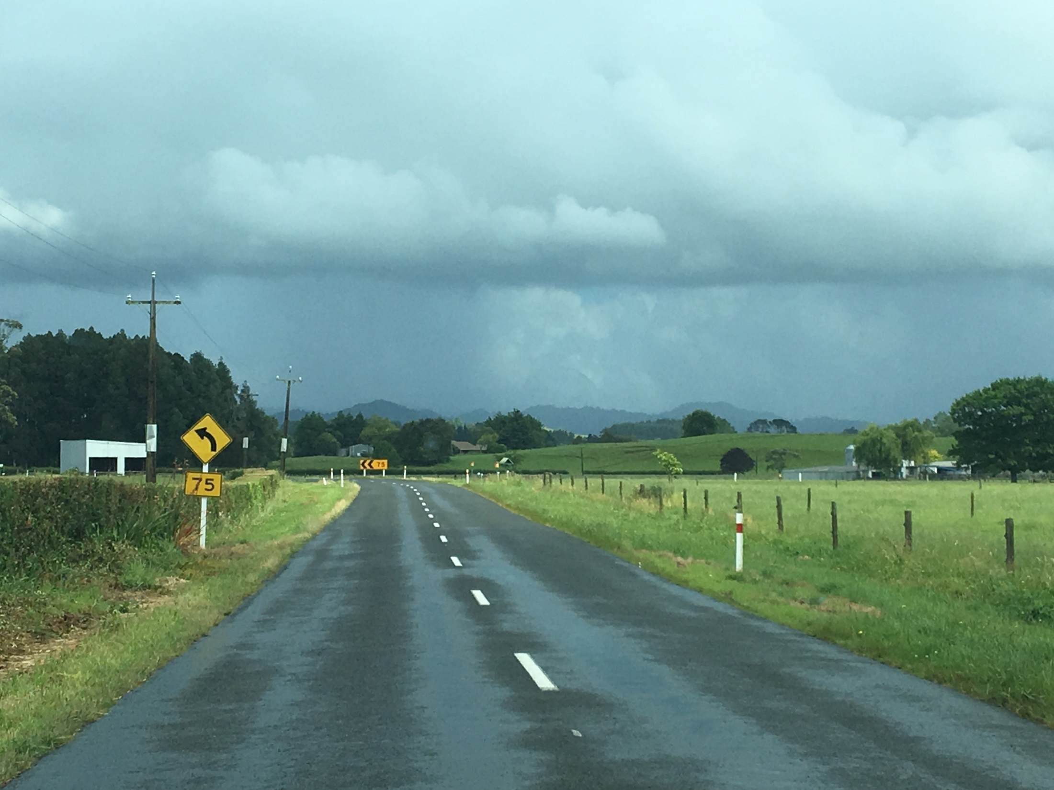

Slide 23
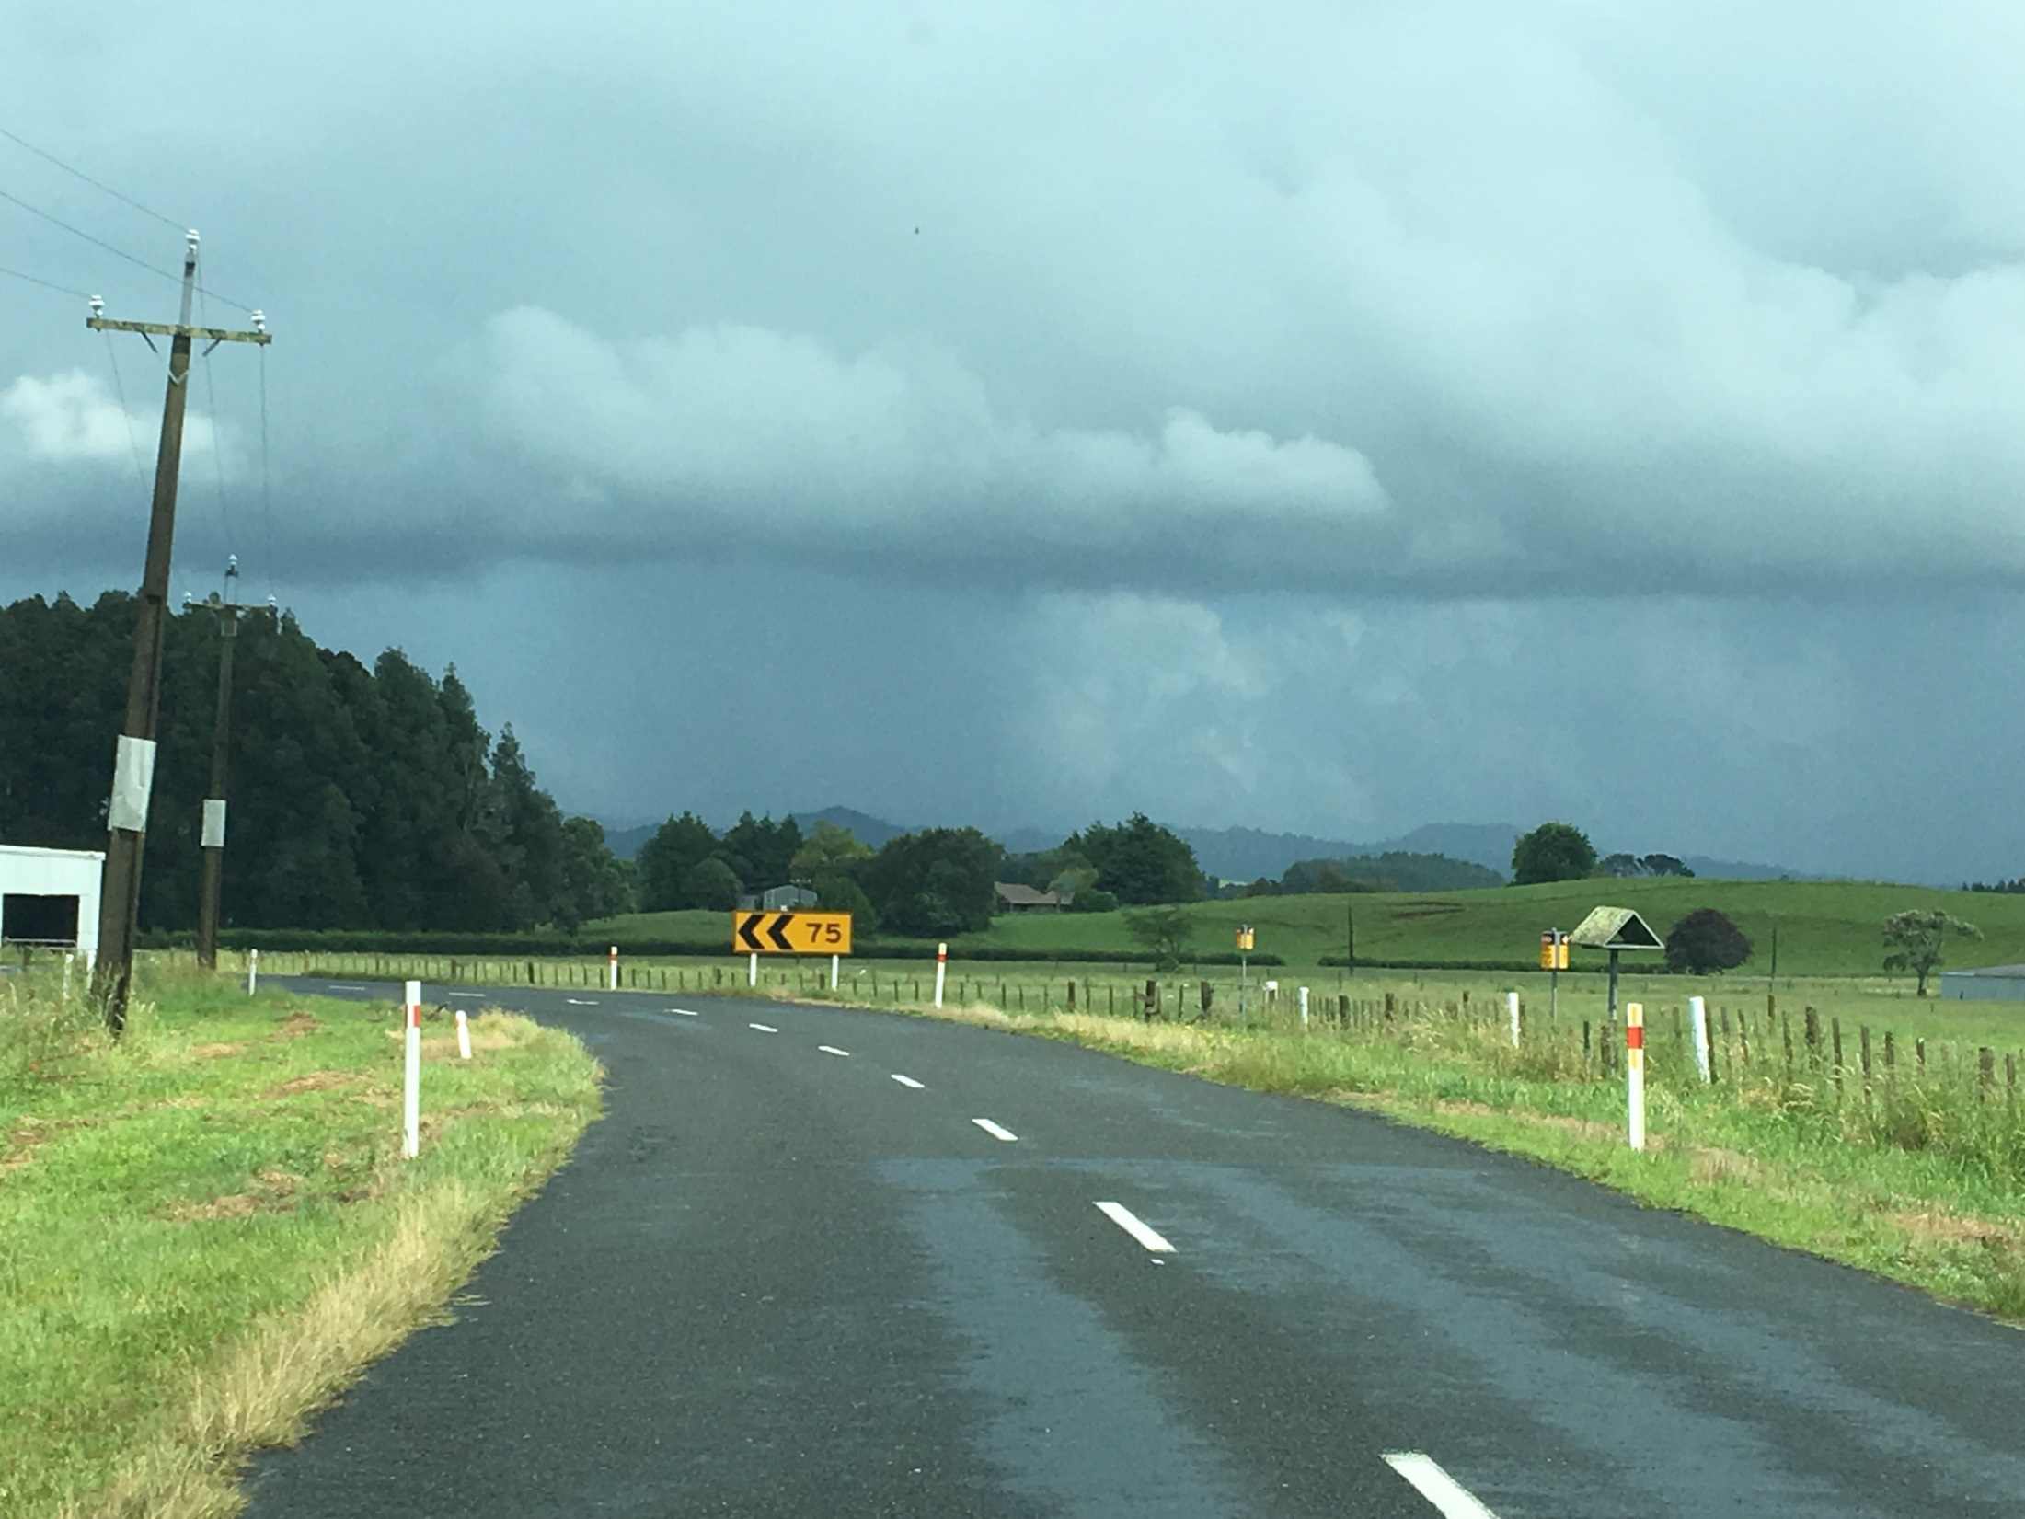

Slide 24
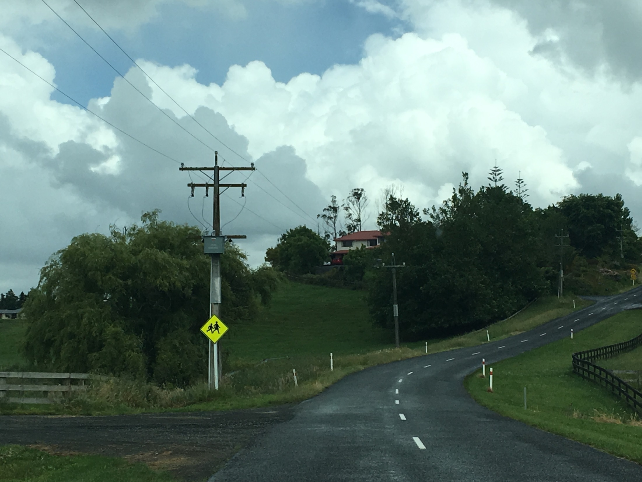

Slide 25
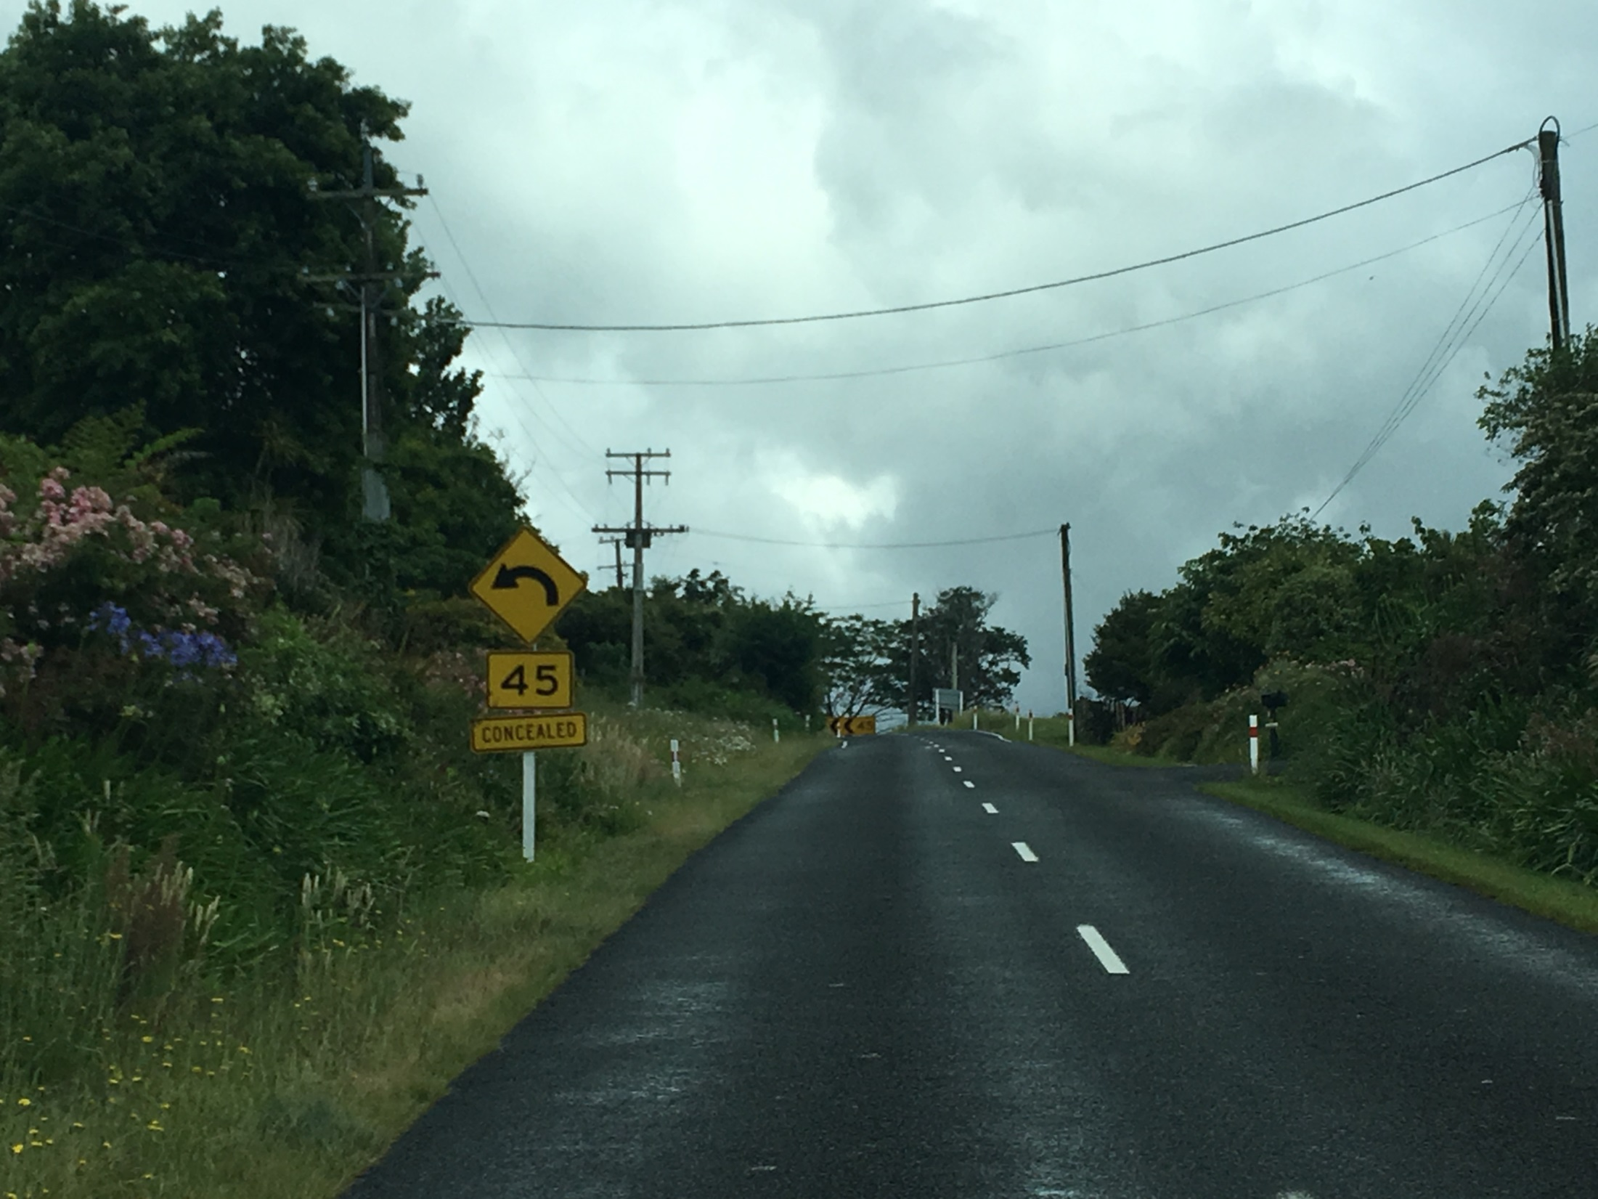

Slide 26
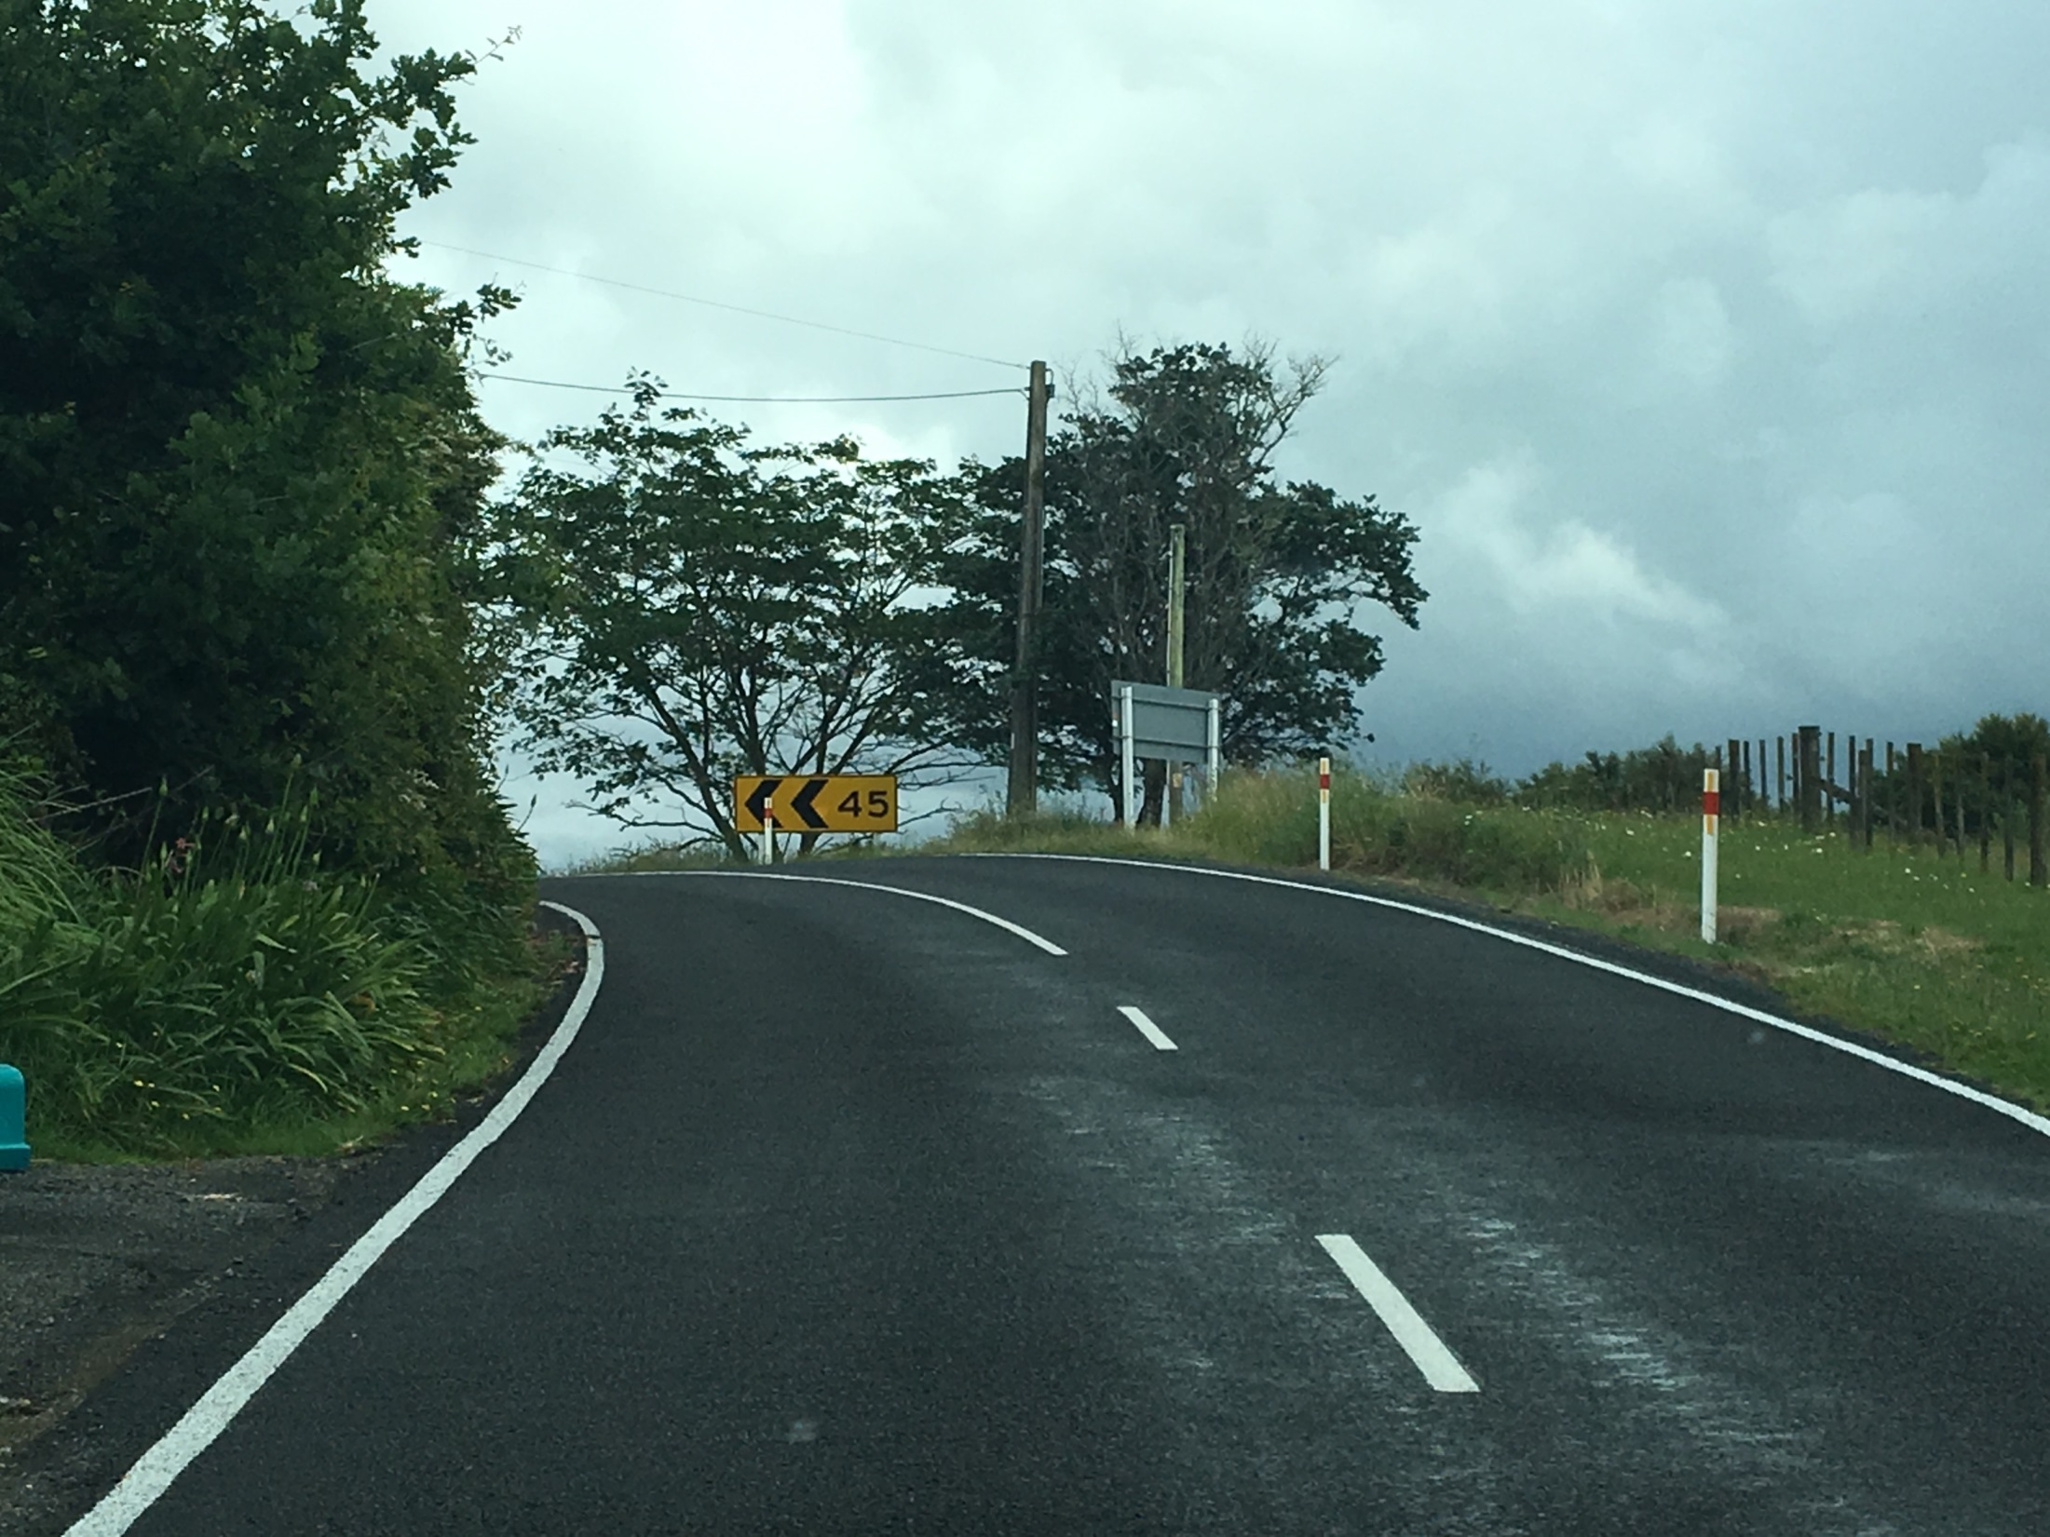

Slide 27
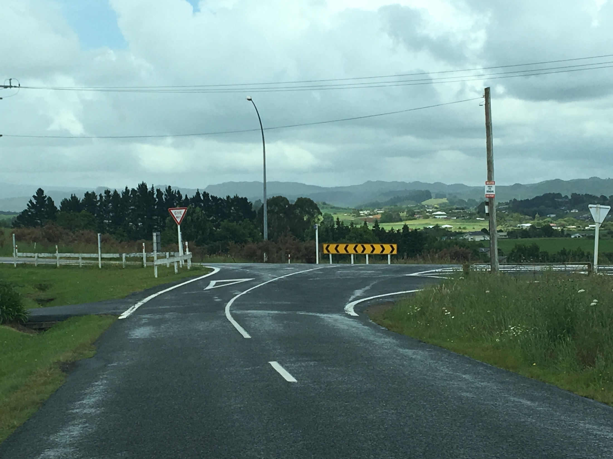

Slide 28
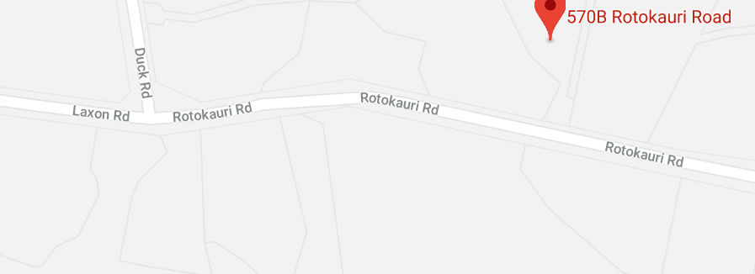



Slide 29
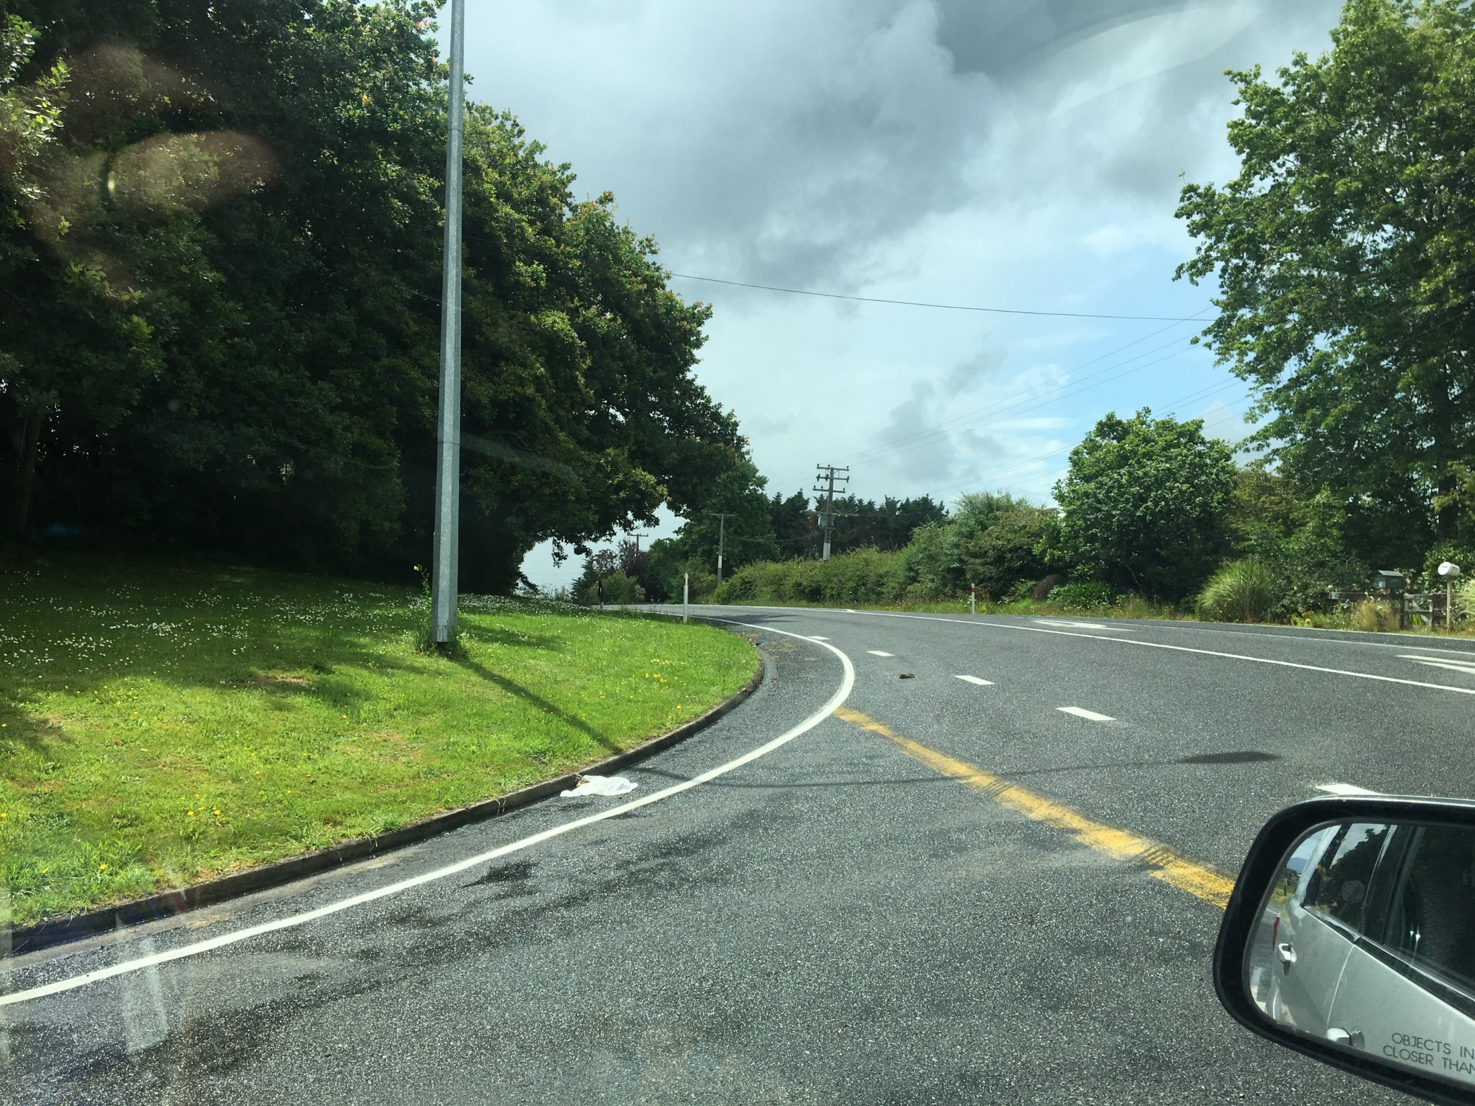

Slide 30
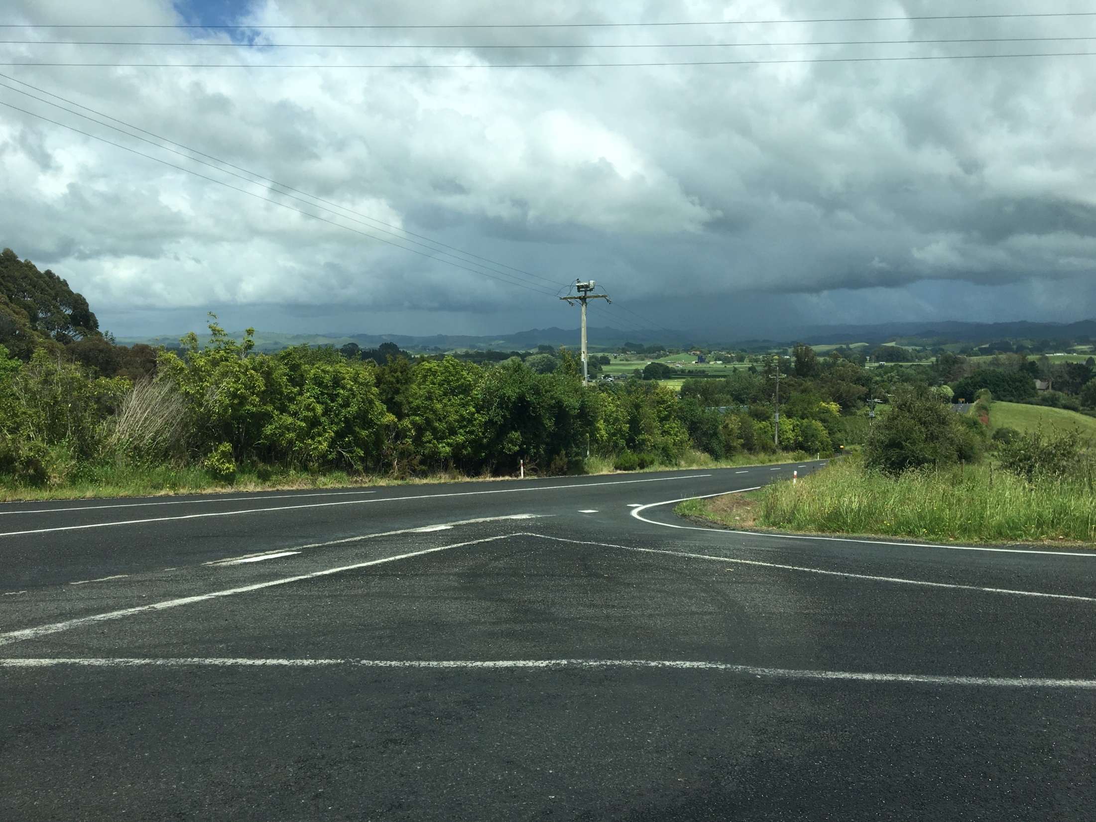

Slide 31
Recommendations………….
Extend the 70 KM/hr speed zone from Rotokauri Rd, past Duck Rd intersection, possibly past Lindsay Rd
Review the speed limit past Lindsay Rd to 70 / 80 KM bearing in mind the local community overwhelmingly prefer 70 KM speed limit (refer to Petition from local residence)
Extend the 70 KM/hr speed zone south end of Duck road past Dromara Rd.
Provide a RH turning lane from State Highway 39 to Laxon Road.
Consider extending a footpath from Rotokauri Rd to Duck Rd for foot traffic to the school and Lake reserve.

