Slide 1
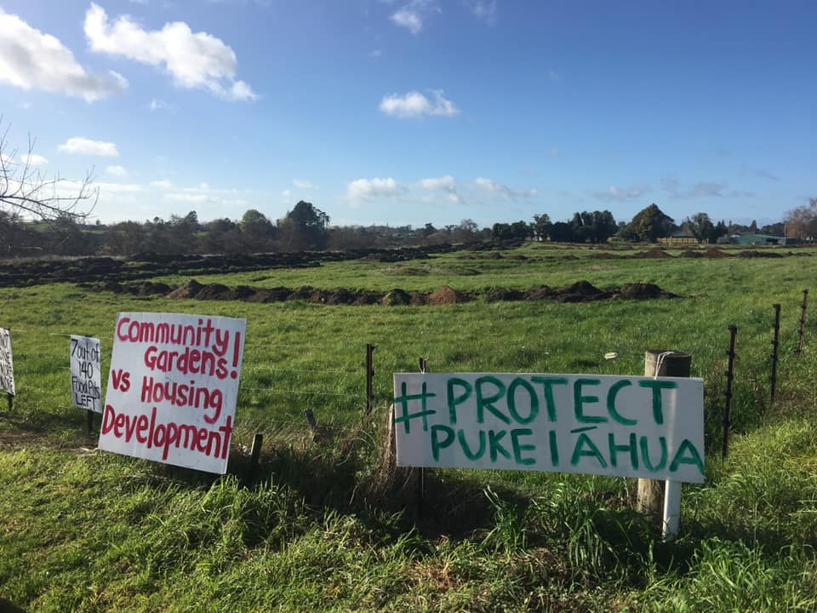
Review of all conditions of resource consent LUC0350/20
Ngāti Tamainupō Submission
WDC Hearing, Galileo St, Ngaruawahia – 29 Jan 2021

Slide 2
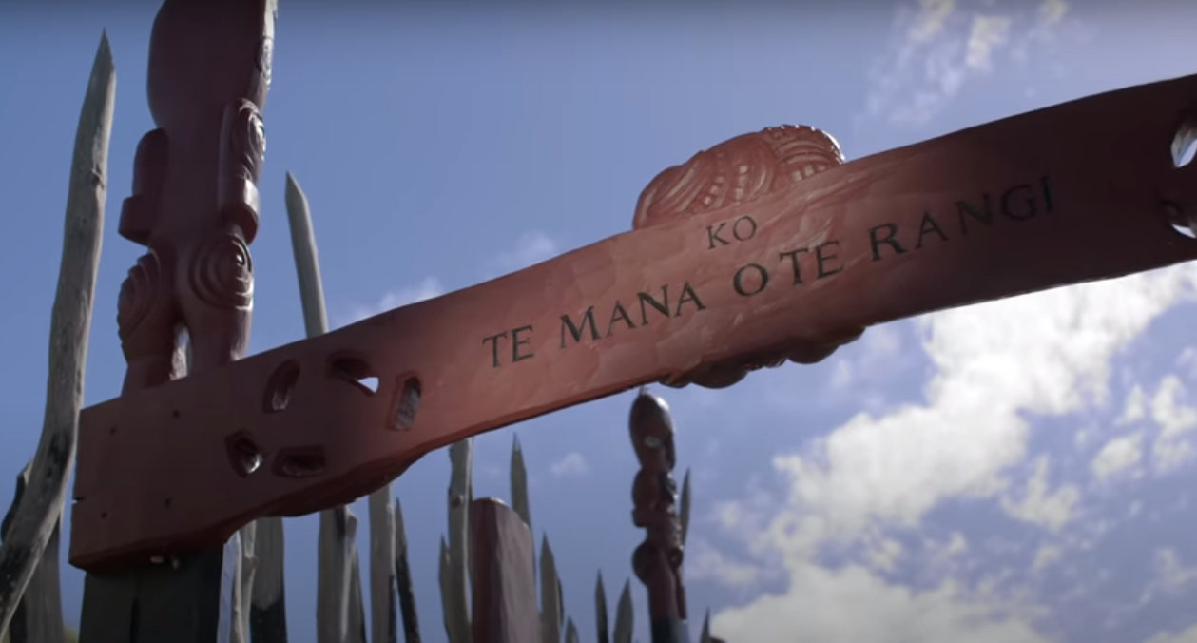
Ngā Uri O Tamainupō
Kōkako = Whaeatāpoko Māhanga = Paratai
Tamainupō = Tūkotuku
Wairere = Hinemoa
Whenu = Hinemotuhia
Keteiwi = Hinemata
Ngaere = Hekeiterangi
Te Mana O Te Rangi
We are 15th, 16th and 17th generation
Ngāti Tamainupō descendants

Slide 3
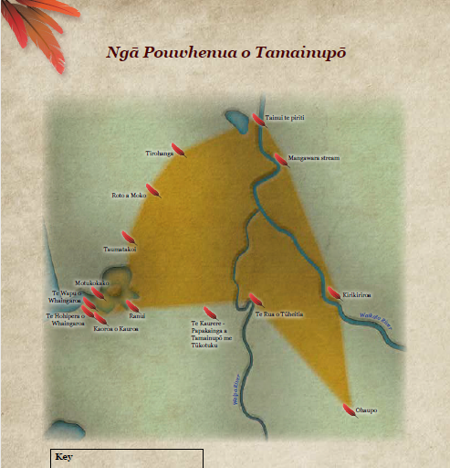
Pou Whenua o Tamainupō
HUNTLY
Whenua
Awa
Moana
Ngahere
Wāhi Tapu
Wāhi Tupuna
Pā
Māra kai (gardens)
NGĀRUAWĀHIA
HAMILTON
WHATAWHATA
RAGLAN
ŌHAUPO

Slide 4
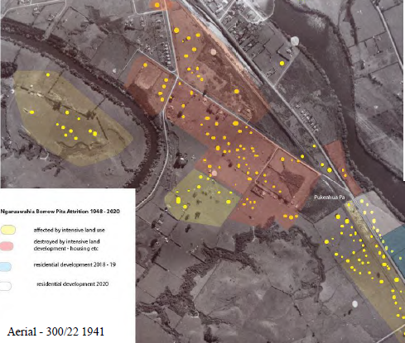
Wāhia Ngā Rua
Open the food pits
Pukeiāhua Pā – Outstanding cultural, archaeological and historical significance
Wāhi Tupuna / Wāhi Tapu
Campaign to save last seven rua of Pukeiāhua Pā
Significance increased due to rarity and proximity to Pā
Narrative carried by every resident and business in Ngāruawāhia

Slide 5
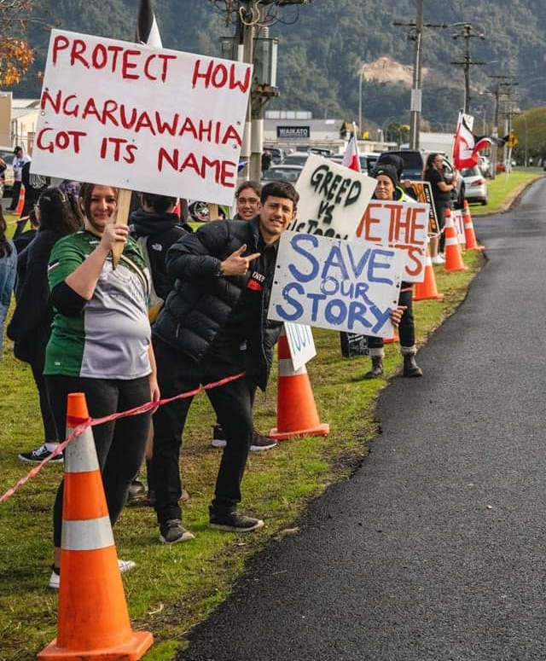
Hapū-led Campaign
268 days straight protest
Over 4,400 sign petition
200+ participate in Hīkoi
250+ school children visit during 2020
Heritage NZ application to upgrade Pukeiāhua listing to include gardens/rua
Community consultation
  75% oppose housing development near Pukeiāhua
  Alternative ideas include community gardens, educational and park/reserve.

Slide 6
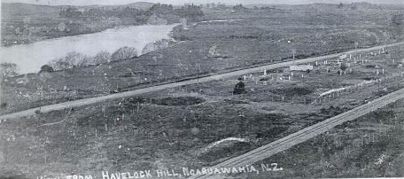
We OPPOSE the decision and all conditions for resource consent LUC0350/20 for bulk earthworks at 5851 Great South Road, Ngaruawahia.

Slide 7
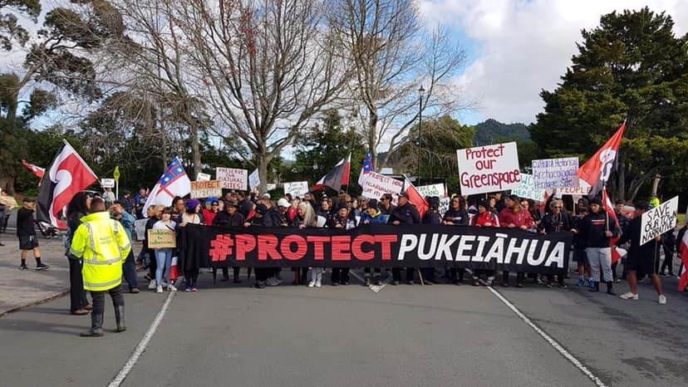
Wāhia Ngā Rua – Protect our unique landscape for future generations

