Slide 1
Marshall & Kristine Stead
Submitter No. 834 & 943
Hearing 17 – Te Kowhai Airpark Hearing Zone
“Highlights Package”
4 March 2021

Slide 2
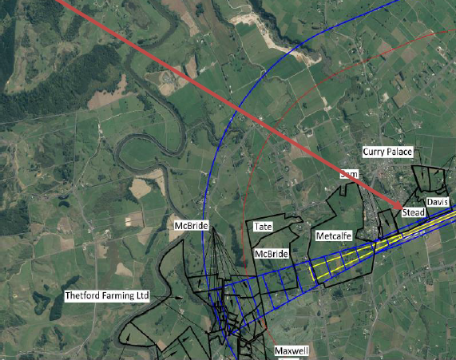
Stead Property
We have lived at 703b Te Kowhai Road, Te Kowhai 3288 for 6 years
We are pilots ourselves and have been members of Te Kowhai Airfield
Have been part of the community for 35 years and do not want to stop the airfield from operating
We are concerned about rules which have been introduced during the district plan change process which could place significant restrictions on how we can use our land in the future
We are unsure as to why the air strip at Te Kowhai Airfield cannot be moved south so that the adverse effects from the Airfield can be avoided

Slide 3
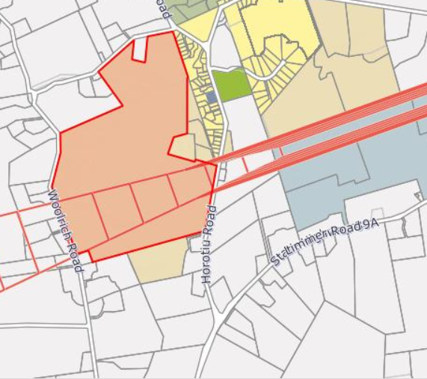
Section 42 A Report & Obstacle Limitation Surface
We support many of the recommendations in the s 42A report, especially the recommendation to revert to the OLS in the Waikato Operative District Plan
We are content with the existing OLS as it allows flight to happen using Visual Flight Rules (VFR)
Pilots only need to travel 5 minutes into Hamilton Airport if they want to switch to use a flight plan which uses Instrument Flight Rules (IFR)
There are other small airfields which operate without IFR (they use VFR) and have houses nearby such as at Pauanui where houses are about 45m from the centre of the VFR runway.

Slide 4
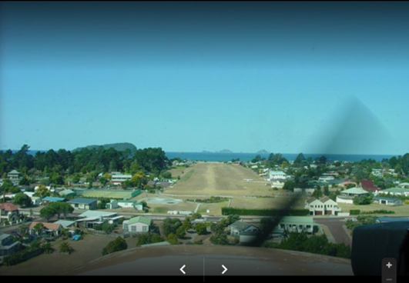
Section 42 A Report & Obstacle Limitation Surface
Photo of Pauanui Airfield showing housing either side of runway

Slide 5
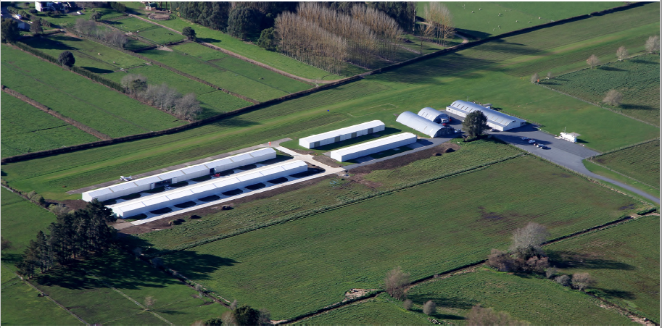
Proposed OLS
There are existing hangars on the NZTE land which appear to be within the proposed OLS. Do these hangars need to be moved to get IFR certification?
If these hangars cannot be moved (we understand there are 30-year leases over them), is NZTE certain that IFR certification can be obtained for them?
If not, why do they want the proposed OLS?

Slide 6
Proposed OLS
We think it is important that the Panel realises that most airfields in New Zealand operate under VFR and the ones that operate under IFR are commercial airports and heliports. We have an up-to-date list of Aerodromes and Heliports in New Zealand which shows that most operate under VFR.
We are happy to provide this to the Panel if they wish to inspect this.

Slide 7
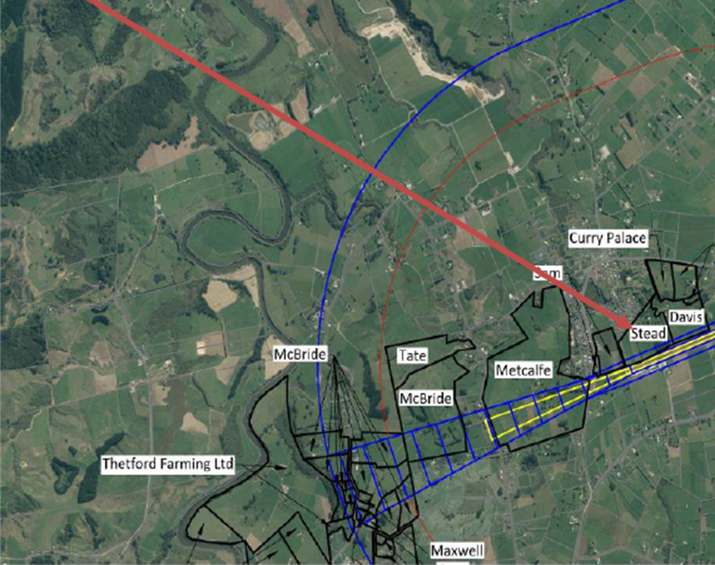
Proposed OLS
We are worried about the uncertainty around the trees on our property. Because of the closeness to the boundary, many of our trees (which are up to 35m high) and an existing fence will protrude through the proposed OLS. When would these trees have to be pruned and who would bear the cost for this?

Slide 8
Airfield Operations
We support the recommendation in the section 42A report to limit annual aircraft movements to 15,000
We support the recommendation in the s 42A report to restrict flying between 0700 hours to 2200 hours
In our opinion, there is still a need to engage with NZTE around how the ongoing adverse effects of the Airfield will be managed in future

Slide 9
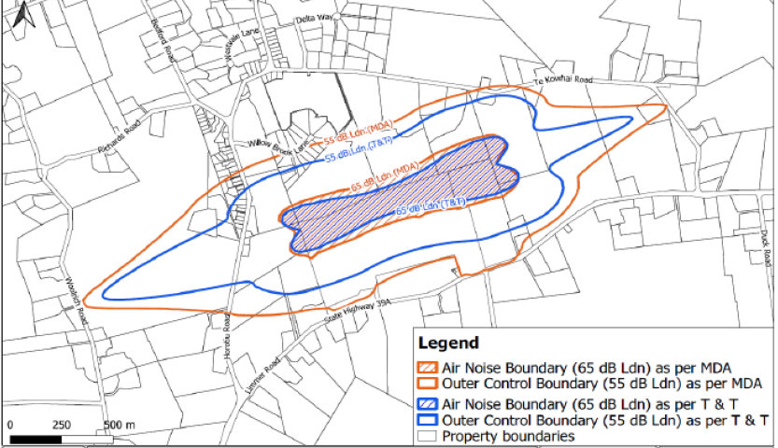
Airport Air Noise Boundary
We are concerned about the (inner) Air Noise Boundary recommended in the Marshall Day Report and the Tonkin & Taylor Report
The current Airport Noise Outer Control Boundary (as present in the ODP and notified in the PDP) only affects our property to a very minor extent
We accept that acoustic insulation will be needed in houses within the Airport Noise Outer Control Boundary as notified in the PDP

Slide 10
Airport Air Noise Boundary
The T & T ANB covers about a 1/3 of our property
If the Panel believes that Air Noise Control Boundaries(ANCBs - as present in the s 42A report) are appropriate in some form, then we prefer the ANCBs in the T & T Report which reflect the 15,000 aircraft movement per annum limit

Slide 11
Rule 24.1.3
Strongly oppose any rule that makes noise sensitive activities non-complying within the ANB
A non-complying activity should only apply if there is no acoustic insulation
It is not fair to restrict development when there will be no real change to the way the Airfield operates now (assuming the Panel accepts that the Airfield will continue to operate under VFR rather than IFR)
Consent notices on new lots can signal the need for acoustic insulation

Slide 12
Circuit Training & Flight Training School
We support the submission point of Mr Greig Metcalfe that Circuit Training and Flight Training Schools are provided for as non-complying activities
These activities are inappropriate near an increasingly residential community
Support the s 42A recommendation that flight training schools and circuit training be provided for as non-complying activities

Slide 13
Conclusion
Support the continued operation of the Airfield. We want the Airfield and the community to coexist
Need appropriate controls in the PDP to manage adverse effects of the airfield
  Retain the operative OLS – continue to operate under VFR as there is no need or justification for IFR
Allow noise sensitive activities within the ANB to be permitted if acceptable acoustic insulation in achieved – prefer Boundary as notified in PDP

