Slide 1
Jason Strangwick on behalf of Lloyd Davis
Submitter No. 943
Hearing 17 – Te Kowhai Airpark Hearing Zone
“Highlights Package”
4 March 2021

Slide 2
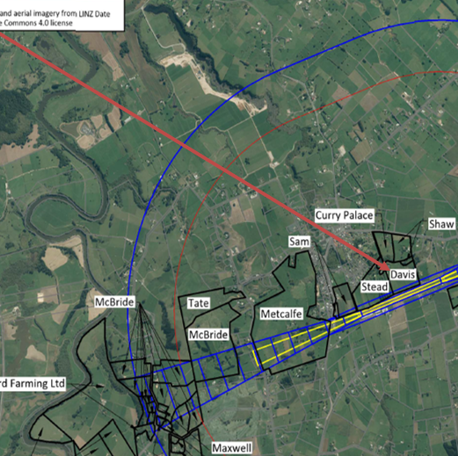
Davis Property
Lloyd resides at 703a Te Kowhai Road, Te Kowhai and has owned the property for approximately 25 years.
Lloyd received advice from Council in July 2018 that his property would be zoned “Village” under the Proposed District Plan
During the district plan change process, it has become apparent that various parties have proposed implementation of rules in the Te Kowhai Airpark Zone which will severely affect how Lloyd can develop his land. This has potential negative financial consequences for Lloyd and the financial future of his family

Slide 3
Davis Property
The rules that NZTE are proposing will prevent development on approximately a quarter of the Davis property.
Lloyd is willing for Te Kowhai Airfield to perform any activities within its own boundary provided it does not adversely impact himself, his family or his property
Lloyd does not understand why NZTE could not move the airstrip south to avoid adverse impacts on his land

Slide 4
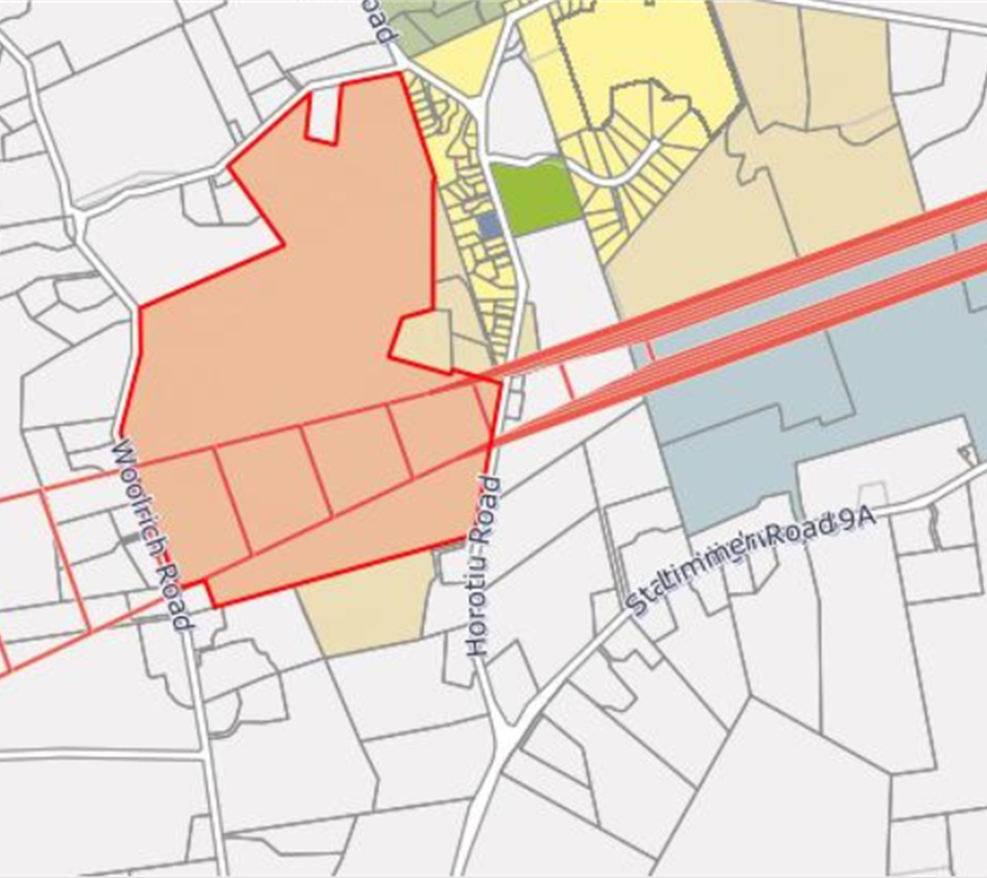
Section 42A Report
Lloyd supports the recommendation in the s 42A report to retain the Obstacle Limitation Surface in the Waikato Operative District Plan (ODP).
This is a community airstrip and NZTE needs to consider the impacts on the neighbors in the community. Retaining the current OLS will allow for existing activity at the airfield to continue, which Lloyd supports

Slide 5
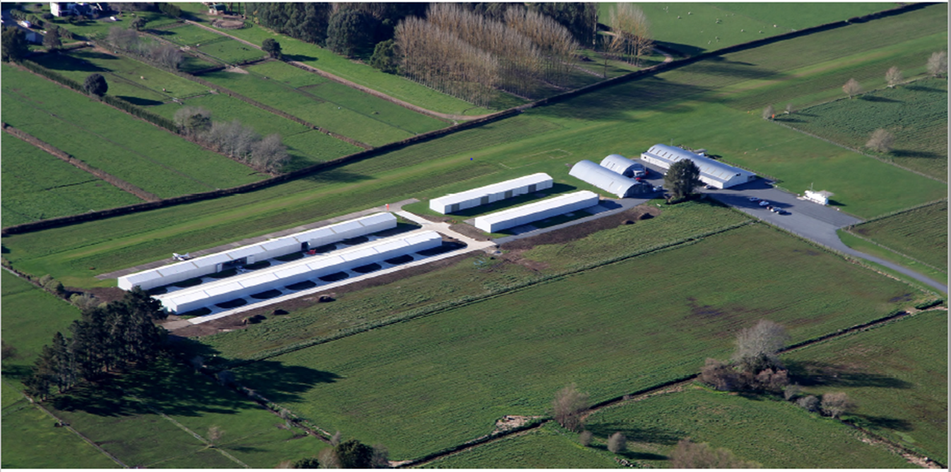
Proposed OLS
There are a number of uncertainties around the proposed OLS, including who ensures compliance.
Lloyd and other concerned landowners have had very little feedback from NZTE as to how they might avoid adverse effects on surrounding land. There has been no discussion about the compensation for dealing with loss of development on his land if the proposed OLS is implemented.

Slide 6
Airpark Operations
Lloyd supports the recommendation in the section 42A report to put a cap on the number of annual aircraft movements (15,000)
Lloyd supports the recommendation to restrict flying to between 0700 hours to 2200 hours
Lloyd has been disappointed in the level of engagement that NZTE has had with landowners that will be affected by the increased activities at the Airfield. Lloyd believes that there would be benefit in formulating a management plan to manage the ongoing adverse effects of the Airfield

Slide 7
Circuit Training & Flight Training School
Lloyd supports that Flight Training Schools and Circuit Training should be provided for as Non-Complying activities
These activities would significantly decrease amenity values for those in the vicinity of the airfield – it is inappropriate for commercial air training to occur at the Airfield – it could more appropriately happen at Hamilton Airport
Lloyd supports the recommendation in the s 42A report which provides for Flight Training Schools and Circuit Training as a non-complying activity

Slide 8
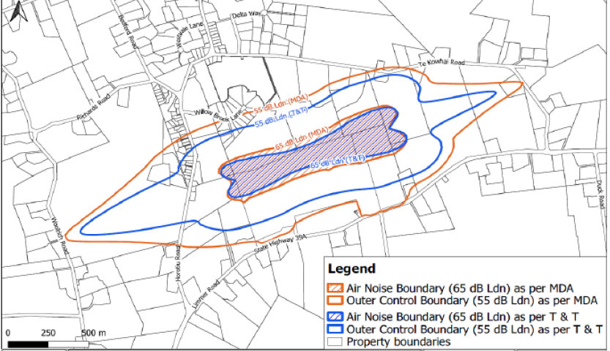
Airport Air Noise Boundary
Lloyd is concerned about the (inner) Air Noise Boundaries (ANB) recommended in the Marshall Day Report and the Tonkin & Taylor Report
The respective ANBs are essentially new. They were not notified in the PDP. There will be many in Te Kowhai that do not know about it.
Lloyd accepts that acoustic insulation will be needed in houses within a suitable Airport Noise Boundary such as that notified in the PDP.

Slide 9
Airport Air Noise Boundary
The T & T ANB would be acceptable if it allows for development if houses are designed with appropriate acoustic insulation.
The Section 42A Report introduces a non-complying activity rule (24.3.1 NC1) for noise-sensitive activities within the T & T ANB. Lloyd strongly opposes this rule as it could effectively remove development rights from up to 25% of his land. The requirement for acoustic insulation should be adequate for development to be a permitted activity.

Slide 10
Mitigation or Avoidance of Adverse Effects
Lloyd does not understand why NZTE could not move the runway southwards to reduce impacts on his property.
It is understood that the majority of the existing air park hangars and buildings are non-compliant based on them being too close to the runway.
It would seem a pragmatic solution to move the buildings sufficiently to re-position the airstrip – which would avoid the restrictions in relation to future development on Lloyd’s land

Slide 11
Mitigation or Avoidance of Adverse Effects
Approximately 140 sections are to be subdivided within the Te Kowhai Airpark Zone which will generate sales in the vicinity of $80million
The cost of relocation of the existing buildings and airstrip would be, comparably, minor
NZTE wants to grow the Airfield and get the commercial reward from that growth but they want neighbours to bear the costs with restriction on height and development.

Slide 12
CONCLUSION
Lloyd Davis is willing for Te Kowhai Airfield to perform any activities within its boundaries provided this does not restrict development potential on Lloyd’s land
Lloyd’s primary concerns are:
  The Proposed OLS and associated rules – Lloyd supports retention of the OLS in the ODP;
  The ANCBs in the Marshall Day Report and the T & T Report – these boundaries were not in the PDP as notified. If the Panel believes either set of ANCBs are appropriate, then Lloyd supports the ANCBs in the T & T Report – providing development is permitted within the inner Air Noise Boundary (ANB) if there is sufficient acoustic insulation;
  To mitigate the adverse effects of any inner ANB, NZTE could shift the airstrip southwards so that the inner ANB does not have an adverse effect on Lloyd’s property

