Slide 1
Rural Zone
Evidence Highlights
Bevan Houlbrooke for
CDL Land New Zealand Ltd

Slide 2
About CDL New Zealand Ltd
Land-based investment and development company.
Acquired land in the R2 growth cell (approx. 109ha).
Urban Expansion Area (UEA).
Plans to deliver a large master planned community by aggregating land

Slide 3
Reasons for Submission
Acknowledge the need to protect the UEA from inappropriate interim subdivision and development.
CDL wishes to increase landholding in R2 to achieve scale and avoid a disjointed and fragmented land development pattern.
Existing R2 landowners often want to remain in their dwelling and only sell the balance land.

Slide 4
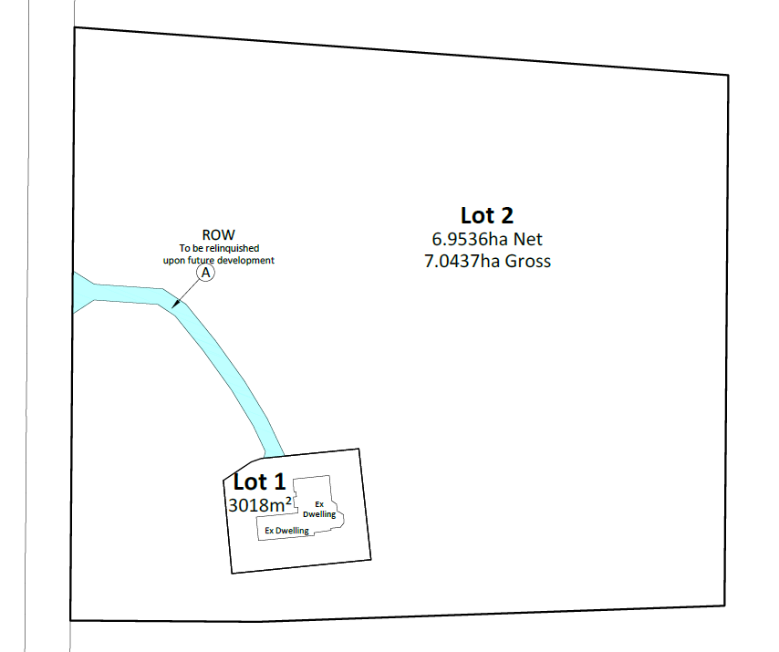
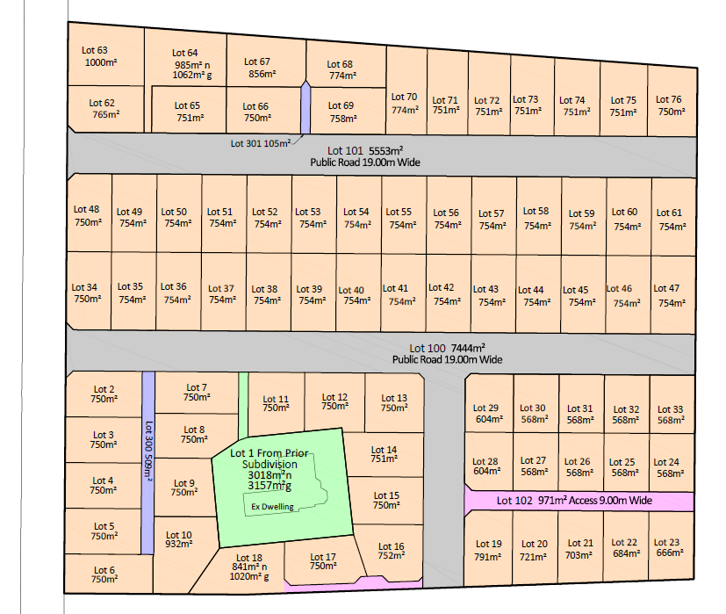
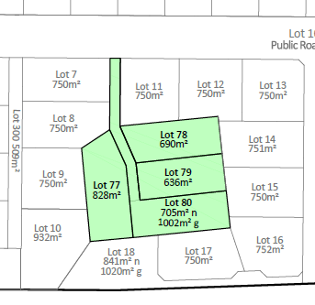
Typical Scenario proposed by CDL
Stage 1 – UEA
Lot 1 – Vendor Retained Land
Lot 2 – Balance land for future development
Stage 2 – Urban Development
Subdivision around existing lot/dwelling
Stage 3 – Infill Subdivision
Potential further subdivision assuming dwelling is removed

Slide 5
Relief Sought - Subdivision in UEA
Make subdivision in the UEA a Discretionary Activity and provide a framework to consider a subdivision around an existing house and making the balance land available for future urban development.
Proposed framework:
  Apply to record of titles issued prior to 18 July 2018 to avoid opportunities for repetitive subdivision.
  Allow creation of 1 additional lot but only around an existing dwelling lawfully established as at 18 July 2018.
  The additional lot to be between 3000m² and 1ha to maximize the size of the balance lot for future urban development.
  Require a consent notice advising no new dwellings are permitted on the balance lot
  Consequential amendments to objectives and policies and prohibited activity rules (PR3).

Slide 6
Relief Sought – Boundary Relocation
Make changes to Rule 22.4.1.4 to generally better facilitate boundary relocations.
Proposed amendments:
  Refer in the rule to not creating additional “records of title” (rather than “allotments”) as this allows boundary relocation by way of compulsory amalgamation (s241 of the RMA).
  Allow for a minimum lot size of 3000m² in the UEA to maximise balance for future urban development.
CDL does not support s42A recommendation to make boundary relocation a non-complying activity in the UEA.

Slide 7
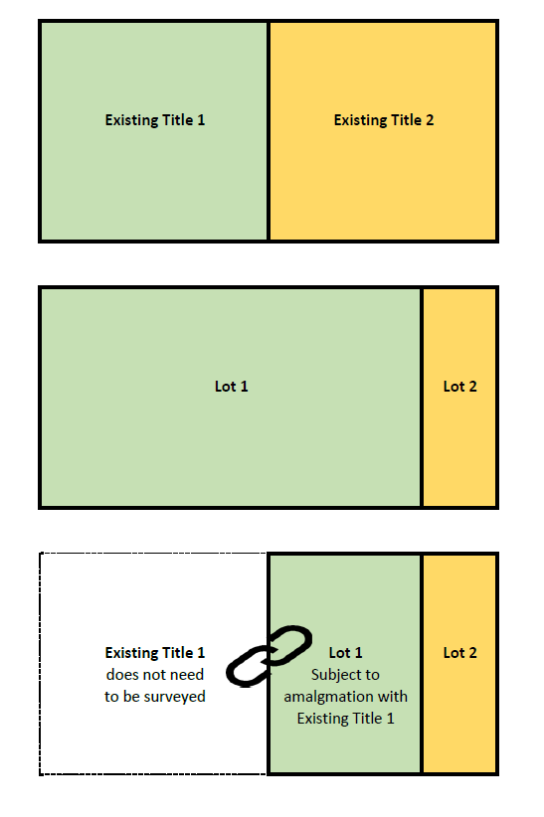
Existing situation
Two existing Records of Title
Boundary Relocation under PDP
Must create no additional “allotments”
Requires physical survey of both existing titles
Requires more legal work (dealing with mortgages)
Boundary Relocation proposed by CDL
Creates one additional “allotment” but no additional “Records of Title”
Utilises s241 of the RMA (compulsory amalgamation condition)
Requires physical survey of only one existing title
Requires less legal work (dealing with mortgages)

