Slide 1
Auckland/Waikato Fish and Game
Ben Wilson
Summary Statement
Thank you Commissioners for the approval to present our evidence concerning the various zone restrictions and the potential impact on maimai at this Hearing.
Auckland/Waikato owns and actively manages some 1600 hectares of wetland in the Waikato District. These wetlands typically require intensive active management to maintain hydrology and weed control.
We request that the rules for earthworks for the restoration of wetlands within areas identified as Significant Natural Areas and Landscape and Natural Character Areas, are inline with the Permitted Activity standards for the restoration of natural wetlands introduced in the Resource Management (National Environmental Standards for Freshwater) Regulations 2020, without the imposition of any additional restrictions. Despite the comments in the Council Rebuttal, we don’t believe this has occurred.
We support the Hearing 18 s42A Officers’ Report in excluding maimai from the building setback rules.
Nearly all game bird hunting in the Waikato District takes place in rural areas that will be zoned as Significant Natural Areas and/or Outstanding Natural Features. Therefore, we request that building maimai be a permitted activity in these areas.

Slide 2
Game bird hunting in the Waikato District
The most popular and heavily hunted district for waterfowl hunting in New Zealand.
Most effort concentrated in the lower Waikato River and associated wetlands and lakes.
Auckland/Waikato issues 7000+ licences, but landowners are not required to hold a licence if they’re shooting on their own land.
Impractical and undesirable to impose consent requirements on maimai given their location and numbers.
Permitted activity status should be limited to maimai less than 10m² in area

Slide 3
Main waterfowl hunting areas in the Waikato District.
Waterbody | Significant Natural Area | Outstanding Natural Feature | Flood Plain Management Area
Waikato River Delta | Yes | Yes | Yes
Lake Waikere | No | Yes | No
Lake Whangape | Yes | Yes | No
Opuatia Wetland | Yes | Yes | Yes
Waikato River margins | Yes (limited) | Yes | Yes
Whangamarino Wetland | Yes | Yes | No

Slide 4
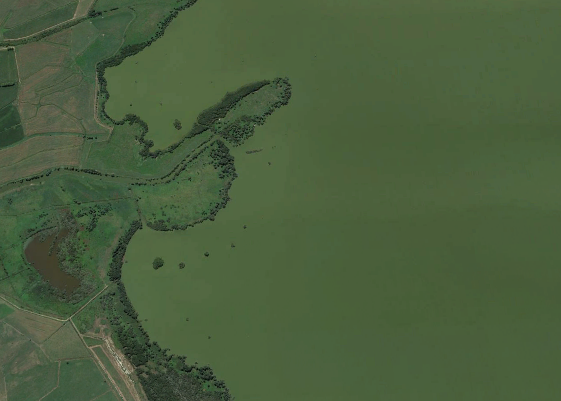
Lake Waikare

Slide 5
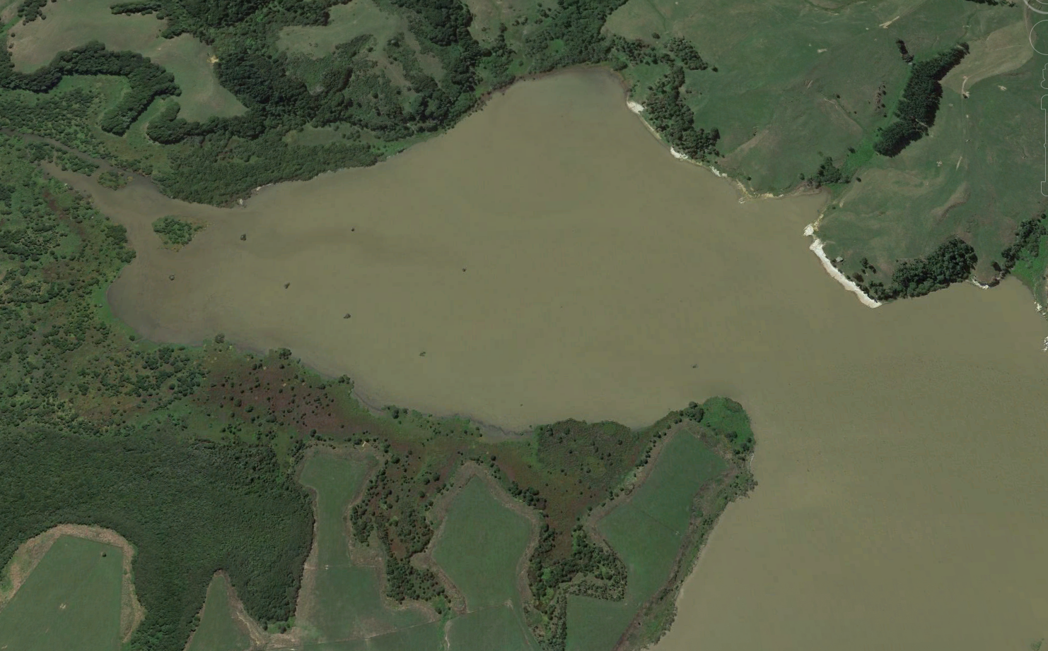
Lake Whangape

Slide 6
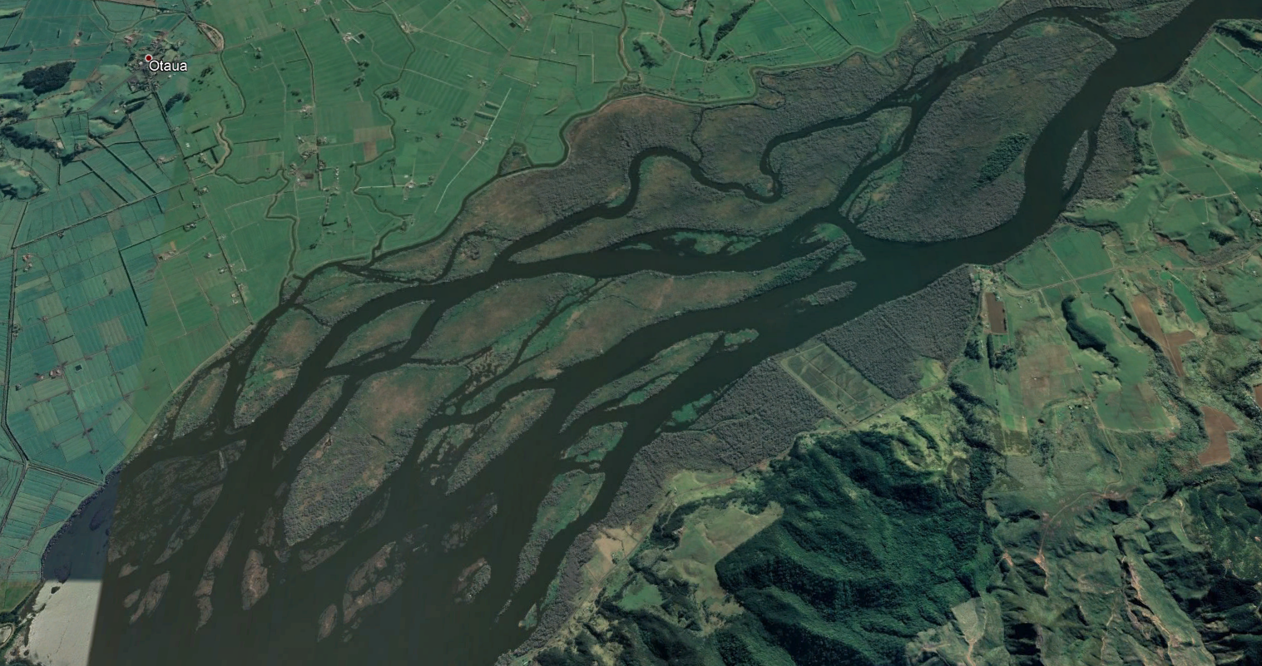
Waikato River Delta
Crucial that we implement regulations that we can all agree on.

Slide 7
Change sought to earthworks rule in accordance with The Resource Management (National Environmental Standards for Freshwater) Regulations 2020 s
We requested changes that will allow for wetland creation, restoration, and enhancement activities to be undertaken as permitted activities in the Rural Zone, including in a Significant Natural Area or Landscape and Natural Character Area, with a maximum area limit of 500m² set and provided it is done in line with a Wetland Restoration Plan submitted to Waikato Regional Council.
The National Environmental Standard for Freshwater (‘NES-FW’) has recently been gazetted in August 2020. The NES-FW provides for both vegetation clearance and earthworks within 10m of a natural wetland, where such works are for the purpose of wetland restoration. The extent of such works is limited to 500m² or 10% of the wetland, whichever is smaller. The Council Rebuttal Evidence states that the District Plans cannot contain rules that are more onerous than those in an NES. However the proposed District Plan limits earthworks in Significant Natural Area or Landscape and Natural Character Area to no more than 250m² .We therefore request that this area restriction is increased to 500m² inline with the NES-FW.

Slide 8
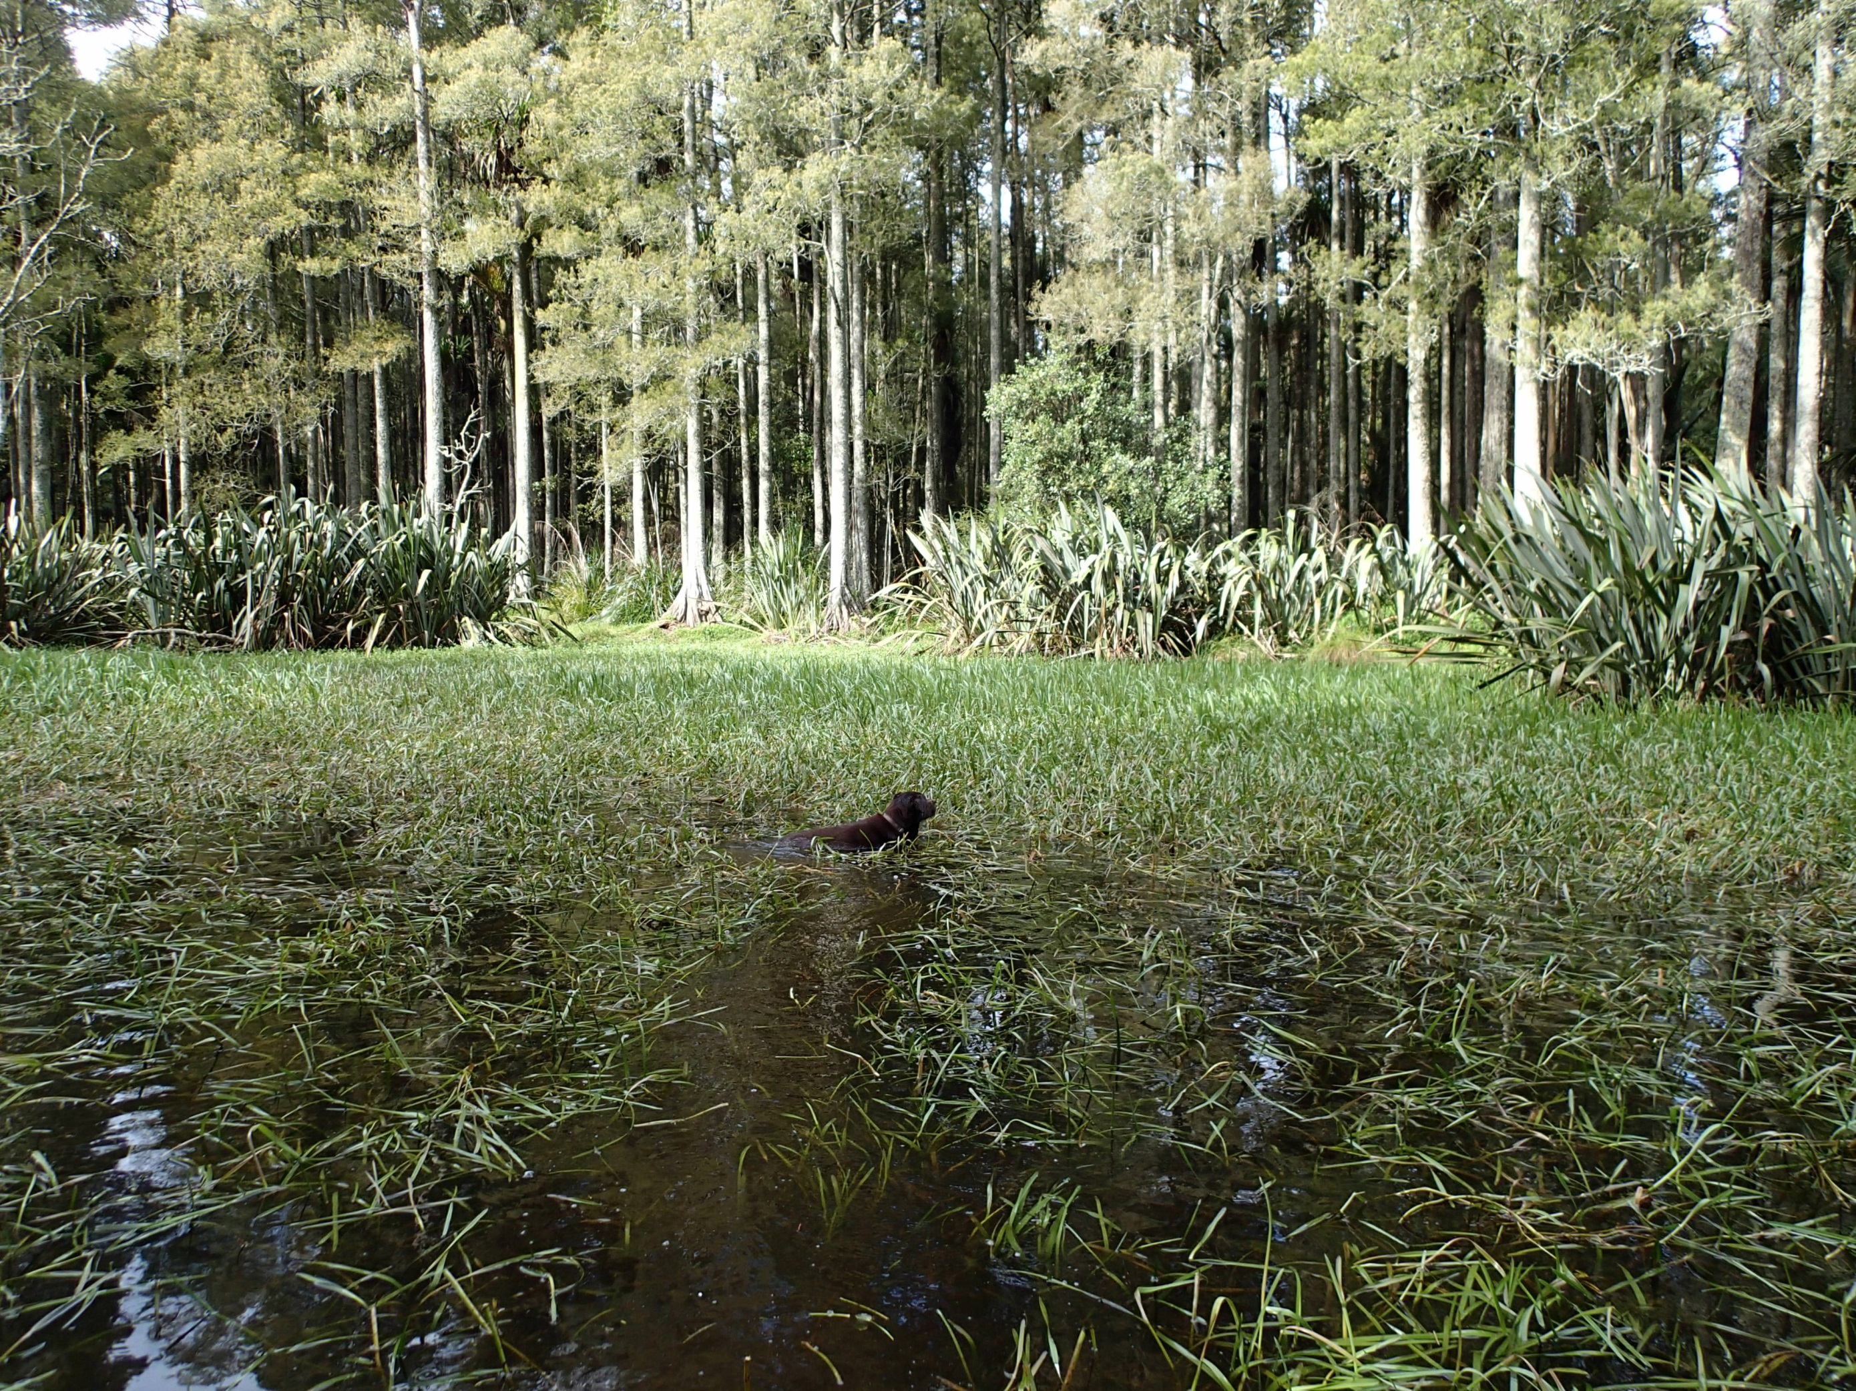
Fish and Game carries out an annual maintenance program on our wetlands due to the impact of exotic vegetation and
to maintain hydrology since many of our wetlands are perched above the surrounding farmland and waterways. Exotic weeds are generally prolific.

Slide 9
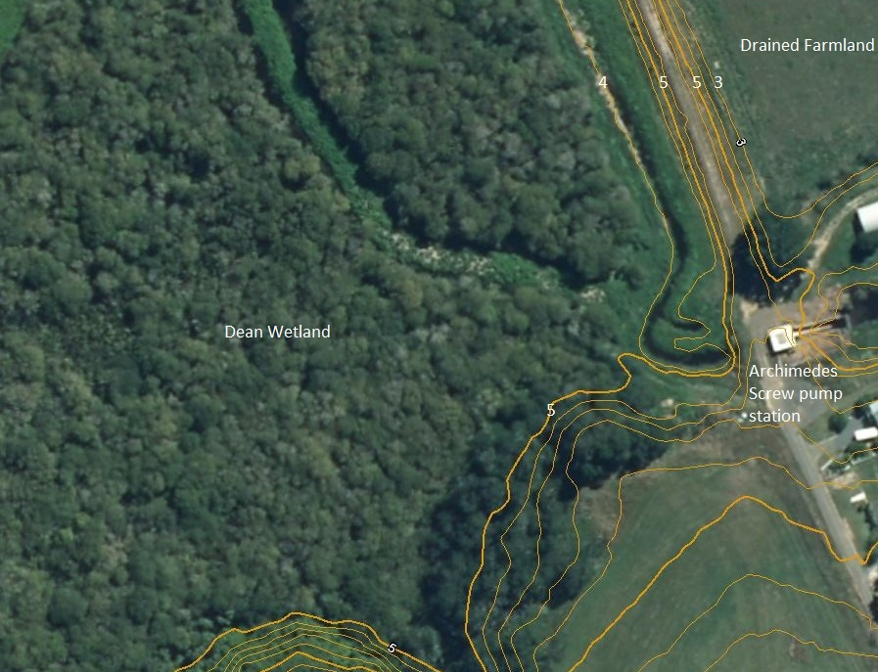
Dean Wetland showing LiDAR contours
This wetland is perched 1-2 metres above the surrounding farmland

Slide 10
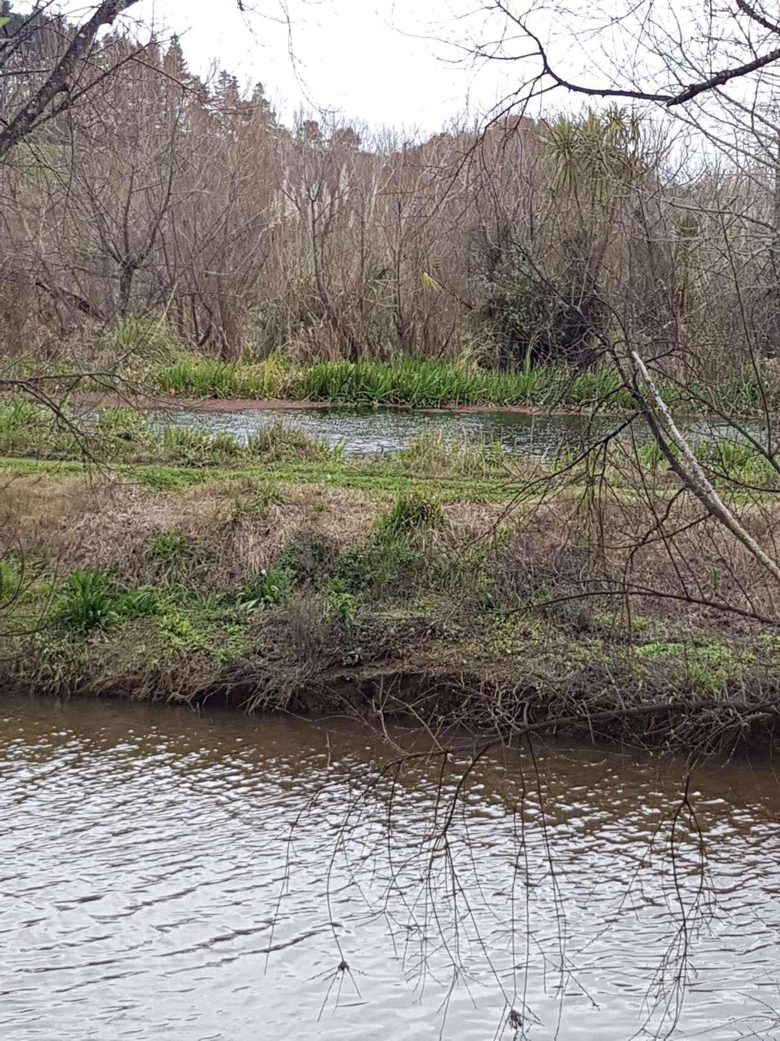
Blythen Wetland
Despite the Mangatawhiri River being in flood (foreground),
the Blythen Wetland is still perched 1.5 m above the river. Water levels in the wetland are maintained by stopbanks and weirs.

