Slide 1
Ian & Darienne Voyle
Submitter #672
Hearing 25 – Zone Extents
10 June 2021

Slide 2
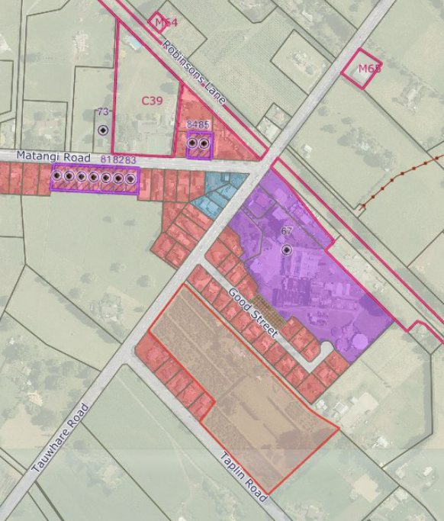
Site – 436A Tauwhare Road, Matangi
The notified version of the PWDP identified the property to remain rural zoned without consideration of the uniqueness of the subject site.
The subject site abuts residential areas along the north-western and eastern boundaries and the Matangi commercial and community facilities are within walking distance. There is strong community demand for a Hamilton – Cambridge Regional bus to stop at Matangi.
The Voyle’s have identified the growth potential of this property due to its location within the Matangi urban limits.
The persimmon orchard does not provide a sustainable livelihood and is becoming a liability and a burden to maintain each year. Any thoughts of intensification would most likely be abhorrent to the adjoining residential occupants and provide no guarantee that profits would increase.
Given the size, location, uneconomic productive activity, and surrounding urban development, the retention of Rural Zoning on the subject site represents an inefficient use of a potential urban land resource.

Slide 3
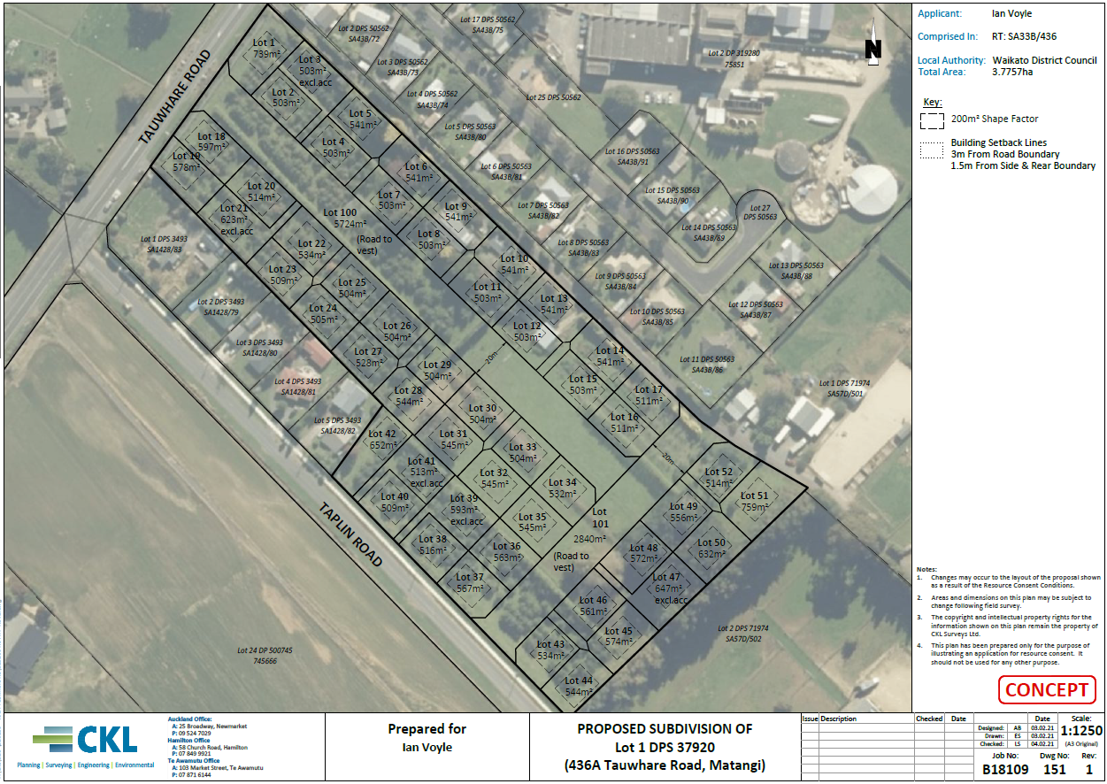
Concept Plan - 436A Tauwhare Road, Matangi
Approximately 52 fully serviced lots and two new roads connecting existing residential areas with the proposed development.
In terms of access and traffic safety effects, the site has frontage to multiple possible entrances with good visibility.
With discretion over the position of proposed building platforms, the site could be developed into approximately 8-10 rural-residential lots (encompassing 5-6 future residential lots each) comprising on-site water and wastewater as a potential solution to overcome the failures of the existing water and wastewater schemes in Matangi. This would ensure future subdivision is not compromised.

Slide 4
Relief sought
The submitter seeks that:
Its property at 436A Tauwhare Road, Matangi be zoned ‘Residential Zone’ on the planning maps;
Add a new rule “Subdivision - Matangi Residential Area”
Subdivision in Matangi must comply with all of the following conditions:
Proposed lots not connected to public water and wastewater infrastructure must have a minimum net site area of 2500m², except where the proposed lot is an access allotment or reserve lot.
Proposed lots connected to public water and wastewater infrastructure must have a minimum net site area of 450m², except where the proposed lot is an access allotment or reserve lot.
Council’s discretion is restricted to the following matters:
(i) Shape, location and orientation of proposed lots;
(ii) Position of proposed building platforms and driveways to ensure future subdivision is not compromised;
Overall, the requested rezoning of the JTQL site gives effect to the objectives of the NPS-UD and accordingly does not preclude integrated and strategic outcomes over time.

